Slide 1
Auto Spare: Smart Car Parts Marketplace
Flutter-based E-commerce Application for Car Spare Parts
“Empowering car owners with smart spare part solutions.”
Track: Mobile Application
Group Code: CAI3_SWD8_G1_DEPI3
Supervised by: Eng. Michael Hany
Team Members:
1. Ahmed tharwat Ahmed Student ID: __________
2.Ahmed Mostafa Almazon Student ID: __________
3. Ziad mohamed rafat Student ID: __________
4.Salma Yousry Abdel Razek Student ID: 21051343
5. Omar Abdelalim Abdelfattah Student ID: __________
6. Freddy Rafik Wahib Student ID:-----------

Slide 2
Thank You
We would like to express our sincere thanks to Engineer Michael Hany for his guidance throughout this project; his valuable feedback and support were truly invaluable.
Under his supervision, we have learned and grown more than we could have imagined.

Slide 3
Aim & Objectives
Auto Spare is a mobile app connecting car owners with spare part sellers.
Search, and purchase car spare parts easily.
Provides roadside assistance via tow truck requests and simplifies spare part purchasing.
Enables sellers to list and advertise products to reach more customers.
Revolutionizes how car owners find spare parts and handle emergencies.
Combines e-commerce with smart automotive support.
A future-ready platform for the spare parts market.

Slide 4
Problem Statement
Current Issues in the Car Spare Parts Market:
🔍 Difficulty finding the right spare parts quickly and reliably.
🏪 Limited access to sellers, leading to inefficient comparisons and higher prices.
🚚 No integrated solution for roadside emergencies, such as towing services.
⚡ Time-consuming and fragmented purchasing process.
📱 Lack of a centralized, user-friendly platform combining e-commerce with emergency support.
Impact:
Car owners face delays, higher costs, and inconvenience.
Sellers struggle to reach a wider customer base efficiently.
Solution:
Auto Spare provides a smart, all-in-one platform that simplifies spare part buying and offers emergency support.

Slide 5
Our Solution Proposed
Our Solutions Provide:
🔍 Search & Compare: Quickly find and compare car spare parts across multiple sellers.
🛒 Seamless Purchasing: Buy spare parts directly through the app.
🚚 Roadside Assistance: Request a tow truck in case of breakdowns for instant help.
🏪 Seller Dashboard: List and advertise products to reach a wider customer base.
📱 Cross-Platform Support: Built with Flutter for smooth performance on both Android and iOS.
💡 Smart Integration: Combines e-commerce with emergency support in one platform.
Benefits:
Saves time and effort for car owners.
Provides efficient access to spare parts and emergency services.
Helps sellers grow their reach and sales.

Slide 6
System Architecture
Technical Stack & Modules:
Frontend: Flutter
Backend: Firebase / Dart
Database: Firestore
Maps & Location: Geolocator package (pub.dev)
Functional Modules:
User Module: Search, purchase, tow requests.
Seller Module: Product listing, advertising, order management
Admin Module: User & seller management.

Slide 7
Workflow
1. Seller creates account.
2.Admin accept/reject account.
3.Seller add product/s.
4.Admin accept/reject seller product/s.
5.User can buy the product/s.
6. (Optional) User can order Tow Truck.

Slide 8
UI Design & Screenshots
• Login
Home Screen
• Category Screen
• Tow Truck Screen
Cart Screen
• Profile Screen

Slide 9
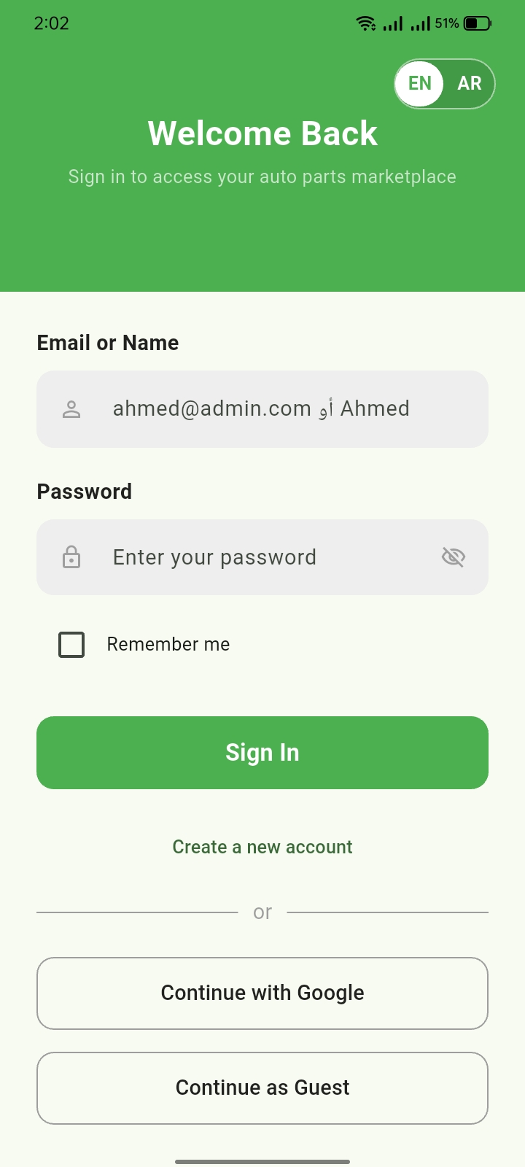
Login

Slide 10
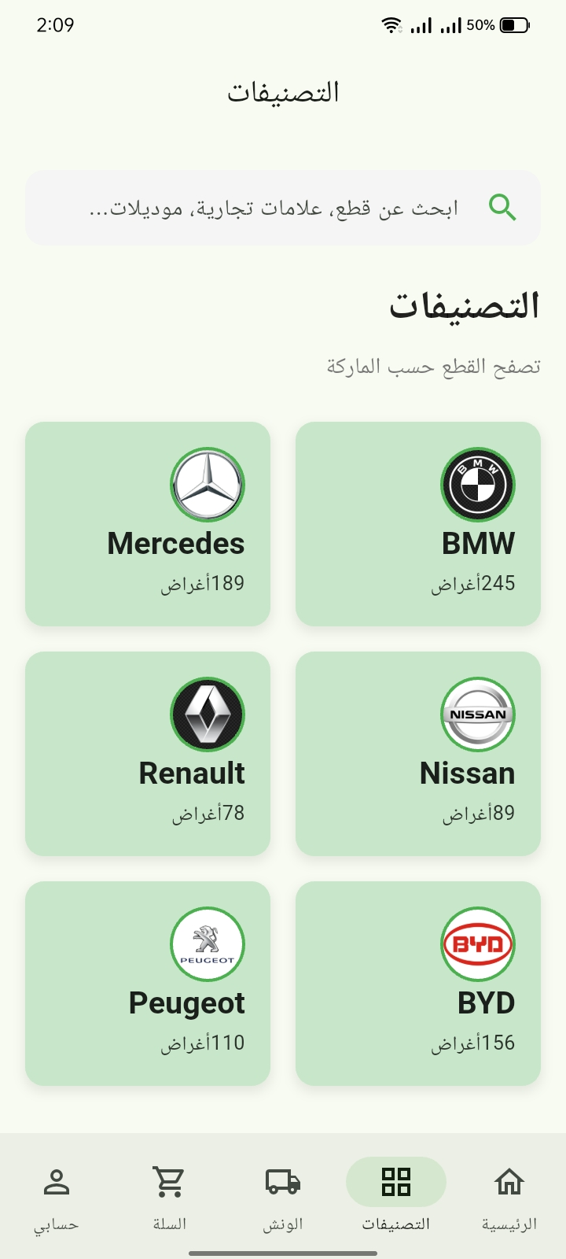
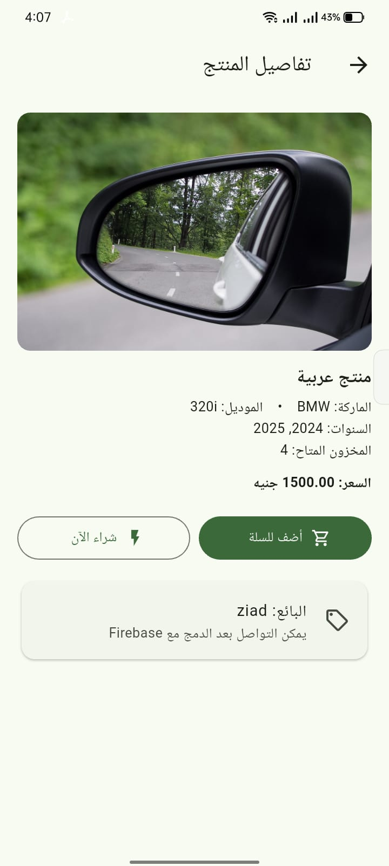
Category Tab

Slide 11
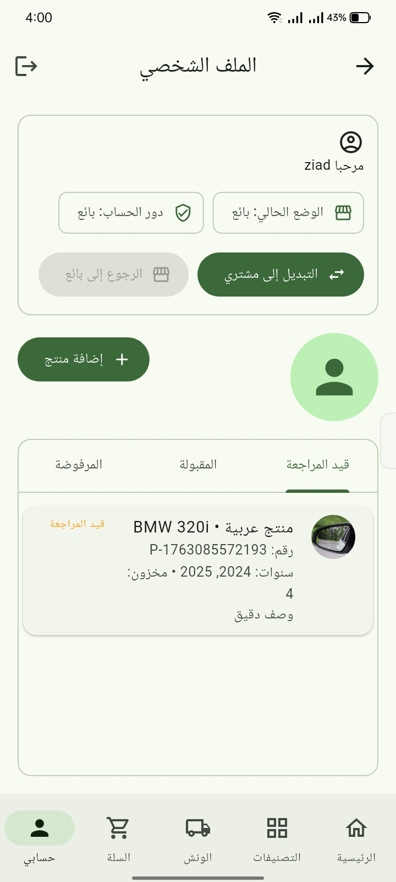
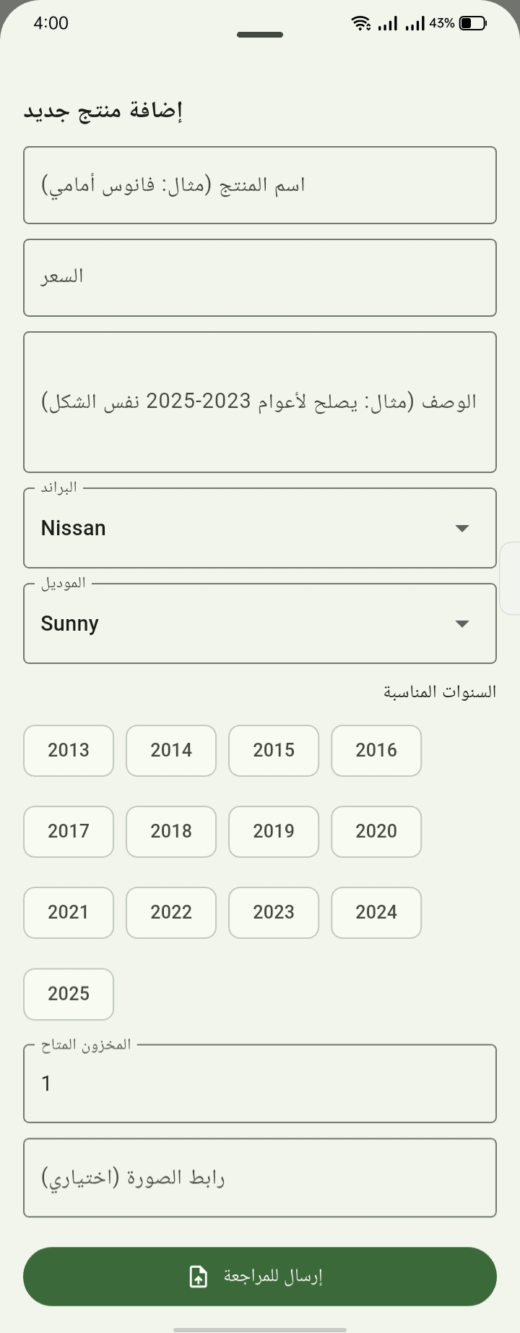
Add Product (seller)

Slide 12
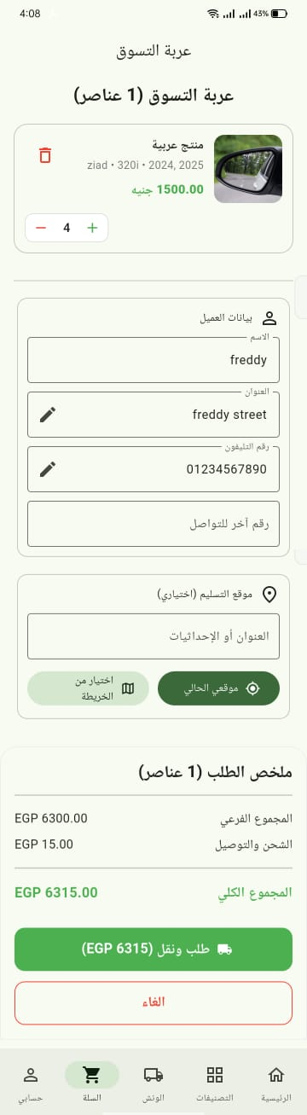
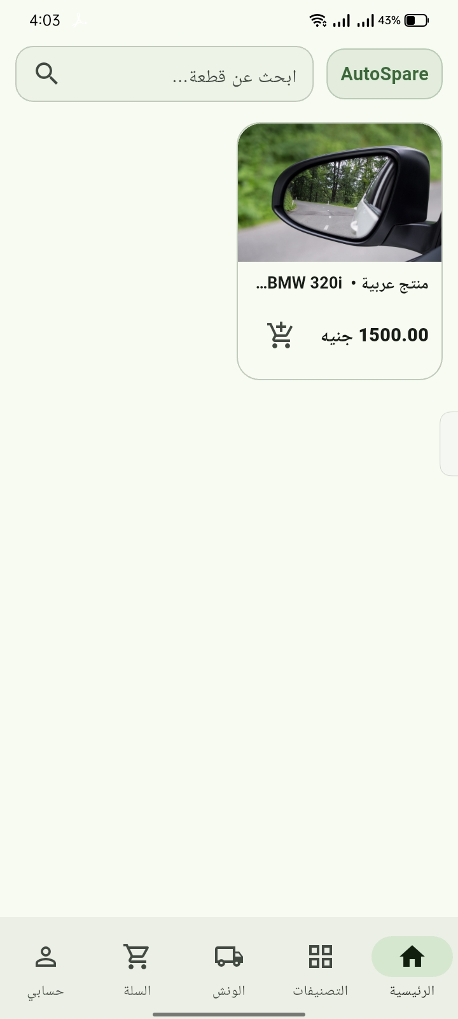
Ordering Product (user)

Slide 13
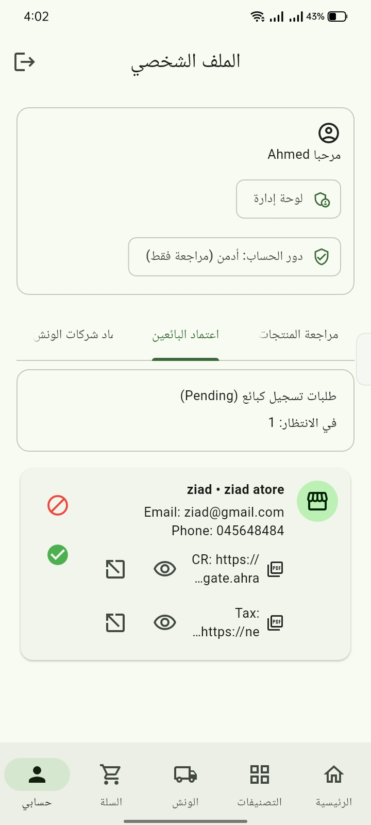
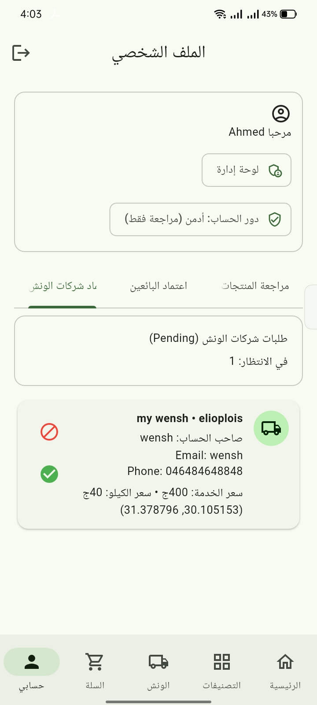

Slide 14
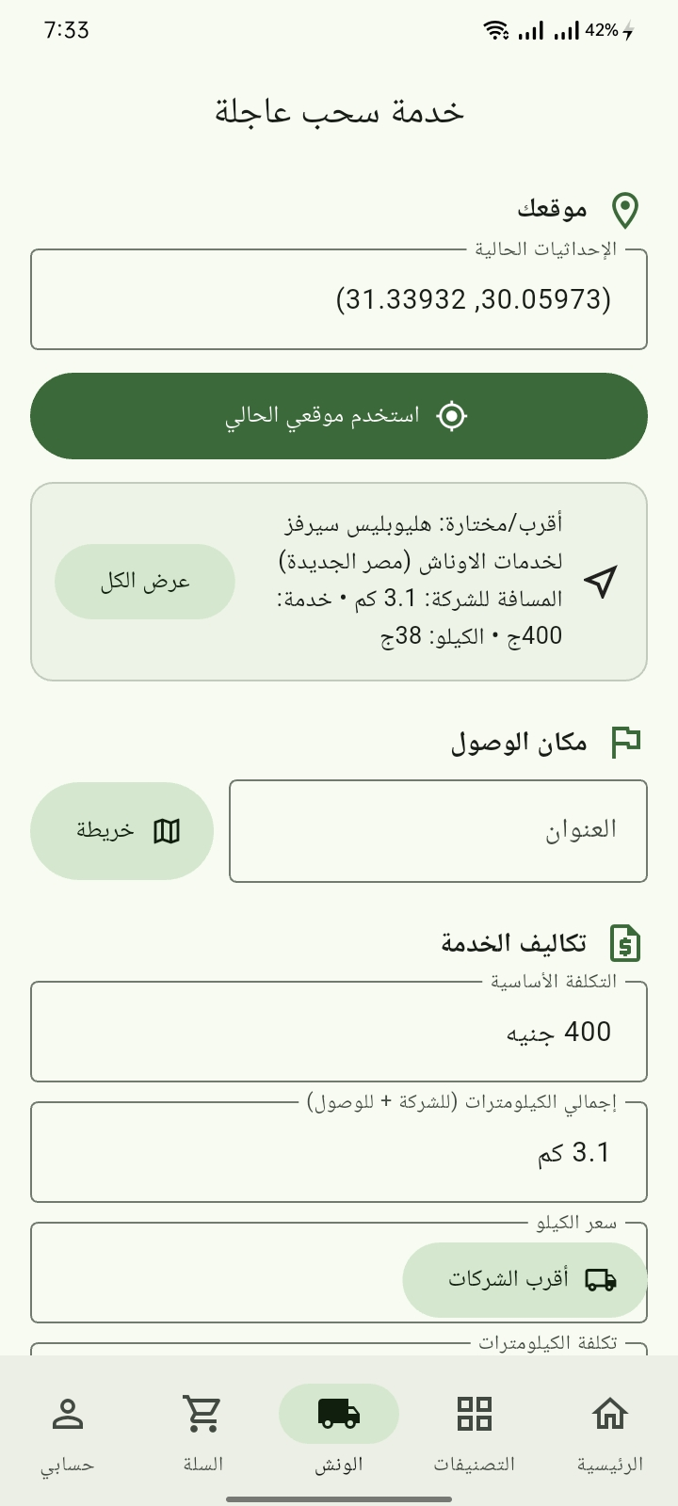
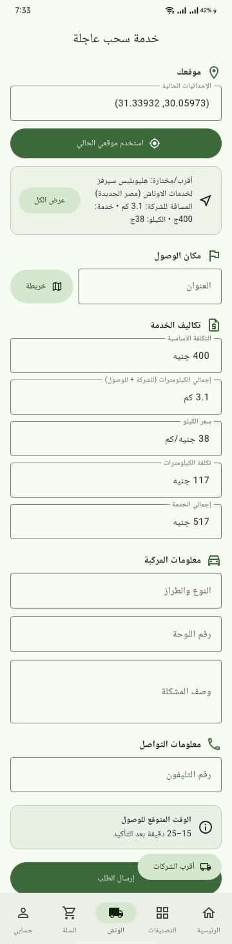
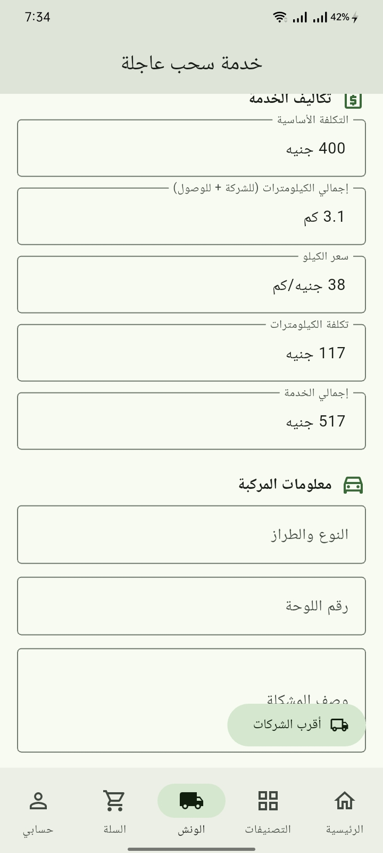
Tow Truck Request

Slide 15
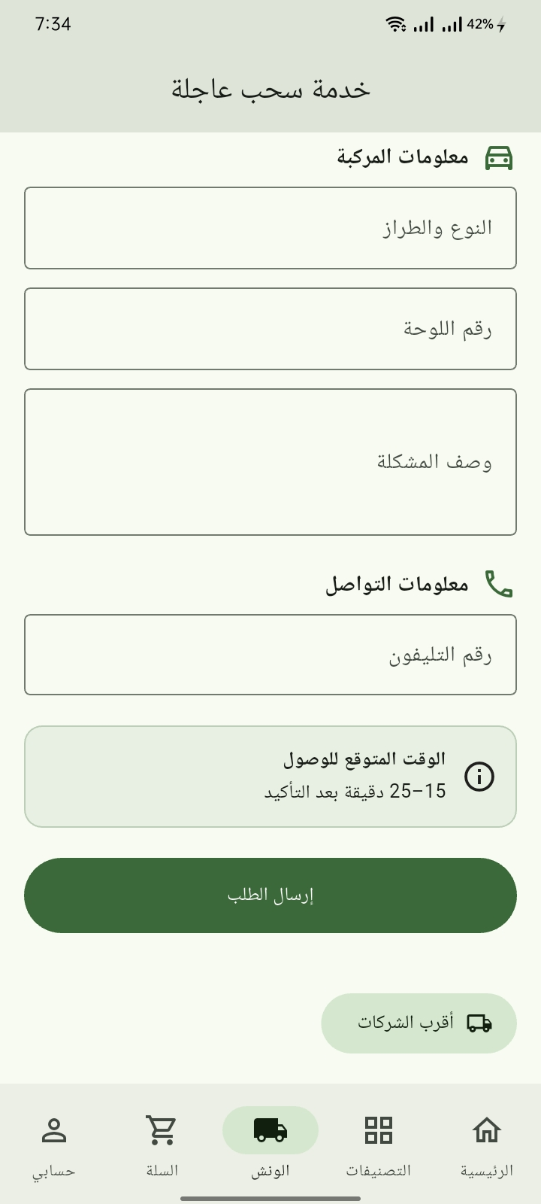
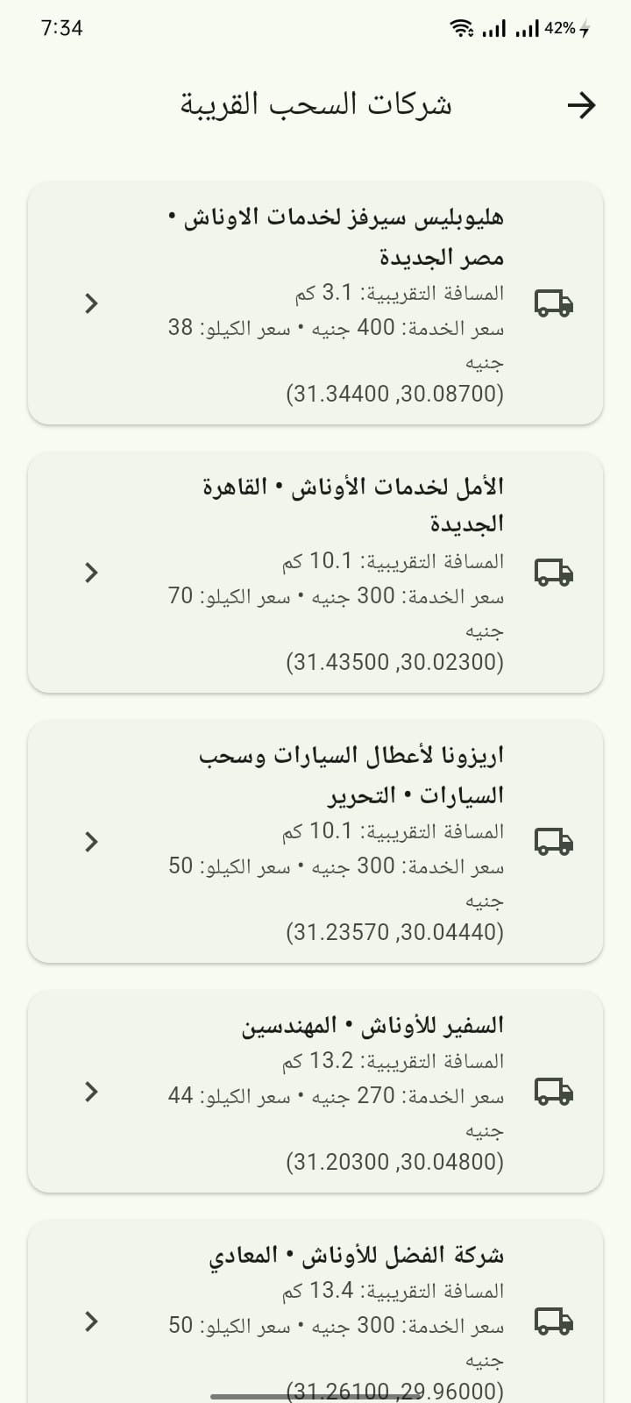

Slide 16
