Slide 1
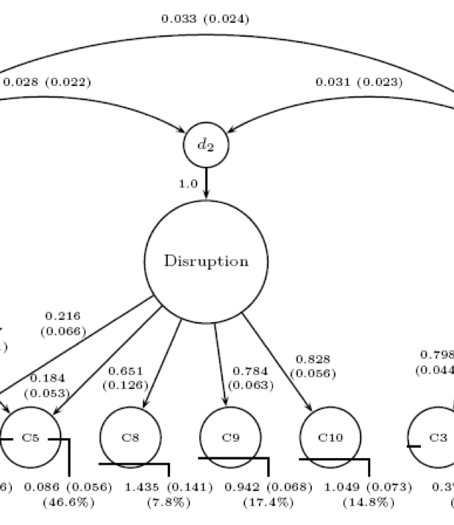
Diagnostic Structural Models: Examining the Distribution of Attributes

Slide 2
Lecture Overview
This lecture will provide an understanding of structural models used in DCMs
What they are: estimates of how attributes are distributed in a sample of examinees
Differing types of structural models
Mplus: log-linear structural models
FlexMIRT: saturated log-linear structural models and higher order models
BayesNets – Discussed in a future lecture
Other methods not readily available in commercial software

Slide 3
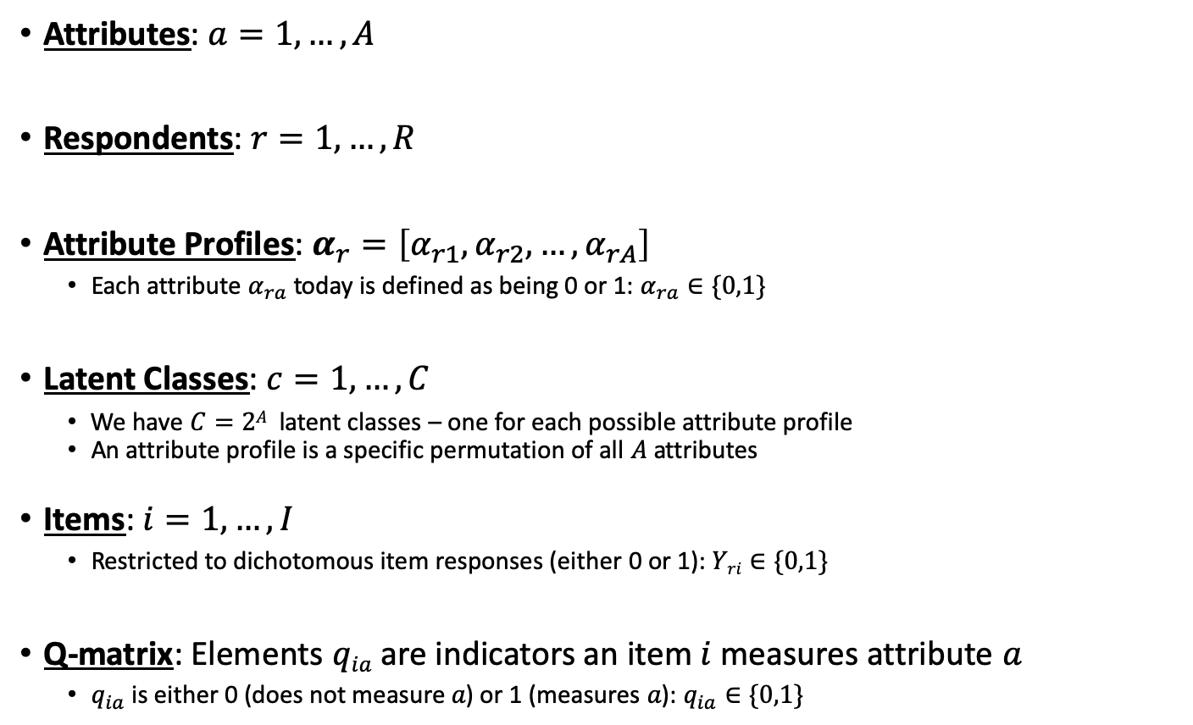
Notation Used Throughout
Attributes: $a=1,…, A$
Respondents: $r=1,…,R$
Attribute Profiles: $α_{r}=\left[α_{r1}, α_{r2},…,α_{rA}\right]$
Each attribute $α_{ra}$ today is defined as being 0 or 1: $α_{ra}∈\{0,1\}$
Latent Classes: $c=1,…,C$
We have $C=2A$ latent classes – one for each possible attribute profile
An attribute profile is a specific permutation of all $A$ attributes
Items: $i=1,…,I$
Restricted to dichotomous item responses (either 0 or 1): $Yri∈\{0,1\}$
Q-matrix: Elements $qia$ are indicators an item $i$ measures attribute $a$
$q_{ia}$ is either 0 (does not measure $a$) or 1 (measures $a$): $q_{ia}∈\{0,1\}$

Slide 4
Structural Models

Slide 5
DCM Structural Models
Throughout this class, attribute profile base-rates have been mentioned as being influential in DCMs
Part of respondent diagnoses: the attribute “base rates”
Describes distribution of attribute profiles in a sample
Proportion of masters for any given attribute
Correlation of attributes
The base-rates represent the probability any respondent has a given attribute profile
For a test measuring A attributes, 2^{A} profiles are possible
The structural model provides the probability for each profile

Slide 6
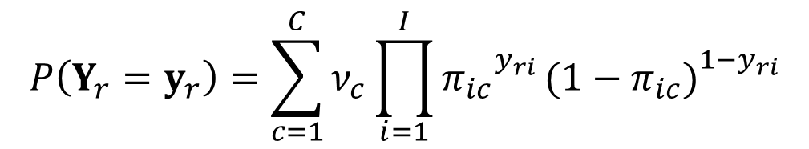
DCMs are Constrained Latent Class Models
Previously we’ve learned how different DCMs provide different parameterizations of the measurement component of the model
The LCDM – and which attributes are specified in the q-matrix
In this lecture we’ll learn about the parameterization of the structural component of DCMs
Choice of structural model not dependent on the measurement component
Observed Data: Probability of observing examinee r’s vector of item responses to all I items
Measurement Component:
Product of Conditional Item Response Probabilities (Item Responses are Independent)
$$P\left(Y_{r}=y_{r}\right)=\sum_{c=1}^{C}{ν_{c}}\prod_{i=1}^{I}{{π_{ic}}_{}^{y_{ri}}}{{(1−π}_{ic})}_{}^{1−y_{ri}}$$
Structural component:
Proportion of examinees in each class

Slide 7
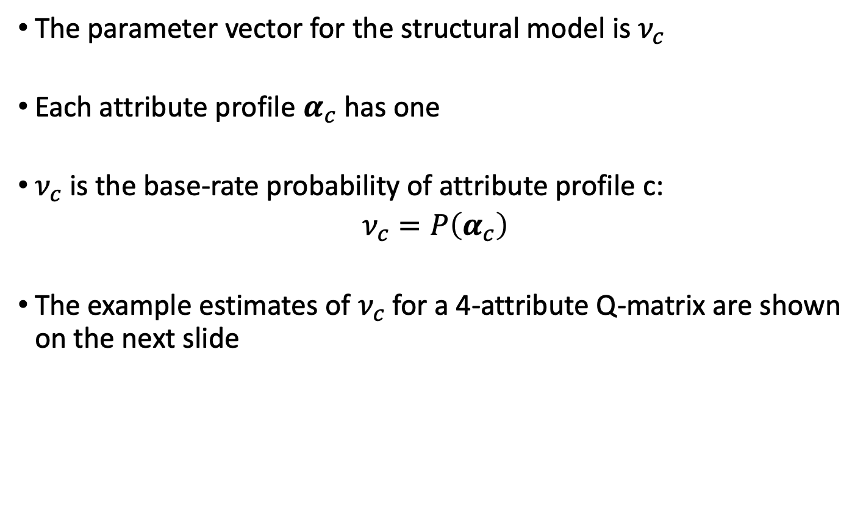
DCM Structural Models – Defined
The parameter vector for the structural model is $ν_{c}$
Each attribute profile $α_{c}$ has one
$ν_{c}$ is the base-rate probability of attribute profile c:
$$ν_{c}=P\left(α_{c}\right)$$
The example estimates of $ν_{c}$ for a 4-attribute Q-matrix are shown on the next slide

Slide 8
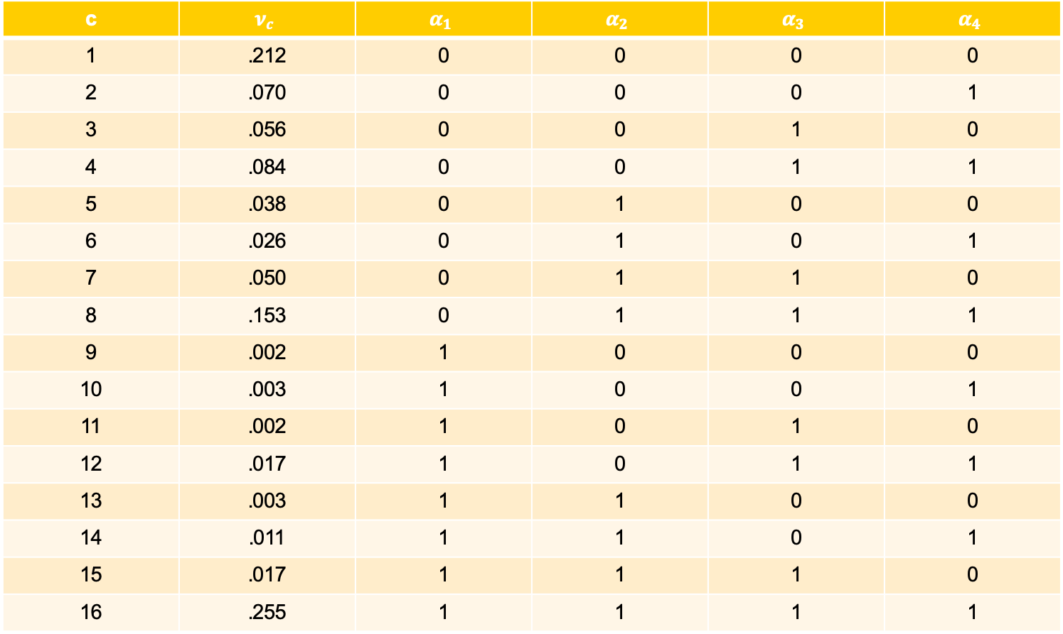
c | $$ν_{c}$$ | $$α_{1}$$ | $$α_{2}$$ | $$α_{3}$$ | $$α_{4}$$
1 | .212 | 0 | 0 | 0 | 0
2 | .070 | 0 | 0 | 0 | 1
3 | .056 | 0 | 0 | 1 | 0
4 | .084 | 0 | 0 | 1 | 1
5 | .038 | 0 | 1 | 0 | 0
6 | .026 | 0 | 1 | 0 | 1
7 | .050 | 0 | 1 | 1 | 0
8 | .153 | 0 | 1 | 1 | 1
9 | .002 | 1 | 0 | 0 | 0
10 | .003 | 1 | 0 | 0 | 1
11 | .002 | 1 | 0 | 1 | 0
12 | .017 | 1 | 0 | 1 | 1
13 | .003 | 1 | 1 | 0 | 0
14 | .011 | 1 | 1 | 0 | 1
15 | .017 | 1 | 1 | 1 | 0
16 | .255 | 1 | 1 | 1 | 1

Slide 9
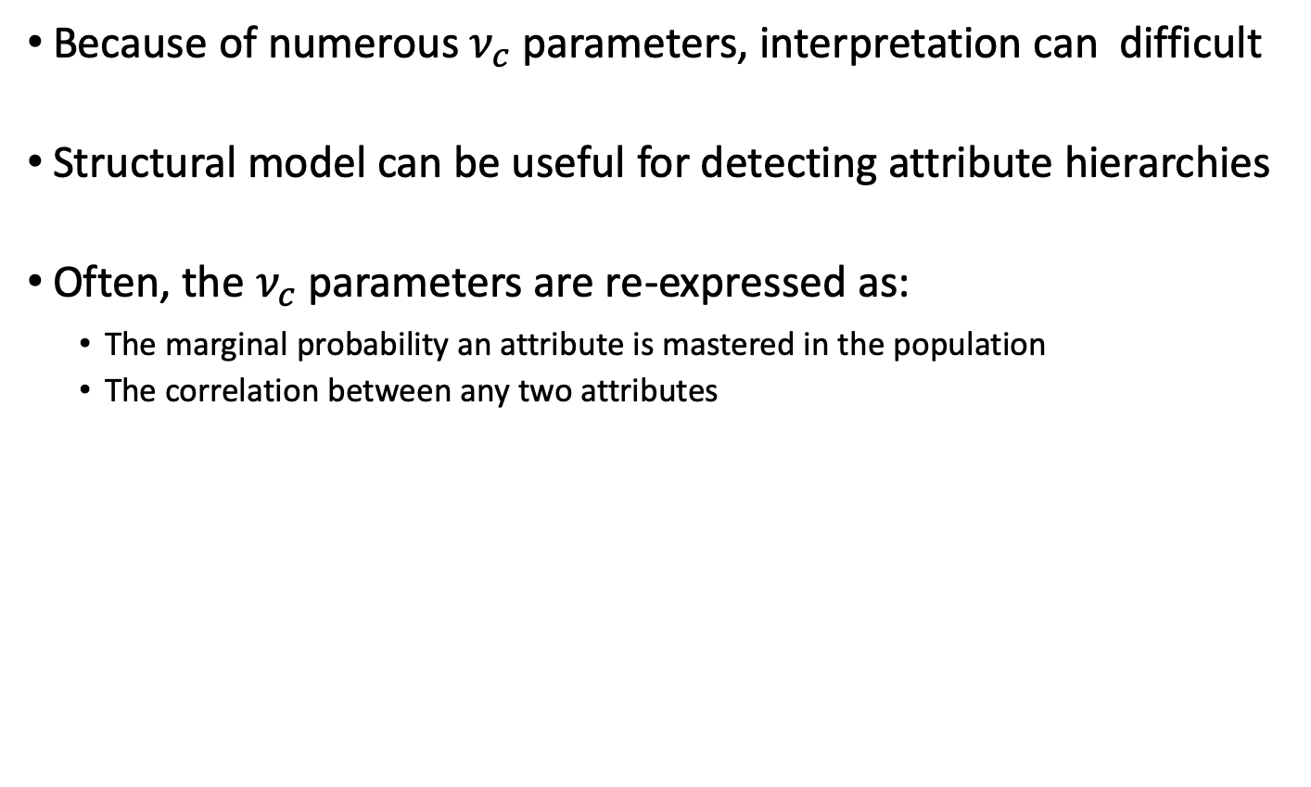
Interpreting the Structural Model
Because of numerous $ν_{c}$ parameters, interpretation can difficult
Structural model can be useful for detecting attribute hierarchies
Often, the $ν_{c}$ parameters are re-expressed as:
The marginal probability an attribute is mastered in the population
The correlation between any two attributes

Slide 10
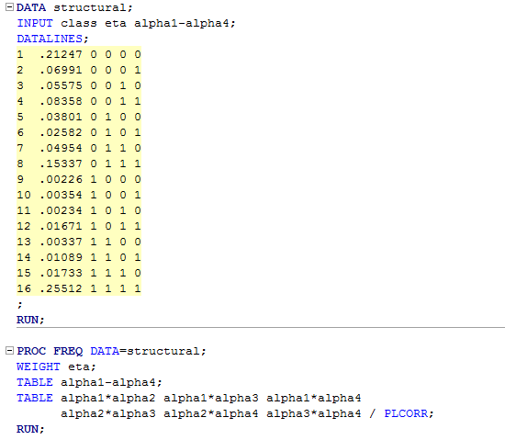
SAS Structural Model Summary
SAS can be used to compute summaries of the structural model parameters

Slide 11
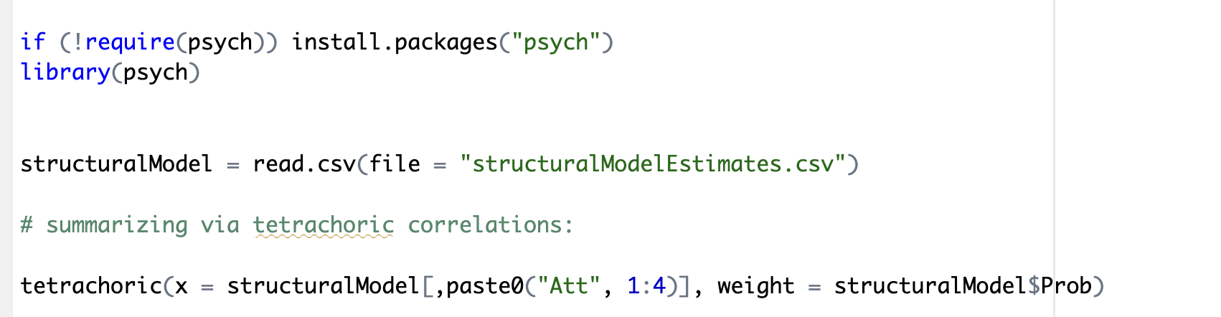
R Structural Model Summary
Using the psych package, we can calculate tetrachoric correlations using R:

Slide 12
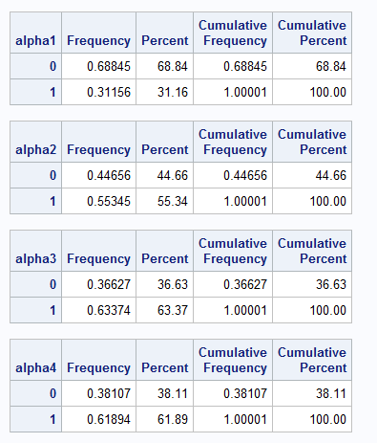
SAS Structural Model Summary
For each attribute, marginally:
Proportion of Masters

Slide 13
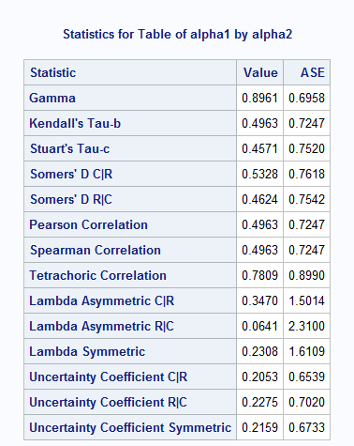
SAS Structural Model Summary
For each pair of attributes:
Tetrachoric Correlation

Slide 14
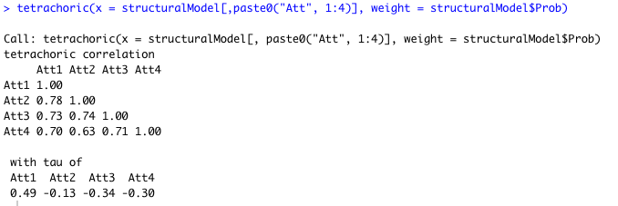
R Structural Model Summary

Slide 15
Attribute Summary
For the DTMR data, we have the following summary of attribute summary information
Such information is helpful in determining nature of attributes in a population of interest
Analogous to information about latent variables in CFA/MIRT
Attribute | Prop. Master |  | Tetrachoric Correlations
1. Referent Unit | .312
2. Partitioning/Iterating | .553 |  | .781
3. Appropriateness | .634 |  | .723 | .740
4. Multiplicative Comparison | .619 |  | .703 | .626 | .711

Slide 16
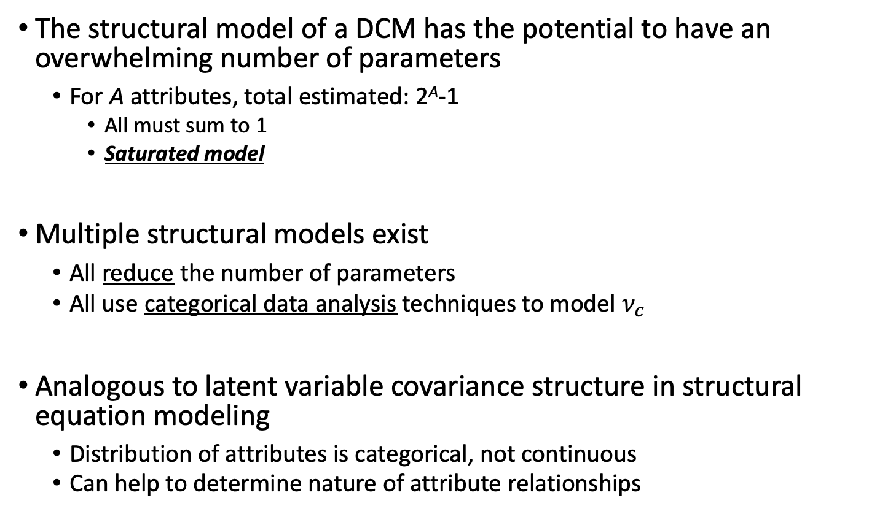
Differing Structural Models
The structural model of a DCM has the potential to have an overwhelming number of parameters
For A attributes, total estimated: 2^{A}-1
All must sum to 1
Saturated model
Multiple structural models exist
All reduce the number of parameters
All use categorical data analysis techniques to model $ν_{c}$
Analogous to latent variable covariance structure in structural equation modeling
Distribution of attributes is categorical, not continuous
Can help to determine nature of attribute relationships

Slide 17
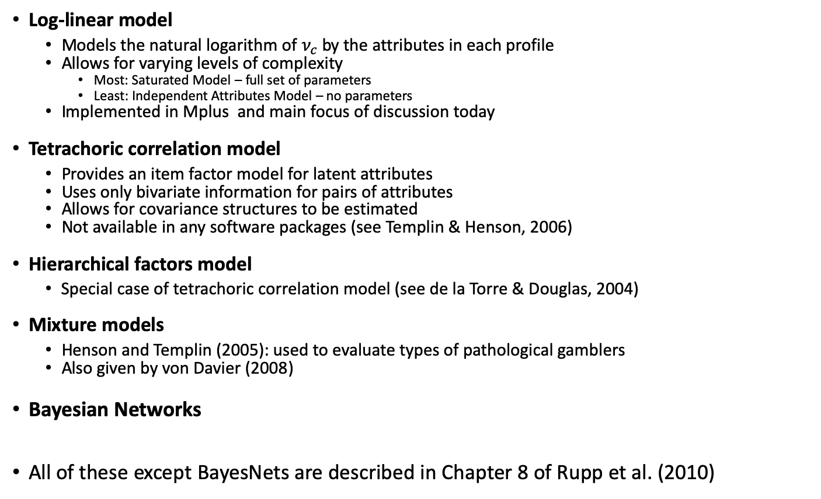
Types of Structural Models
Log-linear model
Models the natural logarithm of $ν_{c}$by the attributes in each profile
Allows for varying levels of complexity
Most: Saturated Model – full set of parameters
Least: Independent Attributes Model – no parameters
Implemented in Mplus and main focus of discussion today
Tetrachoric correlation model
Provides an item factor model for latent attributes
Uses only bivariate information for pairs of attributes
Allows for covariance structures to be estimated
Not available in any software packages (see Templin & Henson, 2006)
Hierarchical factors model
Special case of tetrachoric correlation model (see de la Torre & Douglas, 2004)
Mixture models
Henson and Templin (2005): used to evaluate types of pathological gamblers
Also given by von Davier (2008)
Bayesian Networks
All of these except BayesNets are described in Chapter 8 of Rupp et al. (2010)

Slide 18
Log-Linear Structural Models

Slide 19
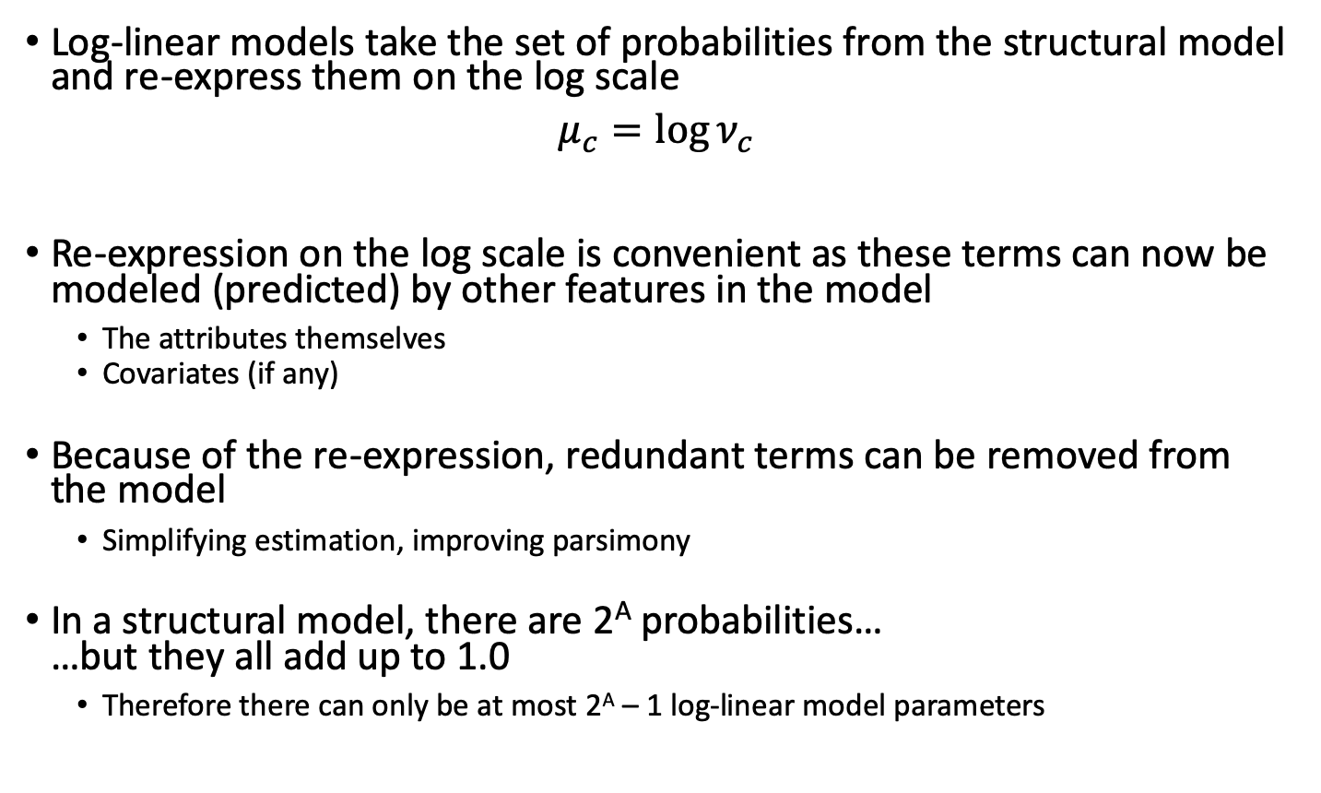
The Logic Behind Log-Linear Models
Log-linear models take the set of probabilities from the structural model and re-express them on the log scale
$$μ_{c}=\log{ν_{c}}$$
Re-expression on the log scale is convenient as these terms can now be modeled (predicted) by other features in the model
The attributes themselves
Covariates (if any)
Because of the re-expression, redundant terms can be removed from the model
Simplifying estimation, improving parsimony
In a structural model, there are 2^{A} probabilities… …but they all add up to 1.0
Therefore there can only be at most 2^{A} – 1 log-linear model parameters

Slide 20
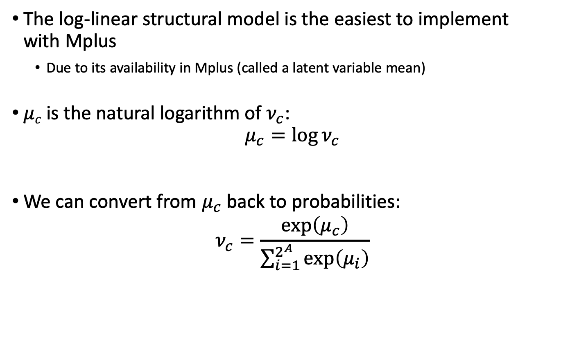
Log-Linear Structural Models
The log-linear structural model is the easiest to implement with Mplus
Due to its availability in Mplus (called a latent variable mean)
$μc$ is the natural logarithm of $ν_{c}$: $μ_{c}=\log{ν_{c}}$
We can convert from $μ_{c}$ back to probabilities:
$$ν_{c}=\frac{\exp\left(μ_{c}\right)}{\sum_{i=1}^{2^{A}}{\exp\left(μ_{i}\right)}}$$

Slide 21
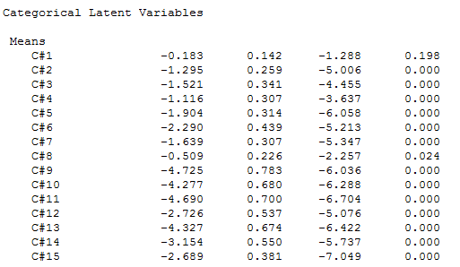
DTMR Latent Variable Means
Mplus fixes the value of the last class “mean” to zero…
So the rest are in reference to this last class
We can overcome this by subtracting off what the last class would have been from every cell

Slide 22
Log-Linear Model Set Up
It is important to remember that the structural model is a re-expression of the probability of any examinee having a given attribute pattern
The “saturated” log-linear model has as many parameters as possible (2^{A} – 1 for a test measuring A attributes)
In our example, we have 4 attributes (16 probabilities, 15 of which must be estimated)
Mplus fixes the value of the last class to zero
Our parameterization (and the Mplus implementation) will reflect this constraint
We will therefore omit what we will learn to be an intercept

Slide 23
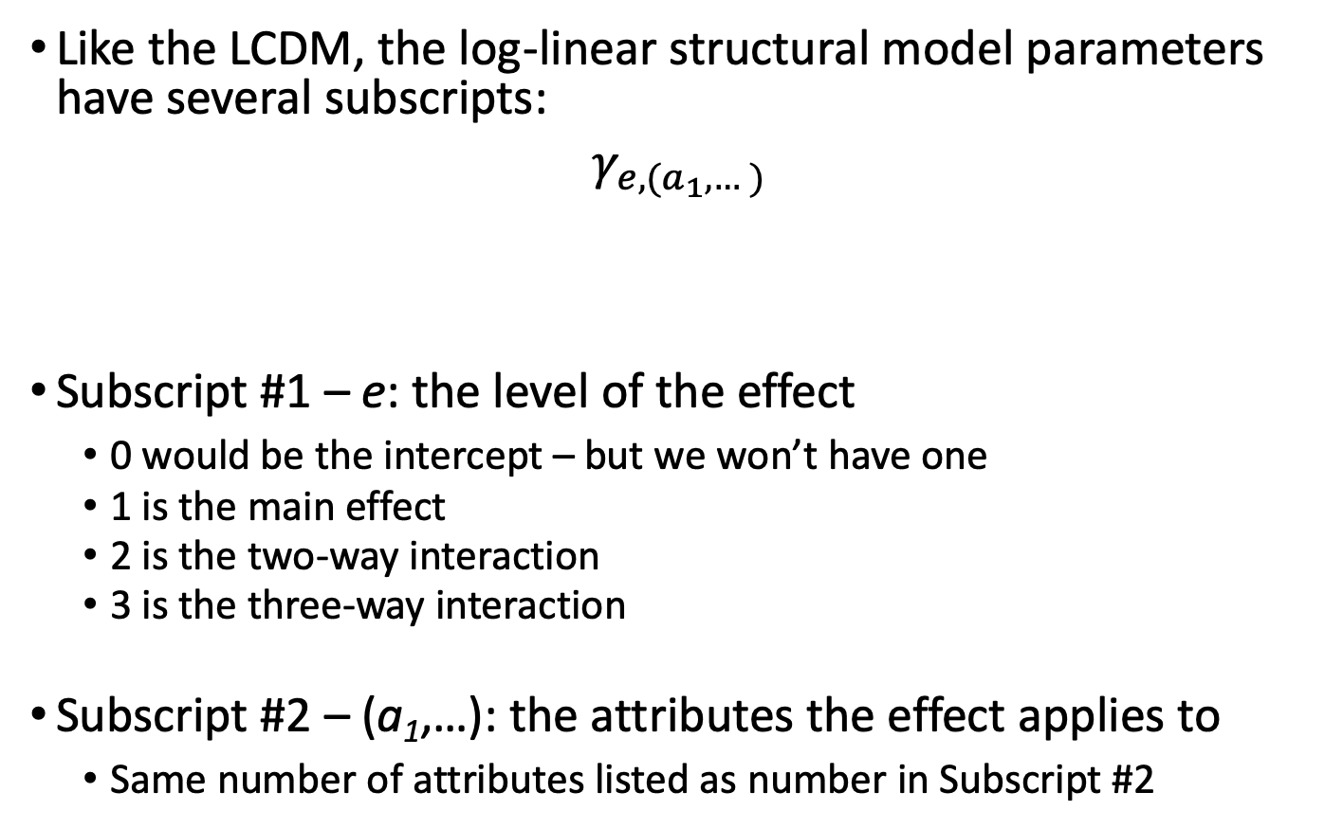
Log-Linear Structural Model Notation
Like the LCDM, the log-linear structural model parameters have several subscripts:
$$γ_{e,(a_{1},…)}$$
Subscript #1 – e: the level of the effect
0 would be the intercept – but we won’t have one
1 is the main effect
2 is the two-way interaction
3 is the three-way interaction
Subscript #2 – (a₁,…): the attributes the effect applies to
Same number of attributes listed as number in Subscript #2

Slide 24
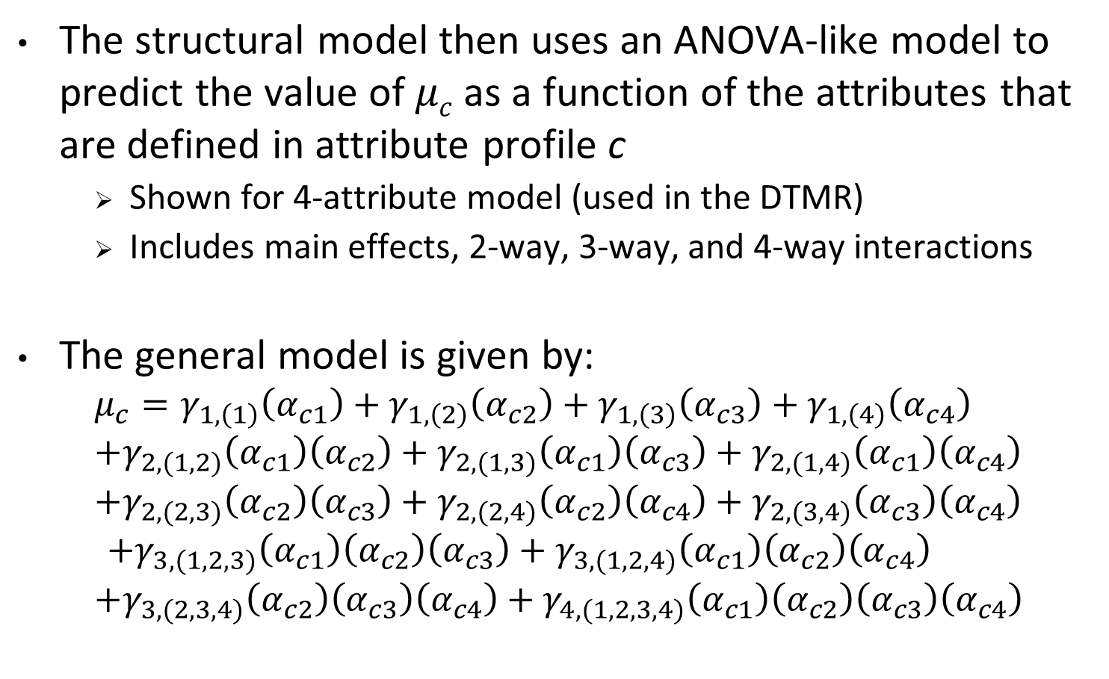
Log-Linear Model for μ_{c}
The structural model then uses an ANOVA-like model to predict the value of $μc$ as a function of the attributes that are defined in attribute profile c
Shown for 4-attribute model (used in the DTMR)
Includes main effects, 2-way, 3-way, and 4-way interactions
The general model is given by:
$$μ_{c}=γ_{1,\left(1\right)}\left(α_{c1}\right)+γ_{1,\left(2\right)}\left(α_{c2}\right)+γ_{1,\left(3\right)}\left(α_{c3}\right)+γ_{1,\left(4\right)}\left(α_{c4}\right)$$
$$+γ_{2,(1,2)}\left(α_{c1}\right)\left(α_{c2}\right)+γ_{2,(1,3)}\left(α_{c1}\right)\left(α_{c3}\right)+γ_{2,(1,4)}\left(α_{c1}\right)\left(α_{c4}\right)$$
$$+γ_{2,(2,3)}\left(α_{c2}\right)\left(α_{c3}\right)+γ_{2,(2,4)}\left(α_{c2}\right)\left(α_{c4}\right)+γ_{2,(3,4)}\left(α_{c3}\right)\left(α_{c4}\right)$$
$$+γ_{3,(1,2,3)}\left(α_{c1}\right)\left(α_{c2}\right)\left(α_{c3}\right)+γ_{3,(1,2,4)}\left(α_{c1}\right)\left(α_{c2}\right)\left(α_{c4}\right)$$
$$+γ_{3,(2,3,4)}\left(α_{c2}\right)\left(α_{c3}\right)\left(α_{c4}\right)+γ_{4,(1,2,3,4)}\left(α_{c1}\right)\left(α_{c2}\right)\left(α_{c3}\right)\left(α_{c4}\right)$$
Main effects

Slide 25
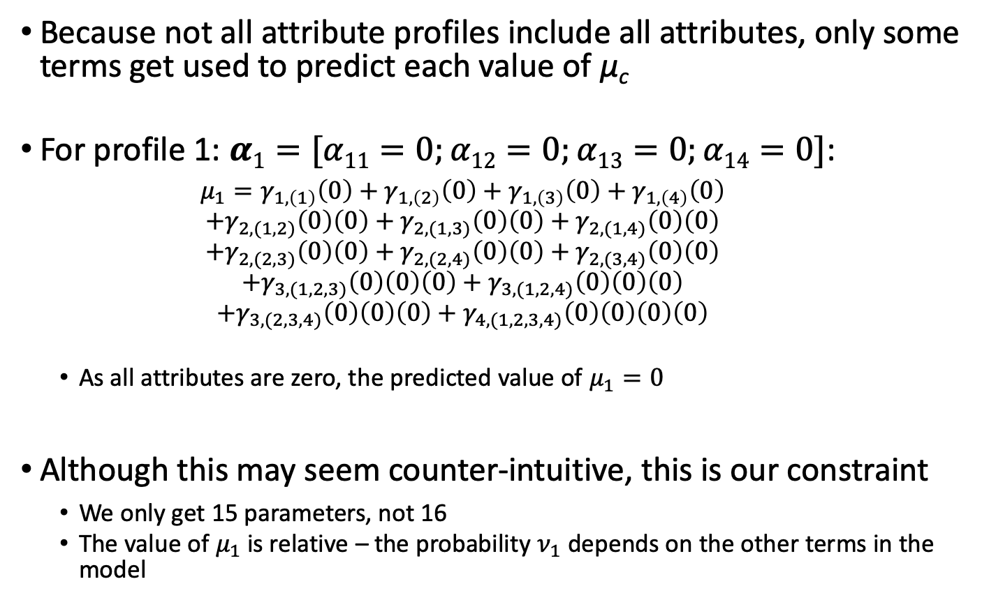
Log-Linear Model Explained
Because not all attribute profiles include all attributes, only some terms get used to predict each value of μ_{c}
For profile 1: $α1=[α11=0;α12=0;α13=0;α14=0]$:
$$μ_{1}=γ_{1,\left(1\right)}\left(0\right)+γ_{1,\left(2\right)}\left(0\right)+γ_{1,\left(3\right)}\left(0\right)+γ_{1,\left(4\right)}\left(0\right)$$
$$+γ_{2,(1,2)}\left(0\right)\left(0\right)+γ_{2,(1,3)}\left(0\right)\left(0\right)+γ_{2,(1,4)}\left(0\right)\left(0\right)$$
$$+γ_{2,(2,3)}\left(0\right)\left(0\right)+γ_{2,(2,4)}\left(0\right)\left(0\right)+γ_{2,(3,4)}\left(0\right)\left(0\right)$$
$$+γ_{3,(1,2,3)}\left(0\right)\left(0\right)\left(0\right)+γ_{3,(1,2,4)}\left(0\right)\left(0\right)\left(0\right)$$
$$+γ_{3,(2,3,4)}\left(0\right)\left(0\right)\left(0\right)+γ_{4,(1,2,3,4)}\left(0\right)\left(0\right)\left(0\right)\left(0\right)$$
As all attributes are zero, the predicted value of $μ_{1}=0$
Although this may seem counter-intuitive, this is our constraint
We only get 15 parameters, not 16
The value of $μ_{1}$ is relative – the probability $ν_{1}$ depends on the other terms in the model

Slide 26
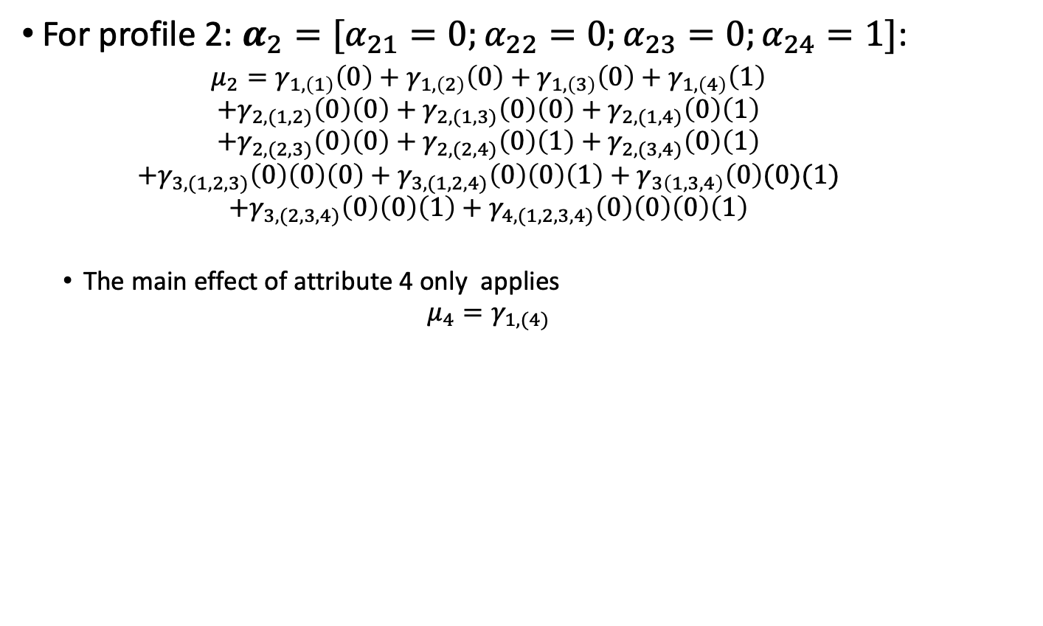
Log-Linear Model Explained
For profile 2: $α_{2}=[α_{21}=0;α_{22}=0;α_{23}=0;α_{24}=1]$:
$$μ_{2}=γ_{1,\left(1\right)}\left(0\right)+γ_{1,\left(2\right)}\left(0\right)+γ_{1,\left(3\right)}\left(0\right)+γ_{1,\left(4\right)}\left(1\right)$$
$$+γ_{2,(1,2)}\left(0\right)\left(0\right)+γ_{2,(1,3)}\left(0\right)\left(0\right)+γ_{2,(1,4)}\left(0\right)\left(1\right)$$
$$+γ_{2,(2,3)}\left(0\right)\left(0\right)+γ_{2,(2,4)}\left(0\right)\left(1\right)+γ_{2,(3,4)}\left(0\right)\left(1\right)$$
$$+γ_{3,(1,2,3)}\left(0\right)\left(0\right)\left(0\right)+γ_{3,(1,2,4)}\left(0\right)\left(0\right)\left(1\right)+γ_{3\left(1,3,4\right)}\left(0\right)(0)(1)$$
$$+γ_{3,(2,3,4)}\left(0\right)\left(0\right)\left(1\right)+γ_{4,(1,2,3,4)}\left(0\right)\left(0\right)\left(0\right)\left(1\right)$$
The main effect of attribute 4 only applies
$$μ_{4}=γ_{1,(4)}$$

Slide 27
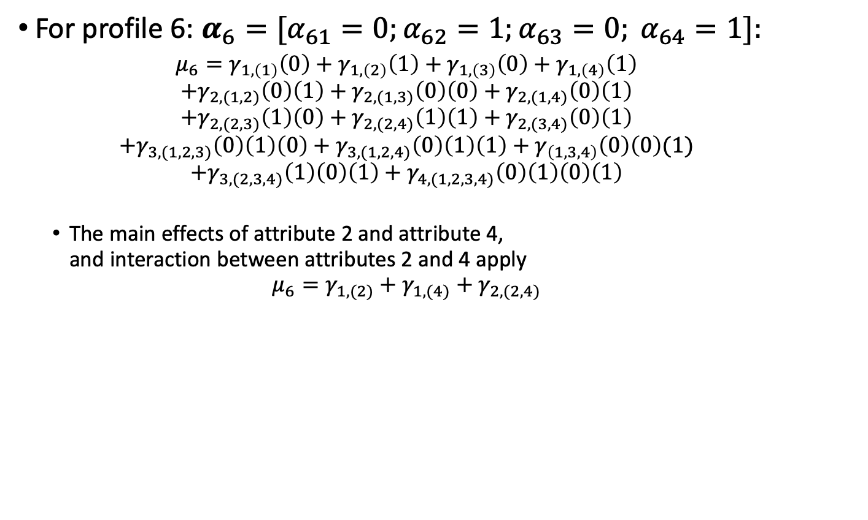
Log-Linear Model Explained
For profile 6: $α_{6}=[α_{61}=0;α_{62}=1;α_{63}=0; α_{64}=1]:$
$$μ_{6}=γ_{1,\left(1\right)}\left(0\right)+γ_{1,\left(2\right)}\left(1\right)+γ_{1,\left(3\right)}\left(0\right)+γ_{1,\left(4\right)}\left(1\right)$$
$$+γ_{2,(1,2)}\left(0\right)\left(1\right)+γ_{2,(1,3)}\left(0\right)\left(0\right)+γ_{2,(1,4)}\left(0\right)\left(1\right)$$
$$+γ_{2,(2,3)}\left(1\right)\left(0\right)+γ_{2,(2,4)}\left(1\right)\left(1\right)+γ_{2,(3,4)}\left(0\right)\left(1\right)$$
$$+γ_{3,(1,2,3)}\left(0\right)\left(1\right)\left(0\right)+γ_{3,(1,2,4)}\left(0\right)\left(1\right)\left(1\right)+γ_{\left(1,3,4\right)}\left(0\right)\left(0\right)(1)$$
$$+γ_{3,(2,3,4)}\left(1\right)\left(0\right)\left(1\right)+γ_{4,(1,2,3,4)}\left(0\right)\left(1\right)\left(0\right)\left(1\right)$$
The main effects of attribute 2 and attribute 4, and interaction between attributes 2 and 4 apply
$$μ_{6}=γ_{1,(2)}+γ_{1,(4)}+γ_{2,(2,4)}$$

Slide 28
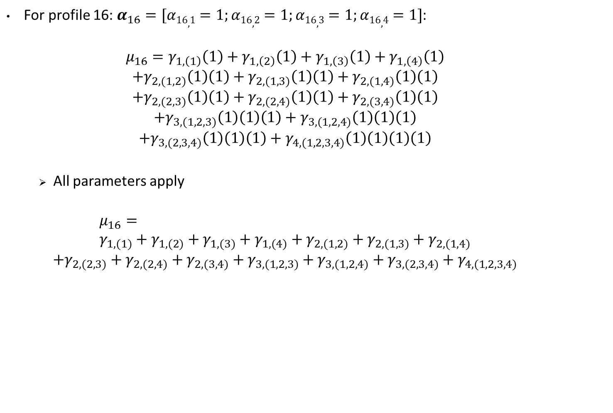
Log-Linear Model Explained
For profile 16: $α_{16}=[α16,1=1;α16,2=1;α16,3=1;α16,4=1]$:
$$μ_{16}=γ_{1,\left(1\right)}\left(1\right)+γ_{1,\left(2\right)}\left(1\right)+γ_{1,\left(3\right)}\left(1\right)+γ_{1,\left(4\right)}\left(1\right)$$
$$+γ_{2,(1,2)}\left(1\right)\left(1\right)+γ_{2,(1,3)}\left(1\right)\left(1\right)+γ_{2,(1,4)}\left(1\right)\left(1\right)$$
$$+γ_{2,(2,3)}\left(1\right)\left(1\right)+γ_{2,(2,4)}\left(1\right)\left(1\right)+γ_{2,(3,4)}\left(1\right)\left(1\right)$$
$$+γ_{3,(1,2,3)}\left(1\right)\left(1\right)\left(1\right)+γ_{3,(1,2,4)}\left(1\right)\left(1\right)\left(1\right)$$
$$+γ_{3,(2,3,4)}\left(1\right)\left(1\right)\left(1\right)+γ_{4,(1,2,3,4)}\left(1\right)\left(1\right)\left(1\right)\left(1\right)$$
All parameters apply
$$μ_{16}= \\ γ_{1,(1)}+γ_{1,(2)}+γ_{1,(3)}+γ_{1,(4)}+γ_{2,(1,2)}+γ_{2,(1,3)}+γ_{2,(1,4)}$$
$$+γ_{2,(2,3)}+γ_{2,(2,4)}+γ_{2,(3,4)}+γ_{3,(1,2,3)}+γ_{3,(1,2,4)}+γ_{3,(2,3,4)}+γ_{4,(1,2,3,4)}$$

Slide 29
Interpretations of Model Parameters
The log-linear model with ALL main effects and interactions is statistically equivalent to the saturated structural model
Two-way interactions are analogous to bivariate correlations in categorical models
Higher-level interactions represent higher level of characteristics of attribute distribution (i.e., skewness, kurtosis, etc…)
Models without interactions imply uncorrelated attributes
Main effects are essentially attribute base-rates
Models without main effects or interactions assume all attribute profiles are equally likely
Higher order interactions can be removed if not significantly different from zero

Slide 30
Log-Linear Model for ECPE Data (Templin & Hoffman, 2013)
To demonstrate the log-linear model, we again present our an example with 3 attributes (so 8 classes)
Full model (all parameters)
Parameter | Estimate | SE | p-value
γ₀ | -0.139 | 0.112 | 0.216
γ_{1,(1)} | -3.539 | 0.888 | 0.000
γ_{1,(2)} | -3.228 | 1.378 | 0.019
γ_{1,(3)} | -0.846 | 0.220 | 0.000
γ_{2,(1,2)} | 3.438 | 1.913 | 0.072
γ_{2,(1,3)} | 1.578 | 1.079 | 0.144
γ_{2,(2,3)} | 3.533 | 1.270 | 0.005
γ_{3,(1,2,3)} | -0.797 | 2.087 | 0.703

Slide 31
Reductions in the Structural Model
Because the three-way interaction was not significant, we can remove that parameter from the model without greatly affecting model fit
New results:
Parameter | Estimate | SE | p-value
γ₀ | -0.159 | 0.103 | 0.122
γ_{1,(1)} | -3.357 | 0.524 | 0.000
γ_{1,(2)} | -2.909 | 0.722 | 0.000
γ_{1,(3)} | -0.836 | 0.214 | 0.000
γ_{2,(1,2)} | 2.785 | 0.608 | 0.000
γ_{2,(1,3)} | 1.255 | 0.583 | 0.031
γ_{2,(2,3)} | 3.222 | 0.638 | 0.000

Slide 32
New Results for Attribute Probabilities
The reduced model only slightly modifies the attribute probabilities:
c | Original η_{c} | New η_{c}
1 | 0.30 | 0.30
2 | 0.13 | 0.13
3 | 0.01 | 0.02
4 | 0.18 | 0.18
5 | 0.01 | 0.01
6 | 0.02 | 0.02
7 | 0.01 | 0.01
8 | 0.34 | 0.34

Slide 33
Tetrachoric Structural Models

Slide 34
Tetrachoric Structural Models
Because most summary information is given about attributes and pairs of attributes, tetrachoric models have been developed
Such models use the tetrachoric correlation between attributes as a model for the probability for each attribute pattern
Available in FlexMIRT, CDM package, and GDINA package

Slide 35
Defining Tetrachoric Correlations
The tetrachoric correlation is a measure of the association between two binary variables
The correlation comes from mapping the binary variables onto two “underlying” continuous variables
Each of the continuous variables is bisected by a threshold which transforms the continuous response into a categorical outcome
The distribution of the underlying continuous variables is
ρ is the tetrachoric correlation coefficient

Slide 36
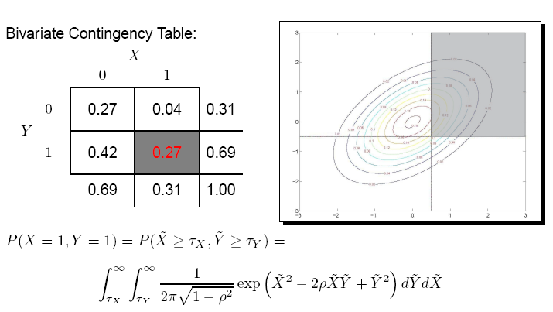
Tetrachoric Correlation Explained

Slide 37
Technical Specifics: Multivariate Attributes
The tetrachoric models assume use the following function to model the probability of an attribute profile:
Where:
Tetrachoric Correlation Matrix
Multivariate Normal Density

Slide 38
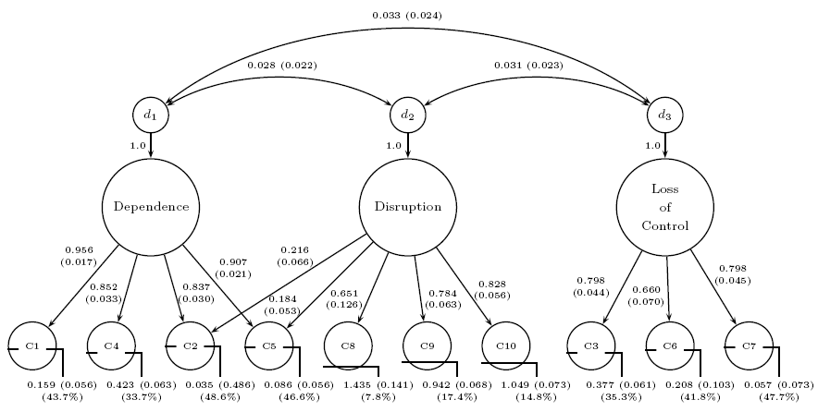
Structured Matrices
Placing a structure on the Ξ tetrachoric correlation matrix expands the model to mimic SEM (Templin & Henson, 2006)

Slide 39
Concluding remarks

Slide 40
Take-home Points
DCM Structural Models describe the distribution of attributes
Means
Correlations
Overall structure
Log-linear structural models are implemented in Mplus
Provide great flexibility in terms of number of parameters
Allow for ability to detect higher order structures
Attribute hierarchies
Allow for potential to model attributes using covariates

