Slide 1

Title: Comprehensive Analysis of Cricket Performance
Subtitle: Insights from the 2023 Cricket World Cup
Date: April 16, 2024
Presenter: Ahmed Ibrahim Khalil

Slide 2
Introduction
Welcome to our detailed analysis of the 2023 Cricket World Cup, where we explore the performance metrics of teams and players across various matches. Our goal is to uncover patterns and insights that could help in enhancing strategies and player development for future tournaments.

Slide 3
Data Overview
The dataset encompasses every inning played in the tournament, detailing metrics like runs, wickets, strike rates, and bowling economies. These metrics are split by player and team, giving us a multifaceted view of the tournament dynamics, from individual contributions to team efforts.

Slide 4
Data Overview
Dataset Size: (1408, 20)
Column Names:
team: The team for which the player played.
player: Name of the player.
bat_or_bowl: Whether the record is for batting or bowling.
bb_bf: Balls bowled or balls faced.
runs: Runs scored or runs conceded.
wkts: Wickets taken.
wicketball_prob: Probability of taking a wicket per ball.
runs_per_ball: Runs per ball.
opposition: The opposing team.
ground: The ground where the match was played.
start_date: Date the match started.
overs: Overs bowled.
mdns: Maiden overs.
econ: Economy rate.
inns: Innings number.
4s, 6s: Number of fours and sixes hit.
sr: Strike rate.
not_out: Whether the batter was not out.
mins: Minutes batted.
Data Types:
Numerical: runs, bb_bf, wkts, etc.
Categorical: team, player, opposition, etc.
Date: start_date.

Slide 5
Team Performance Analysis
We start by aggregating performance stats at the team level. This includes total runs and wickets, which help in evaluating the offensive and defensive capabilities of each team. The analysis reveals top performers in batting and bowling, highlighting teams with exceptional strategies and execution. For instance, Team India’s aggressive batting lineup and Australia’s disciplined bowling attack stood out.

Slide 6
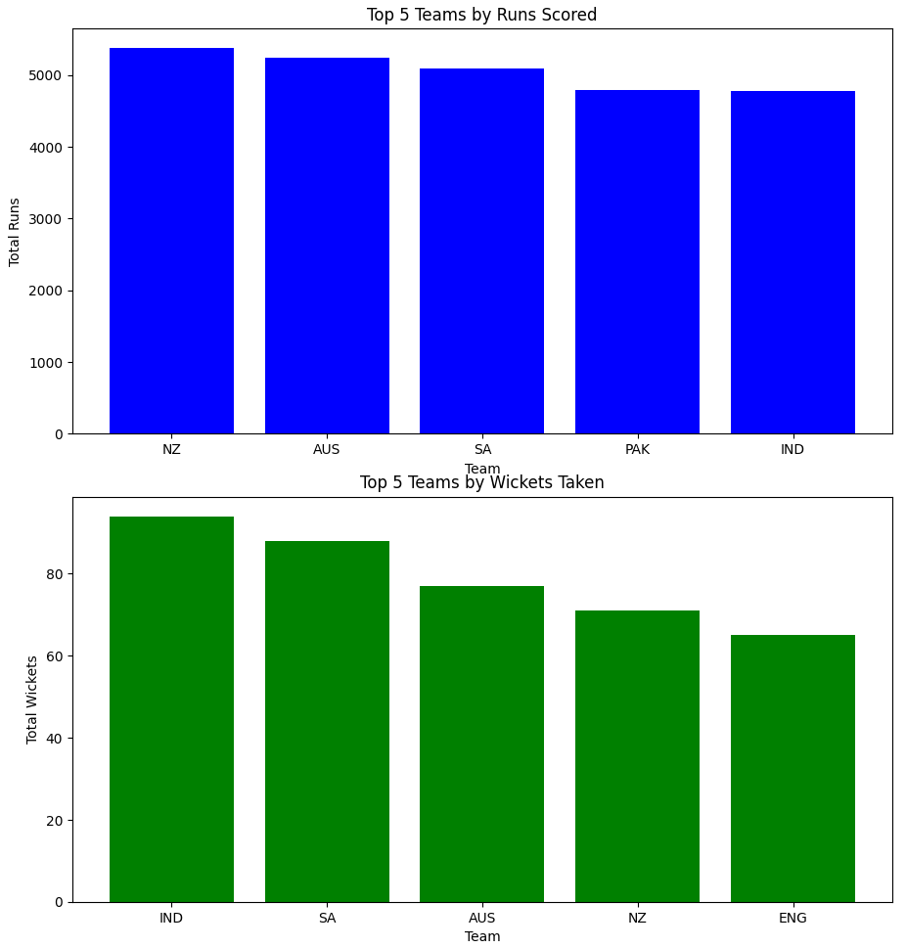

Slide 7
Player Performance Analysis
Focusing on individuals, we identified standout players whose performances significantly influenced their teams' standings. We discuss key performers like Rohit Sharma, who topped the run charts, and Pat Cummins, who led in wickets, analyzing their playing styles and key innings that turned matches in their team’s favor.

Slide 8
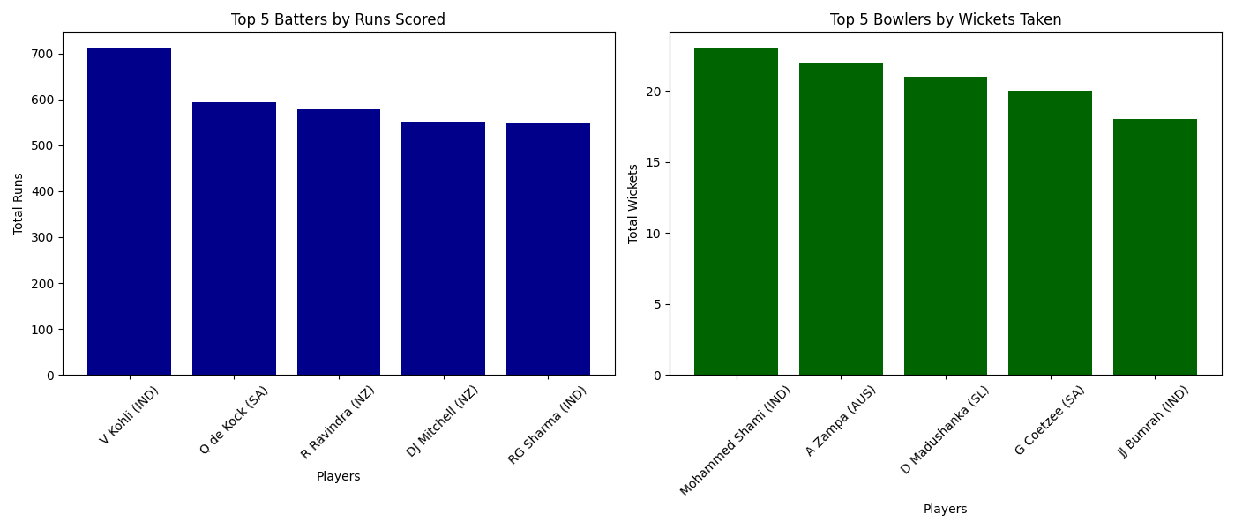
Top Batters and Bowlers

Slide 9
Opposition and Ground Analysis
Our analysis extends to performance against different opponents and at various grounds. We found that certain teams performed exceptionally well under specific conditions. For instance, teams like Pakistan showed remarkable resilience on slower pitches, while South Africa exploited fast, bouncy tracks effectively.

Slide 10
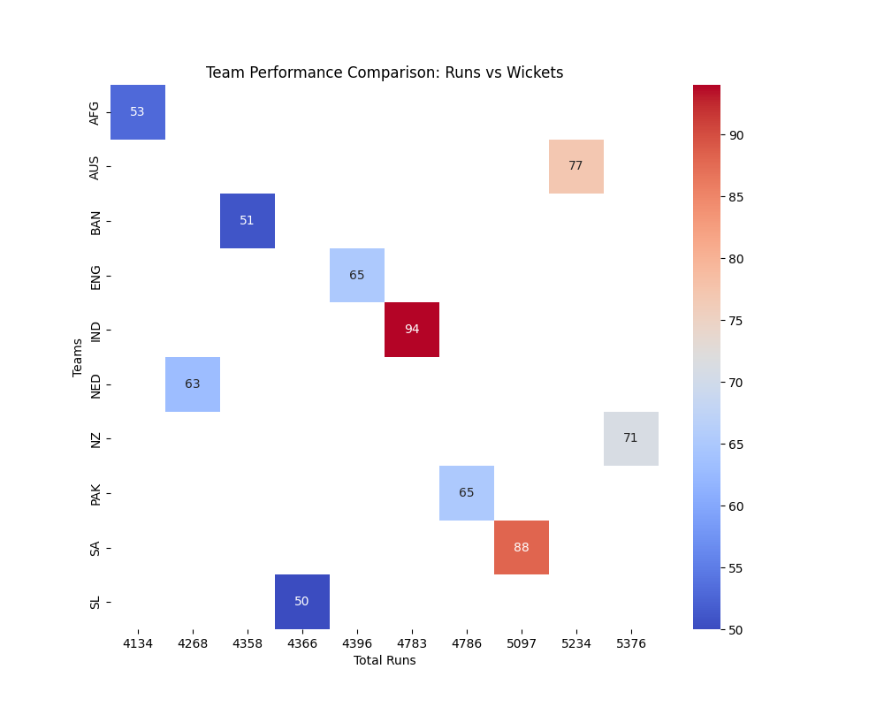
heatmap comparing performance metrics across teams

Slide 11
Temporal Analysis
Temporal trends offer insights into how team strategies and performances evolved over the tournament. We observed that teams like New Zealand improved their game significantly in the later stages, adapting well to the pressures of knockout matches. This section discusses how adaptability and resilience became key factors as the tournament progressed.

Slide 12
Conclusions
The analyses indicate that adaptability and in-depth player performance analysis are crucial for succeeding in high-stakes tournaments. We recommend teams invest in data-driven strategies to tailor their training, selection, and on-field tactics. Additionally, nurturing versatile players who can perform under varying conditions could be vital for future success.

