Slide 1

A cross platform fleet management app offering a driver behavior tracking system
Supervisor: Dr.Islam Elsharawy CO-Supervisor: Dr.momen zaher
Ahmed Diaaeldin 210137

Slide 2

Introduction 1/2
The UN goals:
Climate action
decent work economic growth
Egypt show a road traffic fatality rate of 42 deaths per 100,000 population-one of the highest in the Eastern Mediterranean Region.
The average American driver spent 26 hours in traffic jams in 2020.
https://www.researchgate.net/publication/221720836_Road_Traffic_Injuries_and_Data_Systems_in_Egypt_Addressing_the_Challenges#:~:text=Current%20estimates%20for%20Egypt%20show,DALYs)%20lost%20in%20the%20country.
https://www.autonews.com/mobility-report-newsletter/average-time-spent-us-traffic-jams-cut-73-hours-during-pandemic-study#:~:text=Traffic%20delays%20fell%20nearly%2050,been%20wasted%20sitting%20in%20traffic.

Slide 3
Introduction 2/2
professional drivers face with high risk of death in road traffic accidents, among which, 85% are caused by man-made errors.
Similarly, Lynn and Lockwood (1999) pointed out in their research that considering the company's high mileage of car drivers, their accidents were 50% more often than that of ordinary drivers.
Wanli Han, Jianyou Zhao,Driver behaviour and traffic accident involvement among professional urban bus drivers in China,Transportation Research Part F: Traffic Psychology and Behaviour,Volume 74,2020,Pages 184-197,ISSN 1369-8478,https://doi.org/10.1016/j.trf.2020.08.007

Slide 4
Background:

Slide 5
Motivation:

Slide 6
Technical Problem

Slide 7
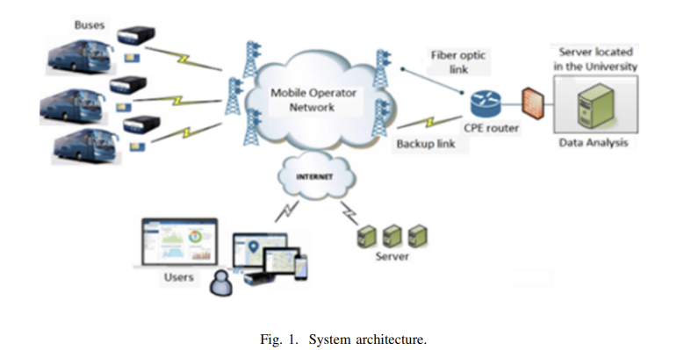
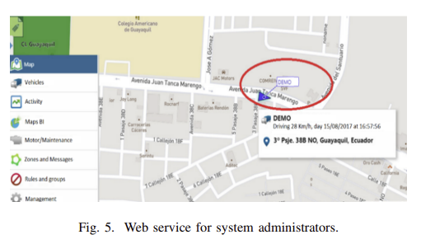
Related work 1/2 : M2M technology for bus fleet management. Case study: A college transportation system
Optimization of transportation services and addressing planning, scheduling, and management challenges in a college campus.
M2M for real-time bus location tracking and analysis for offering speeding real-time notifications, and route compliance (sticking to the planed route).
A system was deployed successfully, After the installation of the geolocation device, the bus driver respected the speed limit on most parts of the route.
Offered only speeding real-time notifications, and route compliance, while more outcome to evaluate driver behavior could have been taken like :
Harsh acceleration and braking.
Cornering behavior.
V. S. Padilla, A. Collaguazo, J. J. Cabrera and J. Pesantez, "M2M technology for bus fleet management. Case study: A college transportation system," 2020 IEEE Technology & Engineering Management Conference (TEMSCON), Novi, MI, USA, 2020, pp. 1-5, doi: 10.1109/TEMSCON47658.2020.9140131.
Notes:
OBU On Board Unit. Lack of real-time information: Insufficient access to accurate and up-to-date information about bus locations, schedules, and route deviations, leading to passenger inconvenience and potential delays. Route optimization: Efficiently planning and scheduling multiple routes to ensure optimal vehicular availability and minimize delays. This involves considering factors such as passenger demand, traffic conditions, and the availability of vehicles. Harsh acceleration and braking: vehicle speed and acceleration patterns.
Cornering behavior: vehicle speed, acceleration, and steering inputs(ex: Steering angle sensor or mobile)
Didn’t show how to calc speed

Slide 8
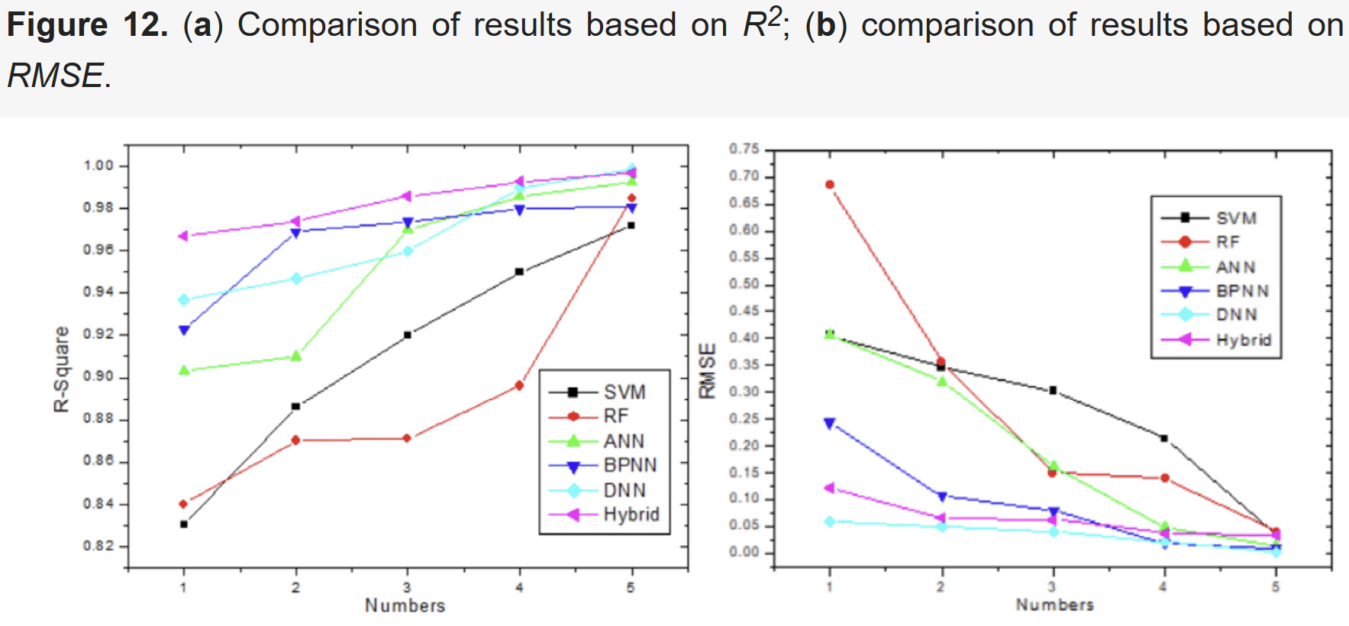
Related work 2/2 : comprehensive review of data-driven fuel consumption prediction models.
Accurately and efficiently predicting the fuel consumption of vehicles is the key to improving their fuel economy.
This paper provides a comprehensive review of data-driven fuel consumption prediction models
Used neural networks (such as BPNN and DNN) and the hybrid model (combining ML and neural network techniques leverage the advantages of different models)
Both consistently exhibit a coefficient of determination above 0.90 and a root mean square error below 0.40.
Fuel Consumption Prediction of Vehicles (kaggle.com)
Zhao, Dengfeng, Haiyang Li, Junjian Hou, Pengliang Gong, Yudong Zhong, Wenbin He, and Zhijun Fu. 2023. "A Review of the Data-Driven Prediction Method of Vehicle Fuel Consumption" Energies 16, no. 14: 5258. https://doi.org/10.3390/en16145258

Slide 9
Problem statement
A cross platform fleet management app offering a driver behavior tracking system to ensure safe driving and minimize fuel consumption.

Slide 10
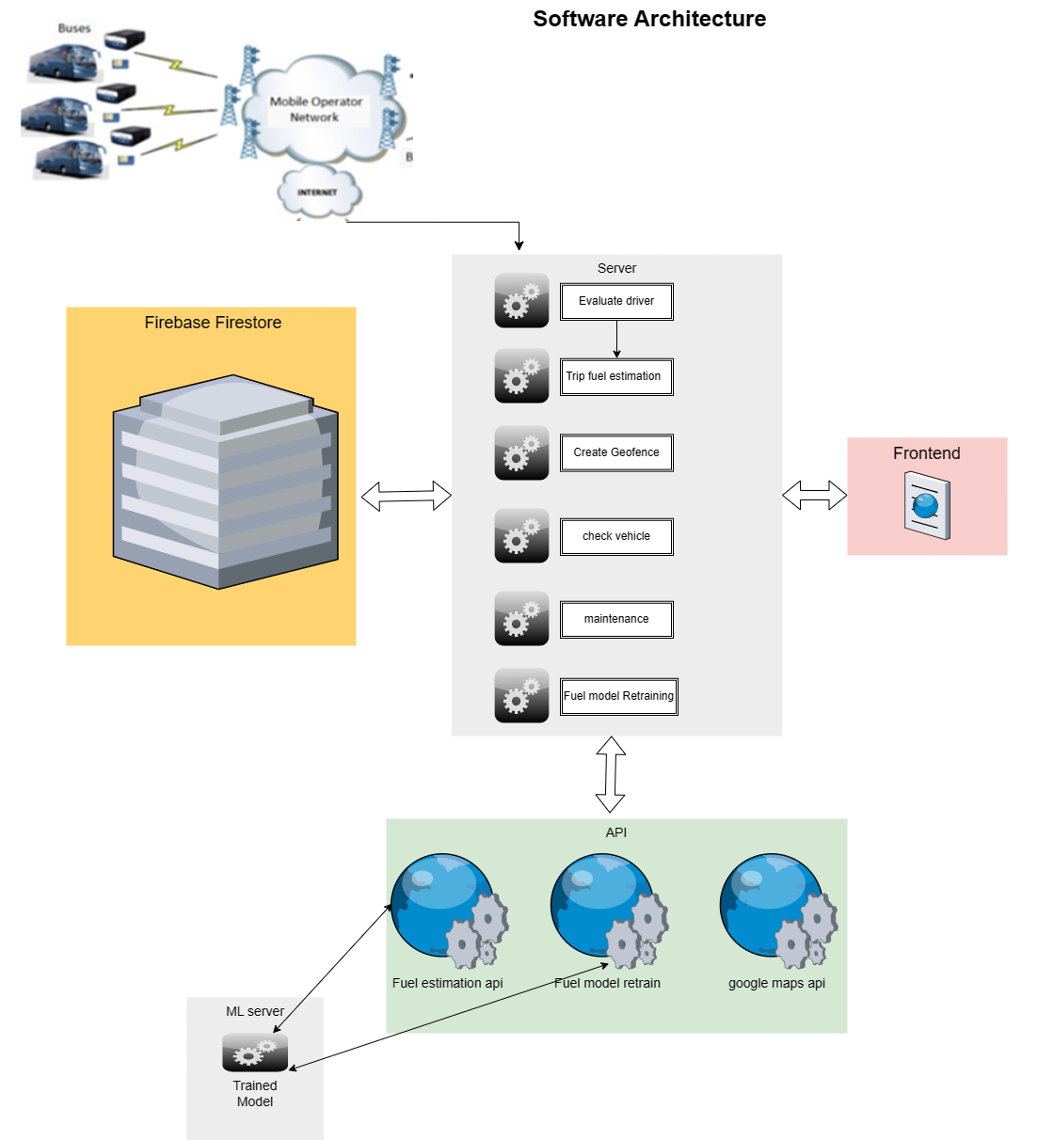
Proposed Solution

Slide 11
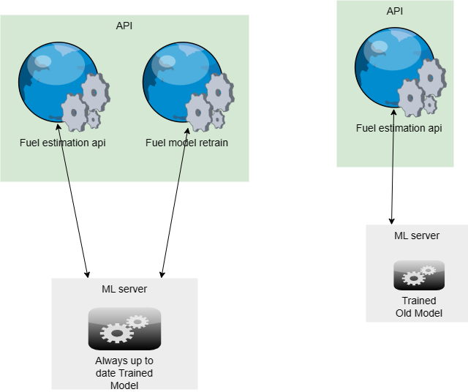



Model Retraining
The final goal of all industrial machine learning (ML) projects is to develop ML products and rapidly bring them into production.
D. Kreuzberger, N. Kühl and S. Hirschl, "Machine Learning Operations (MLOps): Overview, Definition, and Architecture," in IEEE Access, vol. 11, pp. 31866-31879, 2023, doi: 10.1109/ACCESS.2023.3262138.

Slide 12
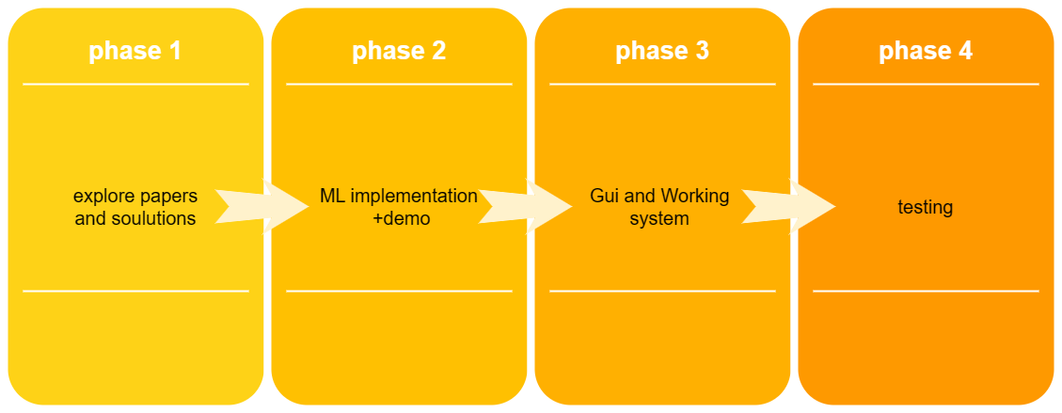

Slide 13
References
D. Kreuzberger, N. Kühl and S. Hirschl, "Machine Learning Operations (MLOps): Overview, Definition, and Architecture," in IEEE Access, vol. 11, pp. 31866-31879, 2023, doi: 10.1109/ACCESS.2023.3262138.
V. S. Padilla, A. Collaguazo, J. J. Cabrera and J. Pesantez, "M2M technology for bus fleet management. Case study: A college transportation system," 2020 IEEE Technology & Engineering Management Conference (TEMSCON), Novi, MI, USA, 2020, pp. 1-5, doi: 10.1109/TEMSCON47658.2020.9140131.
Zhao, Dengfeng, Haiyang Li, Junjian Hou, Pengliang Gong, Yudong Zhong, Wenbin He, and Zhijun Fu. 2023. "A Review of the Data-Driven Prediction Method of Vehicle Fuel Consumption" Energies 16, no. 14: 5258. https://doi.org/10.3390/en16145258
https://www.researchgate.net/publication/221720836_Road_Traffic_Injuries_and_Data_Systems_in_Egypt_Addressing_the_Challenges#:~:text=Current%20estimates%20for%20Egypt%20show,DALYs)%20lost%20in%20the%20country.
https://www.autonews.com/mobility-report-newsletter/average-time-spent-us-traffic-jams-cut-73-hours-during-pandemic-study#:~:text=Traffic%20delays%20fell%20nearly%2050,been%20wasted%20sitting%20in%20traffic.
Wanli Han, Jianyou Zhao,Driver behaviour and traffic accident involvement among professional urban bus drivers in China,Transportation Research Part F: Traffic Psychology and Behaviour,Volume 74,2020,Pages 184-197,ISSN 1369-8478,https://doi.org/10.1016/j.trf.2020.08.007.(https://www.sciencedirect.com/science/article/pii/S1369847820304897)

