Slide 1
GRID-PULSE NTL // Kafr El-Sheikh · autonomous NTL detection
The grid loses power it can't see. We find it.
◆ THEFT SUSPECTED TX-KFS-0456 · single
94% theft probability
~3.08 kW unaccounted beyond natural loss — dispatch field inspection.
Every distribution transformer leaks energy — some to heat, some to theft. Grid-Pulse learns how much loss is normal right now — load, temperature, hour — and flags only the unexplained rest as theft, with the reason it decided.
✓ Energy imbalance +3076 W
✓ Expected loss exceeded +951% vs baseline
✓ Power factor dropped 0.66 (≥ 0.92)
✓ THD increased 22% (> 10%)
✓ Load outside normal pattern anomaly 0.83
≈ 30B EGP
lost to non-technical loss in Egypt, every year
< 1 month
payback per instrumented transformer kiosk
3.40 kW
MEASURED LOSS
0.32 kW
AI BASELINE
3.08 kW
UNACCOUNTED

Slide 2
01 THE PROBLEM
Why the grid is blind
Cable and transformer losses are real, and they rise with heat and load. A fixed threshold cries wolf all summer — so operators mute it, and real theft hides in the noise.
A brick-kiln, a workshop, a battery of hair-dryers hooked past the meter — the transformer feels it as “more loss.” Without context, every hot afternoon looks like theft, and every theft looks like a hot afternoon.
~30%
of generated power lost to NTL in the worst-hit zones
7
independent inputs the model weighs — not temperature alone
3 beats
is all it takes to show a judge the difference, live

Slide 3
02 THE MOAT
Separating heat from theft
Same transformer, three readings. The AI baseline rises with the heat — so the middle case raises no alarm. Only the third leaves an unexplained residual. This is the whole demo.
● NORMAL
● TECHNICAL LOSS
● THEFT SUSPECTED
Baseline load
Hot day, 45 °C
Unregistered hook
Registered demand, clean waveform. Energy balance holds.
Loss climbs — but the model expects it. R rises with heat. No false alarm.
+3.4 kW draw, PF collapses, THD spikes. Baseline stays flat — residual explodes.
load 6.85 kW
power factor 0.98
residual −0.17 kW
probability 0%
load 7.00 kW
AI baseline ↑ tracks temp
residual −0.15 kW
probability 0%
load 10.2 kW
power factor 0.66
residual +3.08 kW
probability 94%

Slide 4
03 THE MODEL
Multi-factor, and it shows its work
A temperature-only model reads as a toy. Ours weighs seven signals; a Random-Forest learns what natural loss should be, and the verdict names every reason it fired.
LEARNED FEATURE IMPORTANCE · TECHNICAL-LOSS MODEL
DETECTION PIPELINE
load_w
0.58
① Energy balance
feeder power − registered meters = measured loss
temp_c
0.27
② AI technical-loss baseline
predicts normal loss now → residual = measured − expected
current_a
0.15
hour
0.002
③ Harmonics & power factor
illegal loads distort the waveform
day_of_week
0.001
voltage_v
0.001
④ Temporal anomaly
Isolation Forest flags draws that don't fit the curve
rated_kva
0.001
⑤ Fusion + explainable verdict
probability, reasons checklist, estimated stolen kW

Slide 5
04 THE HARDWARE
From breadboard to busbar
A real edge node, not a slide. Current transformer → signal conditioning → ESP32 → a strict, signed telemetry contract the backend enforces on every packet.
EDGE NODE — TODAY
PRODUCTION — ROADMAP
ESP32 + split-core CT
Kiosk-grade sensing
› SCT-013-000 clamp, 100 A : 50 mA, non-invasive
› 33 Ω burden + 1.65 V bias into the ADC — measured
› EmonLib RMS, calibration ≈ 60.6, NTP-timestamped
› Posts contract-valid JSON with a bearer token
› Rogowski coils on the LV busbar, IP65
› LoRaWAN backhaul — no field Wi-Fi
› TinyML on-device: send only on theft (−99% bw)
› Theft-location triangulation across feeders
BACKEND
THE INTERFACE
FastAPI · Redis · Celery
An operator's console
› Strict JSON-Schema contract: bad body → 422
› Bad token → 401, every packet authenticated
› Inline or worker detection — same verdict
› Live map + verdicts over WebSocket
› Every transformer on a map: green / amber / red
› Big probability + reasons checklist
› One tap: dispatch inspection, or dismiss
› 2 s polling fallback if the socket drops

Slide 6
05 THE BUSINESS
A business the ministry funds itself
We don't sell software they have to justify — we take a share of the energy we recover. The first month of caught theft pays for the kiosk.
≈ 30B EGP
< 1 mo
SaaS + HaaS
annual NTL loss in Egypt — the pool we recover against
ROI per instrumented kiosk at typical recovery rates
hardware-as-a-service + platform, or % of recovered energy
Customer: distribution companies and the Ministry of Electricity. Wedge: one region, a few hundred kiosks, measured recovery. Moat: the labelled theft data we accumulate makes every next region's model sharper — a data advantage a fixed-threshold competitor can never catch.

Slide 7
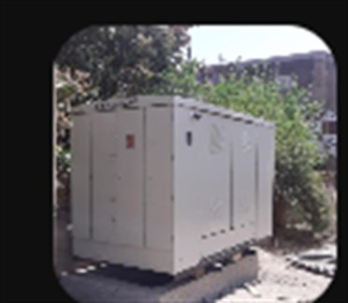
06 DEPLOYMENT · KAFR EL-SHEIKH
Onto the real iron box
The field target is a sealed distribution kiosk (RMU). We retrofit it non-invasively on the low-voltage side — no outage, nothing bolted to the 11 kV.
✓ Wrap 3 Rogowski coils
around the LV busbars — one per phase
✓ IP65 edge node
custom PCB inside the panel; antenna routed outside the metal shell
✓ MV chamber never touched
no galvanic contact, no feeder disconnected
✓ ~30 min & reversible
zero service interruption — unclip and it's as it was
Distribution kiosk (RMU) · Kafr El-Sheikh

Slide 8
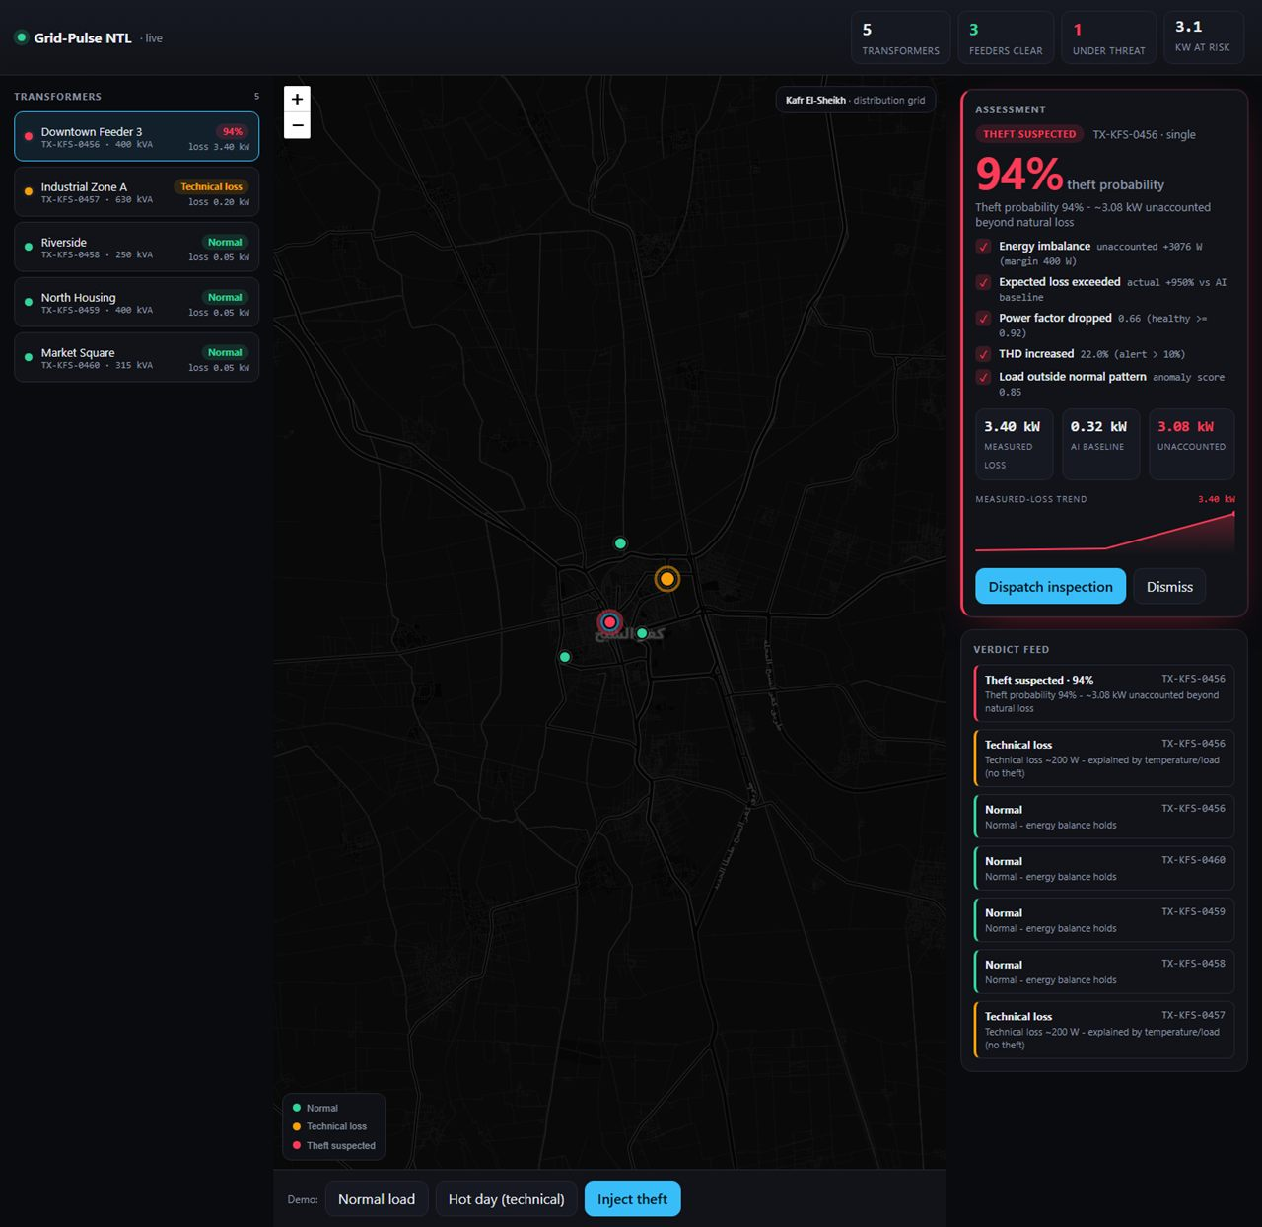
07 THE PRODUCT · LIVE
Running, not rendered
94% live theft verdict
› Reasons checklist — 5/5 independent signals fired
› Colour-coded fleet map — green / amber / red at a glance
› Measured-loss trend + one-tap dispatch to inspection
Every figure in this deck comes straight out of this running system.

Slide 9
THE PITCH, IN ONE LINE
We turn a blind meter reading into a decision an inspector can act on.
Working edge node, real trained model, explainable verdict, and a demo that lands in three clicks. Built in Kafr El-Sheikh — to be deployed across the grid.
NORMAL · TECHNICAL_LOSS · NTL_THEFT_SUSPECTED

