Slide 1
CONFIDENTIAL · INVESTMENT & DEPLOYMENT PROPOSAL · 2026
Autonomous Detection of Non-Technical Loss
on the Egyptian Distribution Grid
An AI edge-and-cloud system that distinguishes electricity theft from the natural losses of heat and load — and localizes it to the transformer, with explainable evidence.
EGP 25–35B
94%
< 2 months
EGP 30M
annual non-technical loss (Egypt)
theft-detection confidence, demonstrated
utility payback per node
seed investment sought

Slide 2
01 GRID-PULSE NTL · FORMAL PROPOSAL
Executive Summary
Grid-Pulse NTL is a business-to-government venture that recovers stolen electricity for distribution companies. A low-cost sensor on each distribution transformer measures the energy leaving it; the platform compares that against registered consumption and an AI-predicted technical (natural) loss, and reports the unexplained excess as suspected theft — with a probability, a reasons checklist, and an estimate of the kilowatts at risk.
The commercial model aligns the company with the utility: a share of the energy recovered, atop a modest hardware and platform fee. At typical recovery rates a single node pays for itself in under two months. The system is built and demonstrated.
The differentiator is not measurement — it is attribution. An AI baseline predicts how much loss is normal for the present heat and load, so only the genuinely unexplained remainder is flagged. This removes the false alarms that make simple meter-difference methods unusable in the Egyptian summer.

Slide 3
02 GRID-PULSE NTL · FORMAL PROPOSAL
The Problem: Non-Technical Loss
Distribution companies lose energy two ways. Technical loss is physical — heat in cables and transformers — and rises with temperature and load. Non-technical loss (NTL) is theft: illegal hooks, tampered meters, unmetered workshops and kilns. In Egypt, NTL is estimated at EGP 25–35 billion per year, and it worsens load-shedding by overloading transformers with demand no one is billed for.
The operational difficulty: both losses present identically at the transformer, as “more loss.” A fixed threshold alarms on every hot afternoon and is ignored — leaving utilities with slow, tip-driven manual inspection.

Slide 4
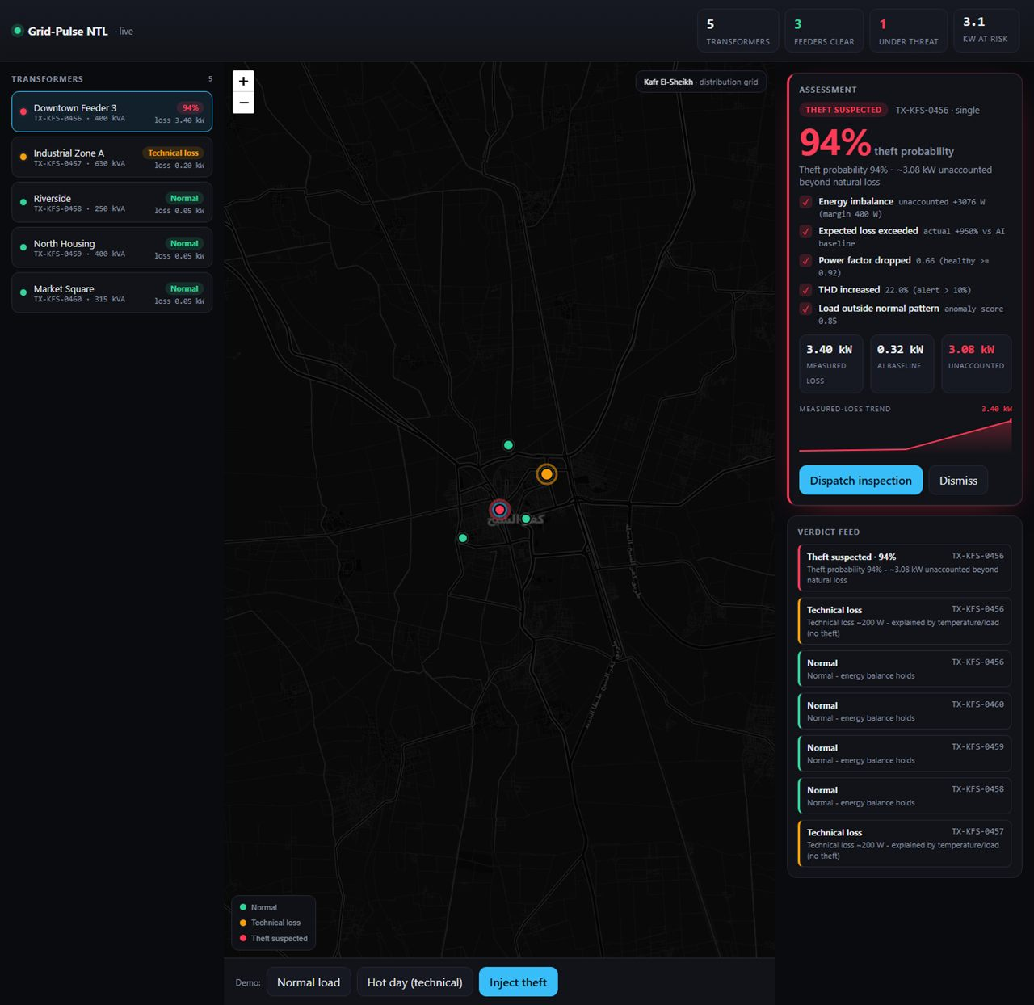
03 GRID-PULSE NTL · FORMAL PROPOSAL
The Solution
Grid-Pulse runs a continuous energy balance at each transformer, predicts the expected technical loss for current conditions, and treats the difference as the candidate theft signal.
That signal is confirmed or dampened by three independent lines of evidence — harmonic signature, power factor, and a longer-horizon energy accounting — before a verdict is issued.
Every verdict is explainable: a probability, a checklist of the indicators that fired, the kilowatts unaccounted for, and a recommended action.
Figure 1. The operator console — a demonstrated 94% theft verdict.

Slide 5
04 GRID-PULSE NTL · FORMAL PROPOSAL
Technology & Detection
• Energy balance
measured output less registered consumption
MEASURED PERFORMANCE (held-out, synthetic)
Theft precision
1.00
• AI technical-loss baseline
Random-Forest over 7 features → expected natural loss
Theft recall
0.78
• Harmonic signature (1D-CNN)
clean / legit-industrial / illegal-bypass
F1 score
0.88
• Transformer energy accounting
excess loss over a horizon as corroborating evidence
Brier score
0.06
Legit-industrial false alarm
0.00
• Temporal anomaly
Isolation-Forest on the consumption pattern
Models retrain on real utility meter data in production.
• Decision fusion & XAI
calibrated probability + reasons checklist

Slide 6
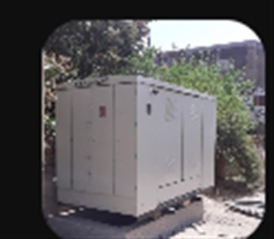
05 GRID-PULSE NTL · FORMAL PROPOSAL
Field Deployment
The field target is a sealed distribution kiosk (ring-main unit). Grid-Pulse retrofits it non-invasively, on the low-voltage side only:
— Three Rogowski coils clipped around the LV busbars — one per phase.
— An edge node in a weatherproof IP65 enclosure; antenna routed outside the shell.
— The 11 kV chamber is never entered; no conductor cut; no feeder disconnected.
— Fully reversible; ~30 minutes per kiosk; no service interruption.
— Production: Rogowski coils + LoRaWAN/cellular, suitable for ~230,000 transformers.
Figure 2. Distribution kiosk (RMU), Kafr El-Sheikh.

Slide 7
06 GRID-PULSE NTL · FORMAL PROPOSAL
Market & Competitive Position
Utilities fight theft today by manual audit, full smart-meter rollout, analytics on meter data, feeder monitoring, or fixed-threshold alarms. Each is slow, blind to cause, or dependent on a metering estate that costs billions to build.
Grid-Pulse occupies the position none of these hold: low capital cost, explainable, and effective on a grid that was never fully metered. One node observes a whole feeder of customers — a fraction of per-meter cost — and the AI baseline removes the false positives that make cheaper analytics unusable. Each verdict adds labelled theft data, a compounding advantage a fixed-threshold competitor cannot replicate.

Slide 8
07 GRID-PULSE NTL · FORMAL PROPOSAL
Business Model & Financials
REVENUE STREAMS
EGP M Y1 Y2 Y3 Y4 Y5
Hardware — EGP 6,000 / node
edge node + gateway share, at margin or leased
Total revenue
4.4
33.5
142.8
324.4
604.8
Platform — EGP 300 / node / month
detection, dashboard, verdicts, reporting
Gross profit
1.9
15.0
67.0
167.1
327.8
Op. expenses
12.0
28.0
50.0
95.0
160.0
Recovery share — 15%
of verified recovered energy, first 24 months
EBITDA
(10.1)
(13.0)
17.0
72.1
167.8
Unit economics: 5-yr gross profit ≈ EGP 20,750 / node (LTV/CAC ≈ 8×); customer payback < 2 months.
Founder's model; breakeven in Year 3.

Slide 9
08 GRID-PULSE NTL · FORMAL PROPOSAL
The Investment Ask
EGP 30M
≈ USD 625,000 seed — through a district pilot and two years to the Year-3 EBITDA turn.
Use of funds: field pilot 40% · product & ML 25% · hardware R&D + certification 15% · team & G&A 12% · go-to-market 8%.
RISK & GOVERNANCE
— Procurement cycles
paid pilot + audited recovery → framework tender
— Hardware capital
sold at margin; fleets asset-financed vs contracts
— Model trust
explainable, human-reviewed, retrained on real data
— Data & privacy
meters transformers, not households
Confidential · Grid-Pulse NTL · Investment & Deployment Proposal · 2026

