Slide 1


QC⁴H₂O: Simulating Water on a Quantum Computer
Tobias Binninger (IET-3, Forschungszentrum Jülich)
Collaboration with Prof. Peter Orth, Quantum Information and Matter, Universität des Saarlandes

Slide 2
QC⁴H₂O: Simulating Water on a Quantum Computer
Objective: Develop methods to simulate molecular water on a quantum computer
Idea/Novelty: Joint treatment of electronic and protonic degrees of freedom
Combination of quantum simulation and quantum optimization

Slide 3
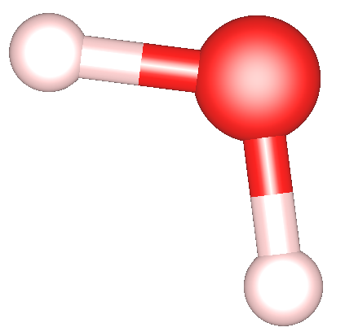
QC⁴H₂O: Simulating Water on a Quantum Computer
Molecular Hamiltonian in Born-Oppenheimer Approximation (atomic units):
Molecular Hamiltonian in Second Quantization:

Slide 4
QC⁴H₂O: Simulating Water on a Quantum Computer
Molecular Hamiltonian in Second Quantization:

Slide 5
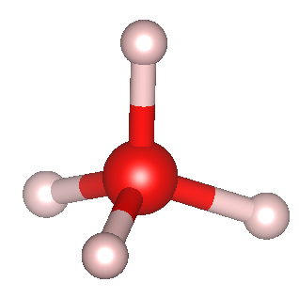
QC⁴H₂O: Simulating Water on a Quantum Computer
Molecular Hamiltonian in Second Quantization:
4 sites for protons along tetrahedral sp³-hybridized orbitals of central oxygen atom
Occupation of proton sites represented by Pauli z-operators:
H₄O

Slide 6
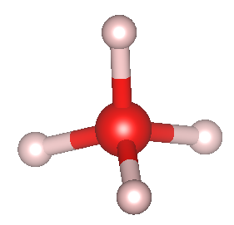

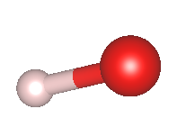
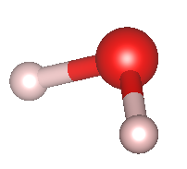
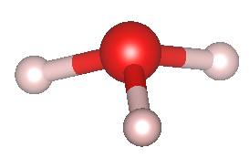
QC⁴H₂O: Simulating Water on a Quantum Computer
Molecular Hamiltonian in Second Quantization:
4 sites for protons along tetrahedral sp³-hybridized orbitals of central oxygen atom
Occupation of proton sites represented by Pauli z-operators:
H₄O

Slide 7
Update 19.03.2025: Implementation: Indices
H₄O
oxygen – proton
proton – proton
electron kinetic
electron – oxygen
electron – proton
electron – electron

Slide 8
Update 23.04.2025: Indices, Spin orbitals
H₄O
oxygen – proton
proton – proton
electron kinetic
electron – oxygen
electron – proton
electron – electron
Each electronic creation/annihilation operator represents one spin orbital
Even indices represent spin up, odd indices spin down orbitals
Careful with the order of indices:
First ”l” then “k”!

Slide 9
Update 25.04.2025: Indices, Spin orbitals
H₄O
oxygen – proton
proton – proton
electron kinetic
electron – oxygen
electron – proton
electron – electron
Each electronic creation/annihilation operator represents one spin orbital
Even indices represent spin up, odd indices spin down orbitals
Sigma^z: Occupation variables: Eigenvalues 0 and 1
Careful with the order of indices:
First ”l” then “k”!

