Slide 1


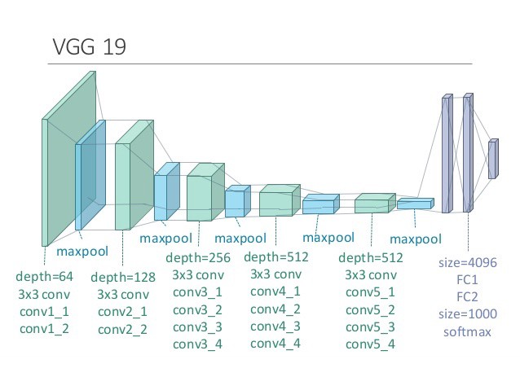

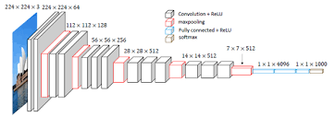
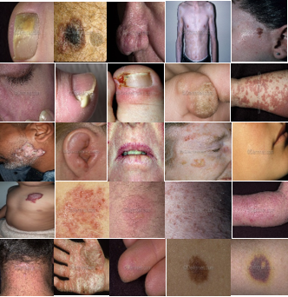
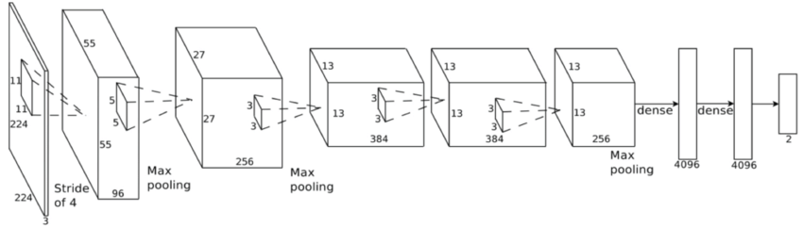
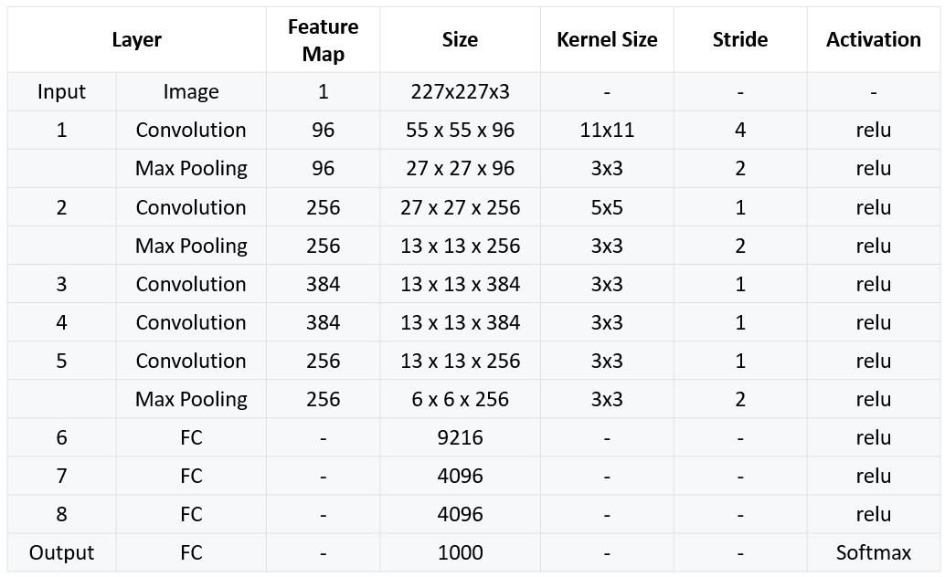
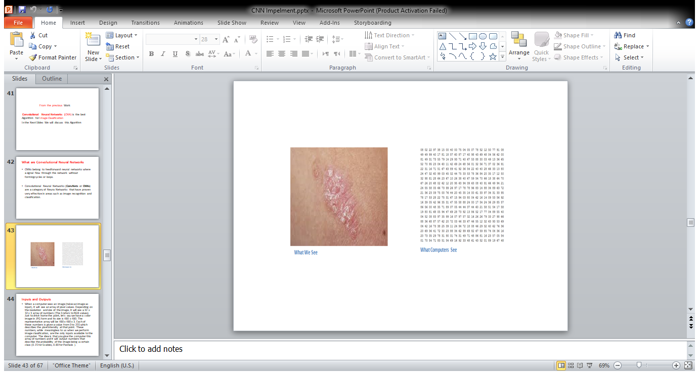
Zagazig University
Faculty of Computers and Informatics
Computer Science Department
Dermatology Diagnosis System
نظام تشخيص الامراض الجلديه
Abstract
Skin diseases are common problem among different countries and ages. Besides their painful effects they are spreading very fast to cover a large body area. The diagnosis of the skin diseases requires a high level of expertise and they are subjective to the dermatologist. Therefore, a computer-aided skin diseases diagnosis system is proposed in this paper to provide both objective and reliable solution to this problem. The system uses a deep learning model to classify the infected images. Classification performances of different architectures of the Convolutional Neural Networks are compared using the DermNet skin image database. These architectures are the AlexNet, the VGG-16, and the VGG-19. The AlexNet architecture produces the best results and is used in the proposed diagnosis system. The proposed system produces 95.7% accuracy in identifying the skin Disease from an input image for the infected area.
introduction
The skin covers all the human body and it is exposed to various environmental effects. Nowadays, skin diseases become wide spread all over the world. Some of these diseases causes death such as a skin cancer . If melanoma is detected early and treated properly, the survival rate is very high . Several algorithms are developed to help patients and doctors in different ways, starting from registration process ending with diagnosing diseases. An algorithm is proposed to automatically distinguish celiac disease from the video capsule image using the 10-fold with an accuracy of 86.47% and LOOCV technique with an accuracy of 85.91% . Another algorithm is proposed to identify lung cancer using tree-based classifiers like Random Forest and XGBoost with Accuracy is 84% . A comparative study on diagnosing the diabetic disease using different machine learning algorithms such as decision tree, logistic regression, K-nearest neighbors, naïve Bayes, and support Vector Machine (SVM) finds out that the logistic regression gives the most accurate results that is 77% . A comparative study on diagnosing the Parkinson’s disease using Decision Tree, Naive Bayes, Neural Network, Random Forests, and SVM finds out that the Random Forests has the highest diagnostic accuracy that is 99.49% . In diagnosing Liver cancer, the SVM with new 2-level genetic optimizer and feature selection produces classification accuracy of 88.49% . Deep convolutional neural networks (DCNNs) is used on chest radiographs for detecting tuberculosis (TB) with Accuracy of 99% . The SVM is used to identify heart disease with accuracy 94.60% . The naive Bayes algorithm is used to identify diabetes disease with Accuracy 95% . The FT Tree Algorithm is used to identify liver disease with Accuracy 97.10% . The RS theory is used to identify dengue disease with Accuracy 100% . The feed forward neural network is used to identify hepatitis disease with Accuracy 98% .
Several computer aided systems are developed to diagnose many types of skin diseases . A classification algorithm for identifying melanoma, which is a type of skin cancer, is developed using the DermNet data set with accuracy 91%. This algorithm uses particle swarm optimization (PSO) and simulated annealing (SA). A CNN that is trained with DermNet data set is used to recognize skin diseases that are produced by diabetes with accuracy of 70% and after using data augmentation the accuracy becomes 91% . The CNN that is trained with DermNet Data set is used to identify melanoma, which is a type of skin cancer, with accuracy of 90.5% . Several deep learning techniques are used in medical image analysis . A survey on applying deep learning techniques in image-based cancer detection and diagnosis is presented . All these studies use training data for deep learning techniques that is not balanced, i.e., it is composed of different categories that are of different sizes. This causes bias in the learning process and results in low classification accuracy.
This paper proposes a diagnosis system that can identify a skin disease from an input image using the convolutional neural network (CNN). The DermNet skin-image data set is used to train and test the CNN. demonstrates the basic concepts of the CNN and describes the three different architectures of it. presents the experiments carried out to compare the different CNN architectures. discusses the results obtained.
The CNN is a category of Neural Networks that has proven very effective in areas such as image recognition , classification and segmentation . The CNN classifiers take an input image, process it and classify it under certain categories . Computers see an input image as array of pixels. Based on the image resolution, it will see h x w x d (h = Height, w = Width, d = Dimension). For example, an image of 6 x 6 x 3 array of matrix of RGB (3 refers to RGB values) and an image of 4 x 4 x 1 array of matrix of gray scale image. In deep learning CNN models, each input image passes through a series of convolution layers with filters (Kernals), pooling, fully connected layers (FC) and an output layer that applies a softmax function to classify an input image with probabilistic values between 0 and 1.
Figure 2-CNN Algorithm
Convolution Layers
Convolution layers extract features from an input image. Convolution preserves the relationship between pixels by learning image features using small squares of input data. Convolution of an image with different filters can perform operations such as edge detection, blurring, and sharpening.
Pooling Layers
Pooling layers reduce the number of parameters when the image size is large. Spatial pooling also called subsampling or downsampling which reduces the dimensionality of each map but retains the important information. Spatial pooling can be of different types such as max pooling, average pooling, and sum pooling.
Fully Connected (FC) Layers
The FC layers take as input the feature map matrix that is extracted from previous layers and combine these features together to create a model.
The Output Layer
The output layer that uses a softmax activation function is used to classify the input image into one of the output classes.
This project compares three different architectures of the CNN in classification task using the DermNet dataset. These architectures are the Alexnet, the VGG 19, and the VGG 16.
Architecture of AlexNet
The AlexNet architecture is proposed and wins the ImageNet Large-Scale Visual Recognition Challenge (ILSVRC). The AlexNet consists of five convolution layers, some of which are followed by max-pooling layers and three fully-connected layers with a final softmax one. The first convolution layer filters the 224×224×3 input image with 96 kernels of size 11×11×3 with a stride of 4 pixels. The second convolution layer takes the output of the first convolutional layer and filters it with 256 kernels of size 5×5×48. The third, fourth, and fifth convolution layers are connected to each other without any intervening pooling or normalization layers. The third convolution layer has 384 kernels of size 3×3×256 connected to the normalized/pooled outputs of the second convolution layer. The fourth convolution layer has 384 kernels of size 3×3×192, and the fifth convolution layer has 256 kernels of size 3×3×192. The fully-connected layers have 4096 neurons. In this paper, the third fully connected layers are changed to have 23 neurons, which is the number of categories in the DermNet data set.
Figure 3-Alexnet Architecture
Figure 4-Alexnet layers
Architecture of the VGG-19
The VGG-19 is a CNN architecture that is used for classification . It is composed of five building blocks. The first and second building blocks are composed of two convolution layers and one pooling layer. The third and fourth blocks are composed of four convolution layers and one pooling layer. The fifth block is composed of four convolution layers. The 3x3 sized filters with a stride of one are used in all convolution layers.
.
The number of these filters are 64 in the first building block, 128 in the second block, 256 in the third block, and 512 in the fourth and fifth blocks. For the pooling layers, the 2x2 sized max-pooling is used with a stride of two. The ReLU is used as an activation function. For easier initialization and faster training, batch normalization is performed at each block. To prevent overfitting, dropout regularization is processed between fully-connected layers. In the prediction block, 4096 channels are divided into
23 classes using softmax function.
Figure 5-vgg19 Architecture
Architecture of VGG-16
Architecture of the VGG-16 is used for classification . It is composed of five building blocks. The first and second building blocks are composed of two convolution layers and one pooling layer. The third and fourth blocks are composed of three convolution layers and one pooling layer. The fifth block is composed of three convolution layers. The 3x3 sized filters with a stride of one are used in all convolution layers. The number of these filters are 64 in the first building block, 128 in the second block, 256 in the third block, and 512 in the fourth and fifth blocks. For the pooling layers, the 2x2 sized max-pooling is used with a stride of two. The ReLU is used as activation function. For easier initialization and faster training, batch normalization is performed at each block. To prevent overfitting, dropout regularization is processed between fully-connected layers. In the prediction block, 4096 channels are divided into 23 classes using softmax function.
Figure 6-vgg16 Architecture
Dataset
Dermnet dataset is one of the largest photo dermatology sources that is available publicly. It has more than 23,000 skin disease images on a wide variety of skin conditions. Dermnet organizes the skin diseases biologically in a two-level taxonomy. The bottom-level contains more than 600 skin diseases in a fine-grained granularity. The top-level contains 23 skin disease classes. Each of the top-level skin disease class contains a collection of the bottom-level skin diseases, the data was divided into training dataset, validation dataset and testing dataset using the following percentages 80% training, 15% validation, 5% testing.5% validation, 5% testing.
Figure 7-Dermnet Dataset
RESULTS AND DISCUSSION
Table 1 shows that the AlexNet architecture of the CNN produces the best training and testing classification accuracy with the DermNet dataset among the different architectures compared. The Alexnet is composed of 5 convolutional layers meanwhile the VGG-16 and the VGG-19 are composed of 16 and 19 convolutional layers, respectively. This allows the AlexNet to extract less features from the images than both of the other architectures and therefore decreases the overfitting effect. This in turn increases the generalization ability of the AlexNet and in turn the classification accuracy.
Table 1. Classification results of different CNN architectures using the DermNet dataset.
CONCLUSIONS
The Convolutional Neural Networks prove high efficiency as a deep learning tool in image classification. This tool is used in the proposed diagnosis system in this paper to provide fast and reliable skin disease diagnosis. After comparing three different architectures of the CNN that are AlexNet, VGG-16 and VGG-19, the AlexNet architecture produces the best classification performance with the DermNet skin disease image database to test the 23 categories of skin diseases. Therefore, the AlexNet architecture is used in the proposed diagnosis system for skin diseases.
Proposed Method
Convolutional Neural Networks (CNN):
Is the best Algorithm for Image Classification in the Next We will discuss this Algorithm .CNNs belong to feed forward neural networks where a signal flow through the network without forming cycles or loops.
The CNN is a category of Neural Networks that has proven very effective in areas such as image recognition classification and segmentation .
Figure 1
CNN Architecture | Training accuracy | Testing accuracy
AlexNet | 95.7% | 95.7%
VGG-16 | 94% | 93.6%
VGG-19 | 94% | 93.9%
أحمد حمدى محمد
ابراهيم السيد محمد
فريق العمل : أحمد السيد جمعه
أحمد جمال ابراهيم
تحت اشراف:- د/ أحمد رافت عباس
م/ أسماء عبدالقادر

