Slide 1
CELLULA TECHNOLOGIES • ML INTERNSHIP PROGRAM
Uber Fare Prediction
Task 1 — Exploratory Data Analysis
Choosing the right plot to understand fares, demand, and the NYC ride patterns behind them.
Prepared by Ahmed Elghrably
AI & ML Engineering Student, Damietta University
Dataset: final_internship_data.csv — real-world Uber trips, NYC

Slide 2
Objective & Dataset
Why EDA first?
Which Plot Should You Use?
Before building any fare-prediction model, we need to deeply understand the data: its distributions, relationships, and quirks. The insight gathered here directly shapes feature choices and modeling decisions in Task 2.
Histogram / KDE
Distribution of one numeric variable
Boxplot
Distribution + outliers, compare across groups
Key columns used in this analysis
Bar / Line Chart
Compare averages; trends over ordered/time values
Fare_Amount — Target — fare paid in USD
Distance / JFK_Dist — Trip length & airport proximity (km)
Scatter Plot
Relationship between two numeric variables
Hour / Weekday / Month — Time-based features
Heatmap (corr.)
Correlation across all numeric features
Weather / Traffic_Conditions — Categorical context
Count Plot
Frequency of categories
Car_Condition / Passenger_Count — Ride & vehicle attributes
Pair Plot
Quick overview of many pairwise relationships
Uber Fare Prediction • Task 1: EDA
02

Slide 3
Data Cleaning Notes
1
2
3
4
Load
Nulls
Drop IDs
Datetime
Read final_internship_data.csv into a DataFrame; inspect shape, dtypes, and summary statistics.
Checked df.isnull().sum() and dropped incomplete rows with dropna() so every plot reflects complete records.
Removed User ID, User Name, Driver Name, and key — identifiers with no predictive value.
Converted pickup_datetime to a proper datetime type to enable hour / weekday / month grouping.
Result: a clean, fully-typed DataFrame ready for question-driven visual exploration.
Uber Fare Prediction • Task 1: EDA
03

Slide 4
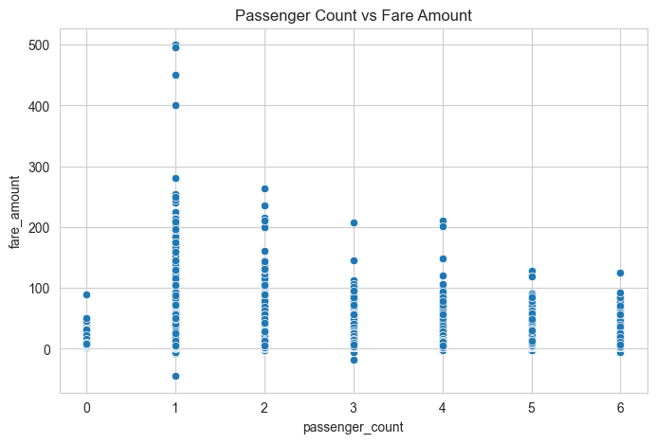
Q1
Does a higher passenger count lead to a higher fare?
VARIABLES
Passenger_Count (numerical) vs. Fare_Amount (numerical)
Plot choice: Scatter Plot
Reveals whether points cluster or trend together — the clearest way to see a relationship between two numeric variables.
INSIGHT
Fares are scattered across nearly all passenger counts with no visible upward trend. Passenger count alone does not drive fare — group size is not a strong price signal, likely because Uber pricing is distance/time based rather than per-seat.
Uber Fare Prediction • Task 1: EDA
04

Slide 5
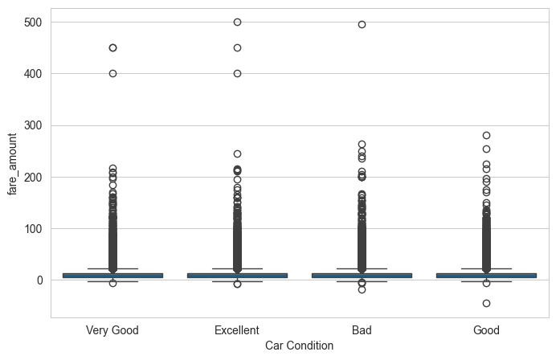
Q2
Does car condition influence the fare amount?
VARIABLES
Car_Condition (categorical: Good / Bad) vs. Fare_Amount (numerical)
Plot choice: Boxplot
Shows median, spread, and outliers per category — ideal for comparing a numeric distribution across groups.
INSIGHT
Median fares and interquartile ranges are nearly identical for Good vs. Bad car condition, both with a long tail of high-fare outliers. Car condition appears unrelated to what a rider pays — fares are driven by trip factors, not vehicle quality.
Uber Fare Prediction • Task 1: EDA
05

Slide 6
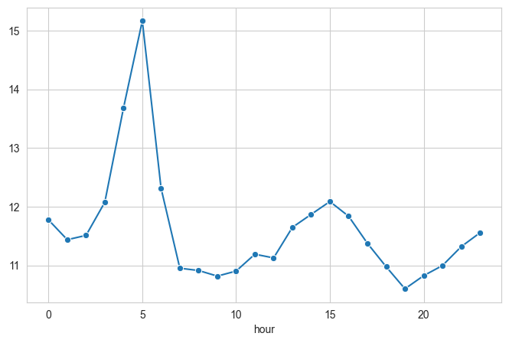
Q3
At what hour of the day are fares typically highest?
VARIABLES
Hour (0–23, ordered) vs. average Fare_Amount
Plot choice: Line Plot
Hour is ordered/sequential data — a line connects consecutive hours and makes the trend across the day easy to read.
INSIGHT
Average fare is elevated in the early morning hours (around midnight–5 AM) and dips during the mid-morning, then stays relatively flat through the afternoon and evening. Late-night/early-morning trips trend toward higher fares, possibly longer airport or cross-town rides.
Uber Fare Prediction • Task 1: EDA
06

Slide 7
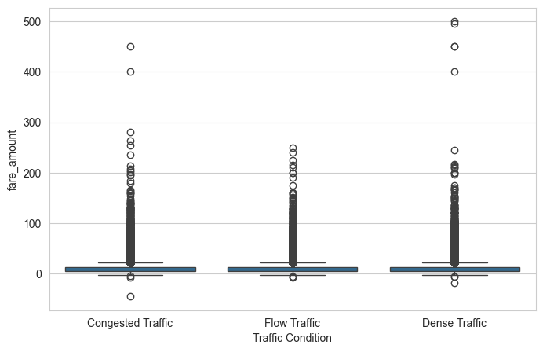
Q4
Does traffic condition affect the trip fare?
VARIABLES
Traffic_Conditions (categorical: Normal / Heavy) vs. Fare_Amount (numerical)
Plot choice: Boxplot
Compares the fare distribution (median + spread + outliers) between the two traffic categories directly.
INSIGHT
Both Normal and Heavy traffic show almost the same median fare and box spread, with outliers reaching similarly high values. Traffic level by itself doesn't shift the fare much in this dataset — distance and time-of-day likely matter more.
Uber Fare Prediction • Task 1: EDA
07

Slide 8
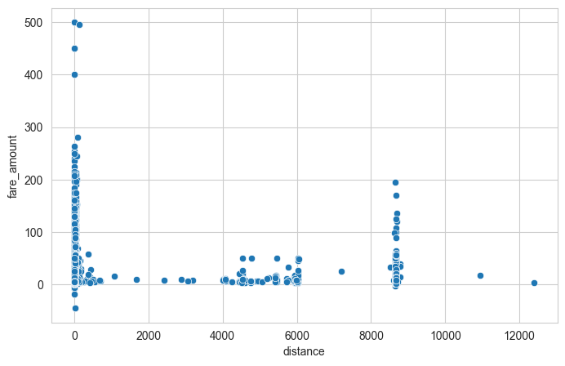
Q5
Is trip distance the strongest predictor of the fare amount?
VARIABLES
Distance (km, numerical) vs. Fare_Amount (numerical)
Plot choice: Scatter Plot
The direct way to test whether two numeric variables move together and whether that relationship looks linear.
INSIGHT
A clear positive relationship emerges: fares rise as distance increases, with a fairly tight, near-linear trend at lower distances and more spread (plus a few extreme outliers) at higher distances. Distance looks like the strongest single driver of fare seen so far — a key feature for Task 2 modeling.
Uber Fare Prediction • Task 1: EDA
08

Slide 9
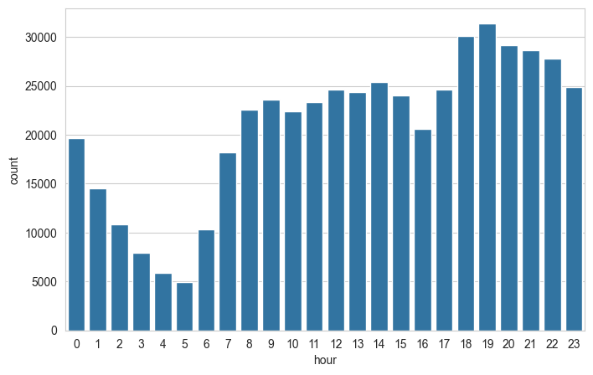
Q6
At what time of day are ride requests most frequent?
VARIABLES
Hour (0–23, discrete) vs. ride count / frequency
Plot choice: Count Plot
Counts categorical/discrete frequencies directly — answers 'how many', not 'how much', so it's distinct from the fare-by-hour question.
INSIGHT
Ride volume is lowest in the very early morning and climbs steadily through the day, peaking in the afternoon/evening commute and evening-out hours. Demand and price don't peak at the same hours — useful context for separating demand patterns from pricing patterns.
Uber Fare Prediction • Task 1: EDA
09

Slide 10
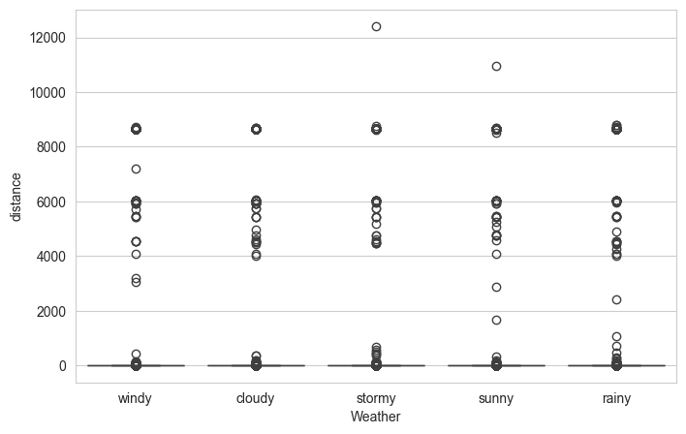
Q7
Does weather condition influence the average trip distance?
VARIABLES
Weather (categorical: Sunny / Windy / Winter) vs. Distance (numerical)
Plot choice: Boxplot
Compares the distance distribution across weather categories, including medians and outlier trips.
INSIGHT
Trip distance distributions look broadly similar across Sunny, Windy, and Winter conditions, each with a comparable median and a spread of longer outlier trips. Weather doesn't appear to change how far people travel — riders take similar trip lengths regardless of conditions.
Uber Fare Prediction • Task 1: EDA
10

Slide 11
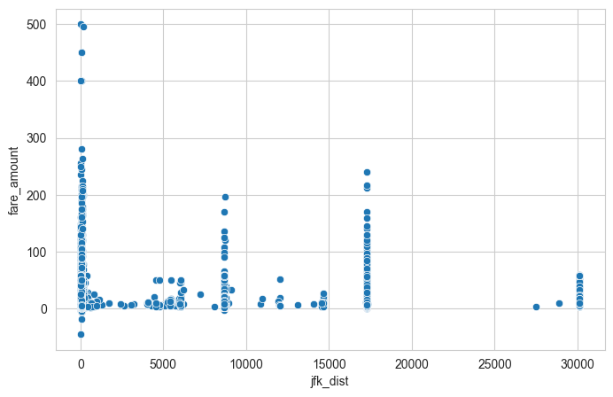
Q8
Are rides that start closer to airports generally more expensive?
VARIABLES
JFK_Dist (km, numerical) vs. Fare_Amount (numerical)
Plot choice: Scatter Plot
Tests the relationship between a numeric distance-to-landmark feature and fare directly.
INSIGHT
Most points cluster at low JFK distance with fares spread across a wide range, plus a distinct band of high-fare trips at larger JFK distances. This hints at flat-rate/long-haul airport trips rather than a simple linear relationship — worth engineering as a separate airport-trip flag in modeling.
Uber Fare Prediction • Task 1: EDA
11

Slide 12
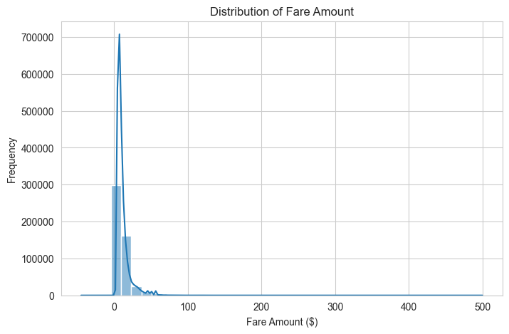
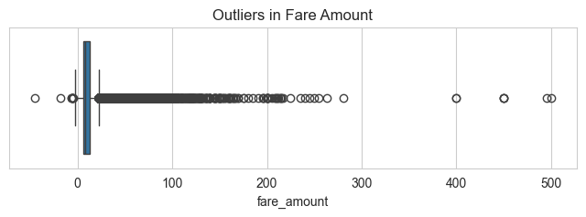
Extra EDA — Fare Amount: Distribution & Outliers
Histogram: fares are right-skewed, most trips cluster in the low range with a long tail of expensive rides.
Boxplot confirms it: a dense low-fare cluster plus several extreme high-fare outliers to treat before modeling.
Uber Fare Prediction • Task 1: EDA
12

Slide 13
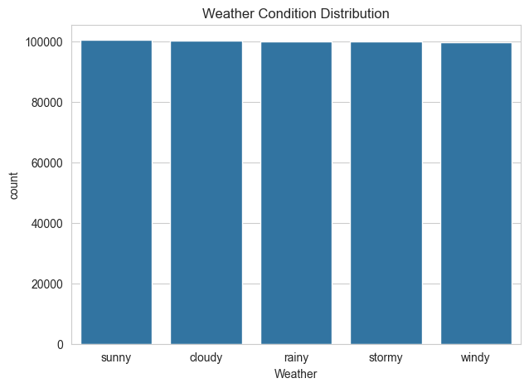
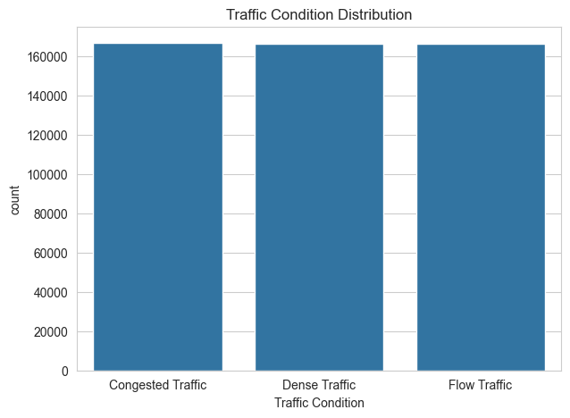
Extra EDA — Category Frequencies
Weather: Sunny conditions dominate the trip log, followed by Windy and Winter.
Traffic: Normal conditions are far more common in the data than Heavy traffic.
Uber Fare Prediction • Task 1: EDA
13

Slide 14
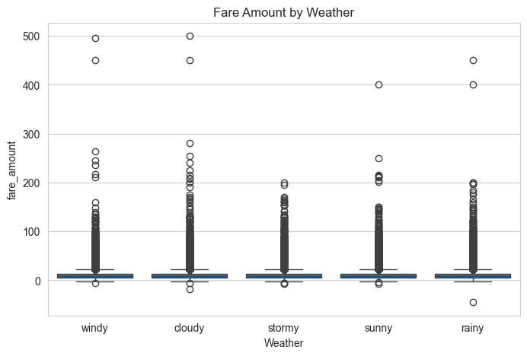
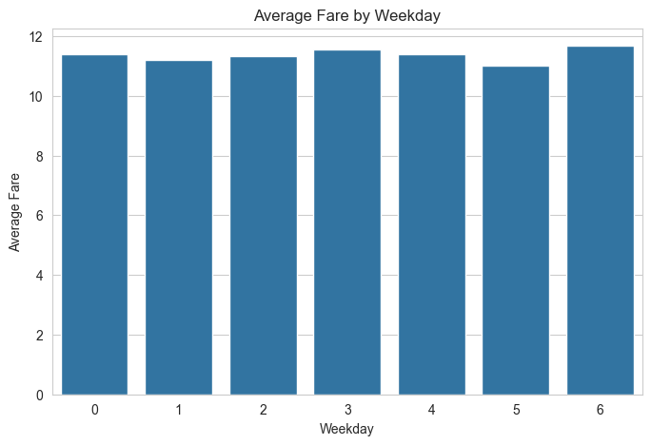
Extra EDA — Fare by Weather & Weekday
Fare by weather: median fares are close across Sunny, Windy and Winter, each with high-fare outliers.
Average fare by weekday is fairly flat — no single day stands out as consistently pricier.
Uber Fare Prediction • Task 1: EDA
14

Slide 15
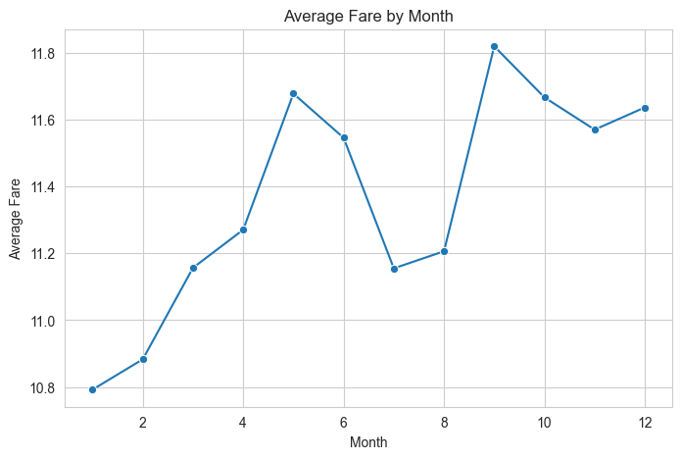
Extra EDA — Average Fare by Month
Grouping fares by month and plotting the average as a line reveals whether pricing shifts seasonally — useful for spotting demand surges (holidays, weather extremes) that a model should account for.
Insight:
Average fares fluctuate month to month without a dramatic single trend, suggesting month alone is a weaker predictor than distance — but still worth keeping as a seasonal feature.
Uber Fare Prediction • Task 1: EDA
15

Slide 16
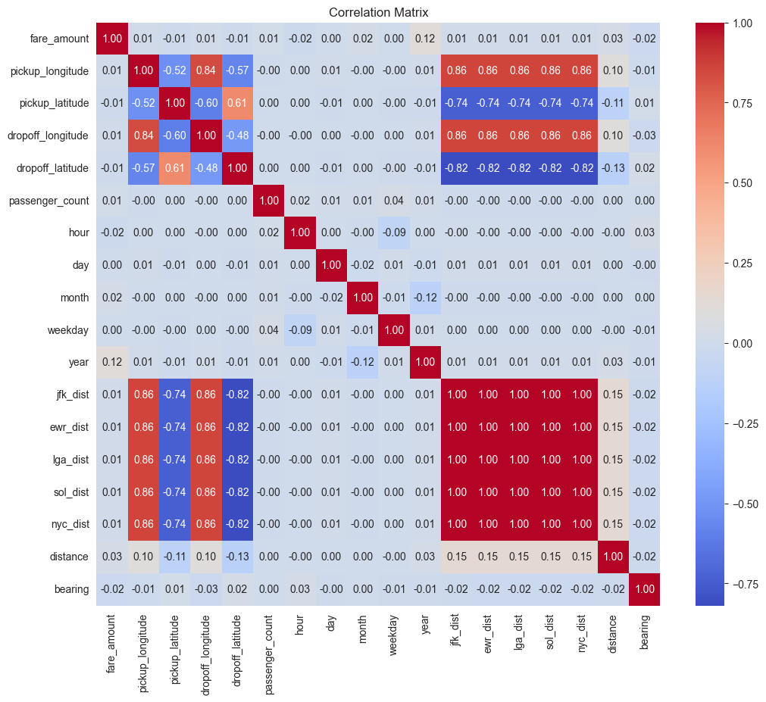
Which Features Relate Most to Fare?
A correlation heatmap summarizes linear relationships across every numeric feature at once — the fastest way to scan for the strongest candidate predictors before modeling.
Insight:
Distance and the airport-distance features (JFK/EWR/LGA) show the clearest positive correlation with Fare_Amount, reinforcing Q5 and Q8. Passenger count and calendar features (hour, day, month) correlate weakly with fare — confirming they're secondary, not primary, predictors.
Uber Fare Prediction • Task 1: EDA
16

Slide 17
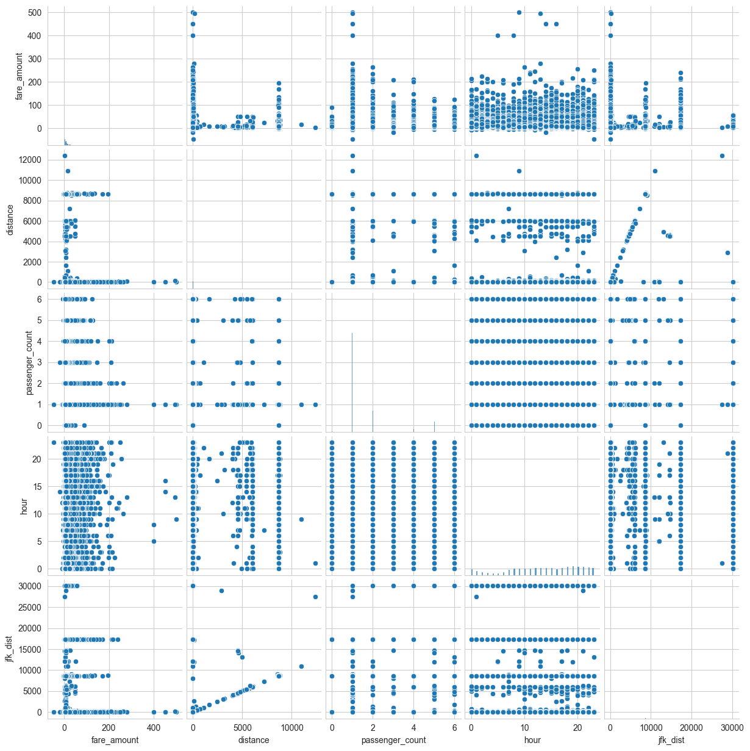
Quick Overview — Pairwise Relationships
A pair plot of Fare_Amount, Distance, Passenger_Count, Hour, and JFK_Dist gives a single-view scan of every pairwise relationship and each variable's own distribution along the diagonal.
Insight:
The Fare_Amount vs. Distance and Fare_Amount vs. JFK_Dist panels show the clearest visible structure, echoing the correlation heatmap. Passenger_Count and Hour panels look diffuse — little pairwise structure with fare.
Uber Fare Prediction • Task 1: EDA
17

Slide 18
Key Insights
What Task 1 tells us before we model
1
Distance drives fare.
Distance and airport-distance features show the strongest, clearest relationship with Fare_Amount — the top candidate predictors for Task 2.
2
Categorical context matters less than expected.
Car condition, traffic level, and weather show minimal impact on fare in this dataset.
3
Demand and price peak at different times.
Ride requests rise through the day, while average fares trend higher overnight — two separate patterns worth modeling separately.
4
Outliers need handling.
A right-skewed fare distribution with high-fare outliers (likely long/airport trips) should be addressed before training a model.
Uber Fare Prediction • Task 1: EDA
18

Slide 19
From Insight to Modeling
Task 2 will build on these findings — engineering distance and airport-proximity features, handling fare outliers, and testing whether time-of-day patterns improve prediction.
Thank you
Ahmed Elghrably — Cellula Technologies ML Internship Program
Uber Fare Prediction • Task 1: EDA
19

