Slide 1


Digital Freelancer:
Managing Freelancing Projects
Project: Working with a Mock Client

Slide 2
Part 1
Project Listing

Slide 3
Sample Project Listing #1: Web Development
Web application development support needed for healthcare application.
Posted 2 hours ago
Hourly: $35.00 - $65.00 Based on experience.
Project Time: 3 months, 25 hours a week.
Project Description:
We are a web development company working with a healthcare client looking to connect patients directly with their doctors. We need someone to be able to take PSD mockup files from our designer and convert them into custom code using HTML, CSS, and JavaScript. We have not decided on which JavaScript library to use, but will be open to working with the one you’re most familiar with. We have the designs for 10 pages and will need them to be completed in 3 months. We are open to working with all levels of experience, but the pay will be adjusted based on your experience.

Slide 4
Part 2
Expression of Interest

Slide 5
Expression of Interest
Which Sample Project Listing did you select to respond to?
Answer: 1 (Web Development)
Please type your initial response to the client below. This should be between 200 - 300 words.
Expression of Interest:
Hey, I am happy to work with you on your healthcare application. I understand that you want to convert PSD files of 10 pages to code using HTML, CSS, and JavaScript, I would like to use react js (open-source front-end JavaScript framework and library) which is suitable to meet the project specifications compared to angular js due to it's virtual DOM implementation and rendering optimizations also it would increase the site’s performance and therefore have more userbase.
I am starting to prepare a demo and I will send it to you just to put guidelines for your reference and to achieve a great performance, I was a part of Egyptian healthcare development team who developed the entire system to be more reliable and to convert it to a digitalization based services so i worked on the same project before this may help us to reach the perfection ISA , I am a web app developer with 1 year of experience with 10+ clients most of them from US, UK and Egypt as i have mentioned.
Based on my experience in healthcare filed i can finish this project within 2 months and half, I will start as soon as possible and the cost will be 45$/h and it will be 40$/h for the upcoming projects.
I am interested to start this project and I am sure at the end we will reach our goals, Let me know If you would like to chat. Ahmed Mamdouh Elsayed. Ahmed.elnabrawe9@gmail.com

Slide 6
Part 3
Project Management Process

Slide 7
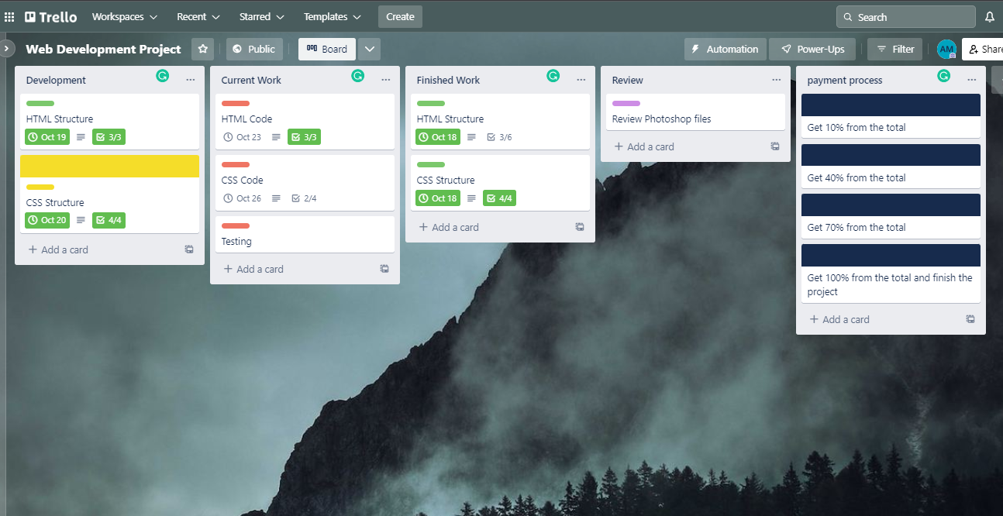
Trello Board
Please include the following information for your Trello board:
A link to your public Trello board should be provided here:
https://trello.com/b/UknD1H8U/web-development-project

Slide 8
Part 4
Invoice and Payment Options

Slide 9
Ahmed Mamdouh Elsayed
Cairo, Egypt
Invoice
Recipient:
Web Development service company
Ciro Egypt
Invoice #: 5
Date issued: 18/10/2022
Date due: 18/1/2023
Services Rendered (Continue on next page)
Service | Description of Work Done | Hours Spent | Amount Per Hour | Total
Get the designs and start working on HTML. | Build the structure and make a flowchart and start to write HTML code | 30 hrs | 45$ | 1350$
Start working on CSS | Build the structure and make a flowchart and start to write CSS code. | 40 hrs | 45$ | 1800$
Testing | Testing CSS and HTML | 20 hrs | 45$ | 900$
Finalize the project | The project will be on service and watch its performance. | 30 hrs | 45$ | 1350$
Total Payment Due: 5400$ Payment Options: Bank Accounts: 1- National Bank Of Egypt: xxxxxxxxxxxxxxxxxxx 2- QNB : xxxxxxxxxxxx
PayPal : ahmed.elnabrawe9@gmail.com

