Slide 1
Generative Modeling
By Eng.Ahmed Hisham

Slide 2
Agenda
1-Neural style transfer
-neural style transfer project (2x)
2-autoenconders
-MNIST auto encoder project
3-deep auto enconder
-deep mnist project
4- convolutional autoencoder
-fashion mnist project CAE
-case study between CAE and AE
5-Noisy convolutional autoencoder
-fashion mnist project CAE
6-Varitional autoencoders moving from past to future
-anime face generation using VAEs

Slide 3
Agenda
8-Introduction to GANs
-mnist using GANs
9-DCGANs
-fashion mnist DCGANs
-CelebA face generation

Slide 4
Neural style transfer
Neural style transfer is an optimization technique used to take two images—a content image and a style reference image (such as an artwork by a famous painter)—and blend them together so the output image looks like the content image, but “painted” in the style of the style reference image.

Slide 5
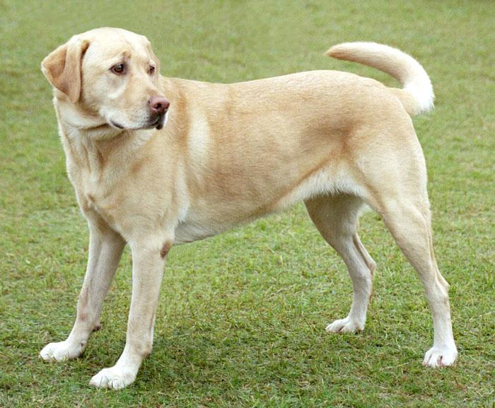
Neural style transfer (content image)

Slide 6
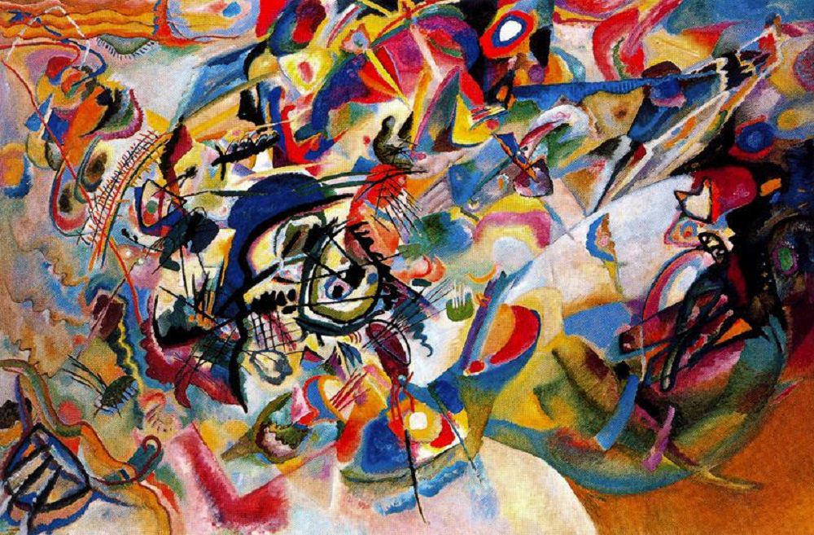
Neural style transfer style image

Slide 7
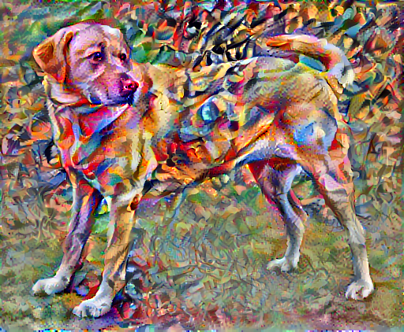
Blended image

Slide 8
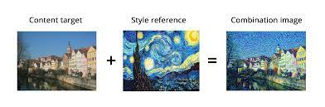
How algorithm works

Slide 9
Step one
Pairs preparation
1-original image
2- style image

Slide 10
Step 2
Pretrained model for visual feature extraction
Ex VGG19, ReSNet50

Slide 11
Step 3
Extract style from style image
Extract content from content image

Slide 12
Step4
Generate an image to match the output

Slide 13
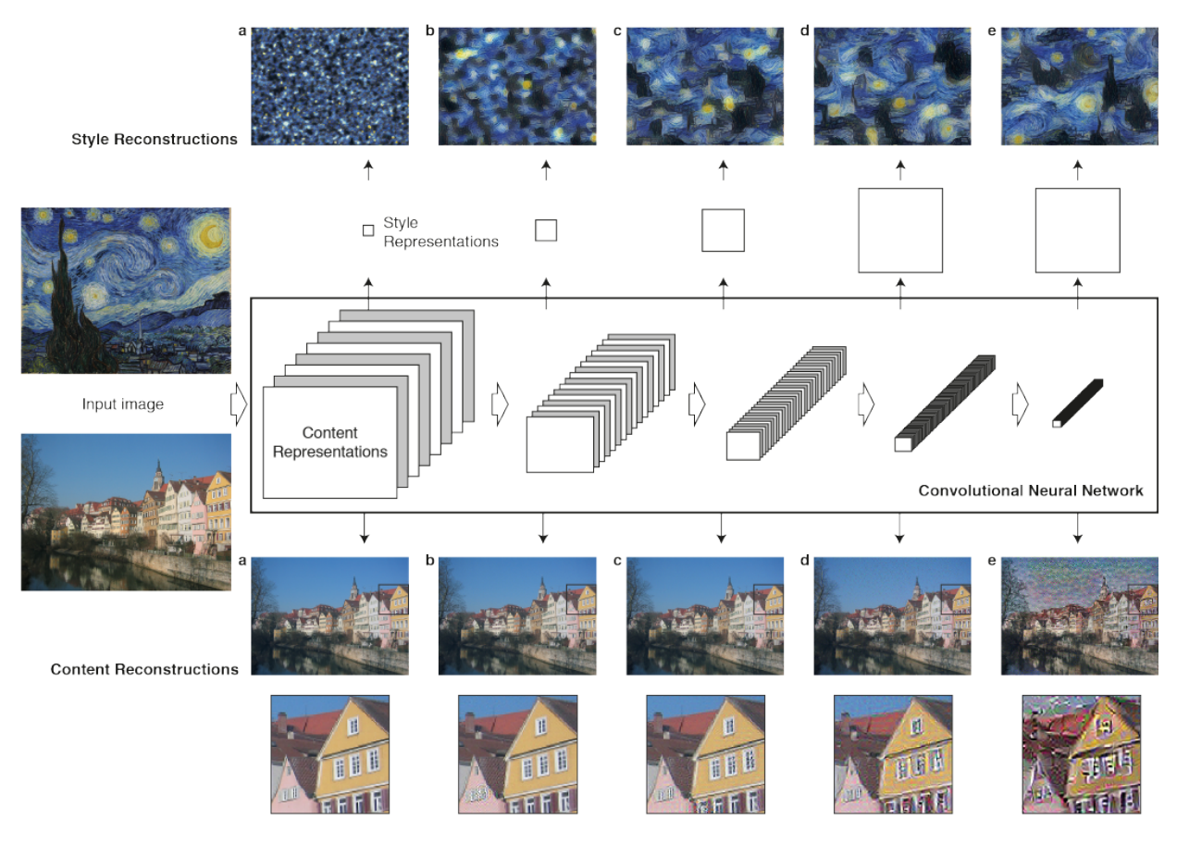

Slide 14
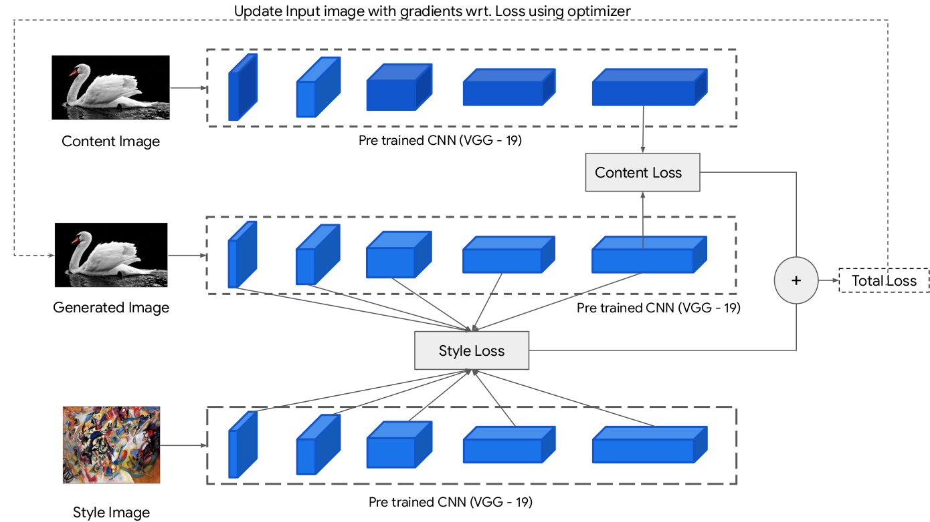
architecture

Slide 15
Important notes
1-Content loss
Content loss
It helps to establish similarities between the content image and the generated image.
It is intuitive that higher layers of the model focus more on the features present in the image i.e. overall content of the image.
Content loss is calculated by Euclidean distance between the respective intermediate higher-level feature representation of input image (x) and content image (p) at layer l.

Slide 16
Important notes
Preprocessing stage
1-converts a tensor to an image
2-loads an image as a tensor and scales it to 512 pixels
3-loads the content and path images as tensors
4-Pretrained model to extract features VGG19
-style layers of interest [conv1(block1),conv1(block2),conv1(block3),conv1(block4),conv1(block5)]

Slide 17
Important notes
the content layer of interest :
block5_conv2
output_layers = style_layers + content_layers

Slide 18

Important notes content loss

Slide 19
Important notes content loss
f- content representation in the generated image
p- content representation in the content image
In code features will refer to generated image , while variable targets will refer to content image

Slide 20
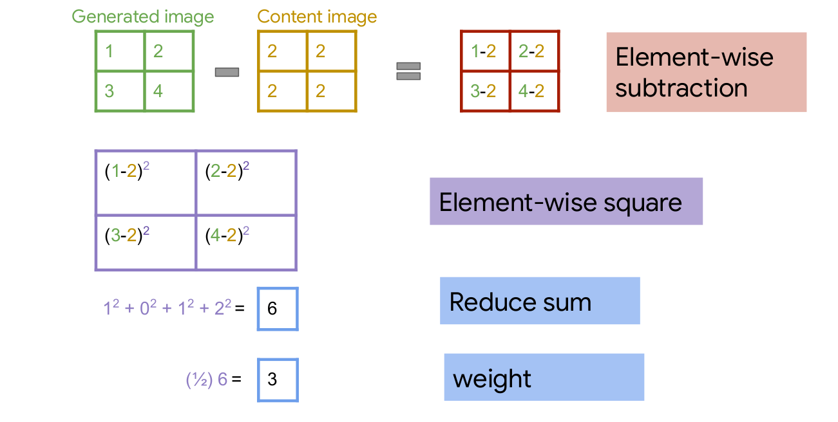
Content loss

Slide 21
Content loss function as logic
Inputs /
features: tensor with shape: (height, width, channels)
targets: tensor with shape: (height, width, channels)
Mathematical calculation
get the sum of the squared error multiplied by a scaling factor
Return content loss (scalar)

Slide 22
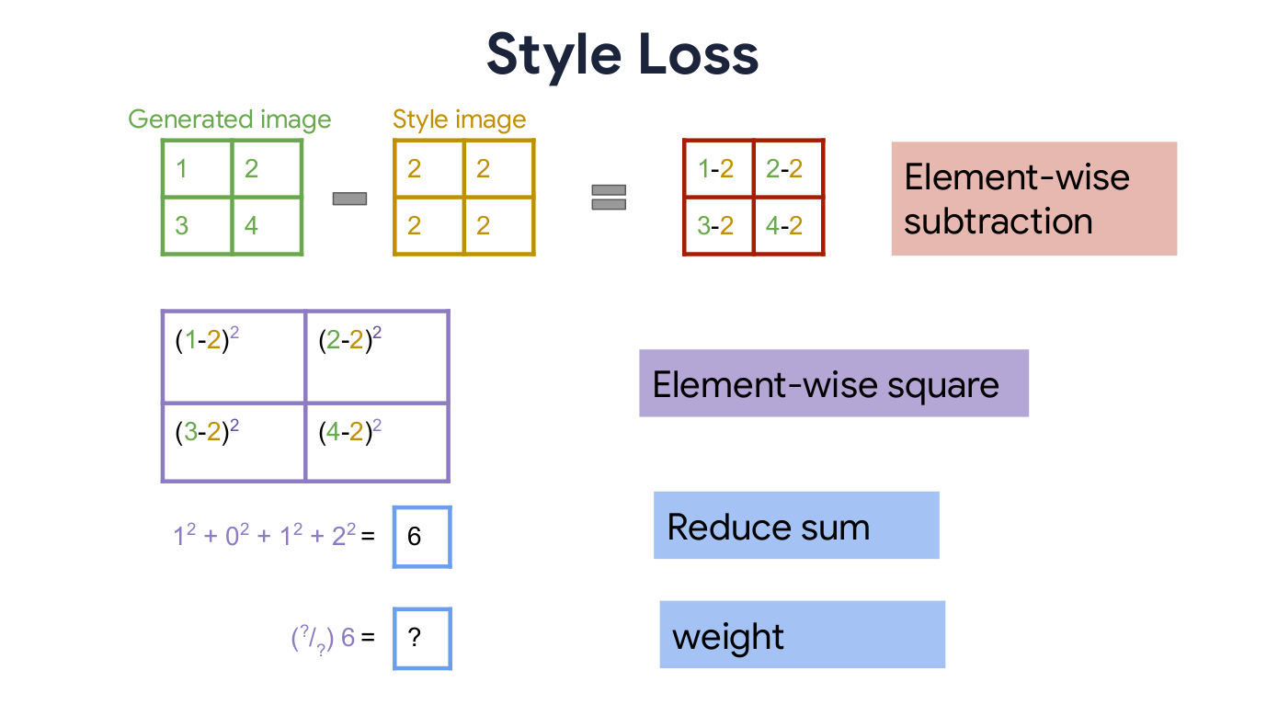
Get style loss

Slide 23
Style loss
Style loss is conceptually different from Content loss.
We cannot just compare the intermediate features of the two images and get the style loss

Slide 24
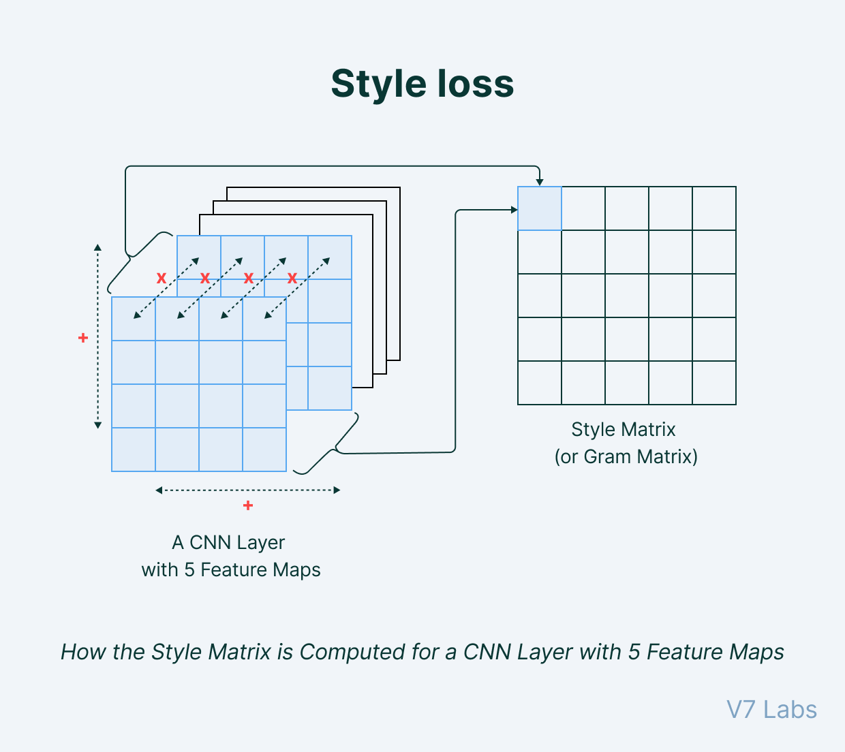
Style loss

Slide 25

GRAM matrix to solve style loss dimensionality
Style loss is calculated by the distance between the gram matrices (or, in other terms, style representation) of the generated image and the style reference image.

Slide 26

Thus, the total style loss across each layer is expressed as:

Slide 27
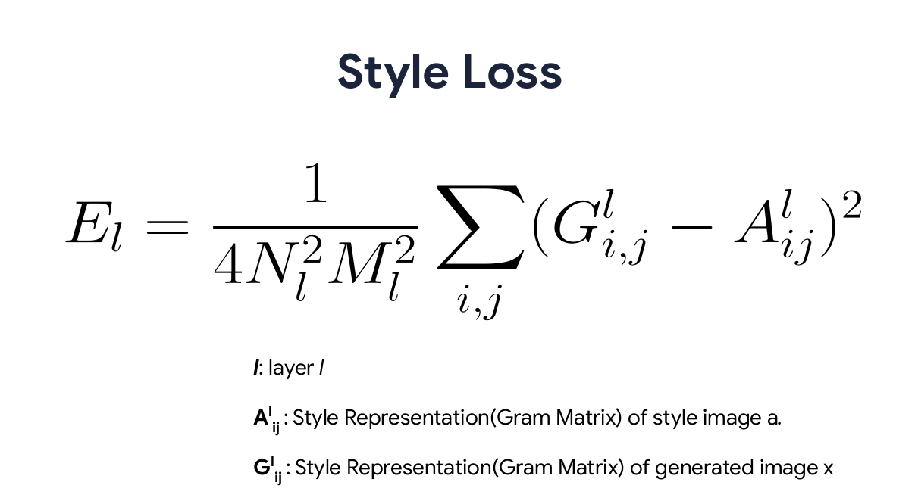
Style loss equation

Slide 28
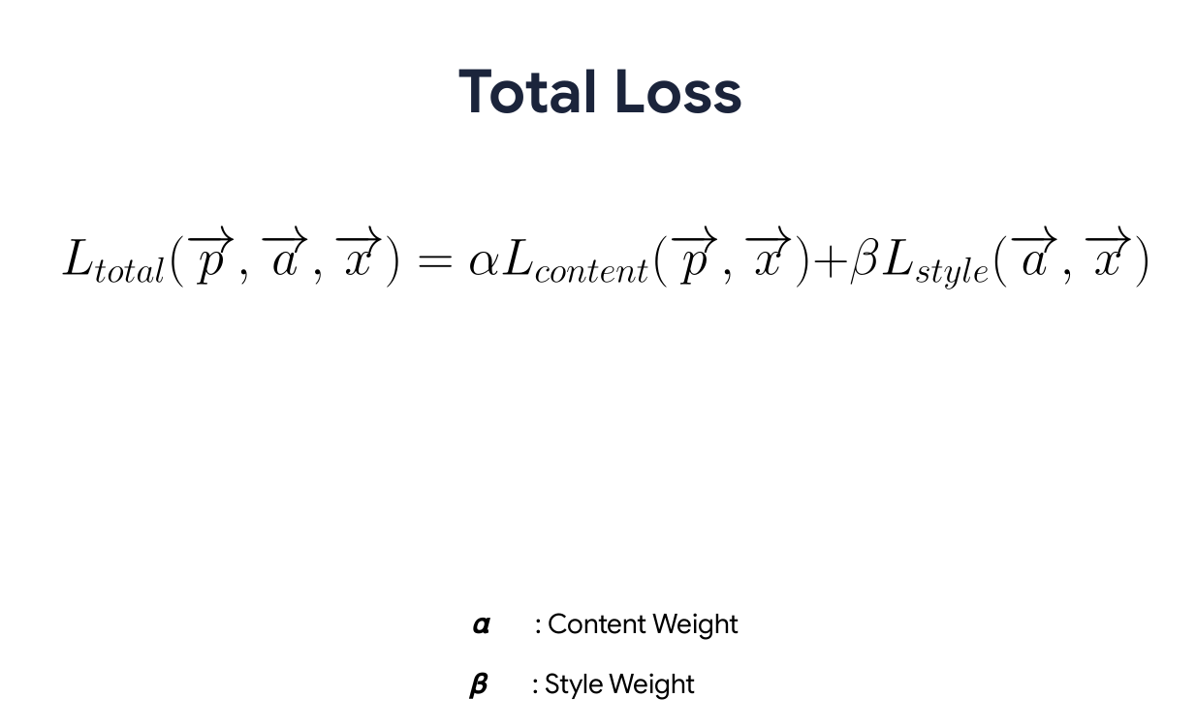
Total loss

Slide 29
ImportantNotes gradient
Calculate the gradients of the loss with respect to the generated image
Arguments needed
image: generated image
style_targets: style features of the style image
content_targets: content features of the content image
style_weight: weight given to the style loss
content_weight: weight given to the content loss
var_weight: weight given to the total variation loss

Slide 30
ImportantNotes update image with style
image: generated image
style_targets: style features of the style image
content_targets: content features of the content image
style_weight: weight given to the style loss
content_weight: weight given to the content loss
var_weight: weight given to the total variation loss
optimizer: optimizer for updating the input image

Slide 31
Style fitting
style_image: image to get style features from
content_image: image to stylize
style_targets: style features of the style image
content_targets: content features of the content image
style_weight: weight given to the style loss
content_weight: weight given to the content loss
var_weight: weight given to the total variation loss
optimizer: optimizer for updating the input image
epochs: number of epochs
steps_per_epoch = steps per epoch

Slide 32
Neural style transfer ended
Check colab
Do the same colab neural style transfer using inception instead of vgg19

