Slide 1
Generative Models
By eng.Ahmed Hisham

Slide 2
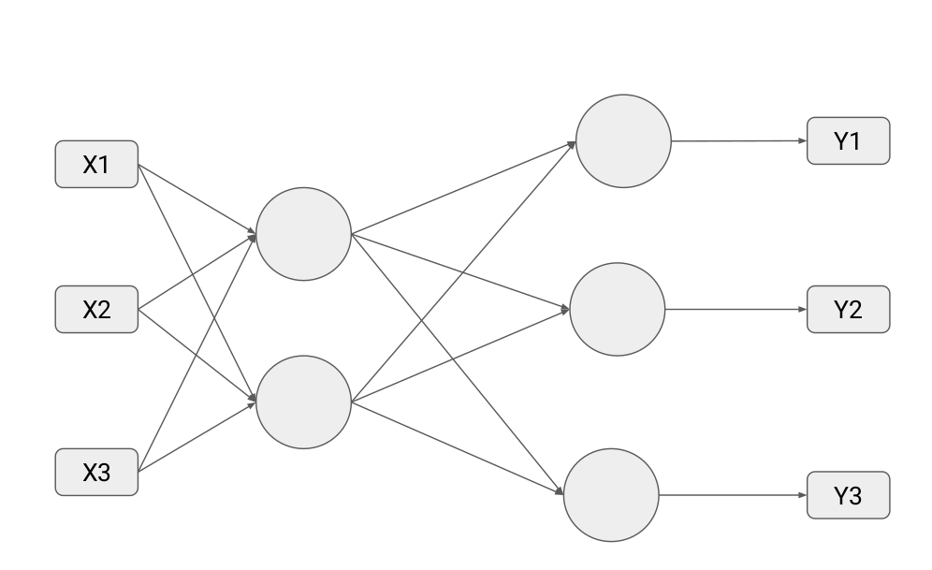
Autoencoders

Slide 3
Autoencoders definition
An autoencoder is a type of artificial neural network used to learn data encodings in an unsupervised manner.
The aim of an autoencoder is to learn a lower-dimensional representation (encoding) for a higher-dimensional data, typically for dimensionality reduction, by training the network to capture the most important parts of the input image.

Slide 4
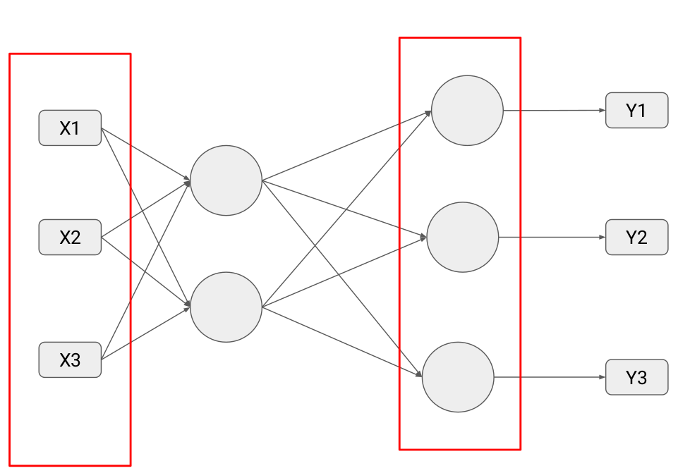
Basic note

Slide 5
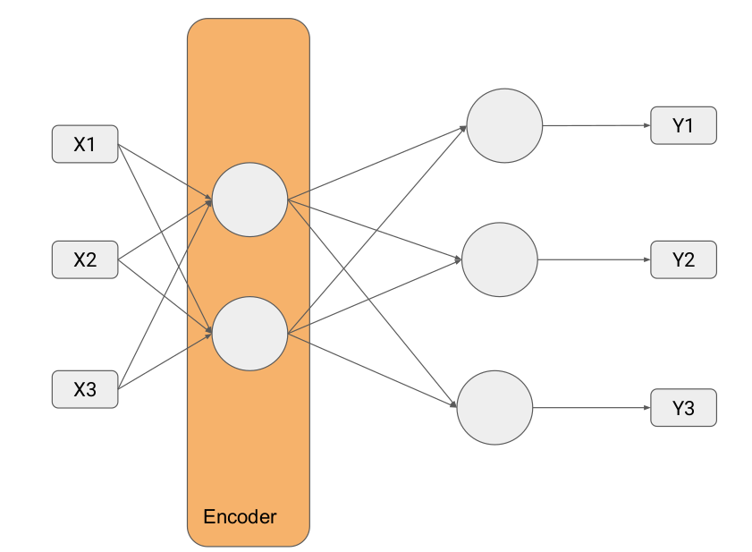
encoder

Slide 6
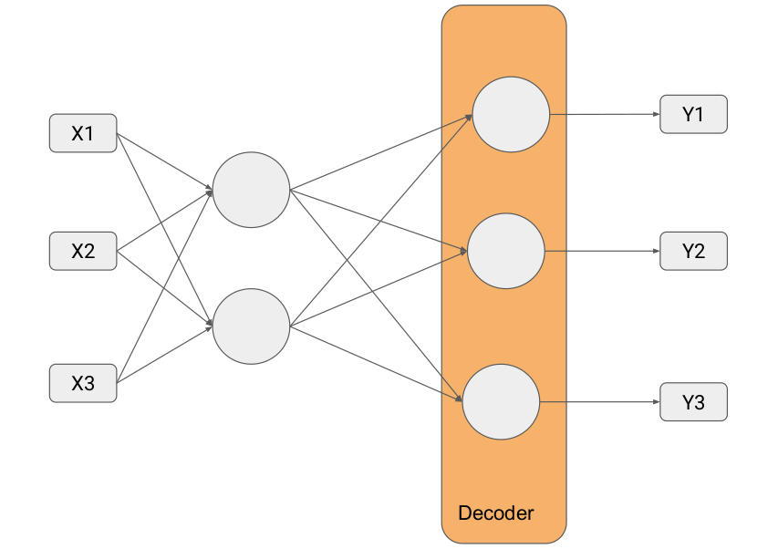
decoder

Slide 7
Very important notation
An autoencoder neural network is an unsupervised learning algorithm that applies backpropagation, setting the target values to be equal to the inputs. I.e., it uses y(i)=x(i).

Slide 8
Basic work flow (very very important)
Suppose we have 3 input features x1,x2,x3 , design an auto encoder to predict the features x1,x2,x3 ?
1st step x1,x2,x3 → shape (3 units )
2nd step encoder uses downsampling or what is known as compression technique so , shape will be (2 units)
3rd step decoder uses upsampling , or decompression (2units input coming from the encoder will be transformed into → 3units to match the input of the network)

Slide 9
Check colab auto-encoder example 1

Slide 10
Task 2
Build a simple autoencoder to generate handwritten MNIST dataset

Slide 11
Steps
1-load mnist dataset using tfds( tensorflow datasets module )
2-normalize all images by dividing by 255.0
3-build simple auto encoder
4-here loss function is BCE

Slide 12
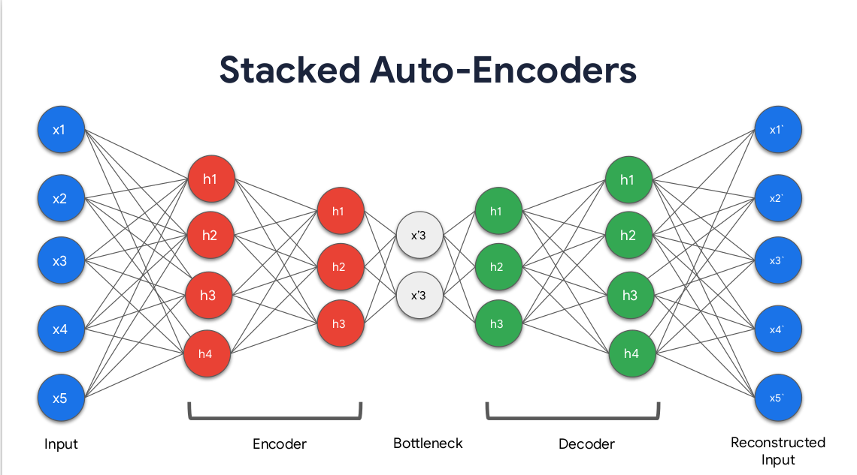
Deep autoencoders

Slide 13
deepautoencoder
1. Encoder: A module that compresses the input data into an encoded representation that is typically several orders of magnitude smaller than the input data.

Slide 14
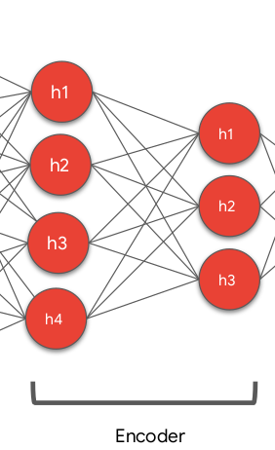
encoder

Slide 15
Bottle neck
Bottleneck: A module that contains the compressed knowledge representations and is therefore the most important part of the network.

Slide 16
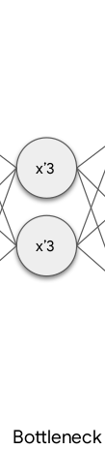
Bottle neck

Slide 17
decoder
Decoder: A module that helps the network“decompress” the knowledge representations and reconstructs the data back from its encoded form. The output is then compared with a ground truth.

Slide 18
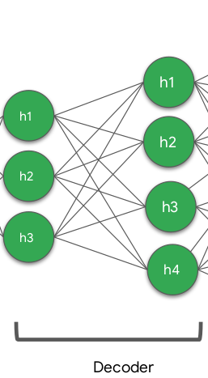
decoder

Slide 19
Convolutional auto encoders
The convolution operator allows filtering an input signal in order to extract some part of its content. Autoencoders in their traditional formulation do not take into account the fact that a signal can be seen as a sum of other signals. Convolutional Autoencoders, instead, use the convolution operator to exploit this observation. They learn to encode the input in a set of simple signals and then try to reconstruct the input from them.

Slide 20
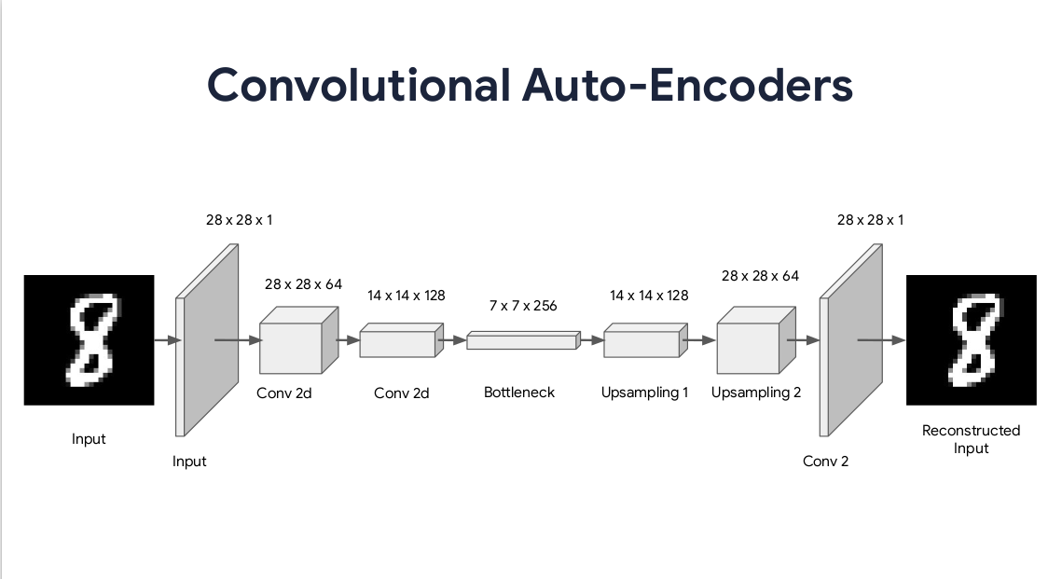
CAE

Slide 21
CAE approach
Instead of using typical or random dense layers at the encoder , we will use Conv2D layers and maxpooling for visual pixel extraction and downsampling
Since we are using downsampling approach at the encoder , so the encoder will return maxpool layer only !

Slide 22
Bottle neck
Bottle neck here will use encoder output after maxpooling where the filters of the last conv2d layer of the encoder will be multiplied by 2

Slide 23
Note in the colab notebook
We have added an extra layer called encoder_visualization just to visualize the latent representation as a visual model that doesn’t have any impact to the original model just a visualization utility

