Slide 1
Variational autoencoder
By eng.Ahmed Hisham

Slide 2
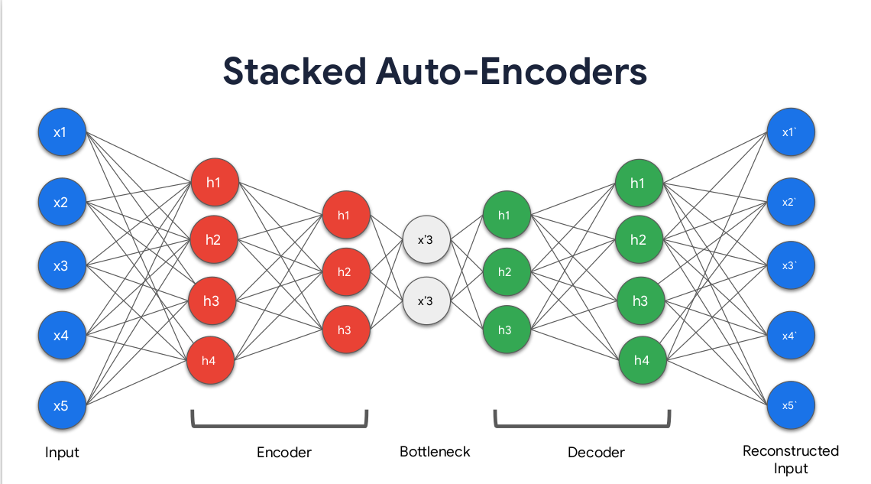
Recap autoencoders

Slide 3
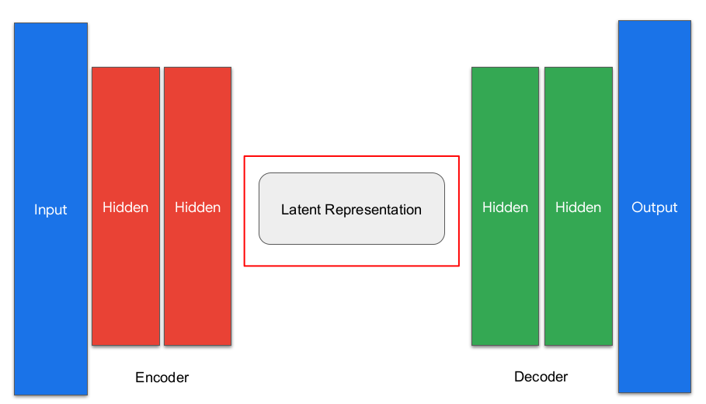
Variational autoencoder

Slide 4
Key difference
This model tends to deal with statistical computations rather than bottle neck layer (downsampling)

Slide 5
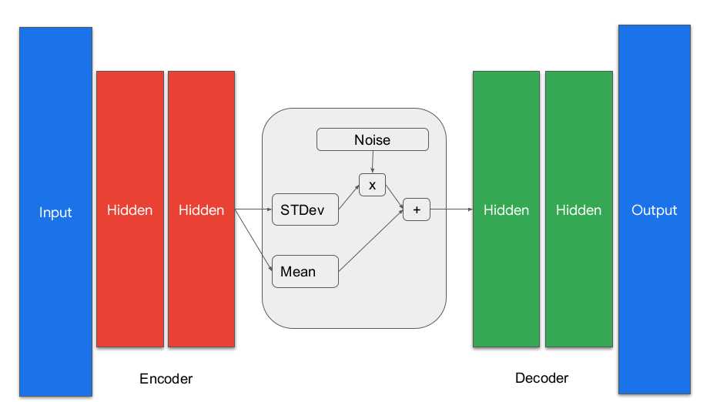
VAE latent layer

Slide 6
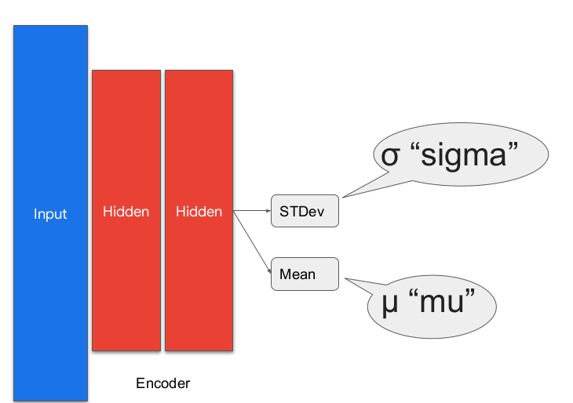
Encoder + latent layer

Slide 7
Sigma and Mu
Sigma and Mu usually are linked to a probability density function → Normal distribution or what is known as Gaussian density probability function

Slide 8
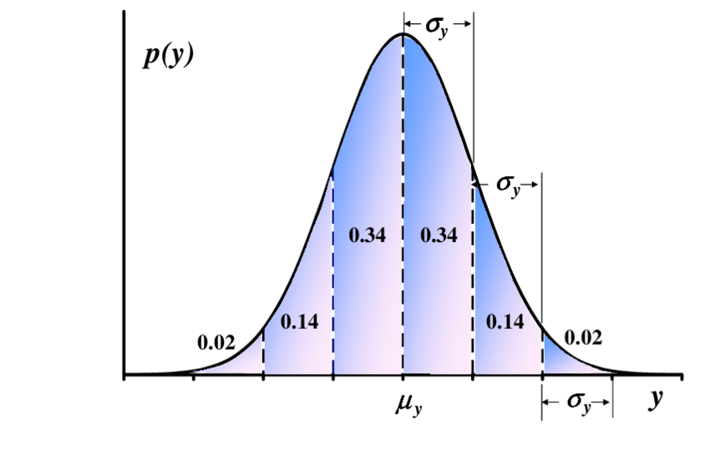
Gaussian distribution

Slide 9
Terminology
Mu→ if we looked at the distribution , we notice that at the middle of the curve there is a function named Mu(y) , since its at the middle exactly , → Mu→ mean value of the curve
Sigma(y)→ if we looked to the curve slopping up and down , taking a slope of a deviating curve , therefore its known as the standard deviation pf the curve

Slide 10
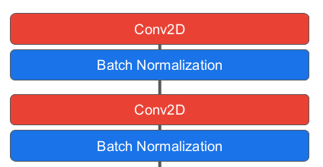
Encoder
No maxpooling here why ?

Slide 11
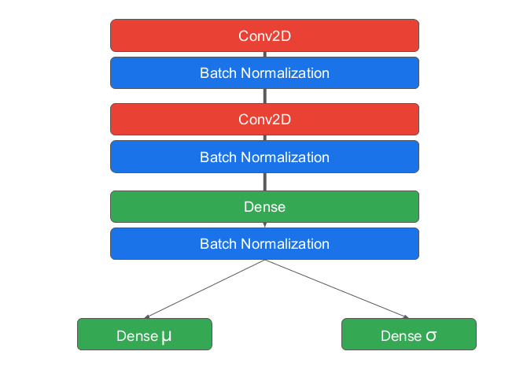
Full encoder architecture

Slide 12
Important notes
The encoder function here
Must take 2 parameters ( input shape and latent dimension )
Recall latent_dimension is the sigma and Mu
must return the following
Mu,Sigma and the flattened batch shape of the last conv2d layer ( no maxpooling return)

Slide 13
Latent layer
Sampling layer ( Mu and Sigma)
1st output of the encoder → Mu and sigma
2nd get the size and dimensions of the batch
3rd generate a random tensor ( generated from Mu and sigma , using gaussian distribution)
4th combine the inputs and noise

Slide 14
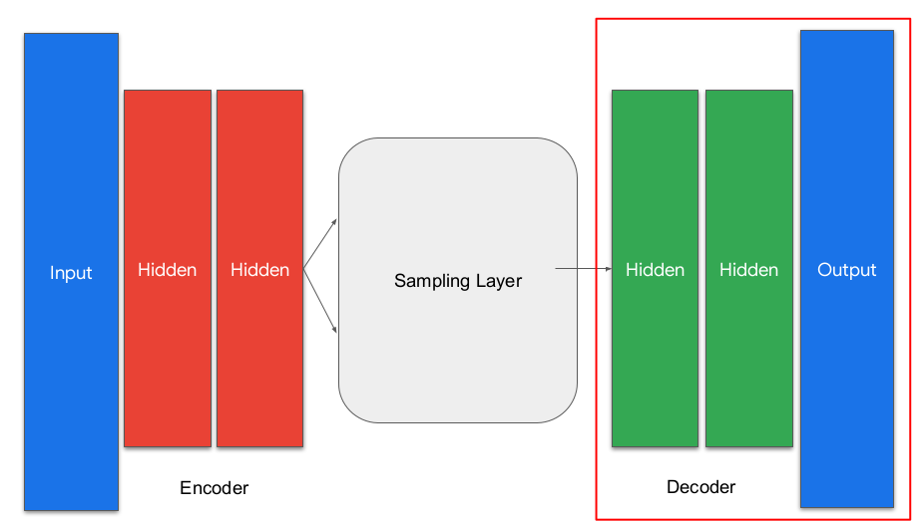
Decoder

Slide 15
Decoder
Traditional decoder except it uses conv2D transpose in its layers

Slide 16
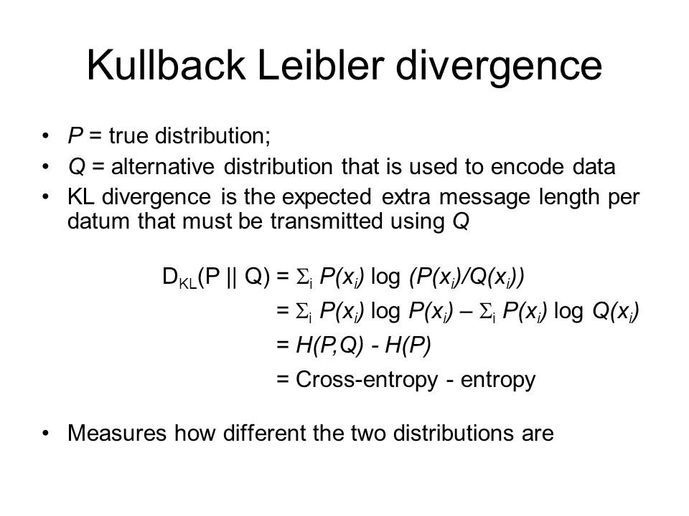
Loss Kullback leiber loss

Slide 17
To simplify KLD
-1/2*mean of (1+sigma – (Mu)^2 - exp(sigma))

