Slide 1
Overview
This project is designed as an FSM with several
States starting from idle through different commands transactions, each with its procedure.
It is designed to perform 32-bit transactions
With the ability for 64-bit extension upon the assertion of REQ64#

Slide 2
Extra feature
I/O Read and I/O Write
Dual address cycle
Write and Read bigger than cash line size
Enabling 64-bit Transactions
Configuration write / read
write and Read on Multiple Targets

Slide 3
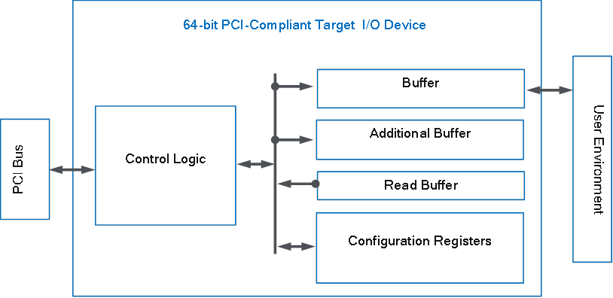
Block diagram

Slide 4
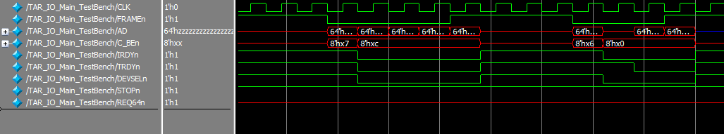
Memory write / read
Four sets of data are written then the last two are checked by read command

Slide 5
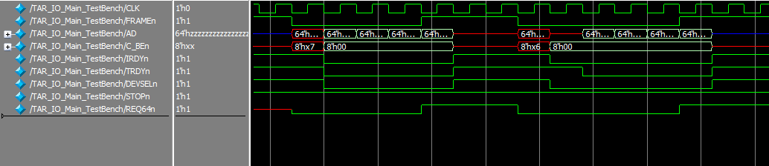
Enabling 64 bit write / read
Four sets of data (64-bit) are written then read through memory write / read
While the REQ64# is asserted low

Slide 6
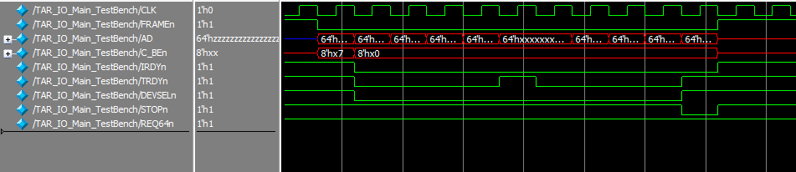
Write and read data bigger than buffer size
The TRDY# is asserted high after 4 words . The STOP# is asserted high after writing on both buffer and additional buffer

Slide 7
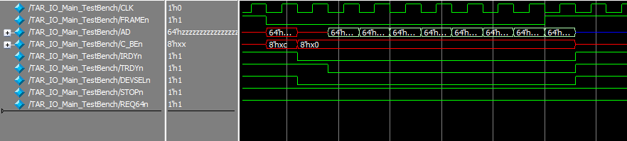
Read the 8 words saved in Buffer and Buffer_additional of the device

Slide 8
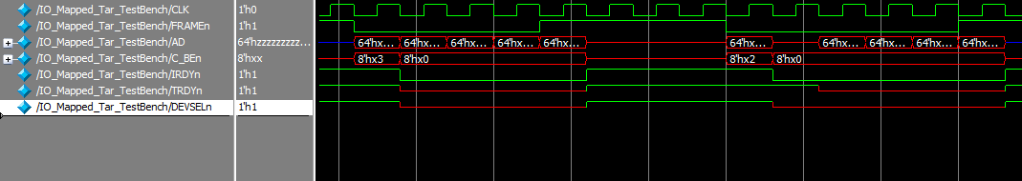
Io_Mapped write / read
Writing and reading from a target configured to be Io address mapped

Slide 9
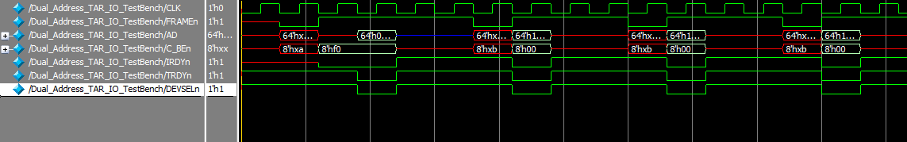
Configuration read / write
Master
(the testbench)
Target 0
Target 1
Target 2
PCI Bus
Reading the cash line size of multiple targets then write the address on the configuration memory

Slide 10
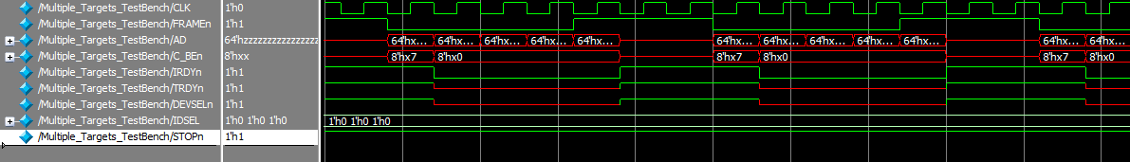
write on Multiple Targets
To test the three devices ,we send four words on each one

Slide 11
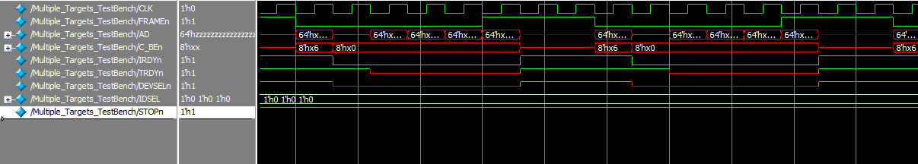
read from Multiple Targets

