Slide 1
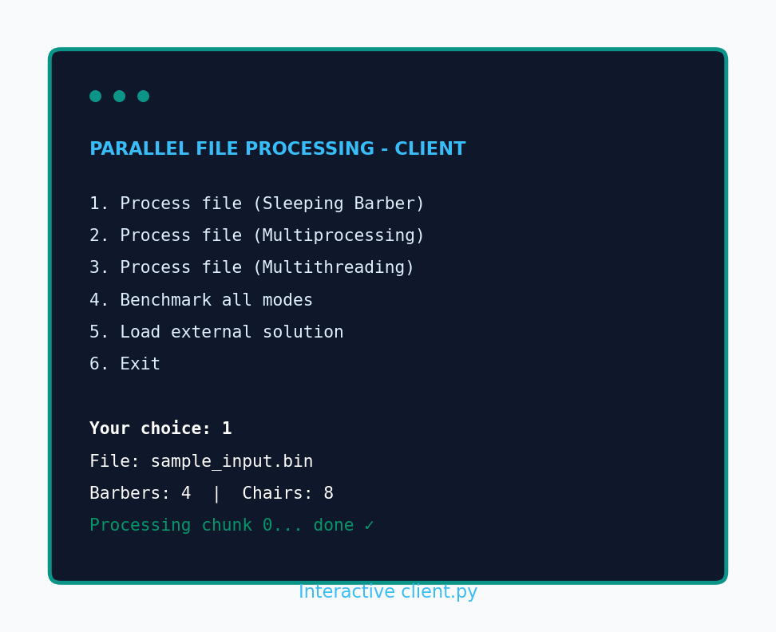
✓
IntegrityCheck
Parallel File Integrity Verification System
Systèmes d'Exploitation Avancé Parallel Processing & Benchmarking
Presented by
Hassen Moussi & Ahmed Arfaoui
→ Pipeline
→ Sleeping Barber
→ Architecture
→ Demo
Click buttons to jump • SHA-256 • Multiprocessing • Sleeping Barber

Slide 2
Project Context
Course: Systèmes d'Exploitation Avancé
Topic: high-performance parallel processing & benchmarking
Application: large file processing (team choice)
Product: IntegrityCheck — verify files after transfer or backup
Tech: Python 3.8+, standard library only
IntegrityCheck | Hassen Moussi & Ahmed Arfaoui

Slide 3
The Problem
IT teams transfer large backup files and archives daily.
A corrupted file can break deployments and backups.
Sequential checksum tools waste multi-core CPU power.
We need fast, parallel, auditable file verification.
IntegrityCheck | Hassen Moussi & Ahmed Arfaoui

Slide 4
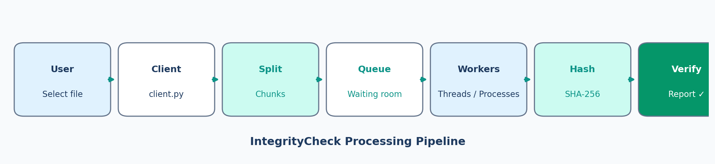
Processing Pipeline
How a file moves through IntegrityCheck
User selects a file → client splits it into chunks → chunks enter the waiting queue → workers hash in parallel → JSON report confirms integrity.
IntegrityCheck | Hassen Moussi & Ahmed Arfaoui

Slide 5
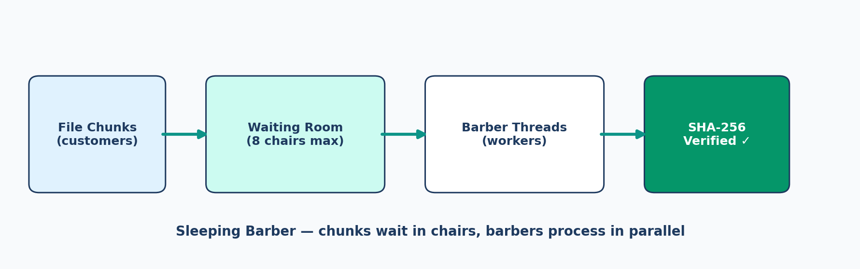
Sleeping Barber
Classic OS algorithm applied to file chunks
Customer = chunk | Barber = thread | Chair = queue slot | Semaphore wakes barbers.
IntegrityCheck | Hassen Moussi & Ahmed Arfaoui

Slide 6
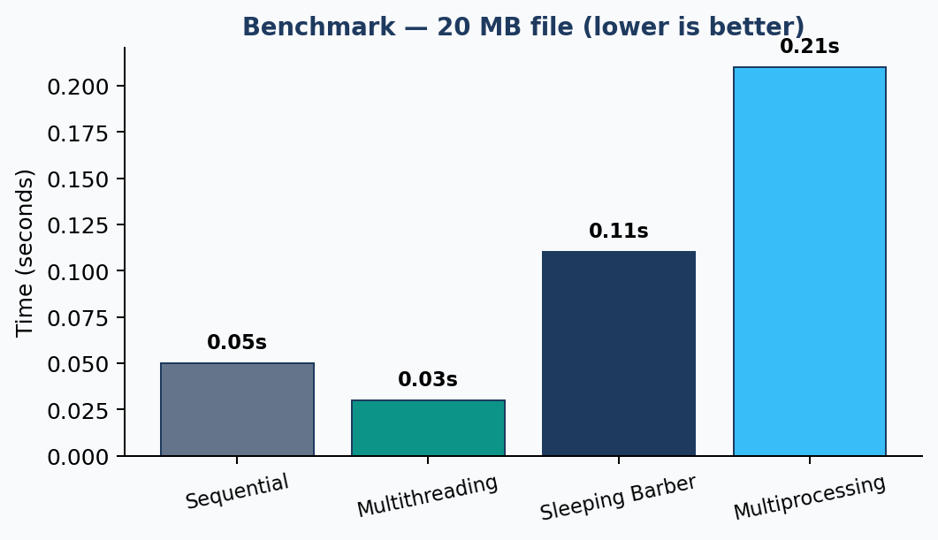
Processing Modes
Four parallel strategies — same SHA-256 result
Sequential
1 worker
Multiprocessing
N processes
Multithreading
N threads
Sleeping Barber
Bounded queue
IntegrityCheck | Hassen Moussi & Ahmed Arfaoui

Slide 7

Project Architecture
Three clear layers
Client layer for users, processing layer for parallel file work, OS concepts layer for IPC and sync.
IntegrityCheck | Hassen Moussi & Ahmed Arfaoui

Slide 8
IPC & Synchronization
Inter-process communication modules:
Pipes — one-to-one process communication
Queues — multi-producer / multi-consumer
Shared memory — protected shared data
Synchronization: semaphores, Dining Philosophers, Sleeping Barber, Producer-Consumer
IntegrityCheck | Hassen Moussi & Ahmed Arfaoui

Slide 9
Software Solution Loading
External Python modules loaded at runtime via importlib.
Plugin example: sample_solution.py
Configurable threads and chunk size.
Enables porting existing file-processing code.
IntegrityCheck | Hassen Moussi & Ahmed Arfaoui

Slide 10
Live Demo
How to run IntegrityCheck
Commands to demo:
python client.py
→ Interactive menu (recommended)
python parallel_processing.py sample_input.bin
--mode sleeping_barber
python parallel_processing.py sample_input.bin
--mode benchmark
--output-report processing_report.json
Tip for demo video: show option 1 (Sleeping Barber) with shop-full messages, then option 4 (benchmark).
IntegrityCheck | Hassen Moussi & Ahmed Arfaoui

Slide 11
Results & Deliverables
Metrics: time, throughput (MB/s), speedup, SHA-256
Output: processing_report.json
Deliverables: source code, REQUIREMENTS.md, demo video, presentation
Authors: Hassen Moussi, Ahmed Arfaoui
IntegrityCheck | Hassen Moussi & Ahmed Arfaoui

Slide 12
Thank You
IntegrityCheck — Fast • Parallel • Verifiable
Hassen Moussi & Ahmed Arfaoui
Questions?

