Slide 1
Botnet Detection
Abd-Elgwad, Ahmed

Slide 2
Table of content
01
02
03
04
05
DATA
EDA
Models
Detect Mirai
Attack
Detect GAFGYT
Attack

Slide 3
DATASET
Real Traffic Data gathered from 9 commercial IoT devices authentically infected by Mirai and BASHLITE.
we aimed at distinguishing between benign and Malicious traffic data by means of anomaly detection techniques.
Multi-Class Classification:
10 Classes of Attacks
1 Class of 'Benign'

Slide 4
01
EDA
Exploratory Data Analysis

Slide 5
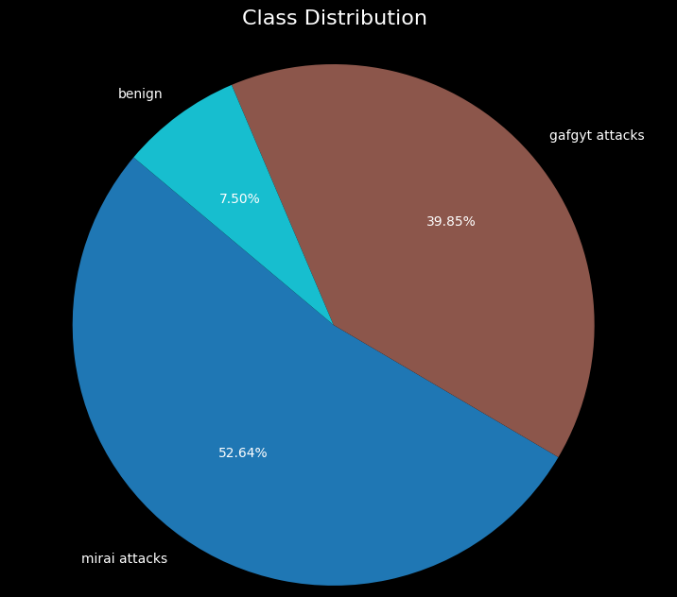
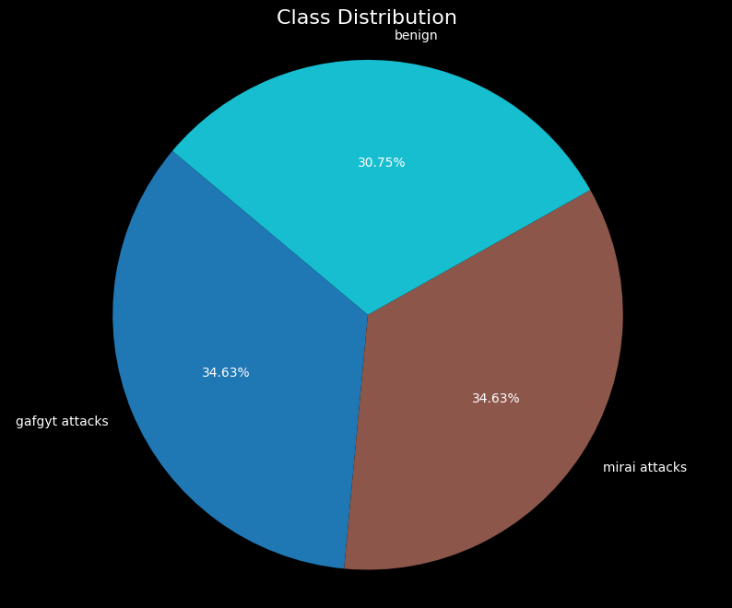
Class distribution shows data unbalance
Data Distribution
Class distribution after undersampling data

Slide 6
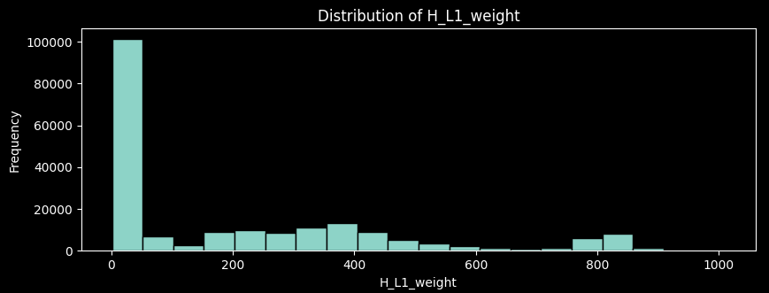
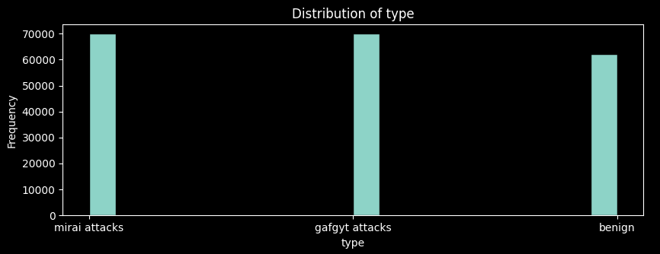
Features distribution
In this section, we spotlight the distribution patterns of two pivotal features within our dataset.
Notably, both features reveal noticeable skewness, signaling departure from a symmetrical distribution.
This pattern is consistent across most features in the dataset.

Slide 7
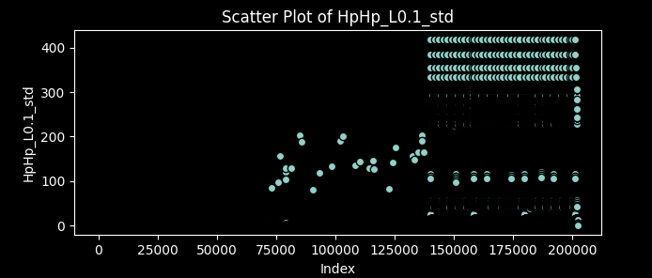
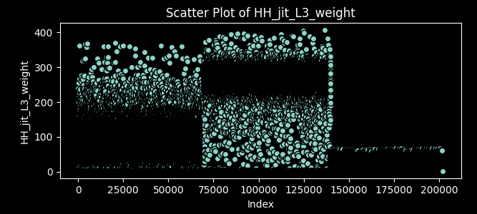
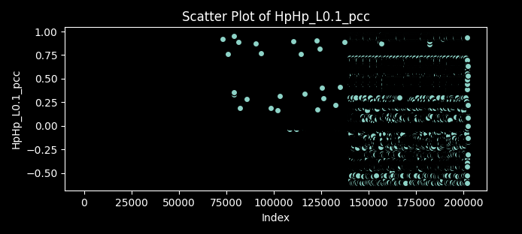
Features distribution
An alternative method to visualize the data distribution allows us to observe the persistent skewness in the data.

Slide 8
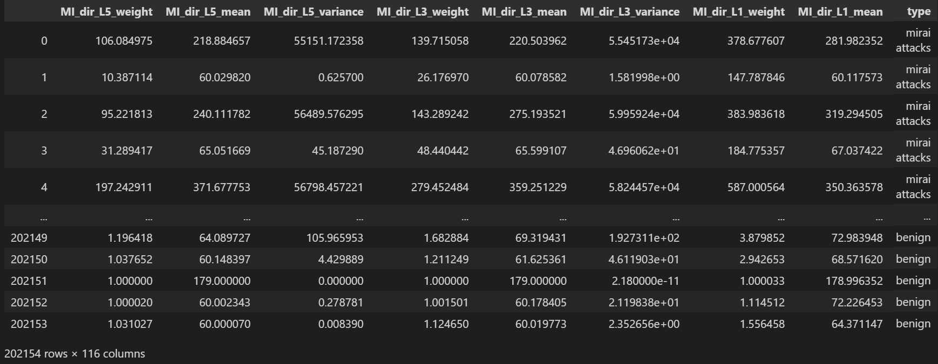
DATA Without Label Encoding/Scaling

Slide 9
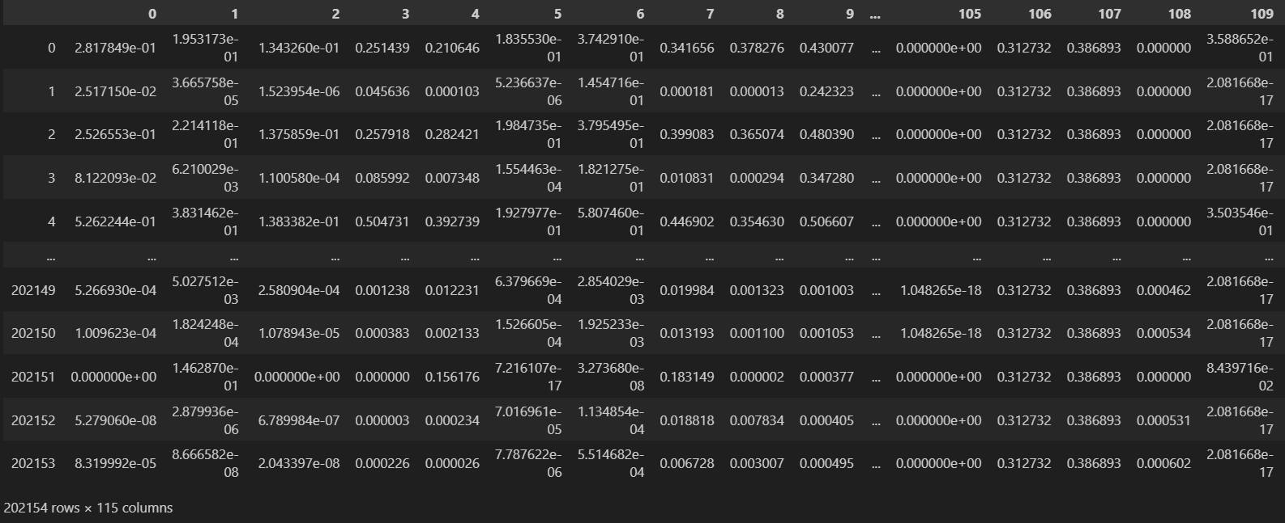
DATA After Label Encoding/Scaling

Slide 10
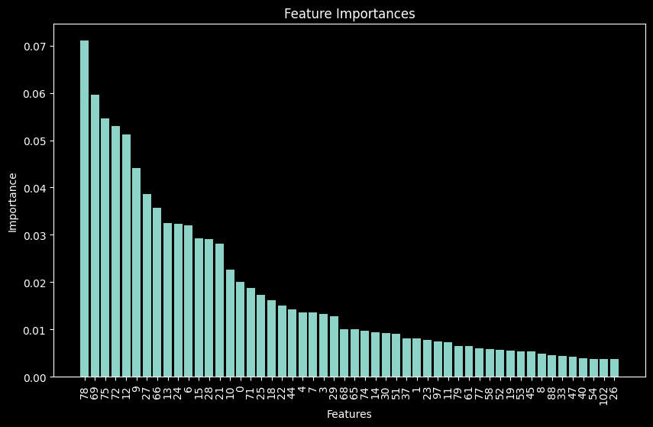
Utilizing an extratree classifier algorithm to identify the top 50 most significant features and assess the importance of each feature.

Slide 11
02
Models
Six Different Models

Slide 12
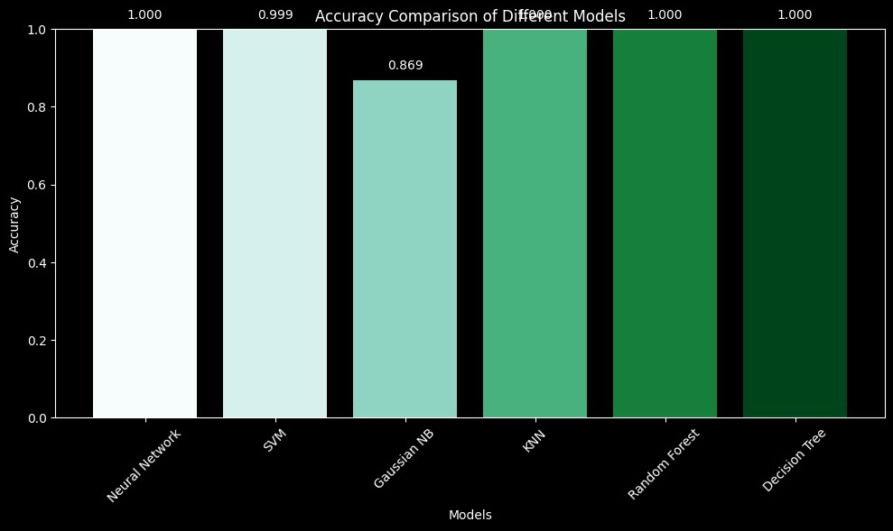
This is a comparison of the six models we implemented, and given the size of our dataset, we have chosen to utilize the Neural Network model.

Slide 13
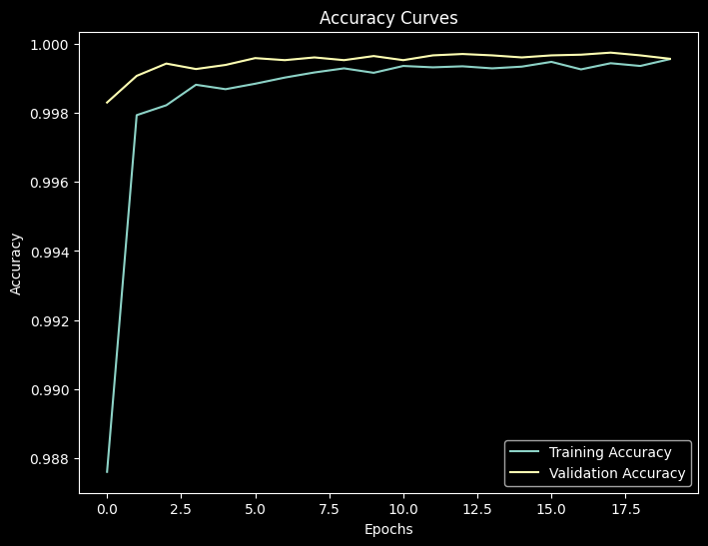
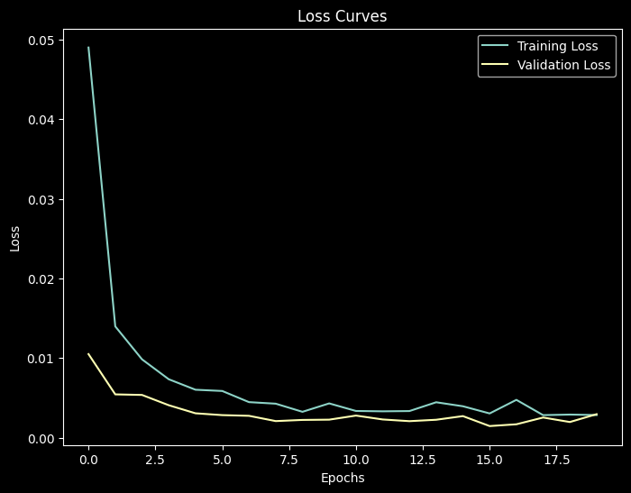
The learning curve for loss and accuracy

Slide 14
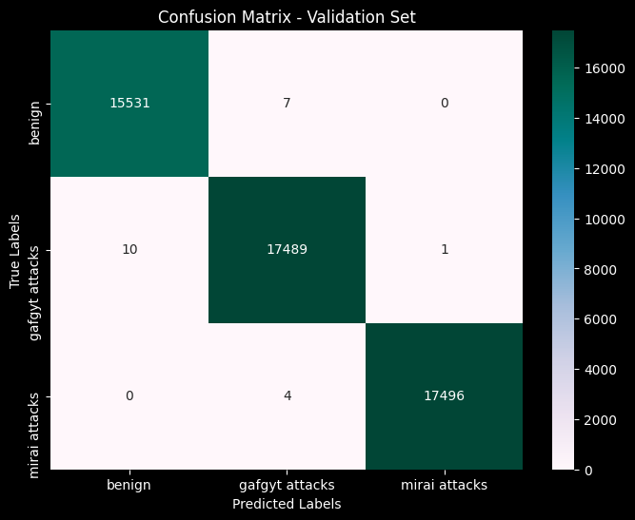

The confusion matrices of Neural network
on validation and test set

Slide 15
03
Detect Mirai Attack

Slide 16
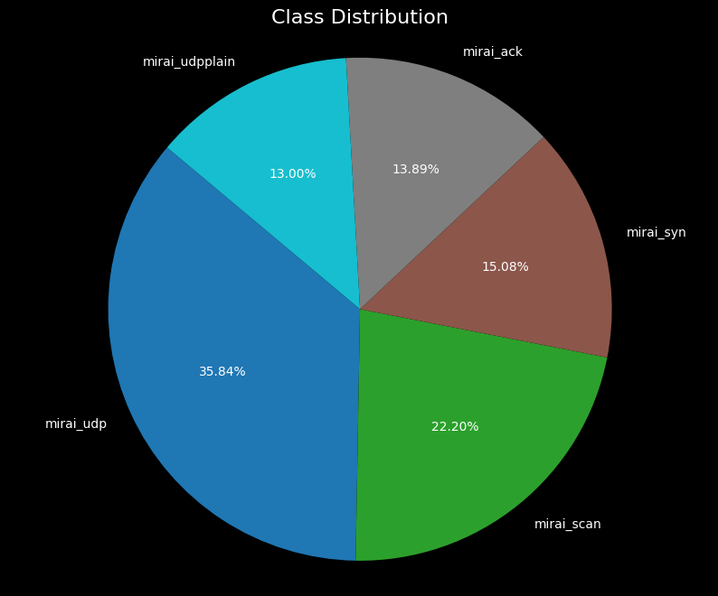
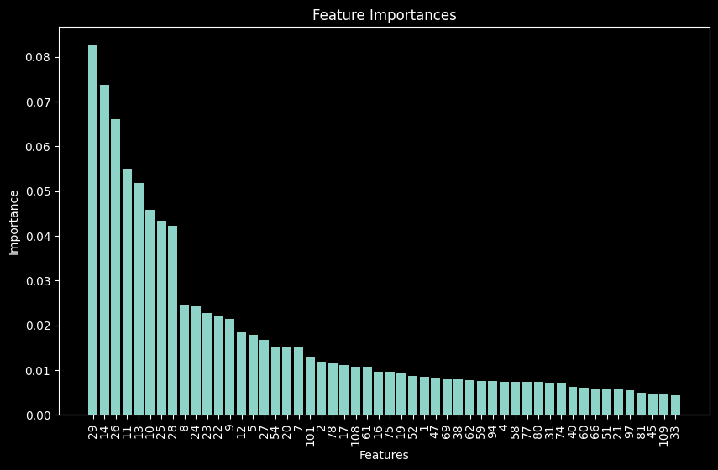
Data distribution and feature selection for Mirai Attacks

Slide 17
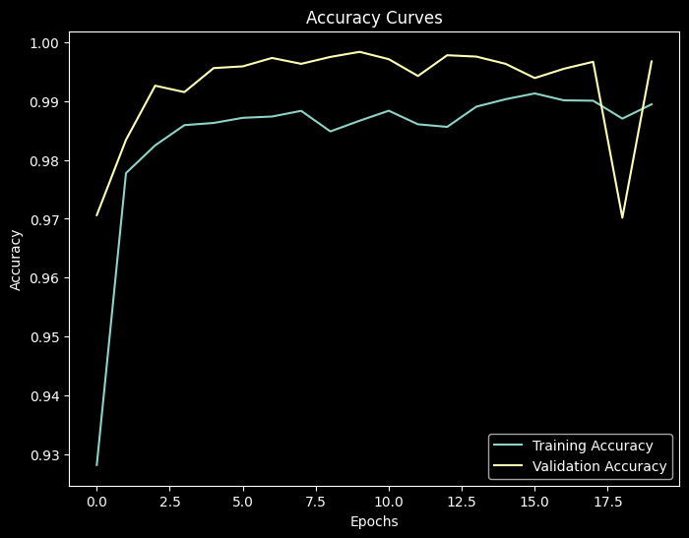
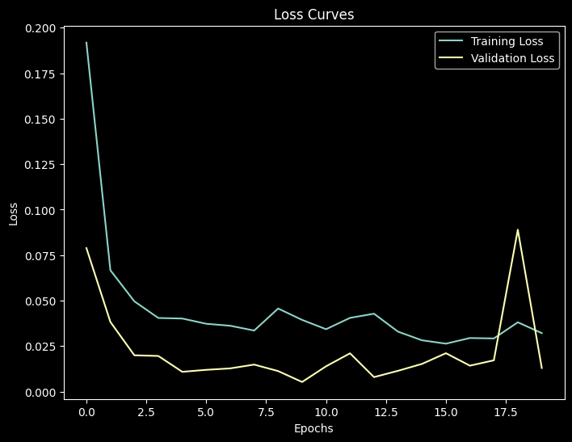
The learning curve for loss and accuracy for Mirai Attacks

Slide 18
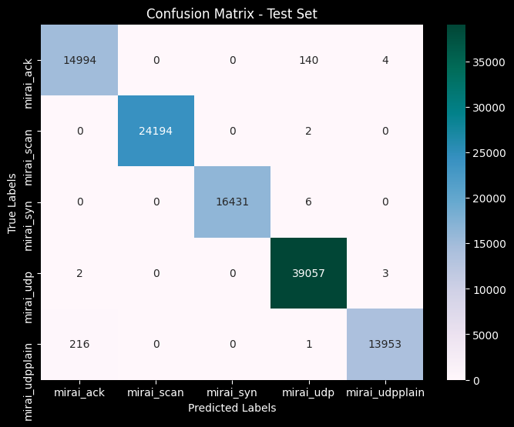
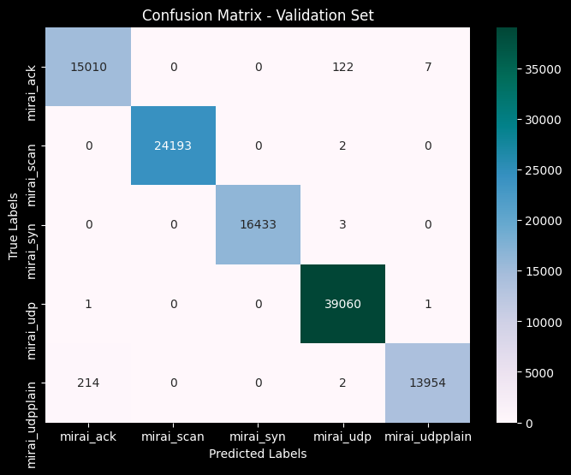
The confusion matrices of Neural network
on validation and test set for Mirai Attacks

Slide 19
04
Detect GAFGYT Attack

Slide 20
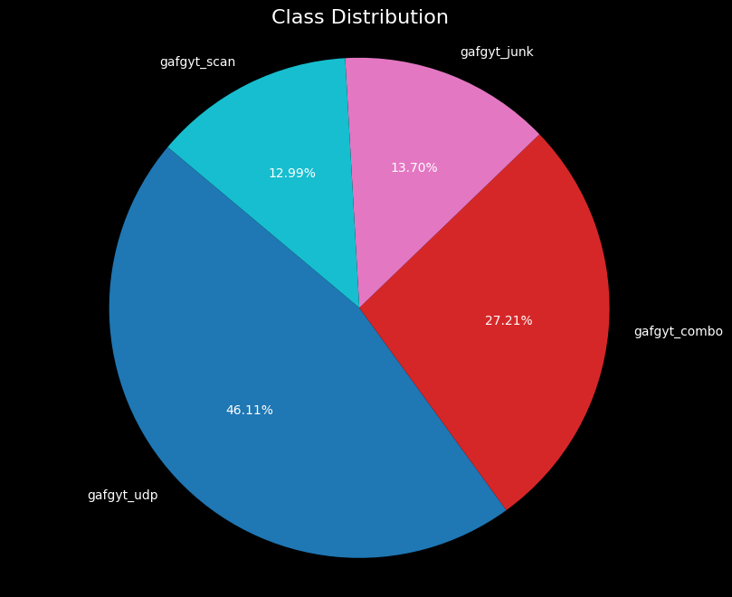
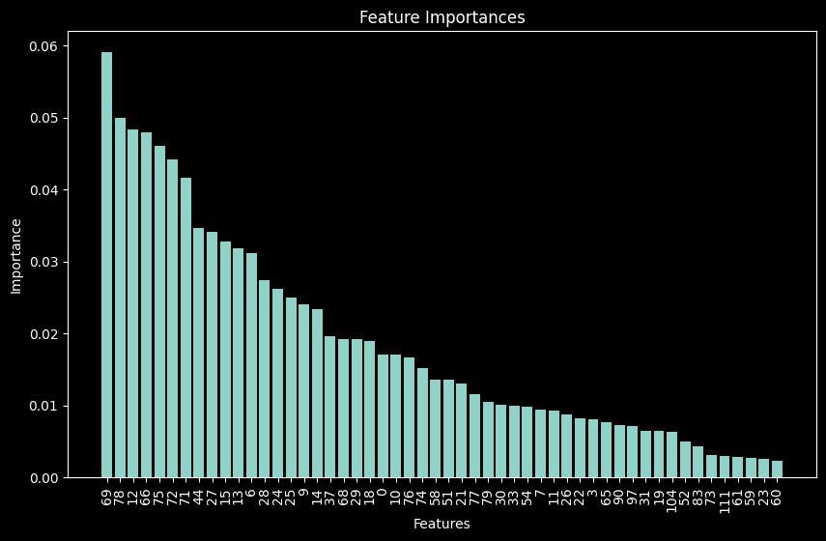
Data distribution and feature selection for GAFGYT Attacks

Slide 21
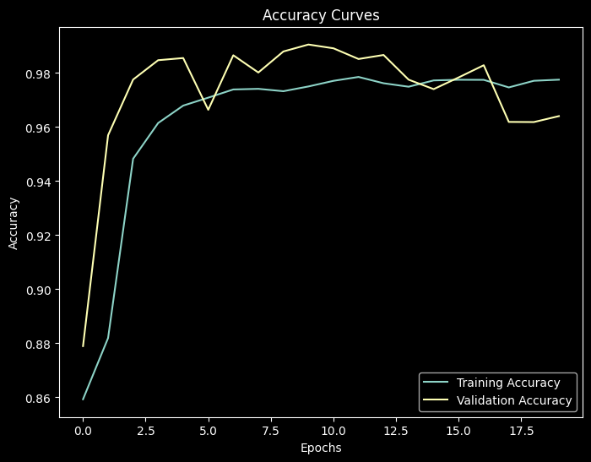
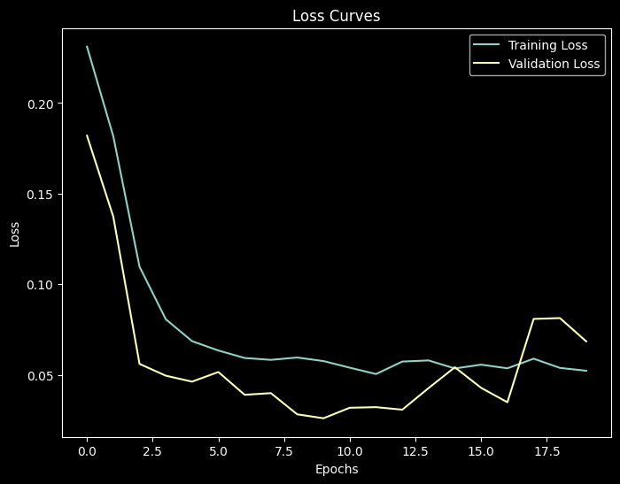
The learning curve for loss and accuracy for GAFGYT Attacks

Slide 22
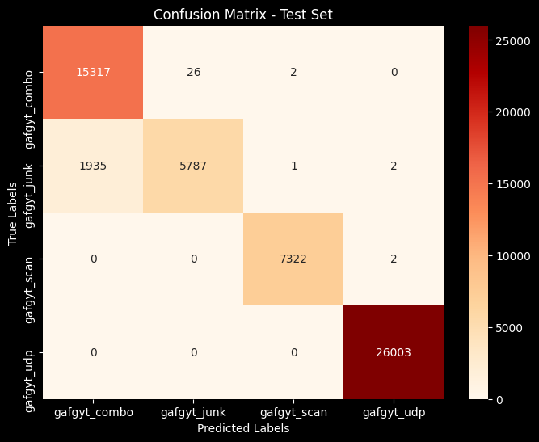
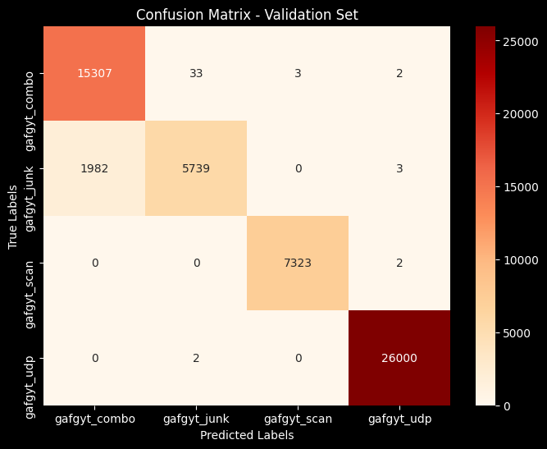
The confusion matrices of Neural network
on validation and test set for GAFGYT Attacks

Slide 23

Future Work
As the landscape of cyber threats continually evolves, it is imperative to ensure that our botnet detection models remain agile and up to date. The proactive integration of new threat intelligence, continuous learning mechanisms, and regular model updates is crucial in staying ahead of emerging attack vectors. By embracing a dynamic and adaptive approach, we can fortify our defenses, effectively identify novel attack patterns, and maintain a resilient security posture against the ever-changing landscape of botnet activities.

Slide 24
THANKS!

