Slide 1
Pattern Recognition
Submitted by:
Ahmed Fawzi
Hendwan Abozide
Rokaia Mohamed

Slide 2
Methods

Slide 3
Methods
K-mean
Number of clusters is entered by user (K).
Centroids of each cluster are calculated.
Euclidean distance is calculated between each pixel and the cluster
Adjust the value of centroids by iterating until convergence
SNN
Initialize random weights array and bias arrays
We chose the activation function to be ReLU
Calculating the output probability of layer using softmax
Then calculating the loss function of each softmax value using cross_entropy
Predict the labels and Plot output image same way as in SVM
SVM
Take snippets from the images (Background, Inner and outer) in different folders
We generate labels from each pixel read from each folder
Generating the X train array values in each in pixel read done on Background, Inner and Outer
Using svclassifier fit the training data with the labels and output the y_pred
get the mean of these lists in different folders and Draw the output image.

Slide 4
Results

Slide 5
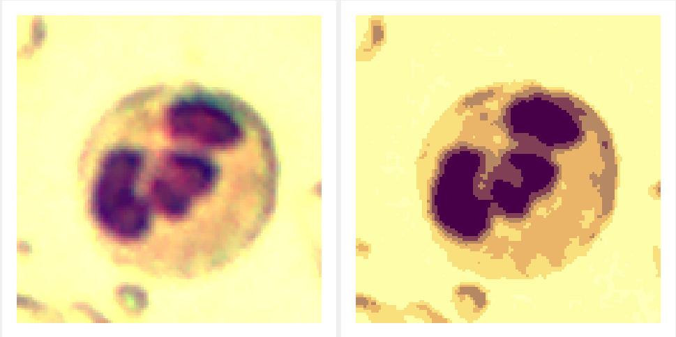
K-mean
Original Image
Segmented Image

Slide 6
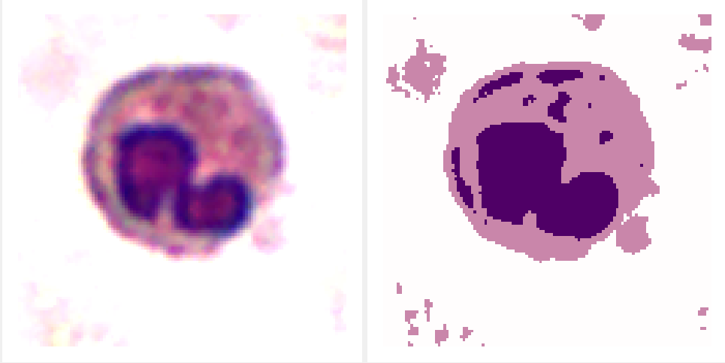
Multi-Class Shallow Neural Network (SNN)
Original Image
Segmented Image

Slide 7
Support Vector Machine (SVM )
Original Image
Segmented Image

Slide 8
Thanks!
Any Question?

