Slide 1

eT3 Cash Application
Smart Wallet Services
Name: Ahmed Gamal
Supervisor: Eng. Ahmed Zakaria

Slide 2
Agenda
What’s eT3 Cash?
Front End
Back End
Data Schemas
Mobile App
Docker
Artificial Intelligence
Conclusion

Slide 3
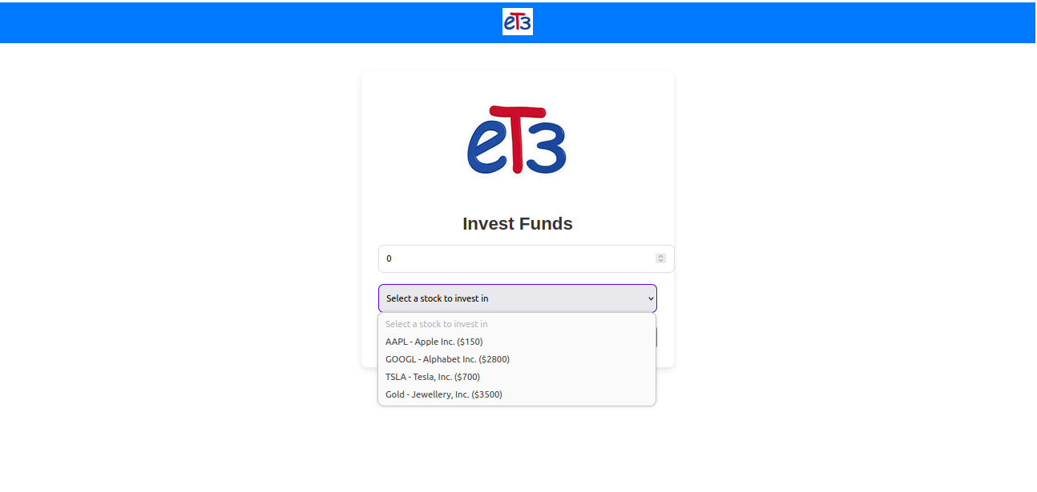
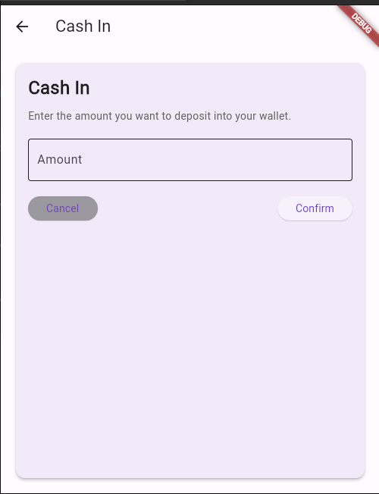
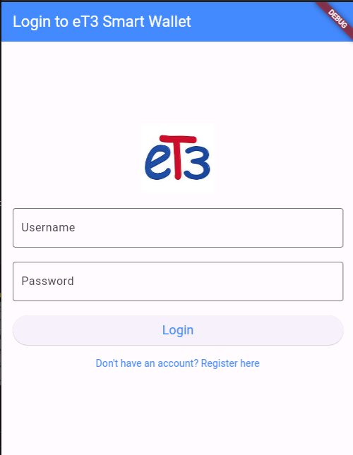
eT3 Cash
eT3 Cash is a comprehensive financial management platform designed to simplify personal and small business finances.
helps individuals and businesses manage their money with ease
Offers actionable insights through data analytics to guide smarter financial decisions
Target Audience
Individuals: Anyone seeking a modern and secure solution for personal finance management.
Small Businesses: Enterprises requiring simplified financial tools without the complexity of traditional banking.
Donors and Investors: Users who want to contribute to causes or grow their wealth through investments.

Slide 4
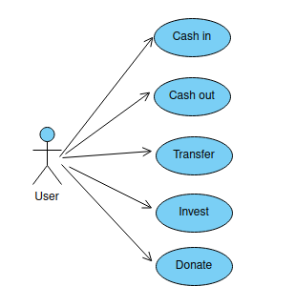
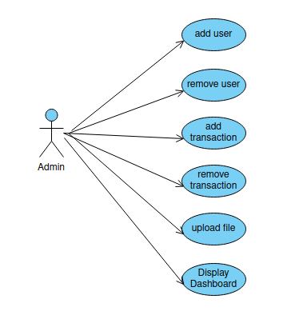
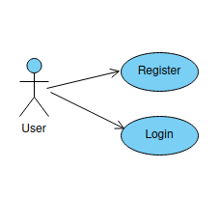
Use Case Diagrams

Slide 5








eT3 Cash Technologies
Back end
Front end
IDEs

Slide 6

Front End Development
Simple and Intuitive
Component-Based Architecture
Lightweight and Fast
Detailed Documentation
Supportive Community
Seamless Integration
Responsive and Adaptable
Why Vue.js?
Simple Web Page with different Components .
Handle APIs requests in Script section each component with its logic.
Handle routing with “vue-router”.
Authorization with token saved in Local Storage.
Some Shared style with reusable components.

Slide 7
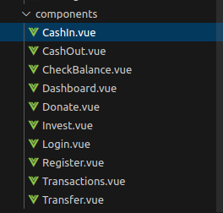
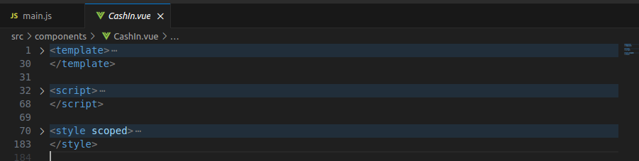
A reusable, self-contained block of code that encapsulates the structure, behavior, and style of a specific part of a user interface (UI). Components are defined using a template for HTML structure, a script for logic and data, and style for appearance, all scoped to that component.
Components

Slide 8
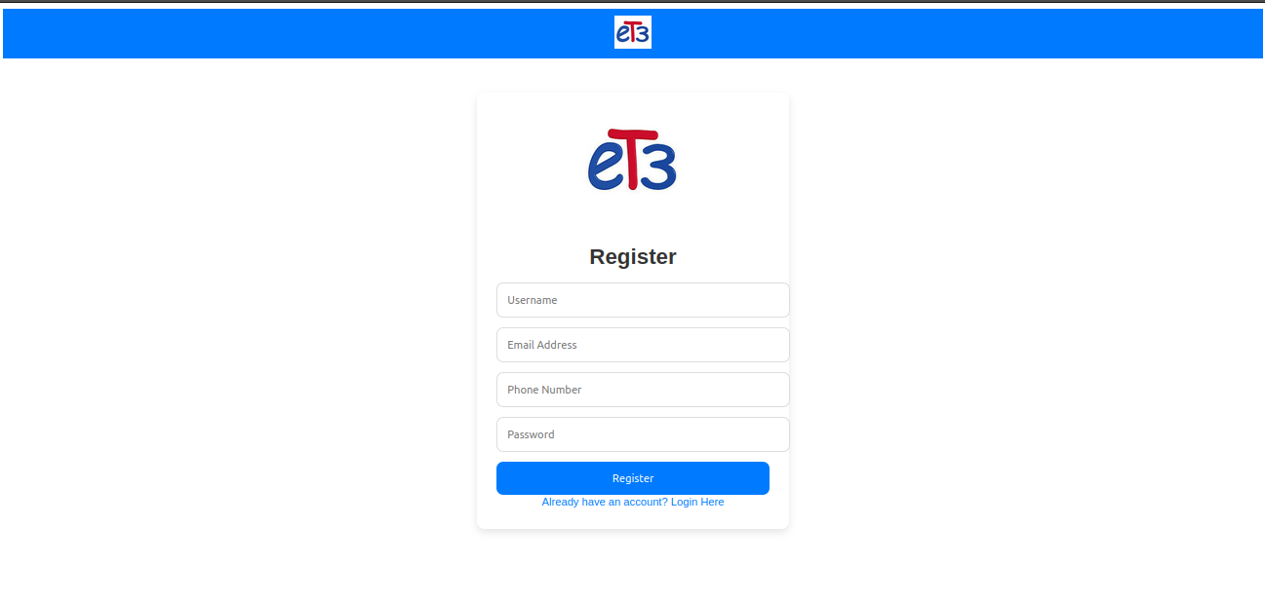
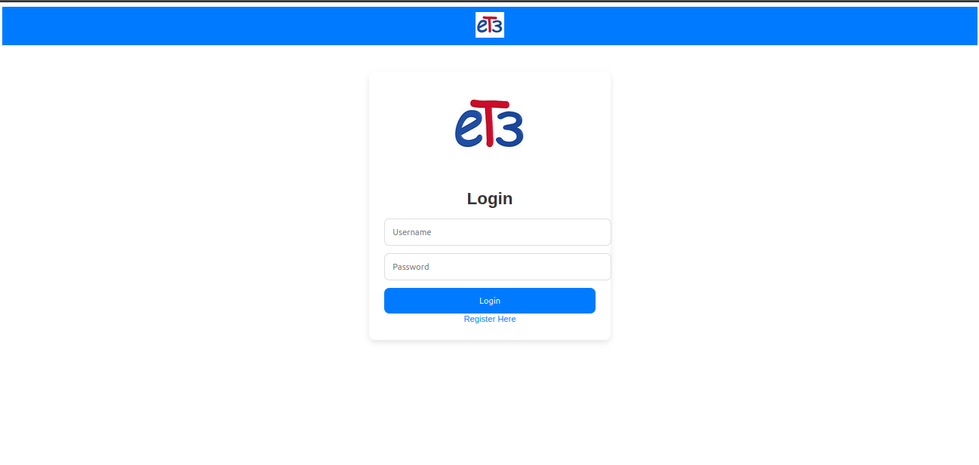
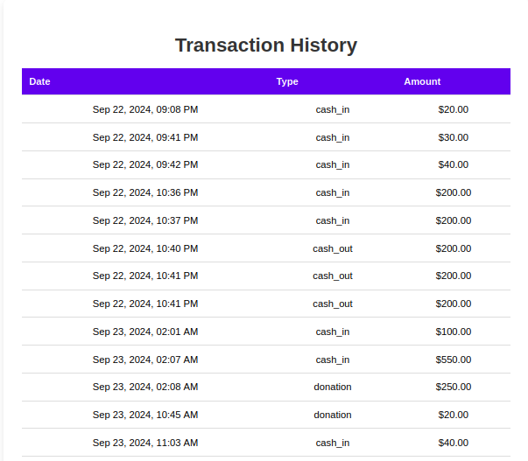
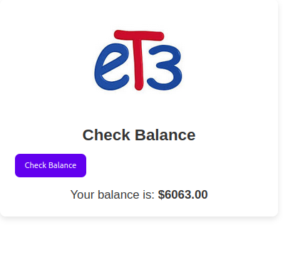
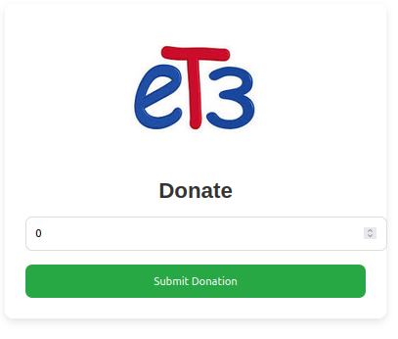

Slide 9

Back End Development
Pre-build Components
REST API Development DRF
Built-in Admin Panel
Community and Documentation
Python Ecosystem Simple
High Security
Why Django?
Brain of the application, responsible for handling business logic, data management.
Works seamlessly with mobile (Flutter) and frontend (Vue.js)
User Authentication and Authorization with saved tokens
Transactions Handling
Wallet Management to handle real-time updates

Slide 10
Models
Custom User
Wallet
Transaction
'api/check-balance/'
'api/register/'
'api/login/'
'api/cash-in/'
'api/cash-out/'
'api/transfer/'
'api/donate/'
'api/market-data/'
'api/invest/'
'api/transactions/'
Transaction Serializer
Wallet Serializer
User Login Serializer
User Register Serializer
Serializers
API URLs
APIList
Register
Login
Check Balance
Cashin
Cashout
Transfer
Donate
Investment
Transactions
Views

Slide 11
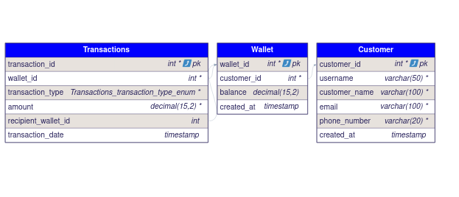
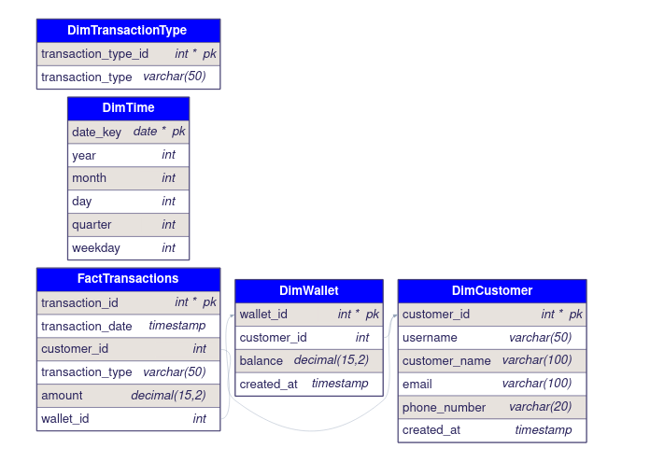
Data Schema
Database
Data Warehouse

Slide 12

Mobile Development
Cross-Platform Development
High-Performance Applications
Strong Ecosystem and Plugins
Future-Proof and Scalable
Seamless Backend Integration
Strong Community
Why Flutter?
Based on Reusable Components, Widgets, Cards, Buttons.
Authentication Screens, Wallet Management Screens.
Stateful Widgets used to Navigate between screens.
Class API Service to handle API requests and store token

Slide 13
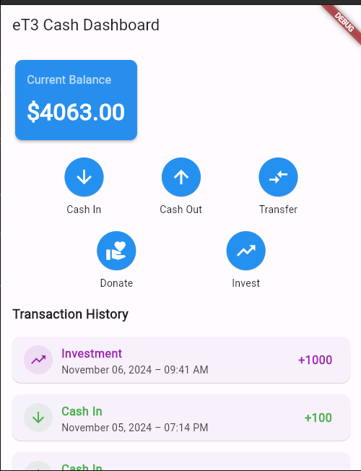
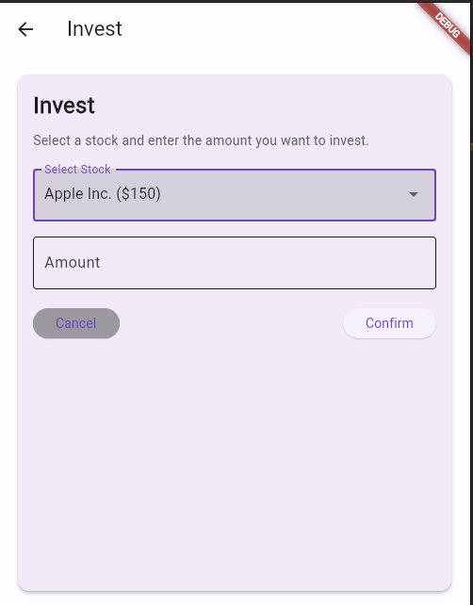
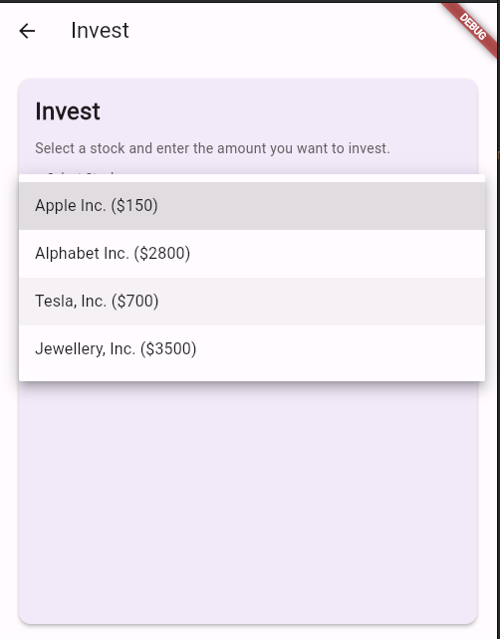
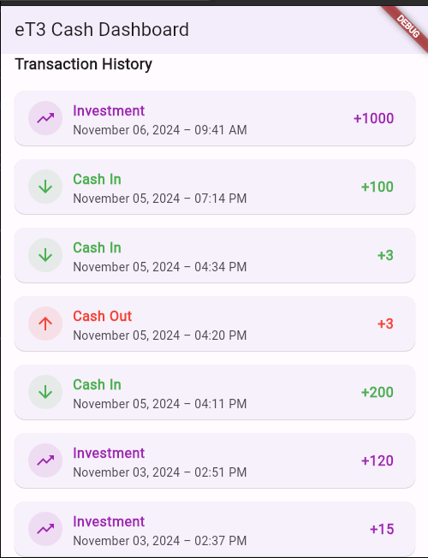

Slide 14

Docker
Consistency Across Environments
Simplified Dependency Management
Portability: run anywhere
Centralized Management
Faster Deployment
Easy Scalability
Why Docker?
DockerFile for frontend:
Vue.js with its dependencies and commands to build and run
Docker Compose File:
To configure whole projects and database and check ports and can manage to build and run the project with one command
DockerFile for backend:
Django with its dependencies and commands to build and run

Slide 15
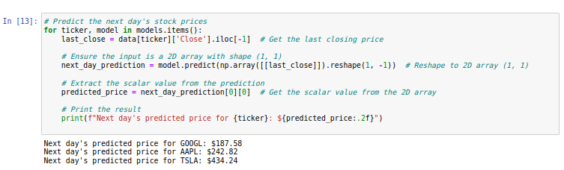
Artificial Intelligence
AI Model to predict the stock price to help user to improve his investment process
Linear Regression to train on data Stock Prices Alphabet, Apple, Tesla,
Supervised Learning Linear Regression model
For continuous values
Trained on: 30 days of historical stock data,
Predicted price: (next day's stock price)

Slide 16
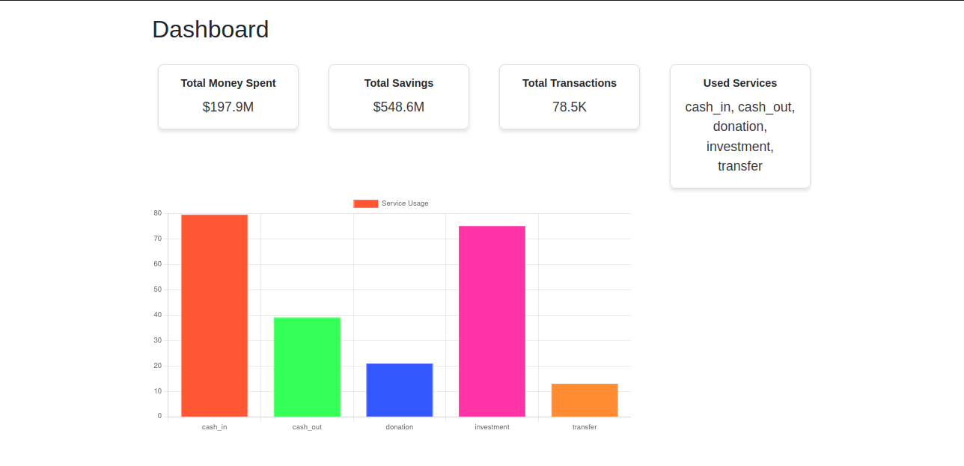
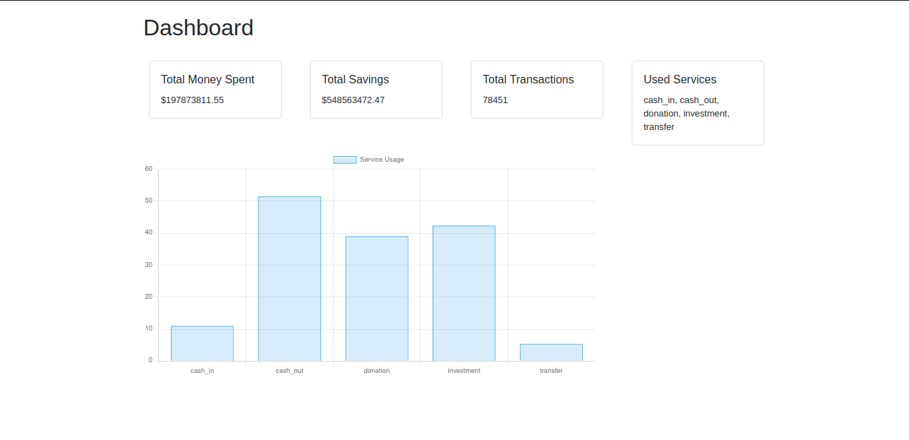
ETL Pipeline
Python Django Project to Implement ETL Pipeline to show the analysis and get insights from the data.
1- Generate CSV Files with every table in data warehouse
2- Implement Logic extract.py, transform.py, load.py, pipeline.py
3- Run ETL Pipeline
4- Produce Simple Dashboard Need more improvements

Slide 17
Conclusion
Technical Skills:
Hands-on Experience
Python Django
Vue.js
Flutter
ETL Pipelines
MySQL
Data Warehouse
Soft Skills:
Problem-Solving
Team Collaboration & Knowledge-Sharing
Brainstorming
Presentation
Communication

Slide 18
Thank You All !
Any Questions?
Wish you all Success!

