Slide 1
NAJAH
To predict the success of your Business

Slide 2
Machine Learning model
Phases to build our model
1- collect our own data
2- preprocessing data (data cleaning – data analysis)
3- model selection
4- build model
5- test our model and display accuracy

Slide 3
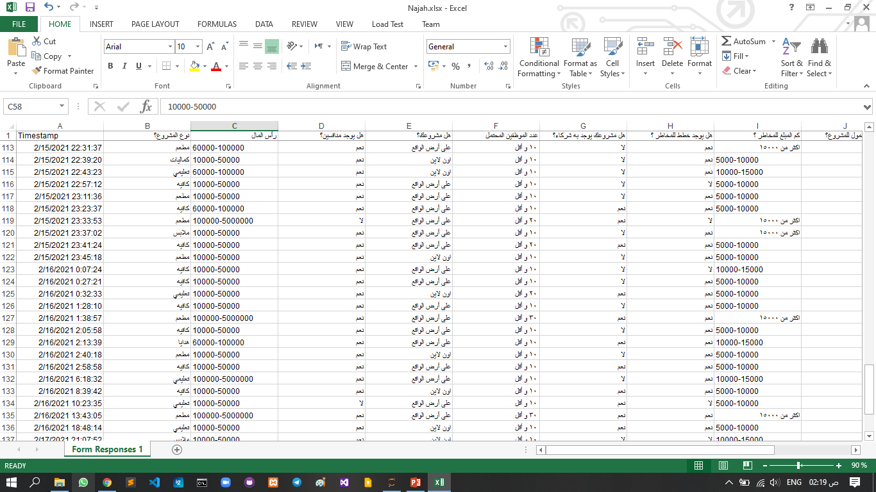
Collect Data
We create google form that contains some questions that used as features in our model.
Some example of our data:

Slide 4
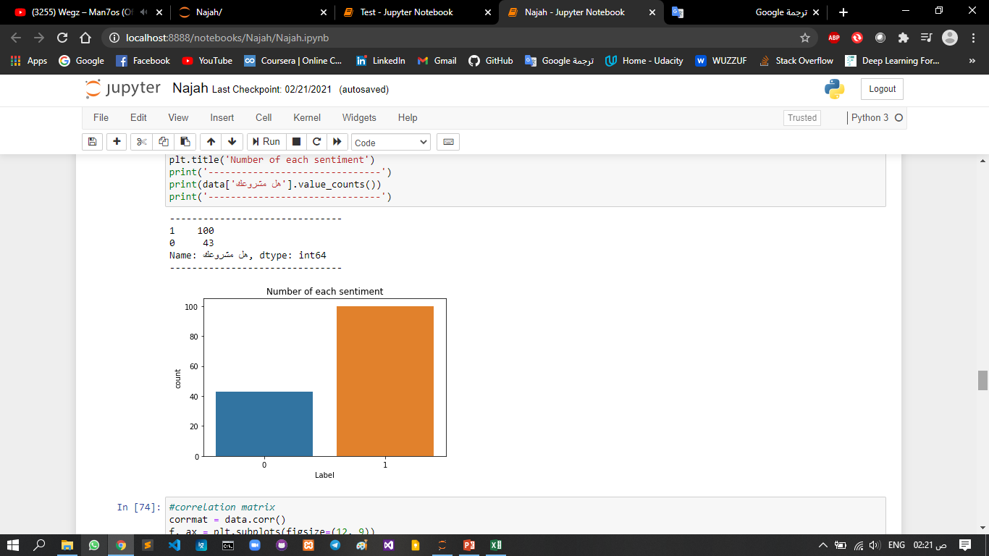
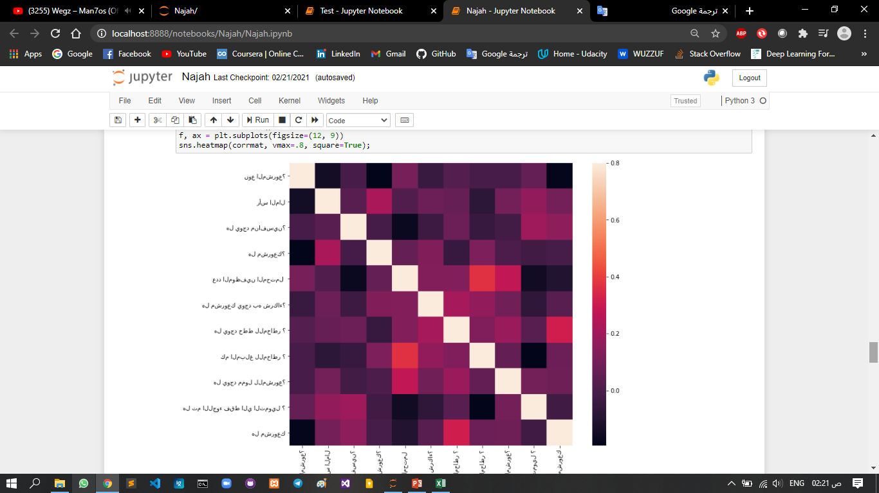
Preprocessing
Analysis our data and understand of its pattern to detect coloration of features
Some plotting of data

Slide 5
Model Selection
Choose algorithm that fit our problem
Algorithms chosen:
1- Logistic Regression with accuracy : 79%
2- SVM with accuracy: 76%
3- Random forest with accuracy : 73%
4- KNN with accuracy : 52%

Slide 6
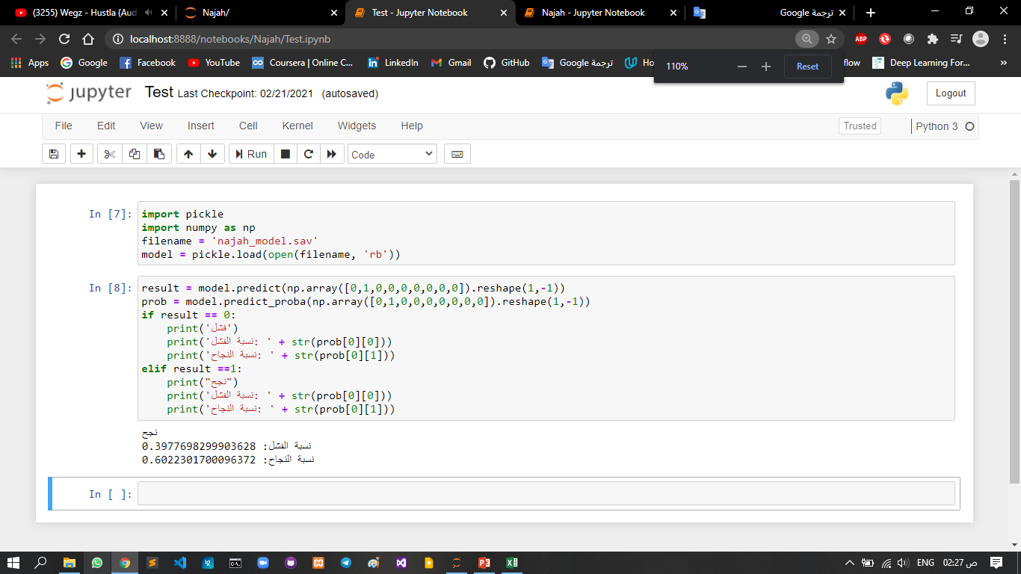
Build Model
1- We choose logistic regression algorithm that give us the highest accuracy
2 – Then we test it with new data and get good result
Example of text :

Slide 7
Finish

