Slide 1


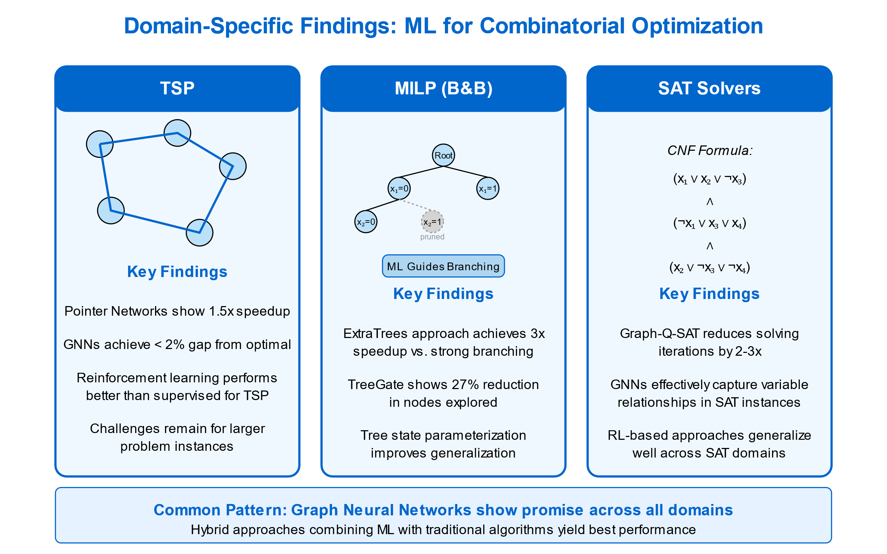
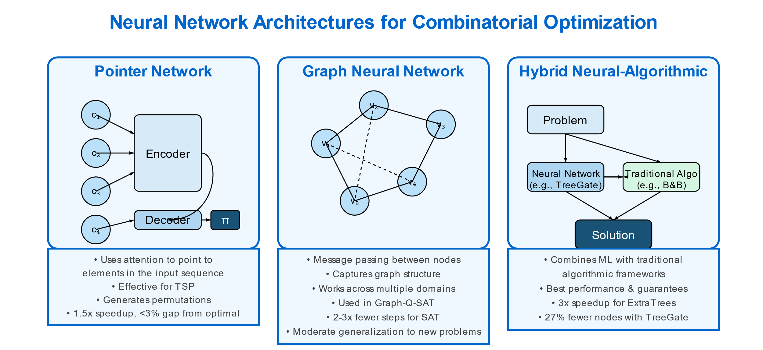
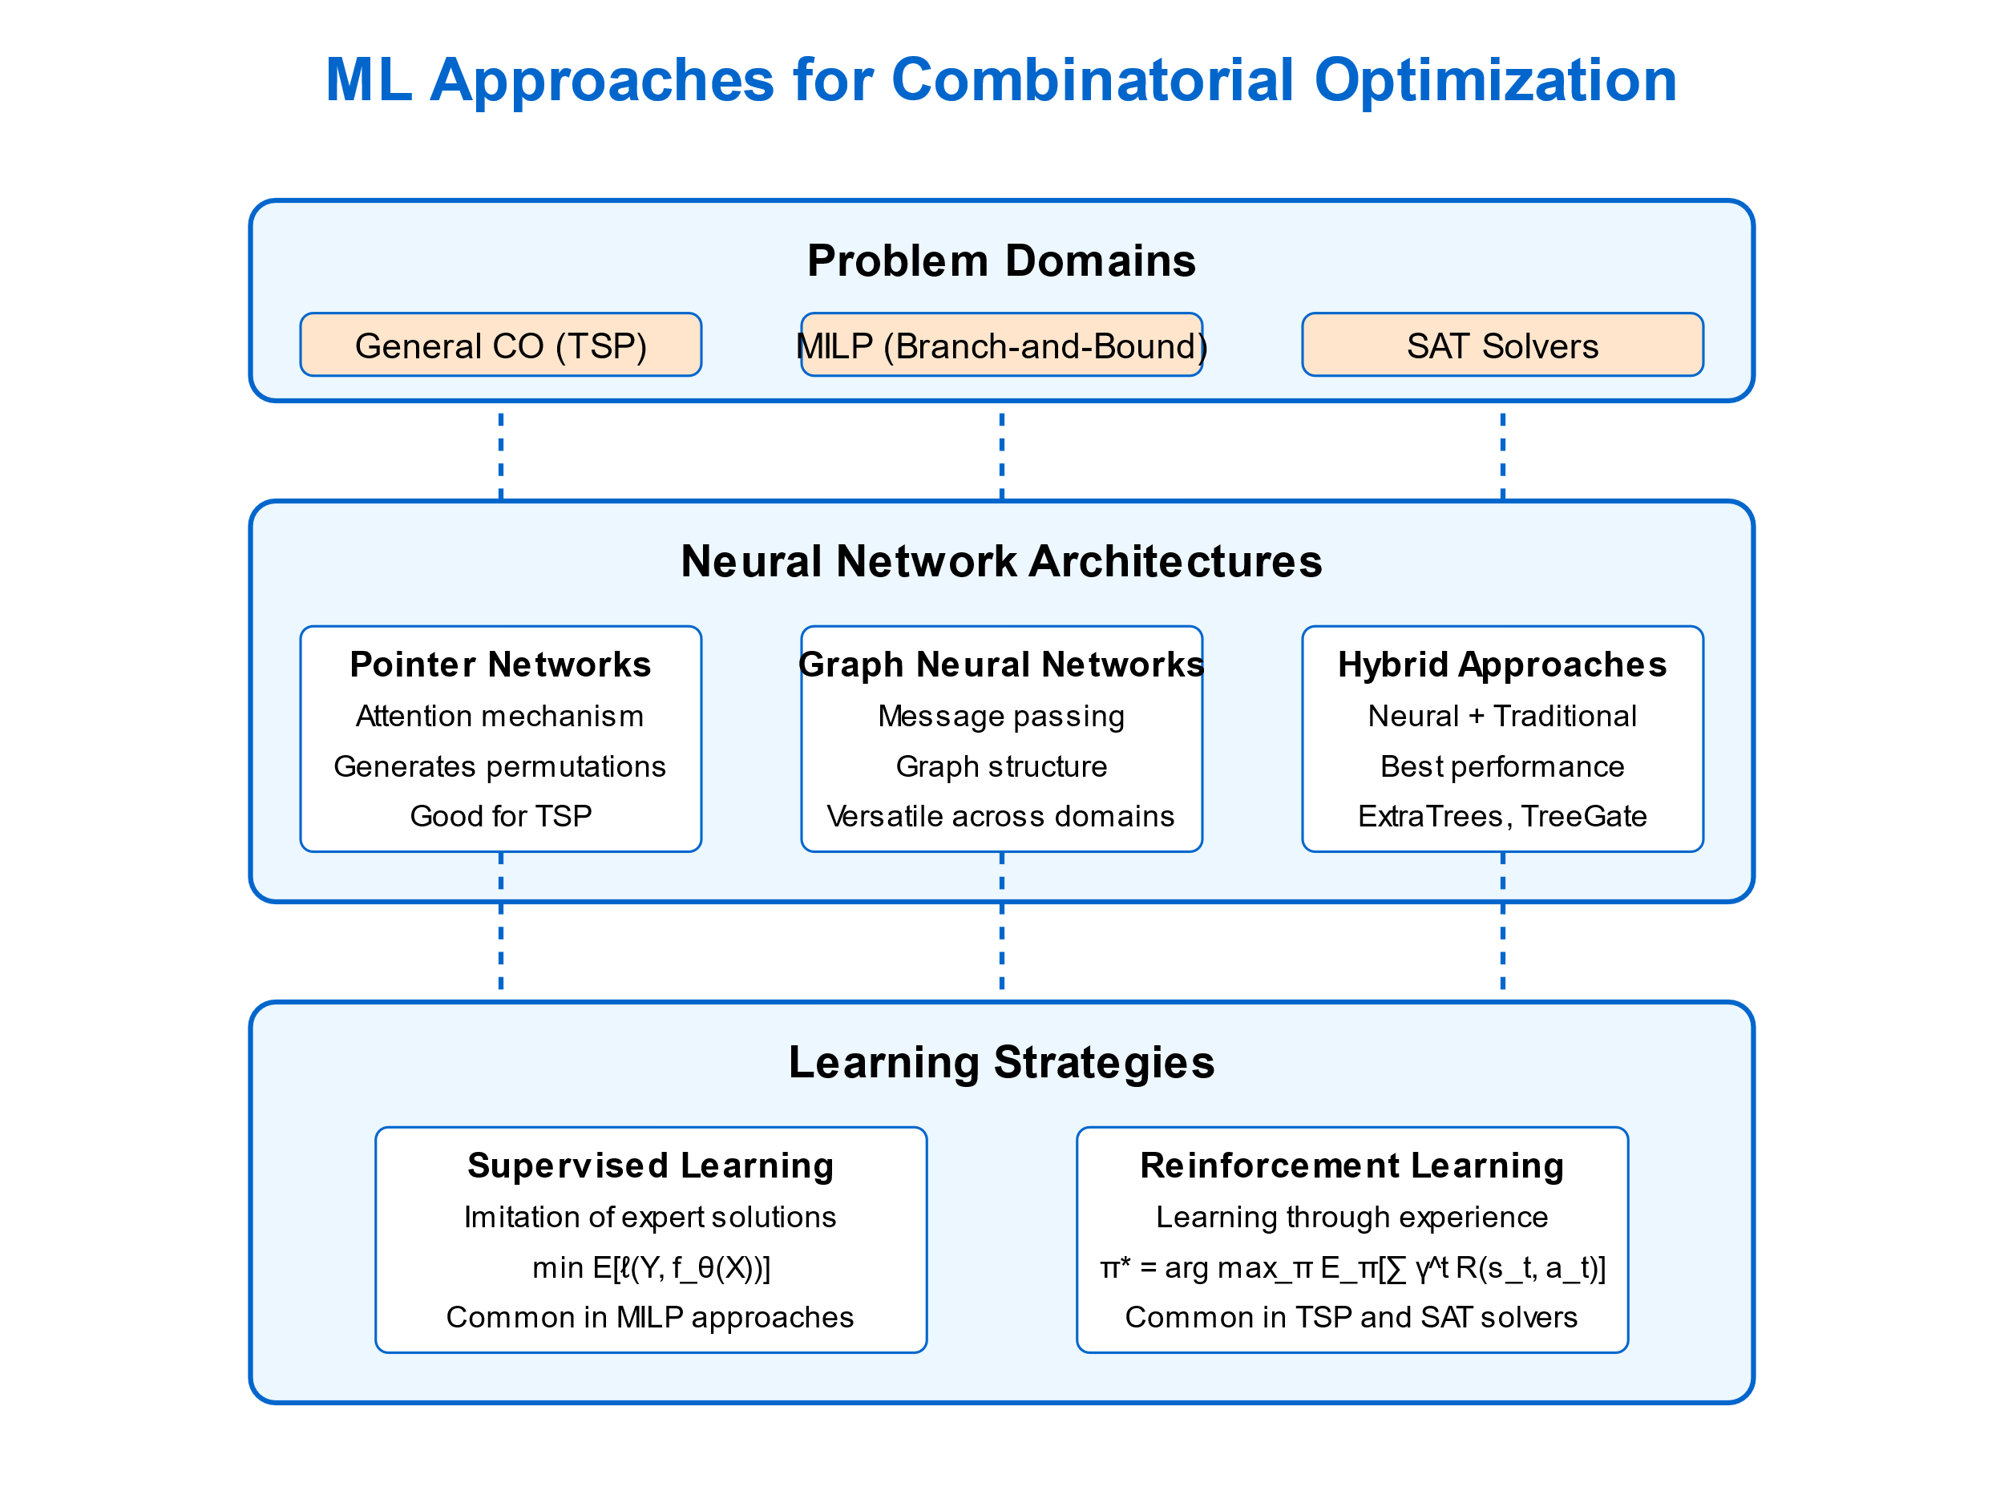
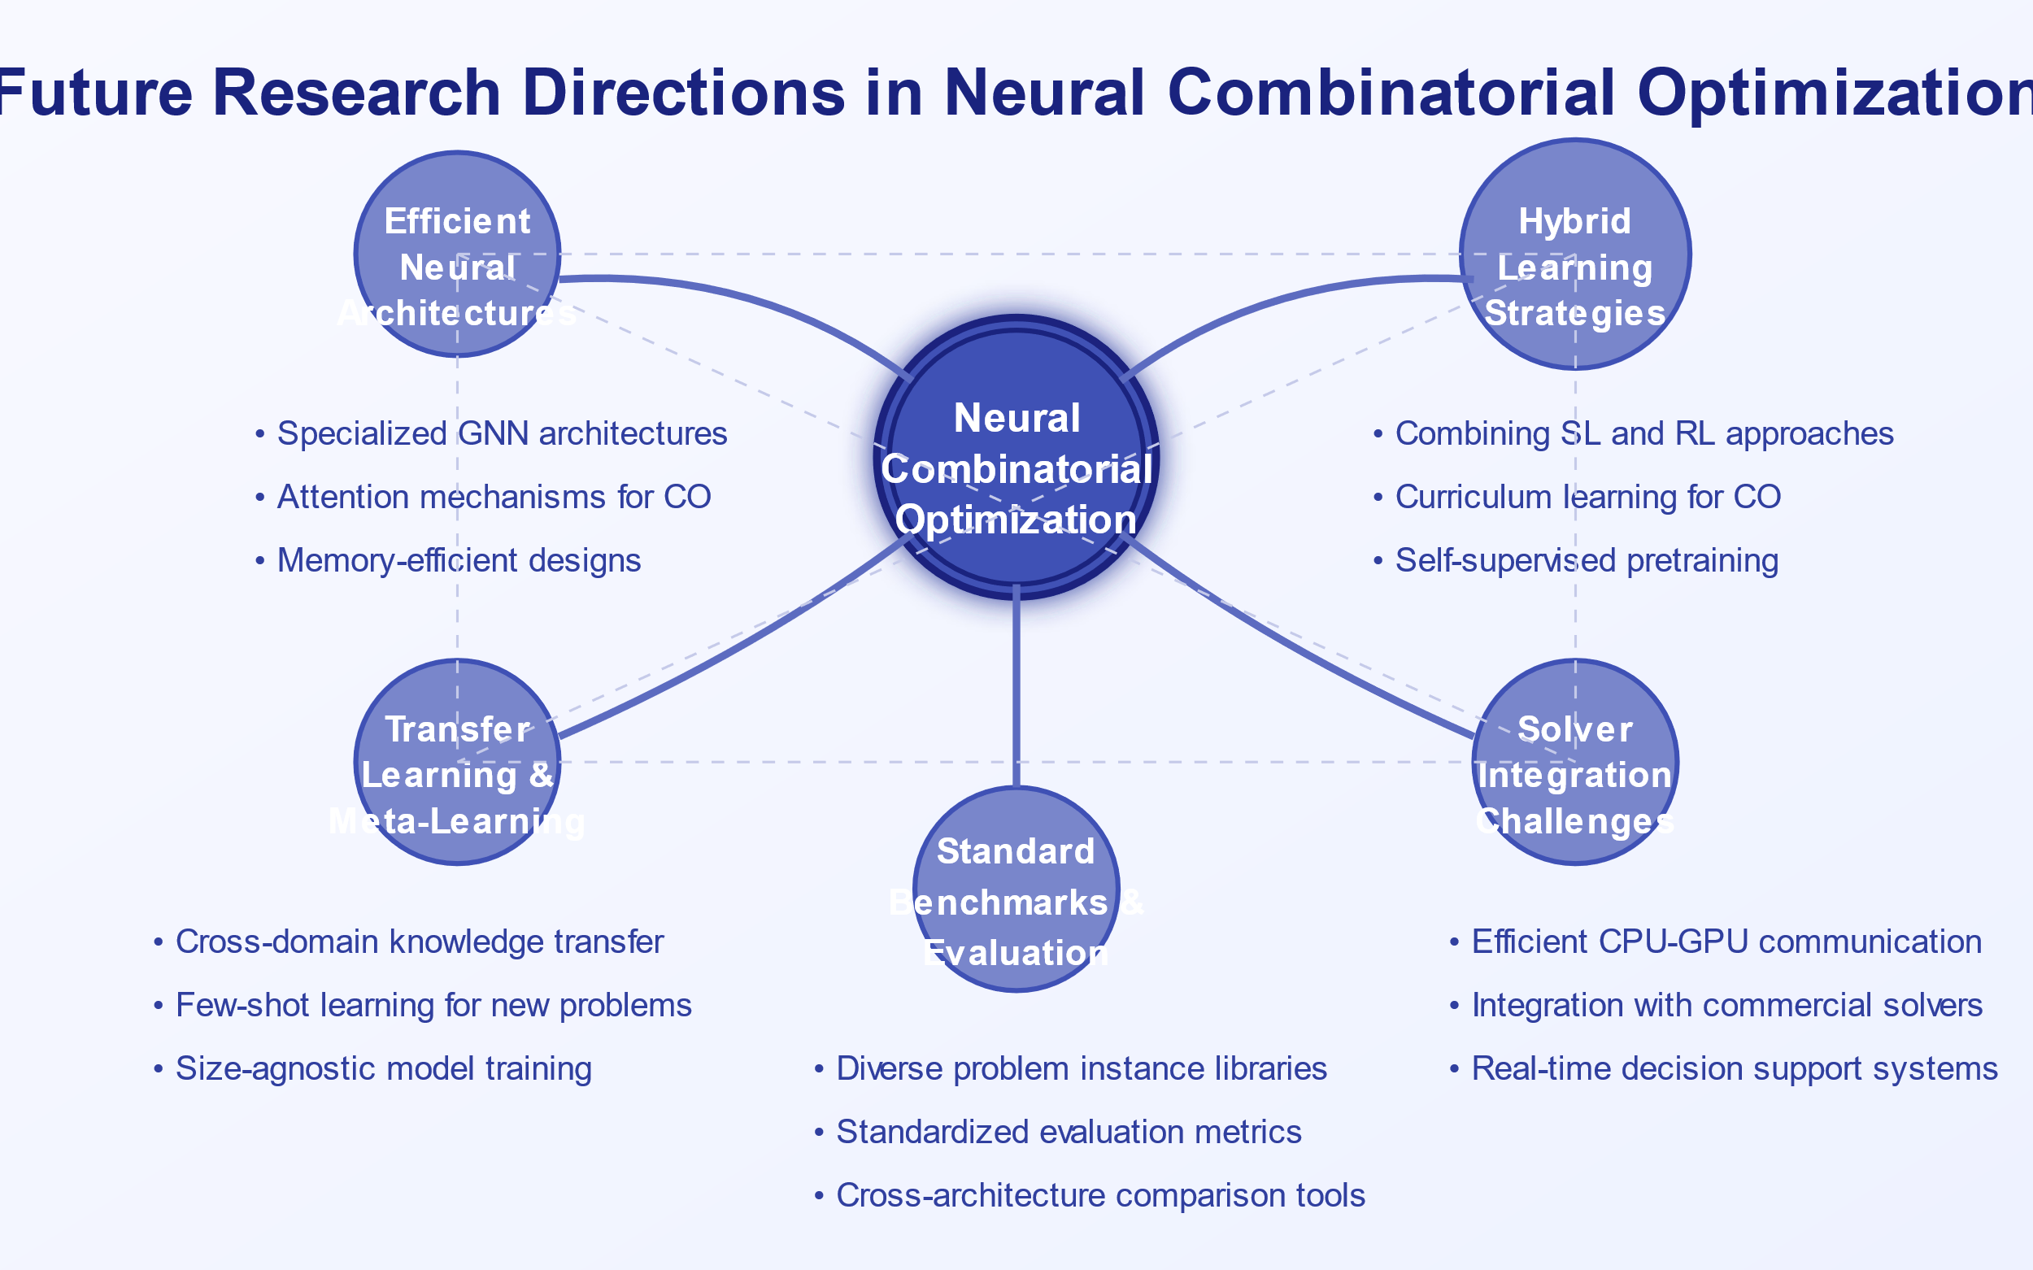
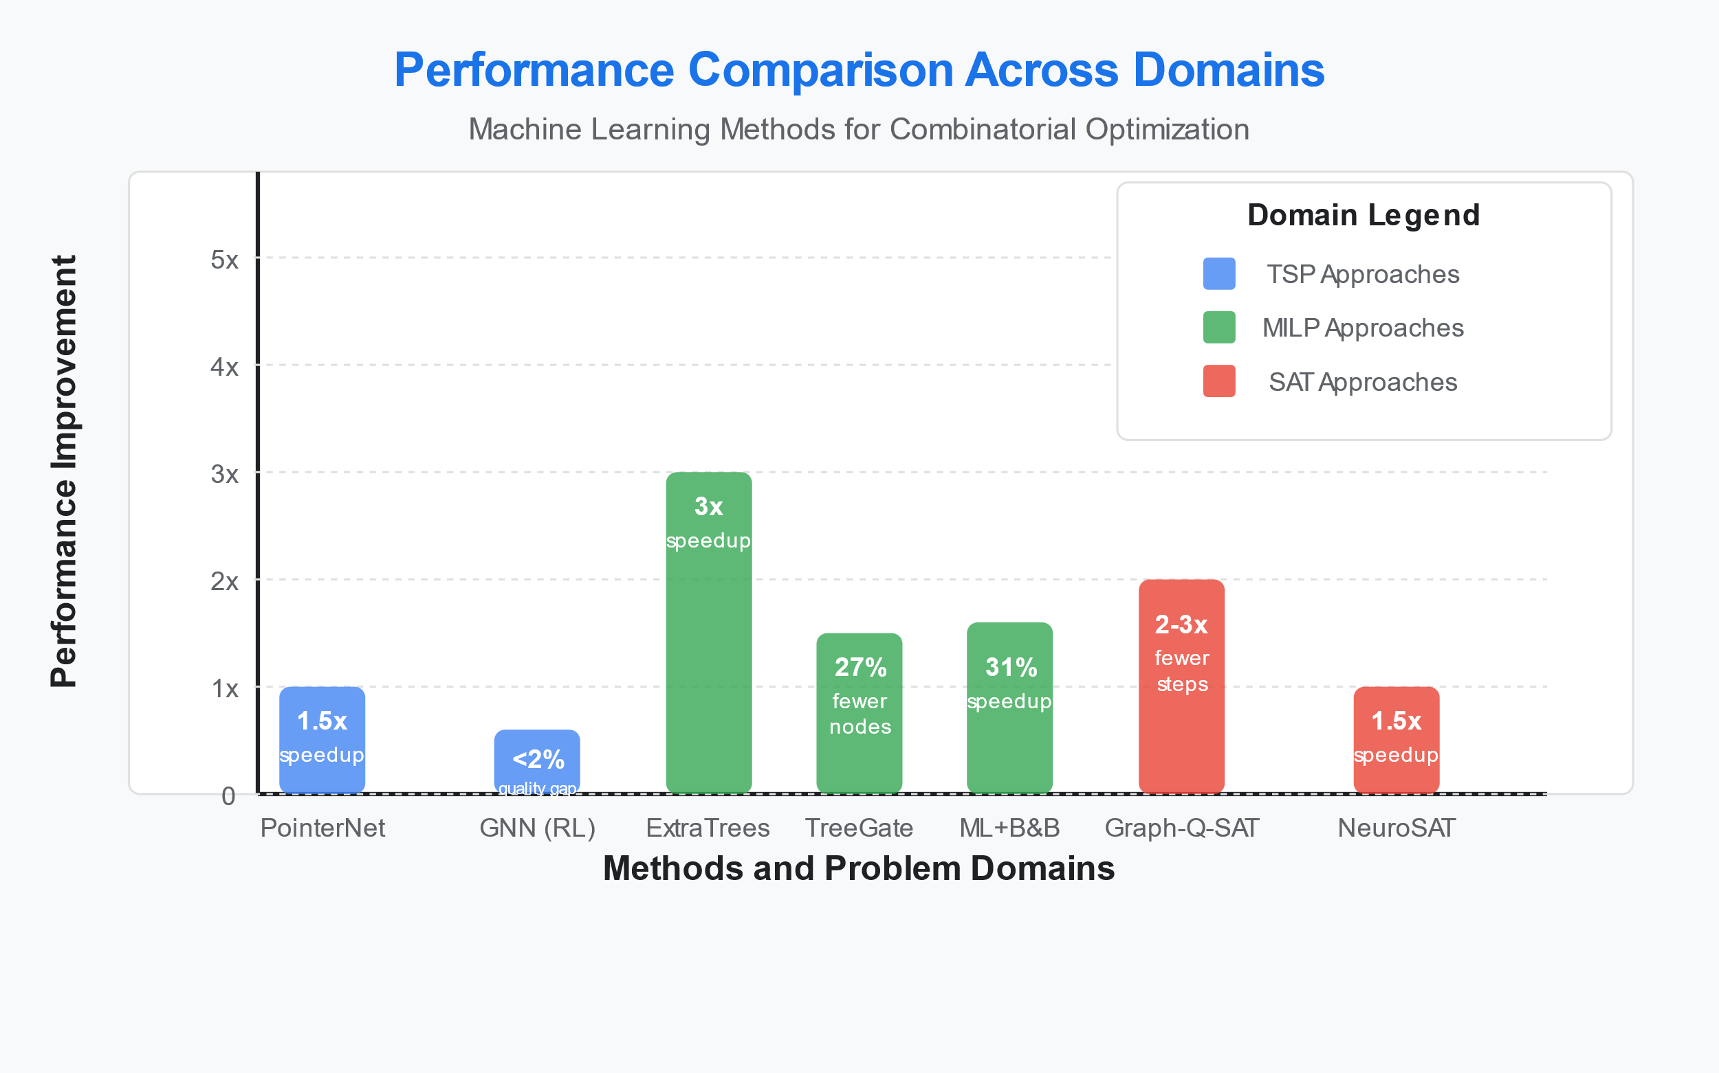
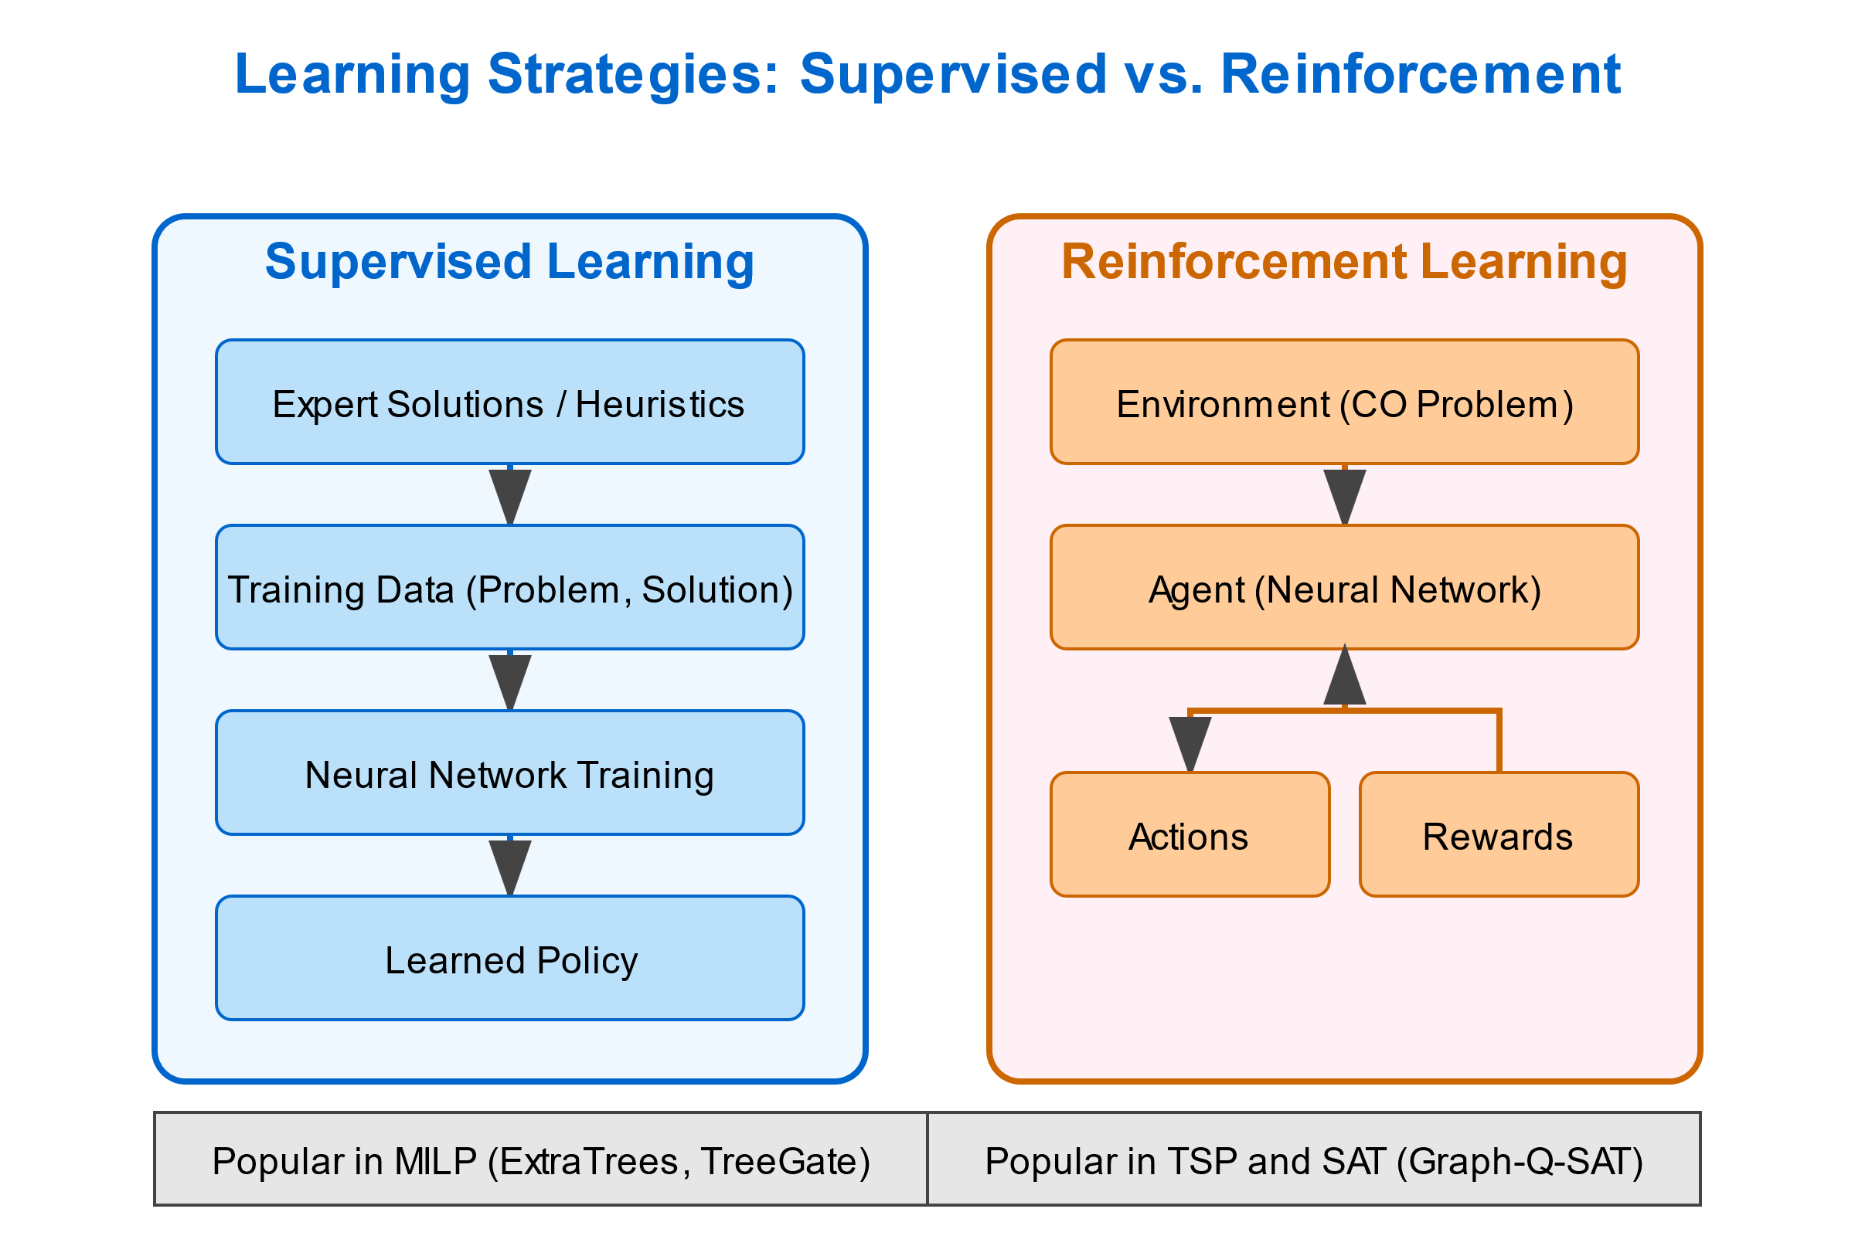
Leveraging Machine Learning to Solve Combinatorial
Optimization Problems
Ahmed Guetti, Osama Baazzi
University Toulouse III Paul Sabatier
Abstract
Background & Methods
Neural Network Architectures
This research reviews recent literature on leveraging machine learning to solve combinatorial optimization problems. We examine three main domains: general combinatorial optimization, Branch-and-Bound methods for Mixed Integer Linear Programming, and Boolean Satisfiability solvers. Our comparative analysis highlights the strengths and limitations of different architectural paradigms and learning strategies.
Introduction
Hybrid neural-algorithmic approaches show the most promise,
Balancing solution quality, computational efficiency, and generalization
Performance Comparison
Future Research Directions
Key Domain-Specific Insights:
TSP: Pointer Networks show moderate speedup with RL training; GNNs achieve near-optimal solutions
MILP: ExtraTrees offers best speedup; TreeGate reduces B&B nodes explored; Hybrid methods balance quality and speed
SAT: Graph-Q-SAT significantly reduces solving time; End-to-end approaches show feasibility but less performance
Learning Strategies
Conclusion
Machine learning approaches show promising results for combinatorial optimization, with The use of Graph Neural Networks, hybrid approaches combining ML with traditional algorithms offering the best balance. While significant advances have been made, challenges remain.
Note: Performance metrics vary by domain (speedup, fewer nodes, fewer steps)

