Slide 1

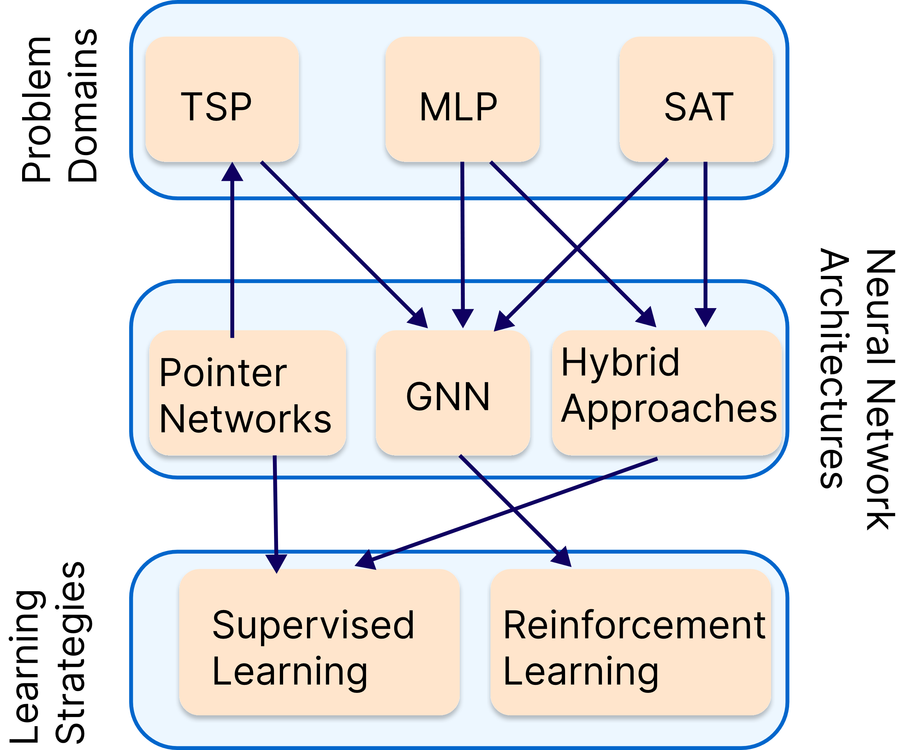
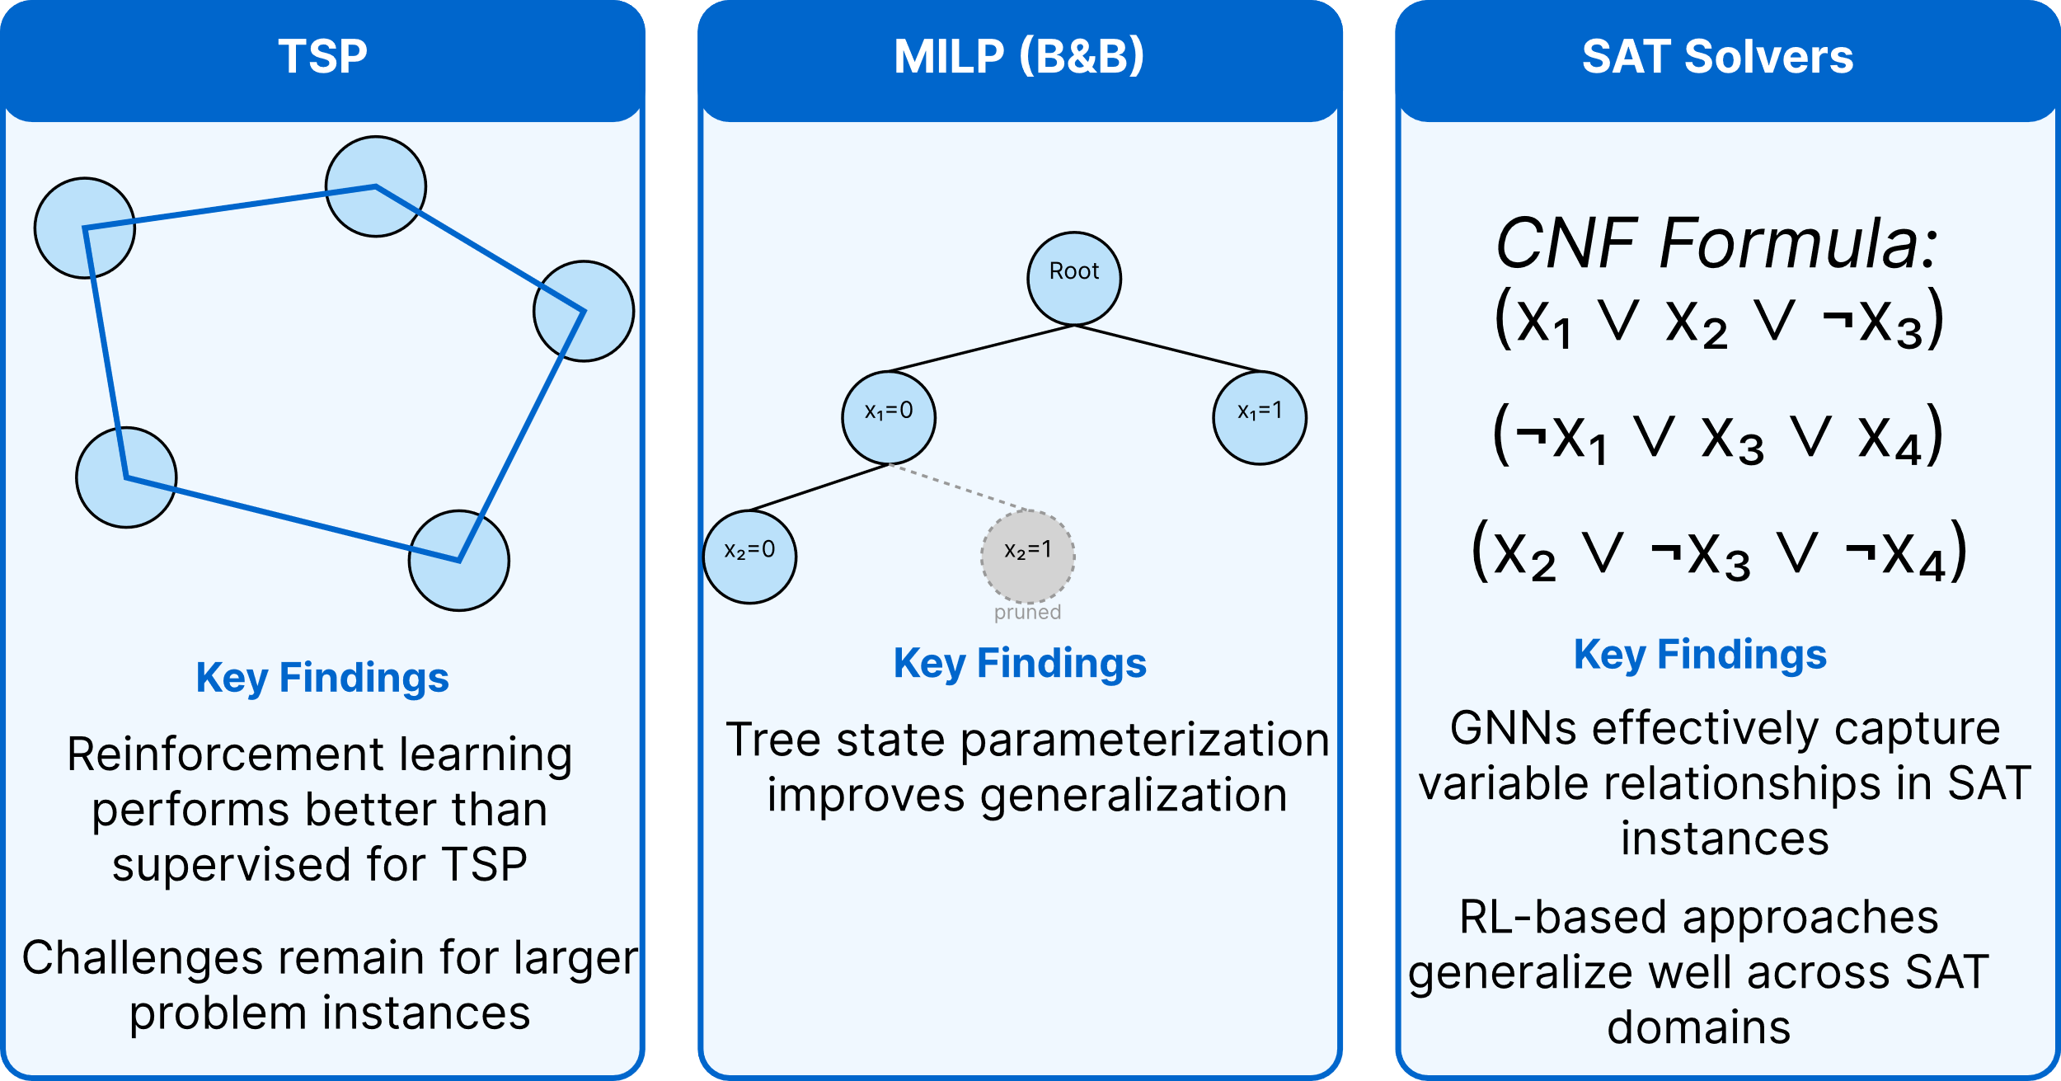
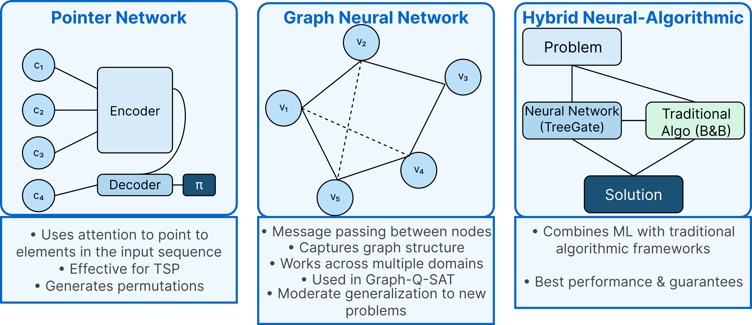
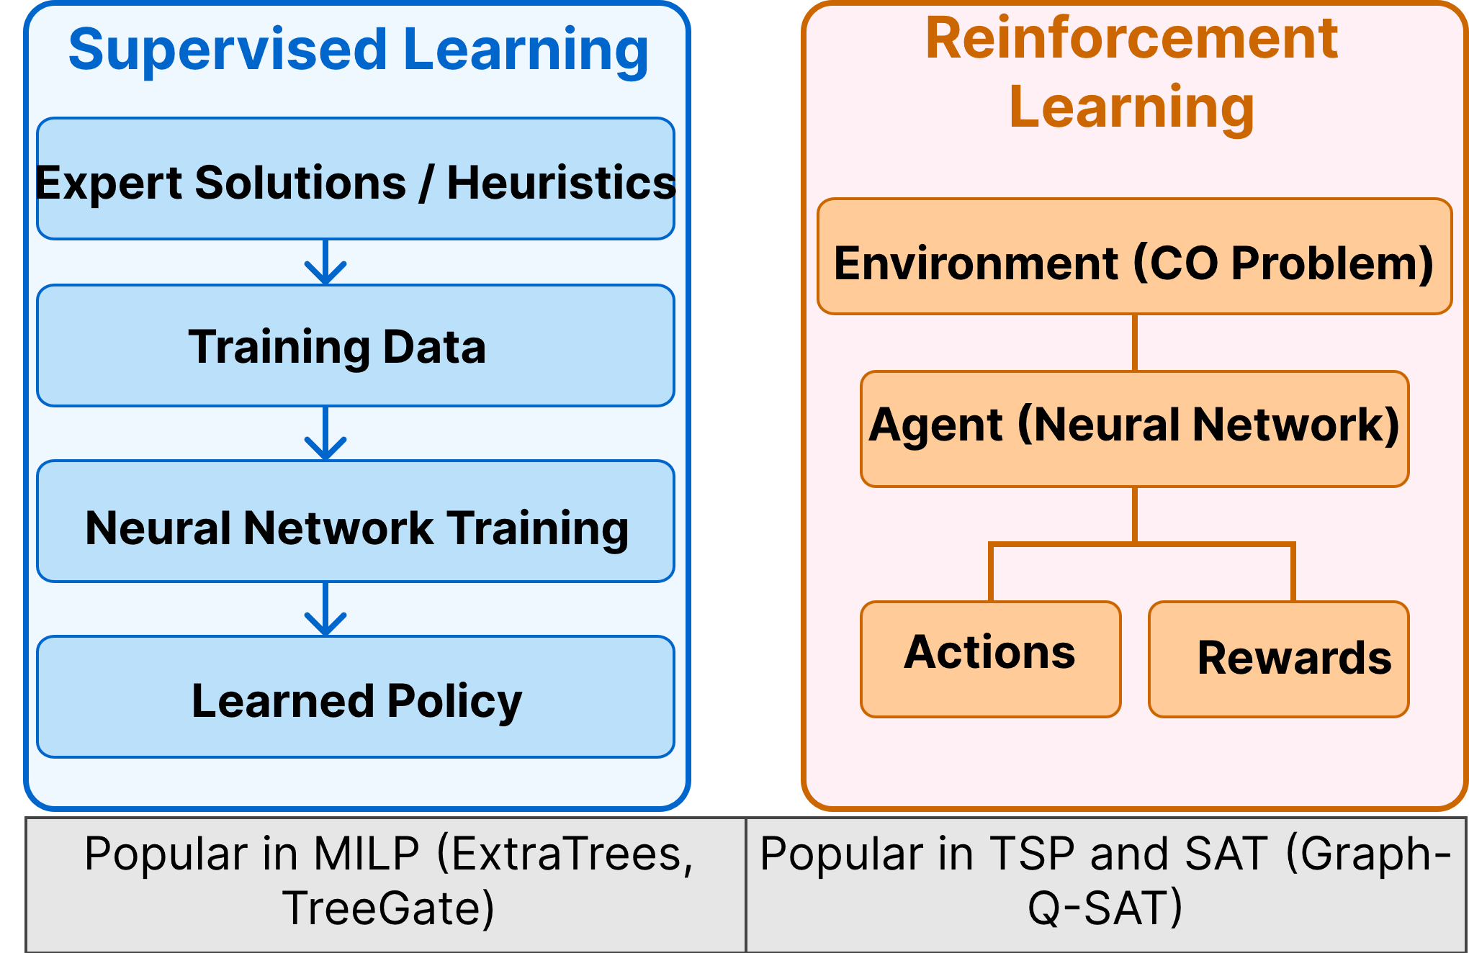
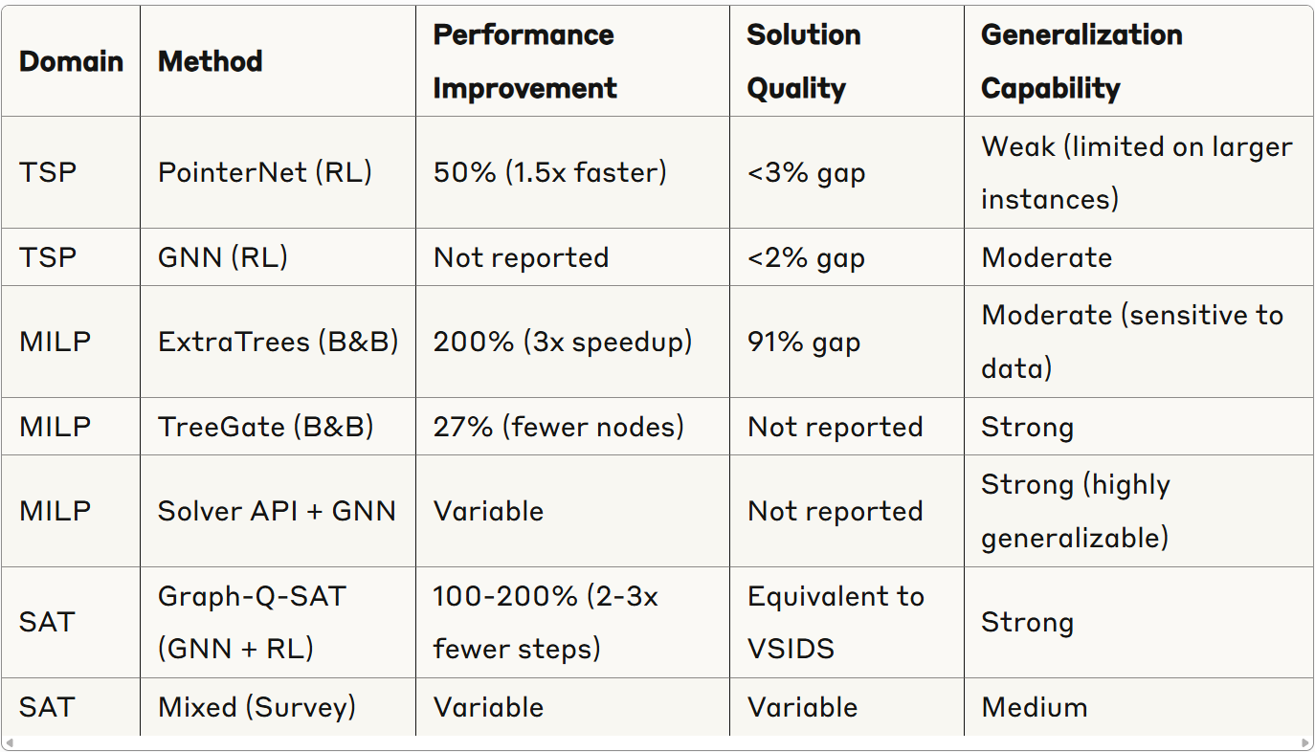
Leveraging Machine Learning to Solve Combinatorial Optimization Problems
Ahmed Guetti, Osama Baazzi
Introduction
Domain-Specific Findings: ML for Combinatorial Optimization
Neural Network Architectures for Combinatorial Optimization
Learning Strategies: Supervised vs. Reinforcement
Performance Comparison
Future Research Directions
TSP: Pointer Networks show moderate speedup with RL training; GNNs achieve near-optimal solutions
MILP: ExtraTrees offers best speedup; TreeGate reduces B&B nodes explored; Hybrid methods balance quality and speed
SAT: Graph-Q-SAT significantly reduces solving time; End-to-end approaches show feasibility but less performance
Efficient Neural Architectures:
Specialized GNN architectures
Attention mechanisms for CO
Memory-efficient designs
Neural architecture search
Transfer Learning:
Cross-domain knowledge transfer
Few-shot learning for new problems
Size-agnostic model training
Meta-learning approaches
Hybrid Learning Strategies:
Combining SL and RL approaches
Curriculum learning for CO
Self-supervised pretraining
Multi-task learning strategies
Solver Integration Challenges:
Efficient CPU-GPU communication
Integration with commercial solvers
Real-time decision support systems
API standardization
Benchmarks & Evaluation:
Diverse problem instance libraries
Standardized evaluation metrics
Cross-architecture comparison tools
Reproducibility frameworks
Hybrid neural-algorithmic approaches show the most promise,
Balancing solution quality, computational efficiency, and generalization

