Slide 1

Amazon Sales Data Analysis
Insights and Recommendations
Ahmed Hesham Taalab
ahmedtaalab05@gmail.com

Slide 2
Introduction
Objective:
- Examine and gain insights from Amazon sales data.
- Understand sales trends, distribution of quantities, performance by country, and fulfillment methods.
- Provide actionable recommendations to improve sales strategies and operational efficiency.
Dataset Description:
- Source: Amazon sales data
- Number of Records: 128,977
- Columns: Order ID, Date, Status, Fulfilment, Sales Channel, ship-service-level, Style, SKU, Category, Size, ASIN, Courier Status, Qty, currency, Amount, ship-city, ship-state, ship-postal-code, ship-country, B2B, Month

Slide 3
Data Cleaning
Initial Data State:
- Overview of missing values and data types
Steps Taken:
- Dropped non-essential columns
- Filled missing values using mode for categorical and median for numerical columns
- Converted date columns to datetime format
- Removed duplicate records
- Corrected data types

Slide 4
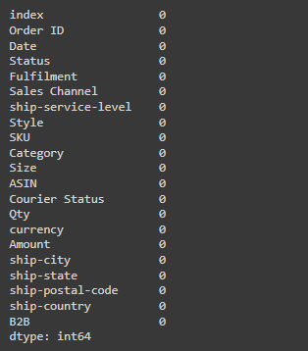
Data Cleaning (continued)
- Cleaned dataset ready for analysis
- Ensured integrity and consistency of data

Slide 5
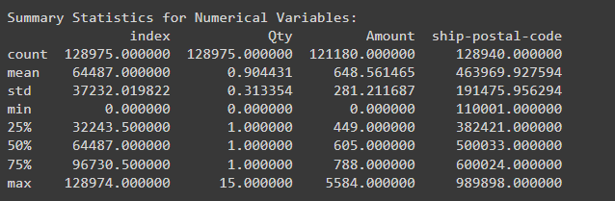
Exploratory Data Analysis (EDA)
- Summary statistics for numerical and categorical variables

Slide 6
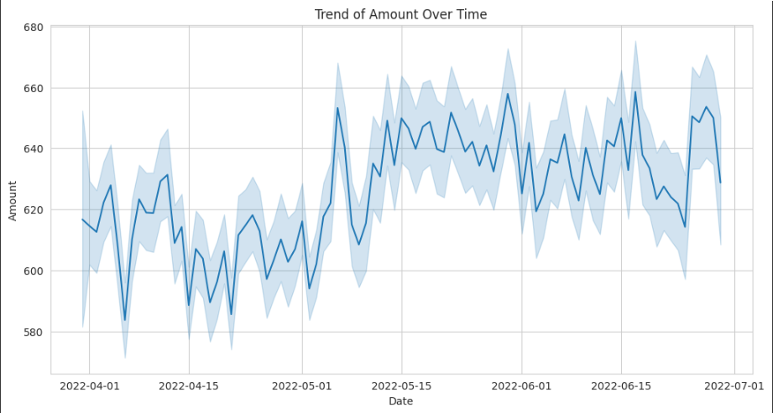
Key Visualizations
- Line chart showing Trend of amount over time.

Slide 7
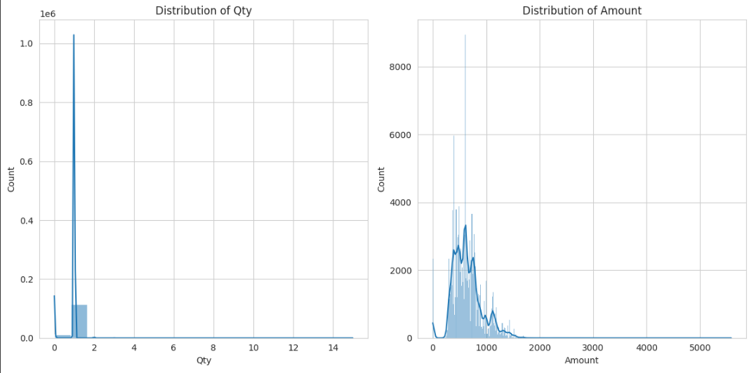
Key Visualizations (continued)
Quantity Distribution:
Amount Distribution:
- Diagrams showing the distribution of quantities and Amount

Slide 8
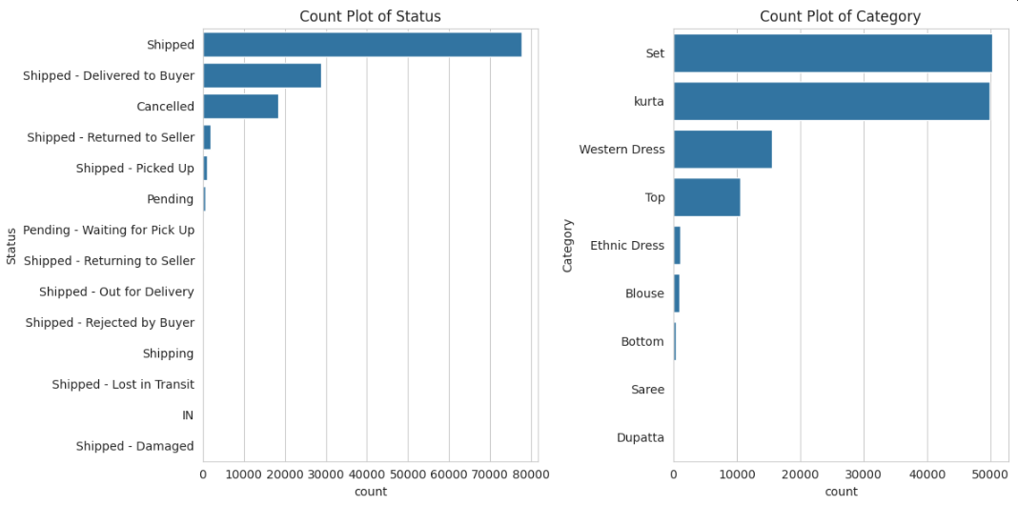
Key Visualizations (continued)
Count Plot of Status and Count Plot of Category
- Bar chart showing Count of Status and Category

Slide 9
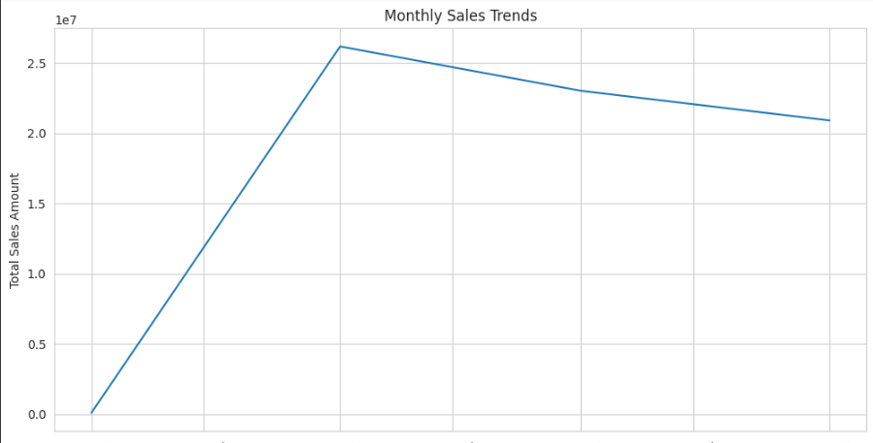
Key Visualizations (continued)
Monthly Sales Trend:

Slide 10
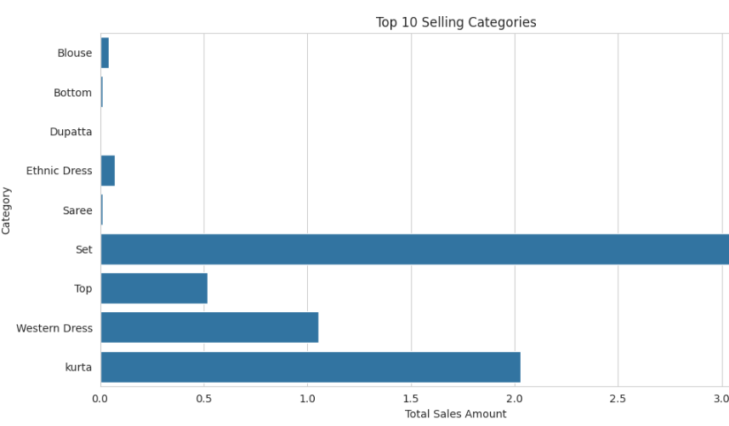
Additional Visualizations
Top 10 Selling Categories

Slide 11
Additional Visualizations (continued)
Top Selling Products

Slide 12
Conclusion
Key Findings:
- Majority of orders fulfilled by Amazon
- Most common shipping service level is Expedited
- Strong seasonality in sales with peaks during certain times
- Electronics and Clothing are top categories
- Sales predominantly through Amazon.in

Slide 13
Recommendations
Marketing Strategies:
- Enhance efforts around peak sales periods
Operational Improvements:
- Focus on fulfillment processes for high-order categories
Sales Channel Diversification:
- Reduce dependency on Amazon.in

Slide 14
Future Work
Further Analysis:
- Incorporate customer demographics and reviews for deeper insights
- Detailed analysis of promotion impacts on sales

Slide 15

Q&A
Discussion:
- Open the floor for questions and discussions

