Slide 1
M-T-M,CRUD
Explain the realation and show Crud operation in this realation

Slide 2
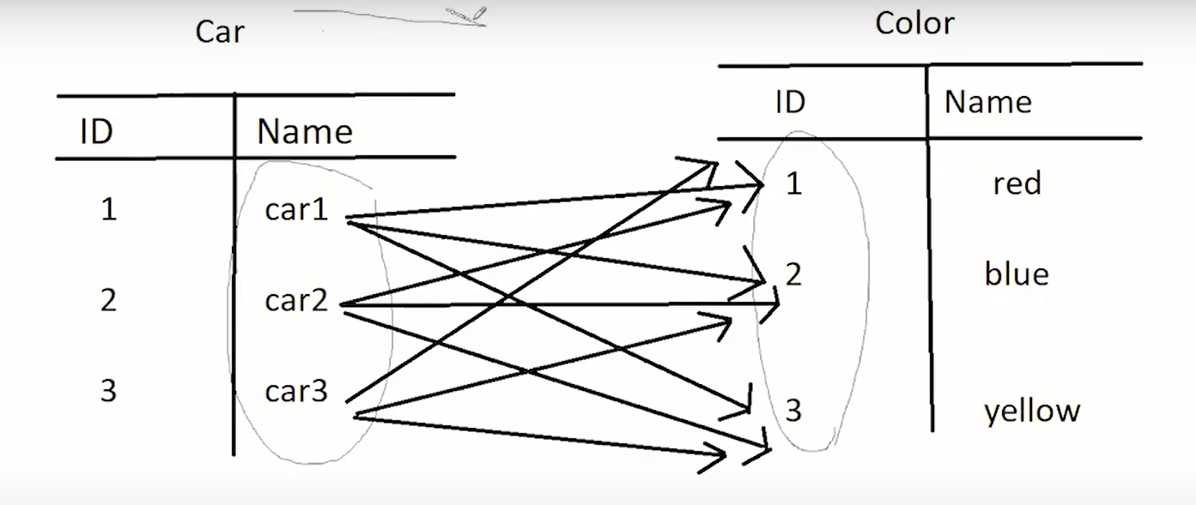
Car to color is many to many realation

Slide 3
Creat class Car and class color
Add attribute for each class
And getter and setter for attribute
And annotation to class @Entity and @Id @GeneratedValue
This structure to creat table in data base
To make Relation
In class Car : creat List from type color and add getter and setter for List
Then add Annatation @Many to Many , @JoinTable , @JoinCoulm , @

Slide 4
IN Class Car
Many to Many(cascade=Cascade.ALL)
JoinTable(name=“” //this name for table in data base ,
joinColumns =@JoinColumn(name = "car_id") // to name id for pointer to class car ,
inverseJoinColumns = @JoinColumn(name = "color_id") // to name id for pointer to Class Color
)

Slide 5
In Class Color do same in Class Car but sample diifernet
joinColumns =@JoinColumn(name = "color_id") // to name id for pointer to class car ,
inverseJoinColumns = @JoinColumn(name = "car_id") // to name id for pointer to Class Color

Slide 6
Run
When run main after setting Configuration creat 3 tables in data base
One of them to car class
Two of them to color class
Three of them have same name join table is car_color and have two attribute is car_id ,color_id

Slide 7
CRUD
Creat operation
creat object of car and object of Color then set vaule for name attribute
Add list object of color in all car object with getList.add(object of Color)
// repact this for all object color to one object Car
save all object Car in session

Slide 8
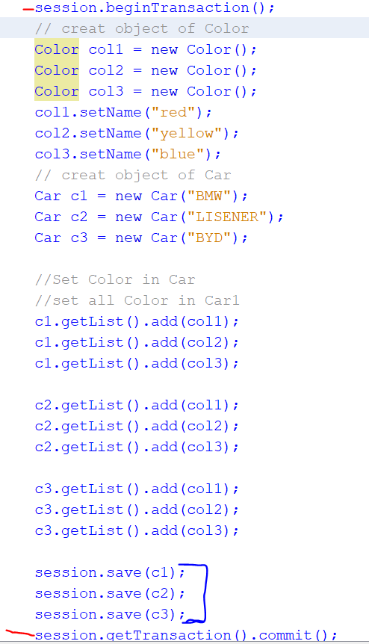
example

Slide 9
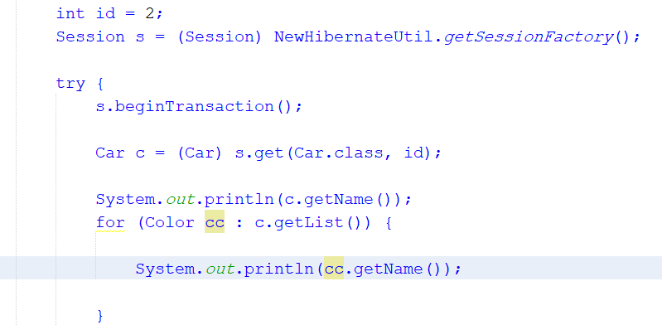
Get data
Use seesion.get to data object which store data that return from data base
After use fetch =FetchType.EAGER in class Car or Color

Slide 10
Different Lazy and Eager
FetchType.LAZY
FetchType.EAGER
If close session when get data not can get all data special other data form anthor class not called
AS not store data after session close
If close seesion when get data can get all data from any Class
AS can store any data after session close

Slide 11
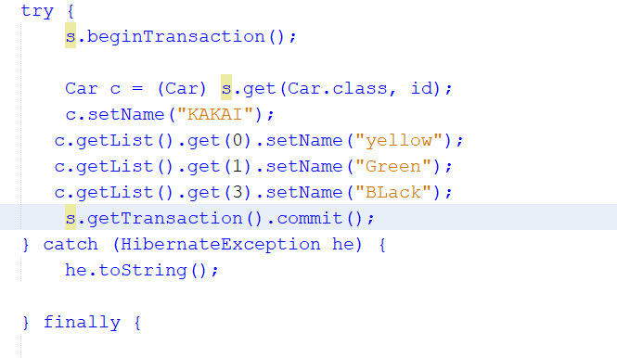
updata
Use get data function and editing data with updata function or assign new vaule with same object reurn data
NOTE
use getlist() .get().setName()
Instead of creat new list with colors
And add

Slide 12
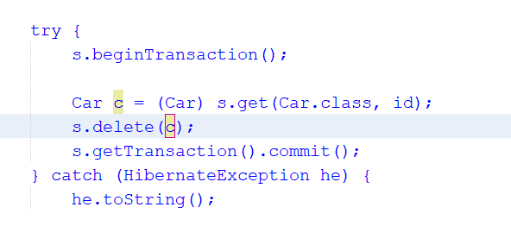
Delete
To delet data from one table get this data by object and use session.delete() pass the object
This code delete all data in three table As CascadeType.All in two class
This means if delet any element in table delete another table

Slide 13
To solve this problem
Change CascadeType to all vaule with out all and Rewove in two class
@ManyToMany(cascade ={ CascadeType.DETACH,CascadeType.MERGE,CascadeType.PERSIST,CascadeType.REFRESH})
Not use CascadeType.ALL,CascadeType.REMOVE

