Slide 1
HCQL (Hibernate Criteria Query Language)
The Hibernate Criteria Query Language (HCQL) is used to fetch the records based on the specific criteria. The Criteria interface provides methods to apply criteria
Advantage of HCQL
The HCQL provides methods to add criteria, so it is easy for the java programmer to add criteria. The java programmer is able to add many criteria on a query

Slide 2
To use criteria
Frist creat seccion
And creat criteria and take class named
Such as
Session s = NewHibernateUtil.getSessionFactory().openSession();
s.beginTransaction();
Criteria c= s.createCriteria(Person.class);

Slide 3
Common method in Criteria
add(Criterion c) is used to add restrictions.
addOrder(Order o) specifies ordering.
setFirstResult(int firstResult) specifies the first number of record to be retreived.
setMaxResult(int totalResult) specifies the total number of records to be retreived.
public List list()

Slide 4
Restrictions in add
Restrictions.gt (name property,vaule);means geather than
Restrictions.ge (name property,vaule);means geather equal
Restrictions.lt (name property,vaule);means less than
Restrictions.le (name property,vaule);means less equal
Restrictions.ne (name property,vaule);means not equal
Restrictions.eq (name property,vaule);means equal
Restrictions.between (name property,minvaule,max vaule);means between two vaule
Restrictions. like (name property,vaule);means like

Slide 5

Restrictions. inlike (name property,vaule);means like +ignore case

Slide 6
Integer[] valus = {6250, 6666, 2};
c.setFirstResult(0);
c.setMaxResults(4);
c.add(Restrictions.isNotNull("salary"));
c.add(Restrictions.ge("salary", 1000));
c.add(Restrictions.between("salary", 1200, 122200));
c.add(Restrictions.like("name", "A", MatchMode.ANYWHERE));
c.add(Restrictions.lt("salary", 500));
c.add(Restrictions.le("salary", 500));
c.add(Restrictions.between("salary", 1200, 122200));
c.add(Restrictions.like("salary", 5555));
c.add(Restrictions.in("salary", valus));
c.add(Restrictions.isNull("name"));
c.add(Restrictions.ne("name", "Ali"));

Slide 7
Return colum with chql
Criteria c = s.createCriteria(Person.class);
c.setProjection(Projections.property("name"));
List p= c.list();
for(int i=0;i<p.size();++i){
System.out.println(p.get(i));}
With setProjection

Slide 8
The out put is value of colum name
Mostafa
Ahmed
maran
Ahmed omar
Yesamin
eslam Khader
Ahmed Shaleen
samh

Slide 9
How use logiacal operation with CHQL
creat object form Criterion and assign vaule with Restrictions
Such as
Criterion cc=Restrictions.eq("position", "junior");
2. Creat anthor criterion
Such as
Criterion c2=Restrictions.like("name", "m", MatchMode.ANYWHERE);
3 . Creat LogicalExpression use Restrictions.or ,and

Slide 10
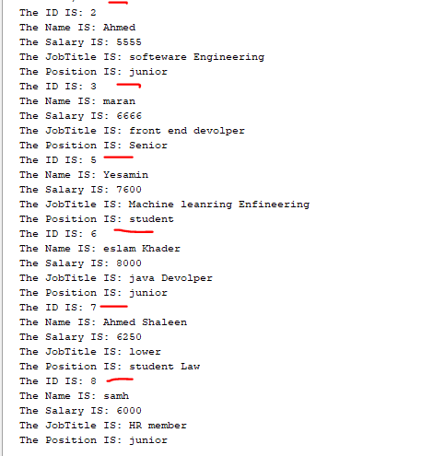
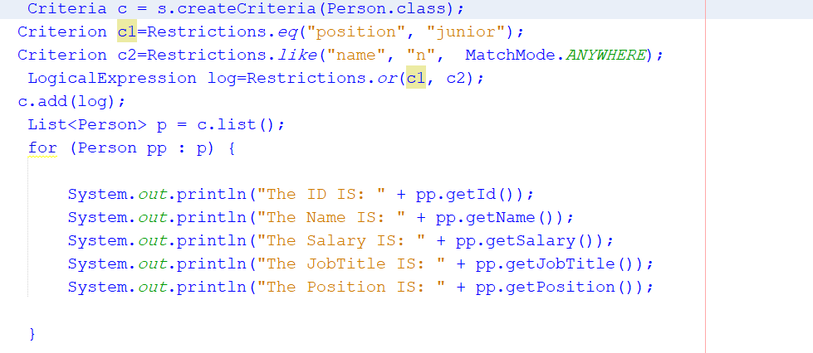

Slide 11
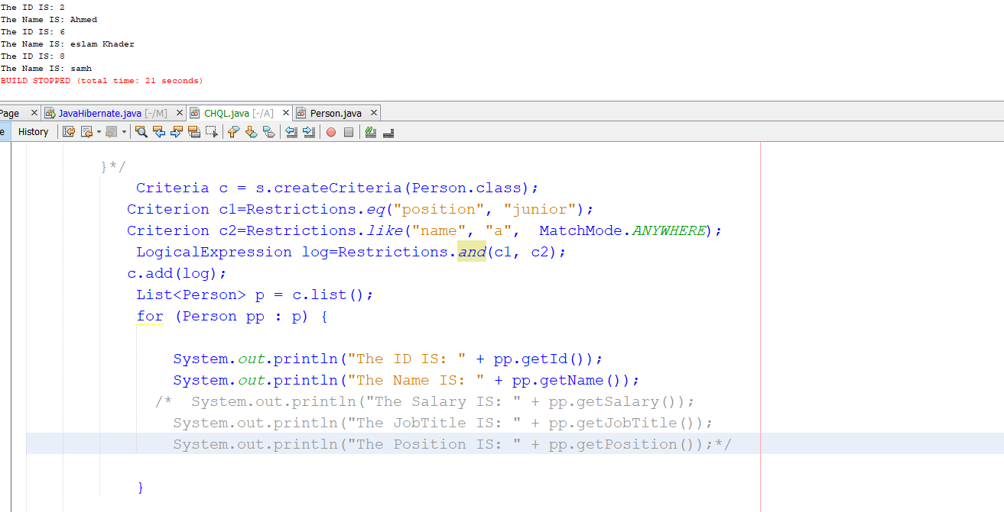
And logiacal

Slide 12
Criteria with Aggregate methods
To do Aggregate method {MIX,MIN,AVA,COUNT,SUM,…}
Frist creat Criteria and work class
setProjection(Projections.max(“”));
Such as
Criteria c1 = s.createCriteria(Person.class);
Criteria max = c1.setProjection(Projections.max("salary"));

Slide 13
