Slide 1
Employee Attrition Analysis
IBM Dataset

Slide 2
Agenda
PROJECT OVERVIEW
DATA MODELING
KEY INSIGHTS
RECOMENDATIONS

Slide 3
PROJECT OVERVIEW
The purpose of this analysis is to comprehensively understand the factors contributing to employee attrition within our organization. By leveraging advanced data analytics, we aim to identify key trends and outliers, uncover the root causes of turnover, and provide actionable recommendations to enhance employee retention, improve organizational stability, and optimize overall workforce satisfaction
Dataset : https://www.kaggle.com/pavansubhasht/ibm-hr-analytics-attrition-dataset

Slide 4
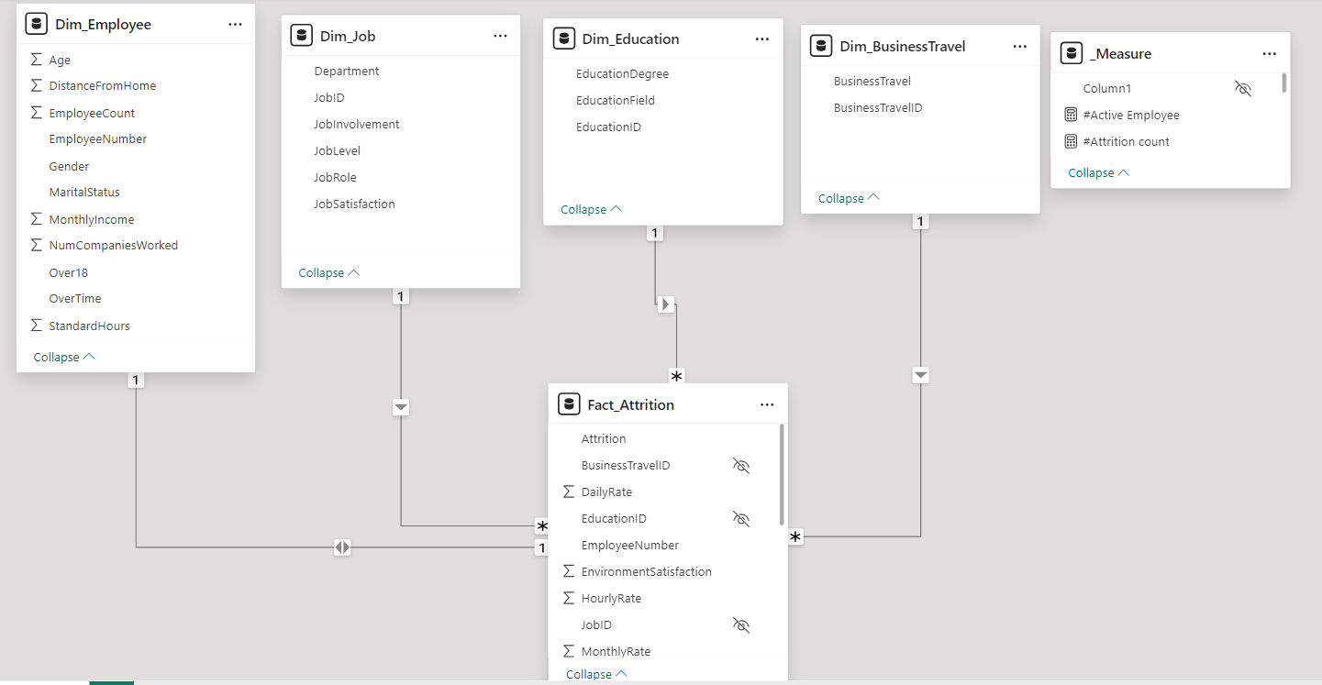
DATA MODELING

Slide 5
KEY INSIGHTS
The Sales department exhibits the highest attrition rate at 28%, followed by the Research & Development department at 15%. This suggests potential issues specific to these departments that need to be investigated and addressed to reduce turnover.
Male employees experienced an attrition rate of 17%, while Female employees had a slightly lower attrition rate of 14.8%.
Employees who leave the company tend to have lower monthly incomes compared to those who stay. This insight suggests that salary and compensation could be significant factors influencing employee decisions to leave.

Slide 6
KEY INSIGHTS
The company's overall attrition rate is 16%, which indicates that a large percentage of the workforce leaves the company annually. This requires new strategies to retain employees and consequently maintain the stability of the system.
Employees who Take longer distances to their homes show higher rates of burnout. This suggests that commuting challenges may be an important factor in maintaining employee energy, suggesting the need for mobility support, assistance in reducing work hours, or a strategy that contributes to employee comfort.

Slide 7
KEY INSIGHTS
The educational background of the employees who left the company indicates that 89 individuals have a background in life sciences, 63 have a medical background, and 35 have a background in marketing. This indicates that there is a group of important cadres whose effort is decreasing, which negatively affects the company and its productivity.
Low levels of environmental satisfaction lead to poor work-life balance, which results in high attrition rates. This insight emphasizes the importance of promoting a healthy work-life balance to improve employee retention and satisfaction.

Slide 8
RECOMENDATIONS
Targeted programs can help mitigate press and problem of High attrition is notably observed in specific departments and among younger employees.
The salary ceiling and the tasks allowed should be balanced, leading to stability and employee satisfaction, without them feeling any emerging discrimination and lack of appreciation for the effort made.
Work to support transportation, help reduce working hours, or follow a strategy that contributes to employee comfort.
Working to improve levels of environmental satisfaction and good health care will contribute to improving the job role of employees and consequently increasing the company’s productivity.

