Slide 1
Car Classification Using Deep Learning
A brief overview of the project.

Slide 2
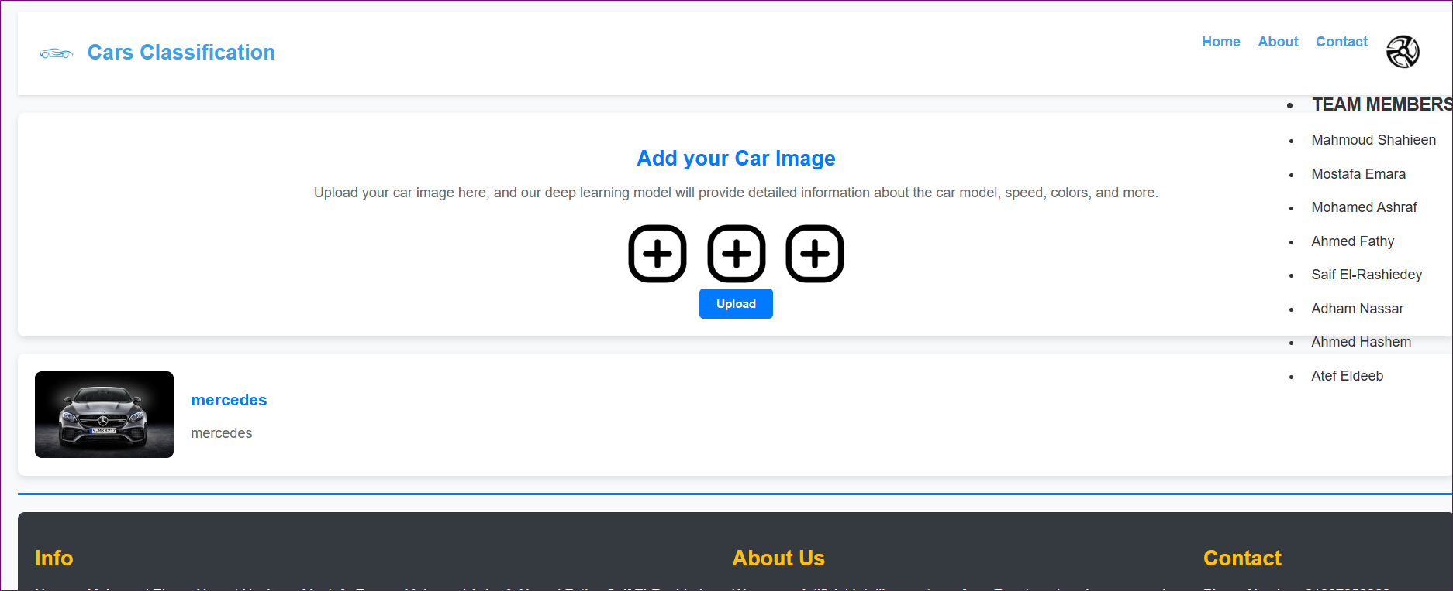

Slide 3
Project Goals
- Main Idea: A web application to classify car images using deep learning.
- Goals:
- Classify cars based on uploaded images.
- Use a pre-trained ResNet50 model.
- Provide a simple and user-friendly interface.

Slide 4
Technologies Used
Frontend:
- HTML5
- CSS3
- JavaScript
Backend:
- Python
- Flask
Machine Learning:
- PyTorch
- Pre-trained ResNet50 model.

Slide 5
Project Structure
deep-learning-project/
├── app.py
├── utils.py
├── static/│
├── js/│
│ └── deepcars.js
├── css/│
└── imgs/
# Static images├── templates/│ └── deepCars.html # Main HTML template├── requirements.txt # List of dependencies└── models/
# Saved model weights├── train_model.py # Model training script (optional)

Slide 6
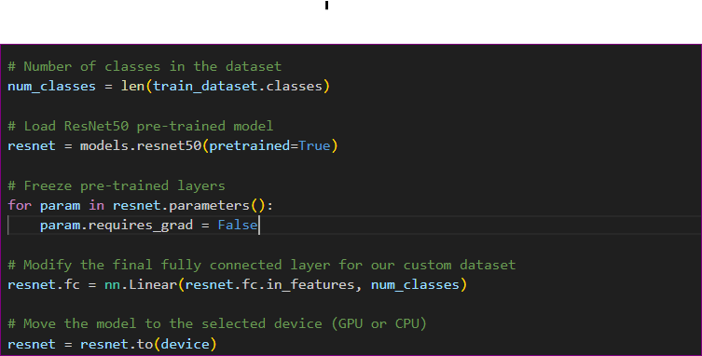
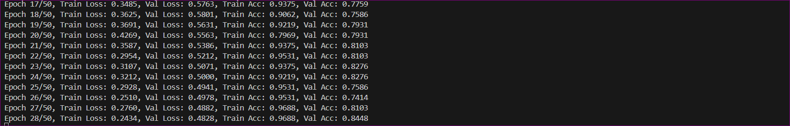
Model Training
ResNet50 Model:
- Utilized a pre-trained ResNet50 model with the final layer adjusted for car classes.
- Frozen pretrained layers, training only the last layer.

Slide 7
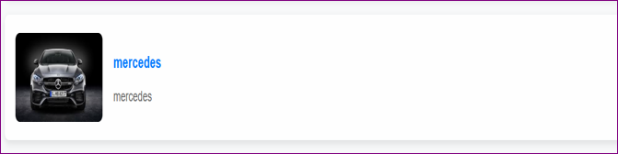
Key Features
- Image Upload: Allows users to upload or drag-and-drop car images.
- Prediction: Classifies the car based on the uploaded image.
- Results Display: Shows the predicted class.

Slide 8
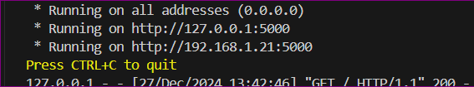
App Usage
How to Run:
1. Download the project.
2. Extract Zip File
3. Open VS in project Folder
4. After Install Libraries (torch, PIL, flask, werkzeug) :
Run the application using:
python app.py
and wait epoch 50/50
5. Open the browser and go to http://localhost:5000.

Slide 9
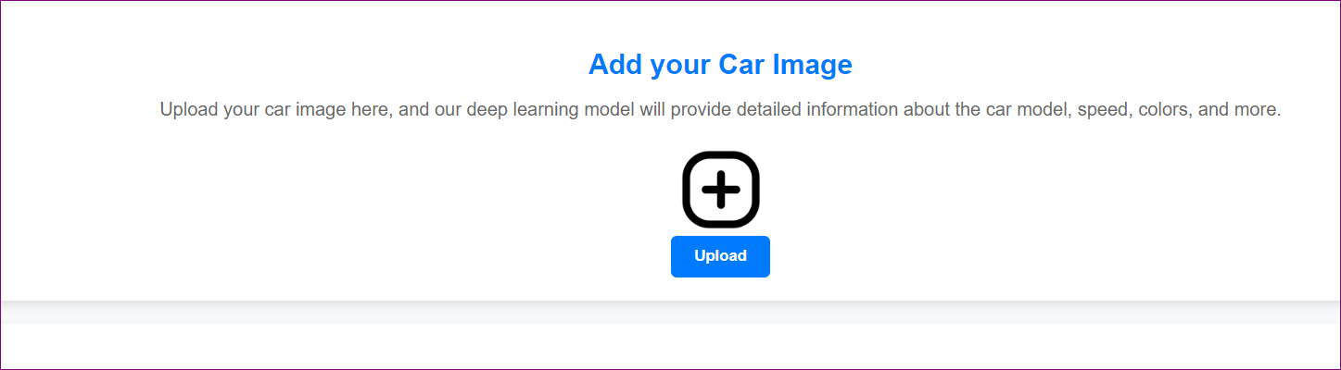
App Interaction
Steps to Use:
1. Open the app in the browser.
2. Upload or drag a car image.
3. Wait for the model to classify the image.

Slide 10
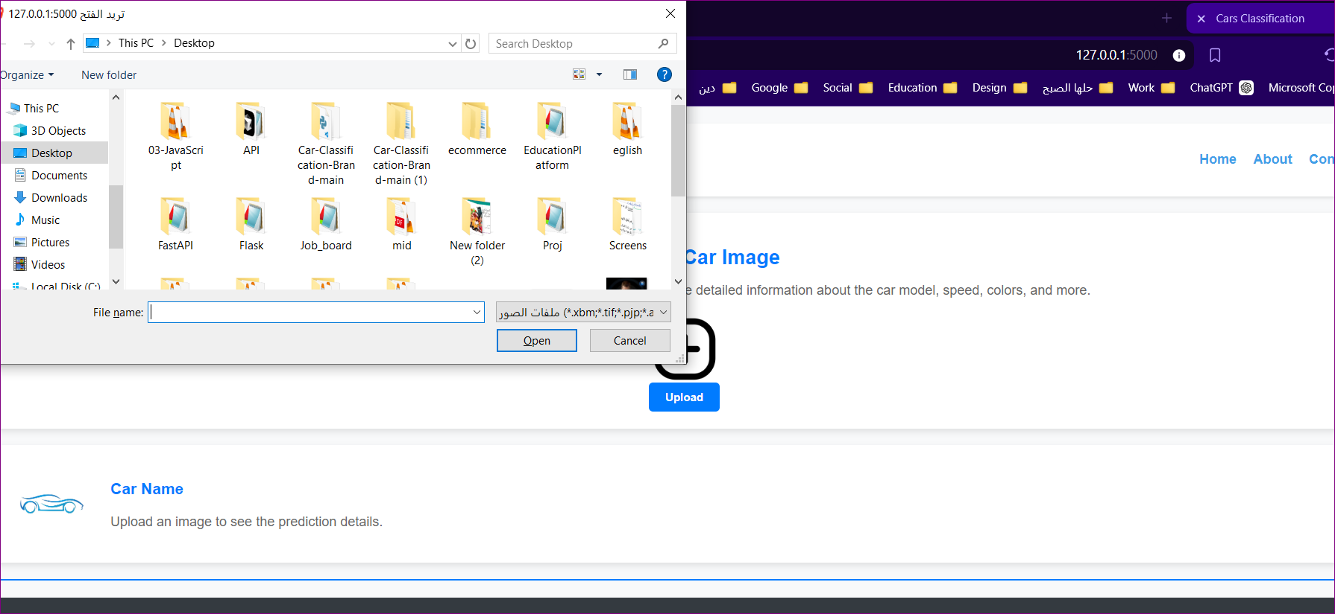

Slide 11
Challenges and Solutions
Challenges:
- Improving model accuracy.
- Handling a large dataset.
Solutions:
- Used a pre-trained ResNet50 model to improve accuracy.
- Added data augmentation techniques to boost performance.

Slide 12
Future Enhancements
Future Work:
- Add support for multiple car types.
- Enhance user interface and experience.
- Integrate additional techniques for classification improvement.

Slide 13
Conclusion
Thank You

