Slide 1


COMAEA / UETMT HCM Software in the Cloud Competency-based Human Capital Management
2013
Presented By
Ayman A. Meneassy
Vice President - UETMT

Slide 2
Online Human Capital Management Software, In the Cloud
Comaea /UETMTsolutions for Competency-based Human Capital Management make industries and companies effectively manage the Competency, Capability and Capacity of their people.
Our customers include companies from a range of industries. Comaea offices and partners are today located in Sweden, Netherlands United Arab Emirates and Singapore.
Attract
Develop
Assign
Retain

Slide 3

COMAEA / UETMT HCM* Software
HRM Administrative
HCM Strategic
Interface HR-systems
Competency
management
Performance management
Resource management
Certificate
Management
CV/Portfolio management
Recruitment
Analysis, Rating & KPI
COMAEA / UETMT UNIVERSE
Human Resource Management (Administrative)
Human Capital Management (Strategic)
Administrative HRM; administrative aspects includes salary & payroll, benefits, legislation, organisation etc.
Strategic HCM; Competency assessment, analysis and
development, strategic change of human capital, performance management, resource utilization, talent management and succession planning etc.
*) HCM = Human Capital Management, is a set of practices related to people resource management.
These practices are focused on the organizational need to provide specific competencies and are implemented in three categories: workforce acquisition, workforce management and workforce optimization. [Gartner Group]

Slide 4
HCM: Defined
HUMAN CAPITAL MANAGEMENT
TALENT MANAGEMENT
Competency-based HCM
Competency Assessment & Analysis
Training & development
Resource Utilization
Recruitment
Succession Planning
Analysis, Ratings & KPIs
Performance Management
Certifications
*) HCM = Human Capital Management, is a set of practices related to people resource management.
These practices are focused on the organizational need to provide specific competencies and are implemented in three categories: workforce acquisition, workforce management and workforce optimization. [Gartner Group]

Slide 5
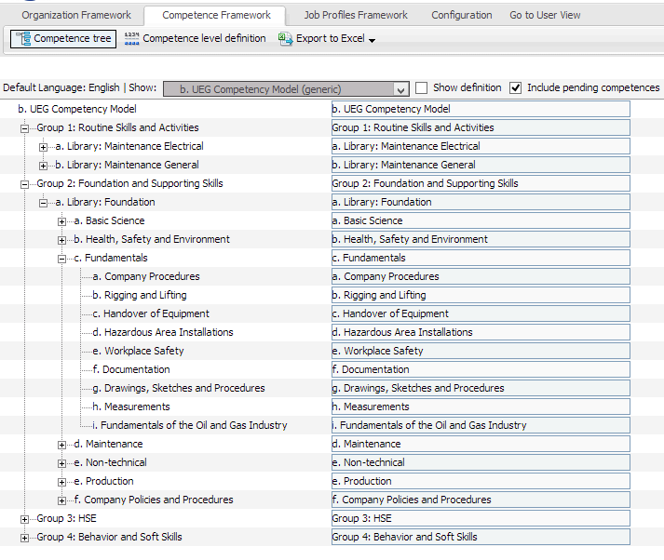
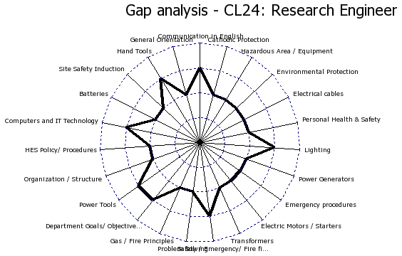
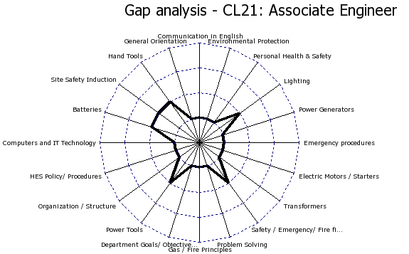
Competency Model / Framework
Competency modelling includes work on underlying competency framework, related job roles and proficiency levels. Model and the related framework is structured in COMAEA / UETMT HCM, can be exported to Excel and accessed by members of the competency modelling team.

Slide 6
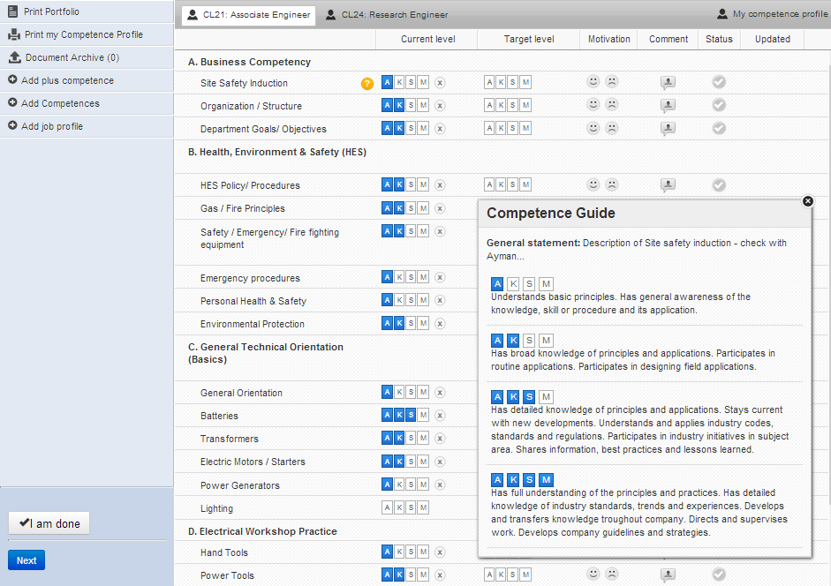
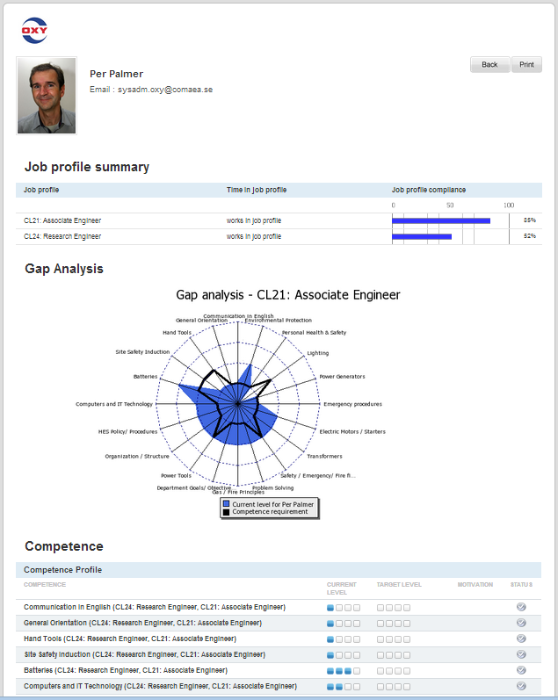
Competency Assessment
Once Competency Model is finalized and validated it is ready to use for assessment, collecting data for next step analysis reporting on management, line managers and individual’s level.
Competency assessment is done through a combination of self-assessment, managers assessment and ferificaton/validation. Competence guide ensures competencies are assessed based on correct information
Portfolio, can be generated for each all employees and is a complete summary of information telated to the competency assessment, gap analysi, Individual Development plans (IDP’s) etc.

Slide 7
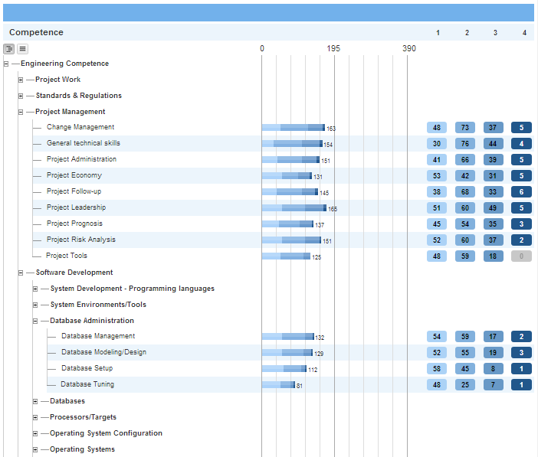
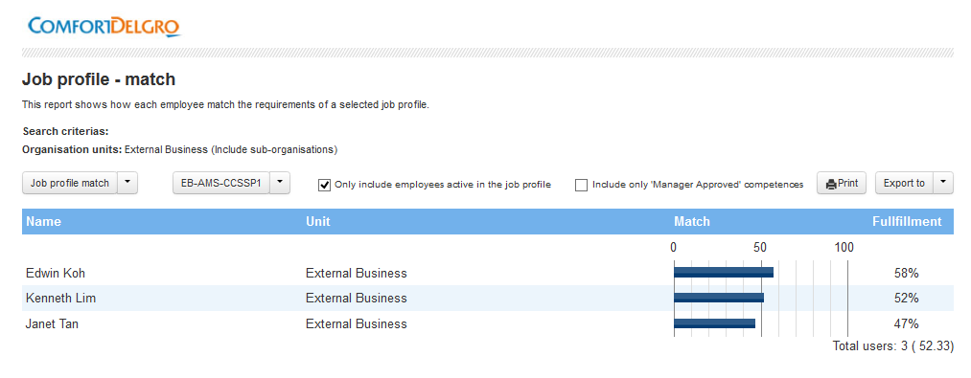
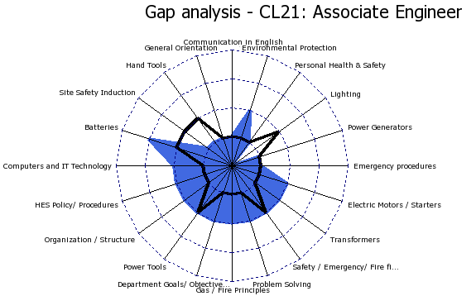
Analysis and Reporting
Reporting and gap analysis is based on verfied or pending assessments and COMAEA / UETMT HCM currently have 15+ reports for analysis, advanced search and filter function to support the gap analyusis on all levels of the organisation.

Slide 8
Advanced Reporting & KPI’s
Specific need on the reporting, customized and semi-customized reports can be handled. The design of such reports are often an essential part of the initial design of the competency programme / initiative. The purpose is to facilitate and monitor specific and relevant KPI’s related to competency of individuals, departments and the entire organisation.

Slide 9
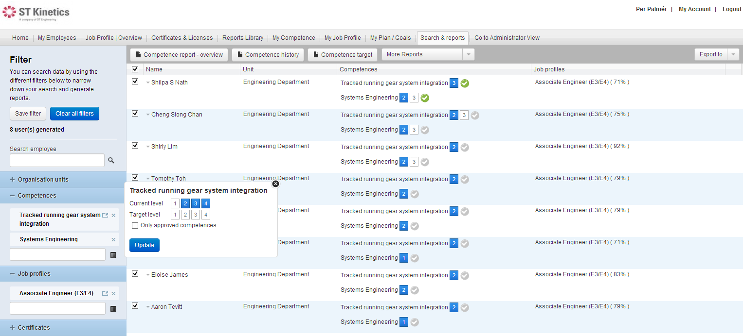
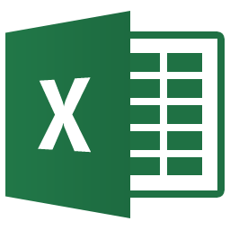
Finding people
Finding the right people can driven by a need to engage and assign people to work tasks, or as part of internal recruitment process. But it is most often used to find the people who need developement. In COMAEA / UETMT HCM you handle both in the very advanced, yet extremly easy-to-use, Search/filter function.
People found can be exported to Excel for further processing and analysis if needed.

Slide 10
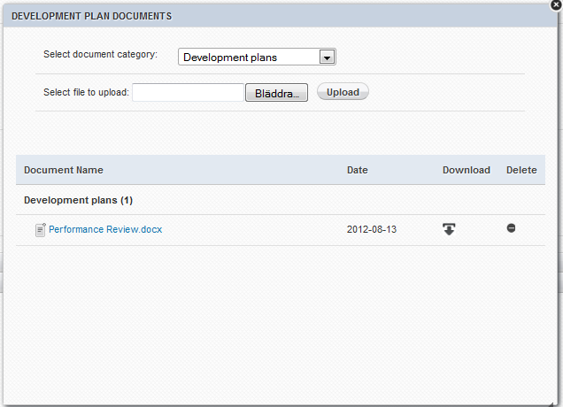
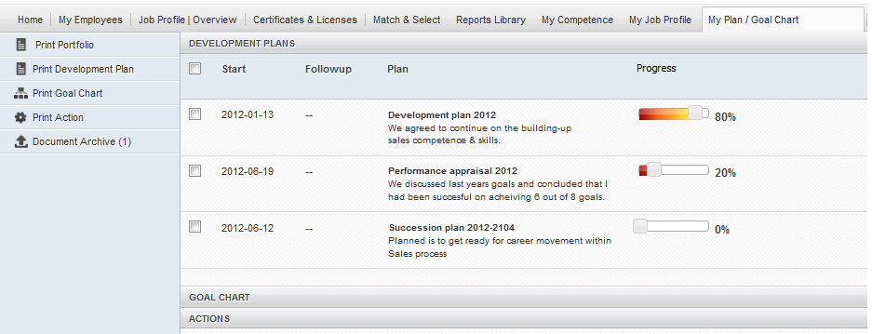
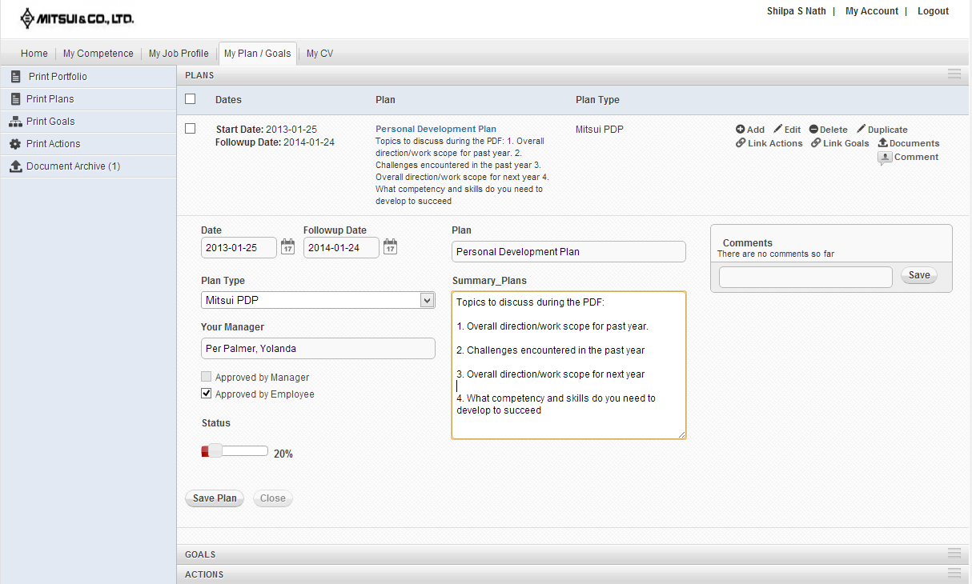
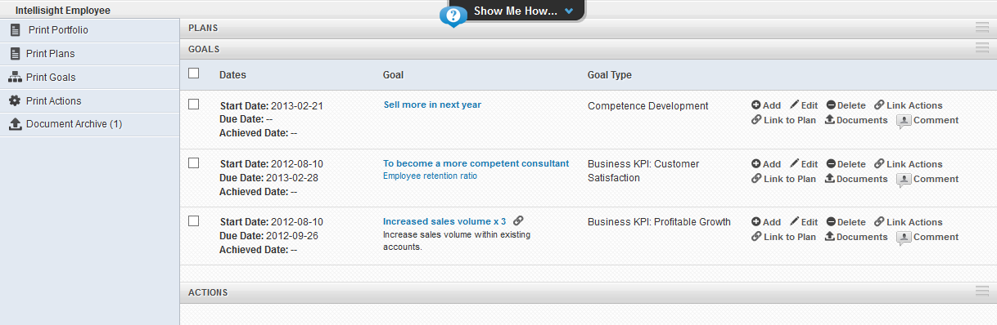
IDP, Career & Succession Plans
In designing a sustainable Performannce Management System (PMS) some key components like Individual Development Plans, Succession Plans, Cascading of goals etc. In COMAEA / UETMT HCM you design templates and align these to the PMS of the company.

Slide 11
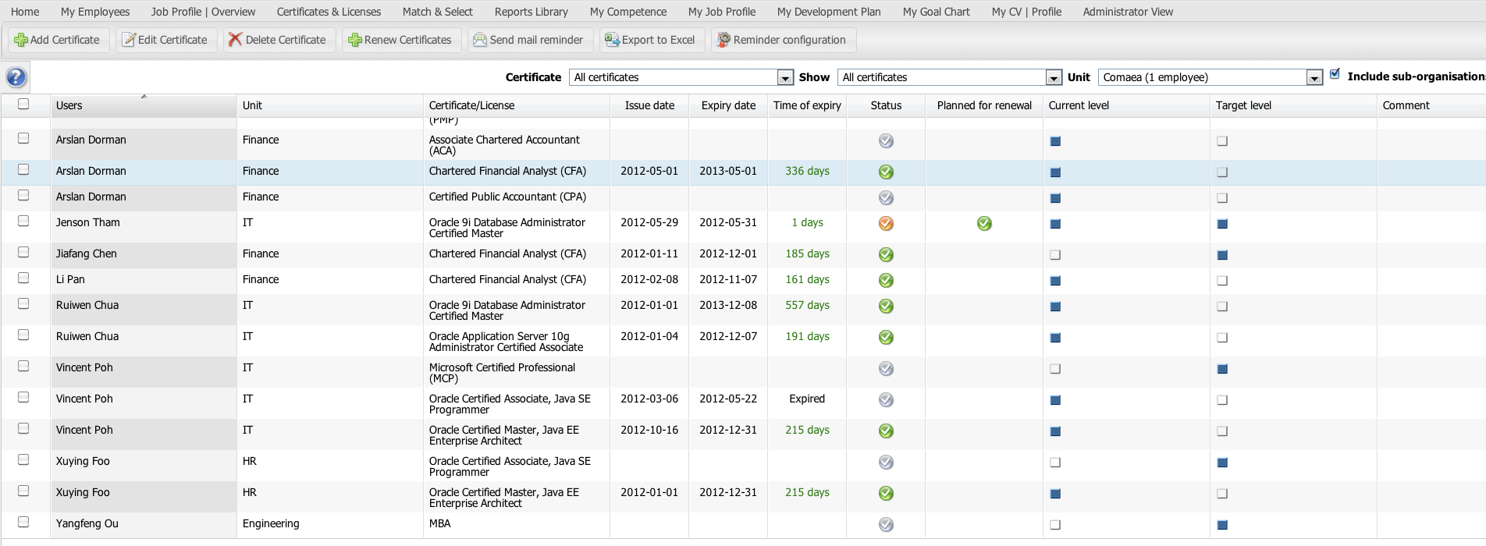
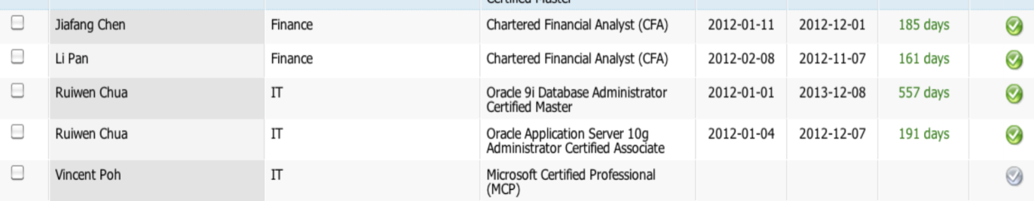
Certification. Accreditation
Certifications and accreditation is supported and COMAEA / UETMT HCM monitor this and notifies/reminds the certificates holders, managers and admnisistrators before a certificate for an employee expires.
© COMAEA / UETMT. 2012 Confidential. All rights reserved.

Slide 12
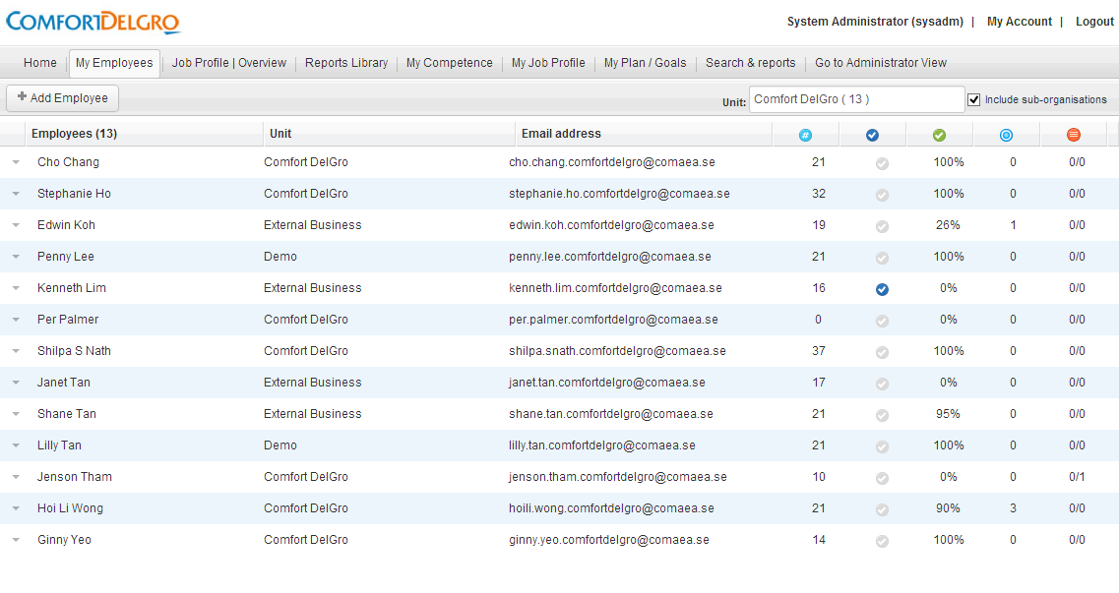
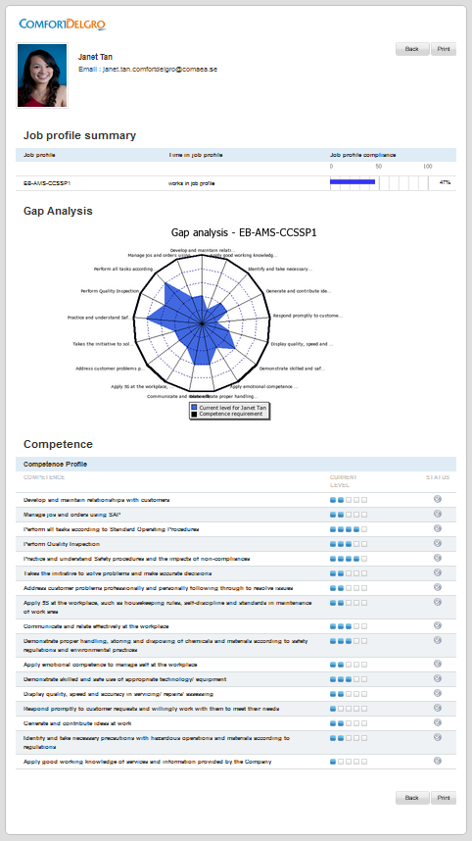
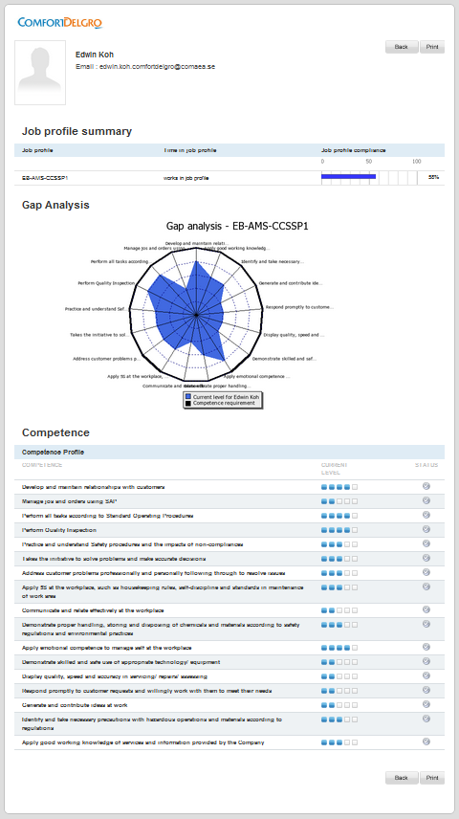

Managers overview
Managers and HR can easily overview and access the information of the employees, and based on role utilise the system for different purposes; competence devlopment, recruiting, sourcing of competency etc.

Slide 13
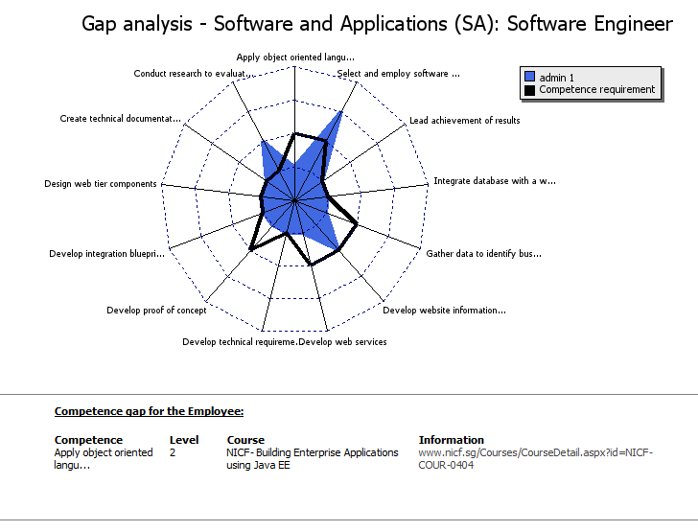
Gap analysis and Train
Linking up actions to close competency gaps is an essential and important feature, which gives managers and administrator possibility to find recommended training and courses for certain competency.
When Competency gap analysis report is generated, trainings that have been associated with specific competences can be pulled out.
This ties together trainings with related competence gaps of an individual.
Reports generated for Managers/HR team will allow for strategic planning of training for teams and organisation.

Slide 14
Plan & Develop

Slide 15
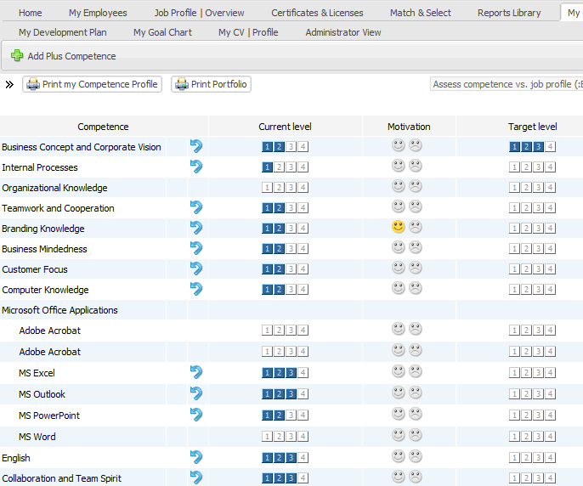
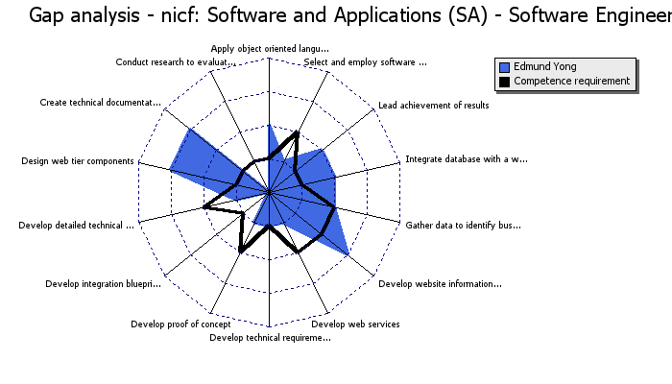
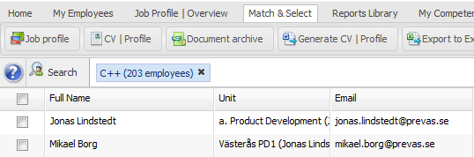

Industry Expertise
The team behind COMAEA / UETMT has experience from early 1990 and includes leadning experts in Competency Management, Competency modelling, Methodology and systems development.
Scalability – you can easily increase number of users (employees, managers etc.)
Flexibility - you can easily add-on modules as your needs increase i.e. Team profiles/targets, Performance appraisal, Documents etc.
Adaptability – Using our ready-to-use ”Competence & Roles Framework” you save time in defining your own competence framework.
Security – high data and information security (SSL, encryption, VPN & back-up)
Interoperability – data exchange and integration with ERP and PA/HR-systems
Multi-language support for use in multi-national companies
COMAEA / UETMT is developed by the leading experts within Strategic Competence Management
Compliant with standards ”Competence Management system” (SS 624070)

Slide 16
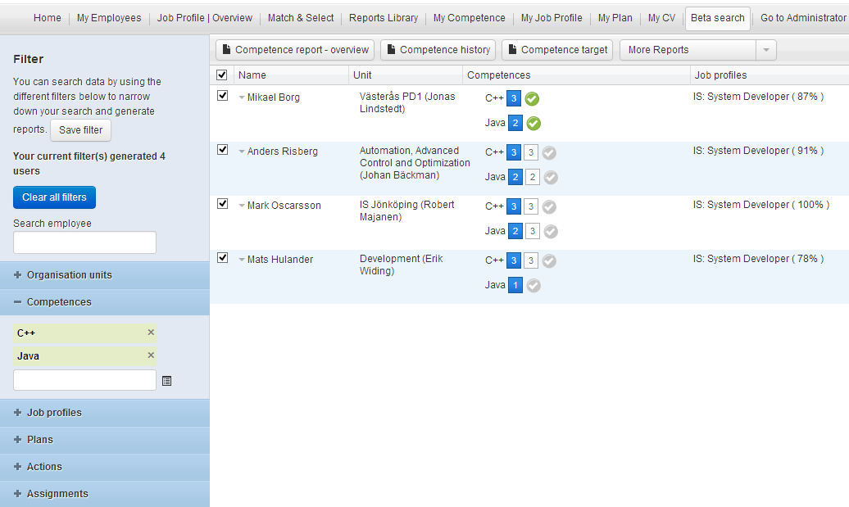
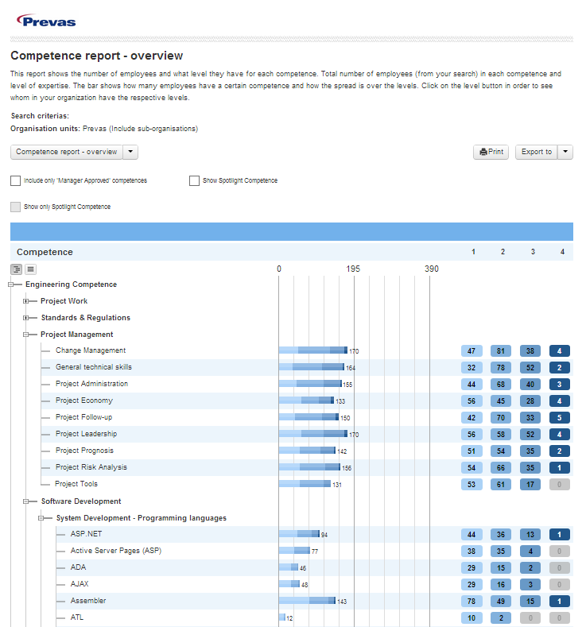

Future Proof
Taking a competency-based approach to talent development and Human Capital Management, the outcome can be integrated in core business processes and management initiatives.
Resource Management Project planning and resource management where it is possible to search and select staff for projects and assignments based on competency and assignments. This also includes time reporting and monitoring of staff utilization.
Recruitment Competency requirement profiles are used for clarity in recruiting process to facilitate screening of candidates and prepare new employees for on-boarding. By using COMAEA / UETMT it is possible to search/select from internal staff before initiating external recruitment.
Succession Planning Assigning selected/key talents to future job positions and setting up of succession plan including goals and actions to reach future position(s). Monitor and overview succession plan for the entire organisation.
Training and Development Linking up competency development with actions and training, including direct links where managers and users have instant access to development activities to close competency gaps on individual and team level.
Certifications Management Certifications and license management to keep track of certificates in the organisation. Certificate administrator, managers and employees are notified/reminded to minimize risk of missing out on renewal of certificate.
Integration with Legacy system Integration with master(legacy) HR-system for synchronization of staff data. By using Comaea API it is possible to exchange with applications and software within your organisation.
More information and details on the items listed above can be provided upon request.

Slide 17
Technology
COMAEA / UETMT HCM is delivered as cloud-based solution using Amazon AWS Services. This ensures high security, and accesability and the solution can be integrated to legacy system for data exchange towards HRM, and ERP systems upon request.
HR/Payroll
COMAEA / UETMT API
Customised
Protocol
ERP
Resource Planning
COMAEA / UETMT HCM Cloud Platform DATABASE & WEB SERVER
LMS
Interfaces
Organisational data
Employee data
Managerial rights
Job roles
Competence Framework
CV (work history, educational background)
Scanned documents
…
Infrastructure
Amazon AWS Service
Private Clouds
…
Free format: Excel, SPSS etc.

