Slide 1
Data Engineering: The Android App Market on Google Play

Slide 2
Targets
Relationships between:
Price
Size
Category
Rating

Slide 3
Pre-Processing
Scams & developer experiments
Data Cleaning
10.13.XX
10.20.XX
Junk Filtration
Numeric conversions

Slide 4
Categories
Exploring
Highest/ lowest shares of active apps for each category
Game, Family, Tools, Business & Medical Apps
Distribution
Average volume of rating all app categories (4.17)

Slide 5
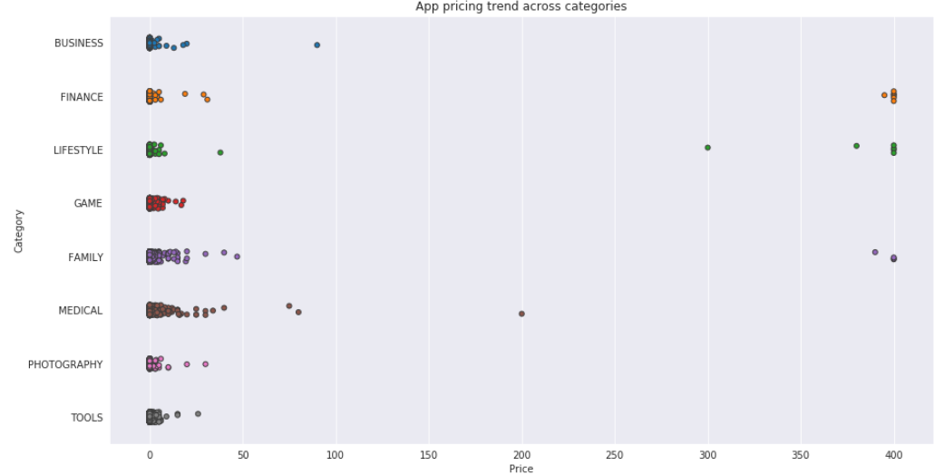
Categories - continued
Pricing

Slide 6
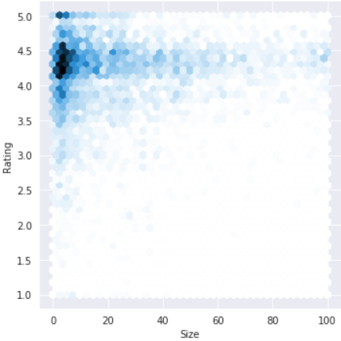
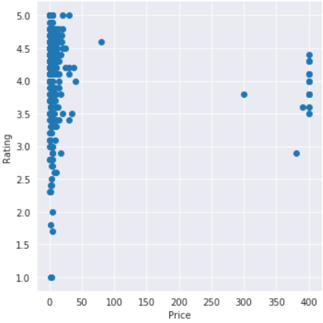
App price, size & rating relations
Paid vs. Free Apps
It turns out that paid apps have a relatively lower number of installs than free apps, though the difference is not as stark as expected!
Rating - Size
Rating - Price

Slide 7
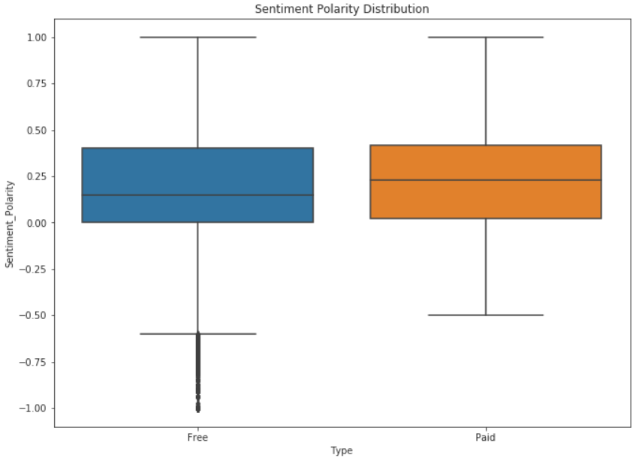
Sentiment Analysis of User Reviews

Slide 8
Thank you!
Any Questions?

