Slide 1
Machine learning project 2
Our goal is to detect fraudulent Medicare providers using real claims data
Written by: Ahmed Haytham, Anthony Shady, Amir Bassem, Yassin Amr

Slide 2
Dataset Overview
4 datasets: Beneficiary, Inpatient Claims, Outpatient Claims, Fraud Labels
558K+ claims linked to 5,410 providers
138K+ beneficiaries across inpatient & outpatient data
Providers labeled as Fraud / Not Fraud

Slide 3
Data Challenges
High missing rates in diagnosis & procedure codes (>80%)
Missing or incomplete physician identifiers
Inconsistent date fields (admission, discharge, death dates)
Strategy used: Remove unusable columns, create presence indicators, clean date fields

Slide 4
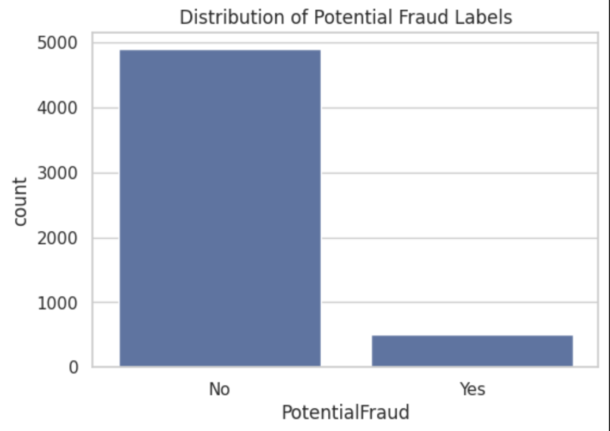
EDA: Class Distribution
Fraudulent providers = ~9%

Slide 5
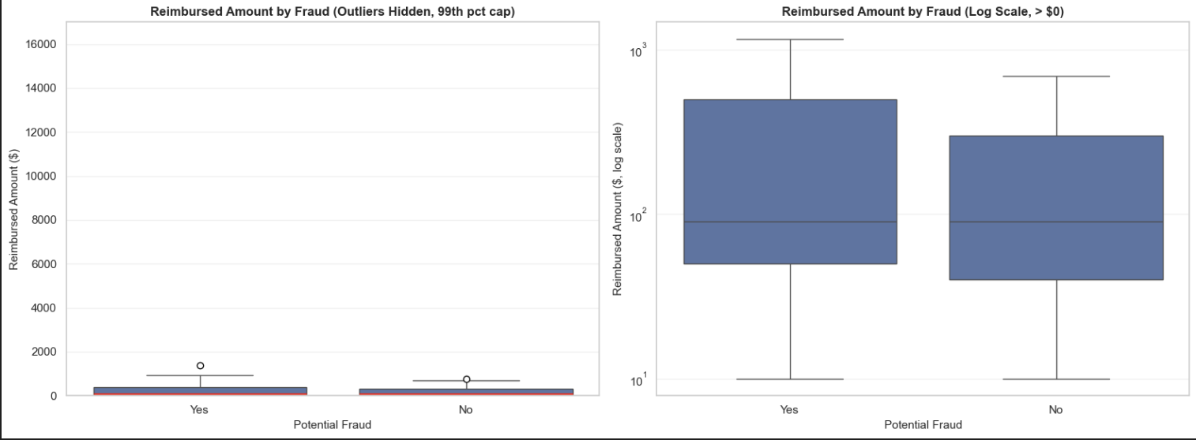
EDA: Financial Patterns
Fraudulent providers tend to show higher reimbursement amounts
Strong financial outliers identified using IQR
Inpatient claims generally more expensive than outpatient
Insight: Financial features are strong predictors

Slide 6
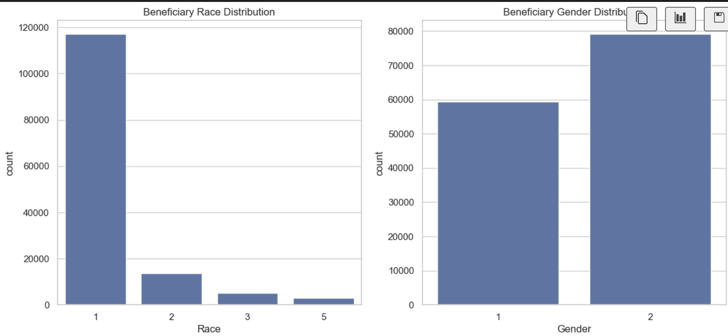
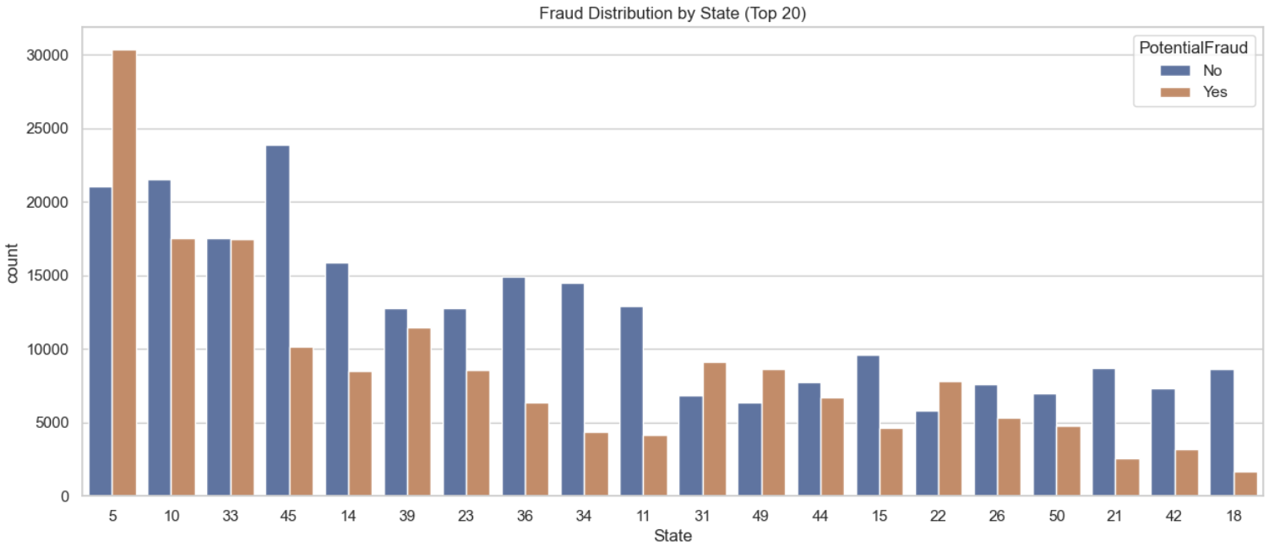
EDA: Behavioral & Demographic Patterns
Fraud varies across states
Beneficiary demographics (age, gender, chronic conditions) analyzed
Frequent diagnosis & procedure codes examined
Helps identify anomalies in provider behavior

Slide 7
Feature Engineering Strategy
Aggregation by Provider
Three feature groups created:
Volume metrics (total claims, unique patients, unique physicians)
Financial metrics (sum/mean/std of reimbursements)
Health metrics (chronic condition prevalence)

Slide 8
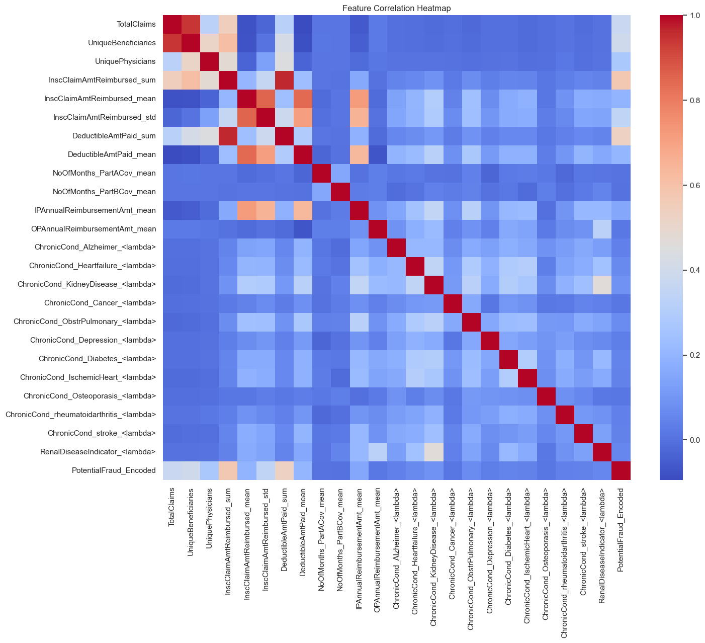
Correlation & Insights
Correlation heatmap generated for all engineered features
Financial metrics show the strongest correlations with Fraud
Chronic conditions and volume metrics show moderate contributions

Slide 9
Class Imbalance
A major problem we faced was that the data was clearly imbalanced (9% are fraudulent).
To address this, we decided to use class weighting as it :
Works perfectly well with tree-based models that have built-in weighting parameters (scale_pos_weight).
Preserves data distribution unlike undersampling.
Reduces overfitting unlike oversampling (SMOTE) that could memorize synthetic fraud patterns.

Slide 10
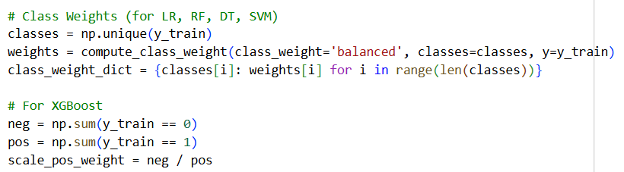
Class Imbalance

Slide 11
Modelling
We experimented with five algorithm families to capture different data relationships:
Logistic Regression (LR)
Random Forest (RF)
Decision Tree (DT)
Support Vector Machine (SVM)
XGBoost
We first trained all models with default parameters (incorporating class weights).

Slide 12
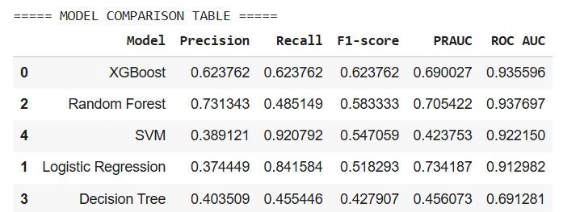
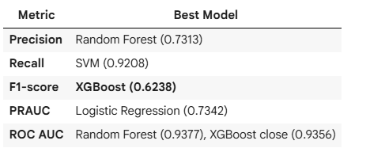
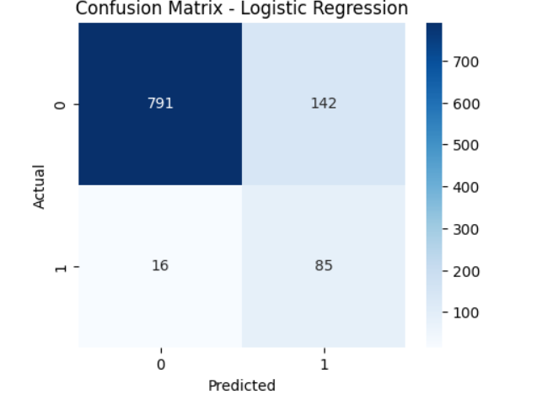
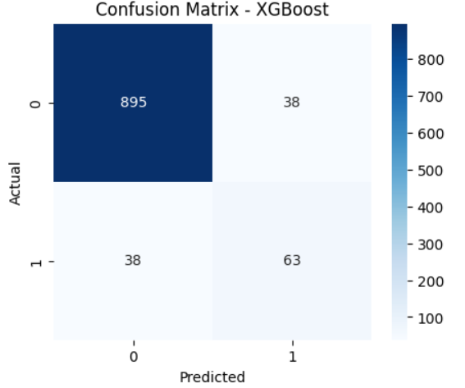
Modelling

Slide 13
Modelling
Based on the previous metrics, we suggest two models to be used according to the business need.
We suggest using XGBoost as a primary model if a balance between is the metrics is needed:
  Highest F1-score (0.6238), providing most reliable balance across all metrics.
  Highly robust to class imbalance which is found in fraud detection(10% only are fraud)
  Suitable for mixed-data scenarios by encoding (already done in preprocessing).
  Explainable and interpretable using SHAP values.

Slide 14
Modelling
2. We suggest using Logistic Regression as a secondary model the priority is catching as many fraudulent cases as possible:
  Strong recall performance (0.8416), second only to SVM .
  Highest PRAUC (0.7342, so much higher than SVM), especially relevant for imbalanced data
  Extremely interpretable and easy to explain to business stakeholders
  Fastest to train and deploy

Slide 15
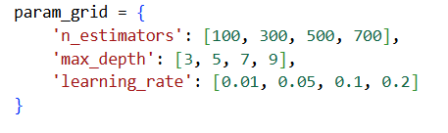
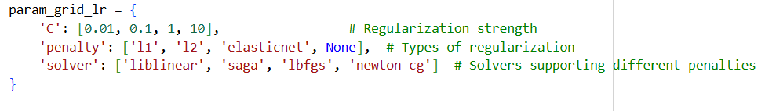
Hyperparameter Tuning
We implemented a two-phase tuning strategy to first explore the parameter space and then validate the findings using robust cross-validation.
Phase 1: Using fixed hold-out test set (End of Modeling Notebook):

Slide 16
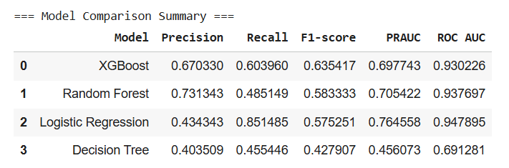
Hyperparameter Tuning
After tuning the hyperparameters for the chosen models (XGBoost: [n_estimators=300, max_depth=7, learning_rate=0.2], Logistic Regression: [C=10, penalty=l2, solver=liblinear]):
  XGBoost: The F1-score increased to 0.6354, making it the highest among the four models.
  Logistic Regression: The recall improved to 0.8515, which is the highest among the four models.

Slide 17

Hyperparameter Tuning
Phase 2: Using 5-Fold Stratified Cross-Validation (Beginning of Evaluation Notebook):
After tuning the hyperparameters for the chosen models (XGBoost: [learning_rate': 0.1, 'max_depth': 5, 'n_estimators': 100.0], Logistic Regression: [C': 0.01, 'penalty': 'l2', 'solver': 'liblinear’]):
  XGBoost: The model's recall improved to 0.71, indicating better sensitivity to fraud, despite a small drop in the raw F1-score (~0.595) compared to Phase 1.
  Logistic Regression: The tuning maintained the core strength of high recall (0.83), confirming its role as the secondary, high-sensitivity model.

Slide 18
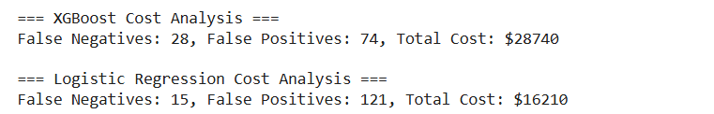
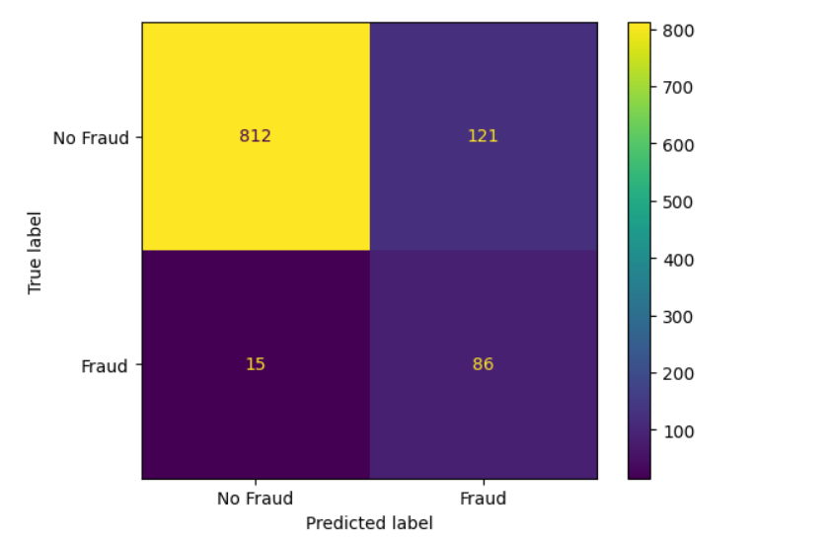
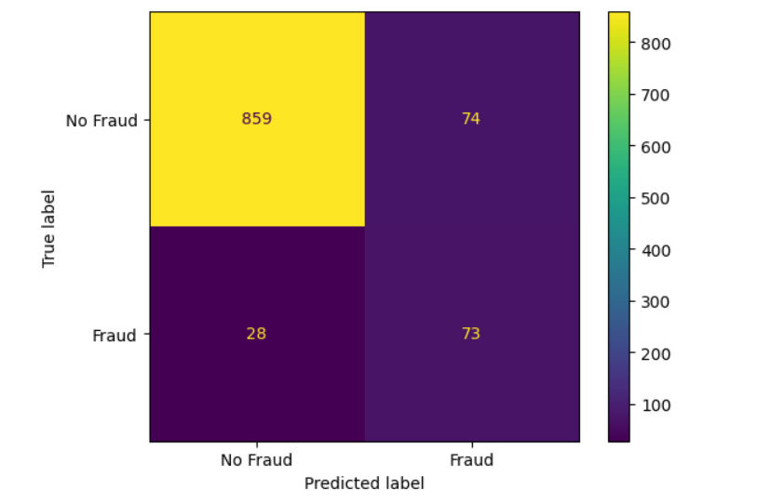
Evaluation

Slide 19
Evaluation
False Positives (Legit flagged as Fraud):
Characteristics: These providers often had very high InscClaimAmtReimbursed_sum (e.g., $460,400) and DeductibleAmtPaid_sum.
Insight: The model conflates "High Volume/High Cost" with "Fraud". Large, legitimate hospitals are at risk of being flagged.
Mitigation Strategy: Normalize by provider scale
Add per-beneficiary and per-physician ratios (e.g., reimbursed_sum / unique_beneficiaries). This prevents large legitimate providers from being flagged simply for high totals.

Slide 20
Evaluation
False Negatives (Fraud flagged as Legit):
Characteristics: many samples showed high total reimbursements ($255090), large numbers of unique beneficiaries, and high deductible sums ($32150), yet their per-claim statistics and chronic-condition ratios were often mid-range (not extreme).
Insight: These fraudulent providers look like high-volume, legitimate providers — large totals but without clear, extreme outlier signatures in medical conditions — so the model treats them as normal.
Mitigation Strategy: Add temporal and trend features
Compute spikes, rolling averages, or month-over-month deltas.
Fraud often appears as sudden changes rather than continuously high values.

Slide 21
Conclusion
After thorough data preprocessing, validation and evaluation, we propose two models based on the need for balance or catching most fraudulent cases:
XGBoost: For a fraud detection task where both precision and recall matter, XGBoost provides the most reliable balance.
Logistic Regression: Even though its F1-score is lower than XGBoost, Logistic Regression is ideal when minimizing false negatives is the primary business goal (83% Recall).

Slide 22
Thank you!
Any questions?

