Slide 1
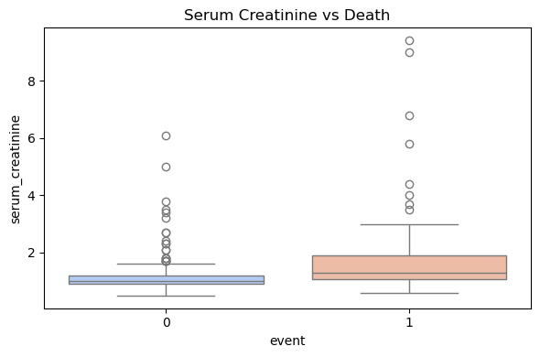
Observations: Higher median among deceased patients: Patients who died had a higher average serum creatinine level, suggesting impaired kidney function. Many outliers among the deceased: Some cases reached extremely high levels (above 8 mg/dL), which could indicate severe kidney failure. Surviving patients showed a more concentrated and less dispersed distribution: Most of them had low serum creatinine values, closer to the normal range. 📌 Conclusion: An elevated serum creatinine level — a key indicator of kidney function — appears to be clearly associated with a higher likelihood of death. This suggests that deteriorating kidney function may be a critical risk factor in patient prognosis.
Interpretation of the Plot: Serum Creatinine vs Death

Slide 2
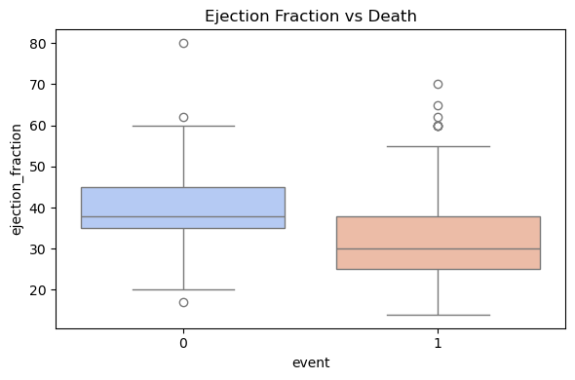
🔍 Key Observations: Median (the line inside the box): It's higher in the group that survived. → Meaning: Most of the patients who lived had a higher ejection fraction than those who died. Interquartile Range (the box): Slightly wider in the surviving group, indicating relatively more variation in their ejection fraction values. Outliers (the dots above and below): Some patients had high ejection fraction even though they died — which is expected, as other factors also contribute to mortality. 📌 Conclusion: Patients who died generally had lower ejection fraction compared to those who survived. This is a strong indication that weakened heart function may be associated with an increased risk of death.
✅ Interpretation of the Plot: Ejection Fraction vs Death

Slide 3
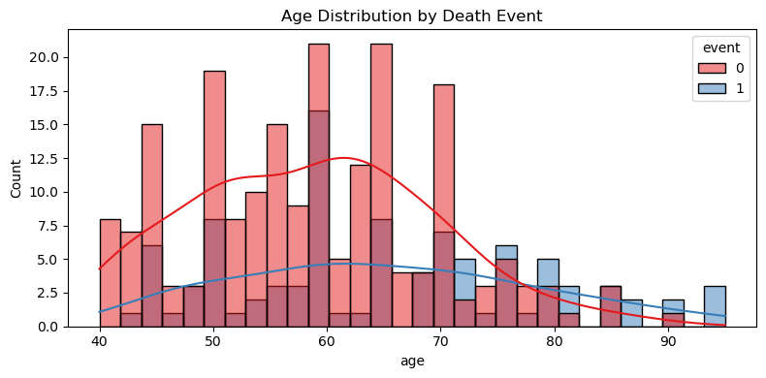
🧠 Analysis of the Plot: Age Distribution by Death Event
Key Observations:
Mortality increases with age: The blue curve starts low and gradually rises, indicating that the likelihood of death increases significantly after age 60.
Younger patients mostly survived: Most of the surviving patients (red bars) are concentrated between the ages of 40 to 65.
Fewer very elderly patients: Although older age is linked with higher mortality, the number of patients above 85 is quite low, possibly due to the nature of the dataset or sample selection.
📌 Conclusion: Age is a critical factor in predicting mortality. As patients get older, their risk of death due to heart disease or its complications increases. This insight highlights the importance of early intervention and close monitoring in elderly patients.

Slide 4
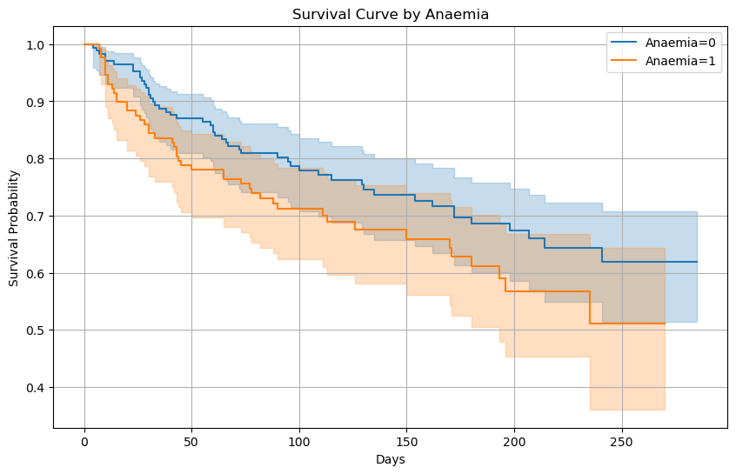
📊 Key Conclusions: Patients without anemia (blue line) have a higher probability of survival over time compared to patients with anemia (orange line). The difference between the two lines is very clear, especially after about 100 days. Having anemia appears to be a risk factor that negatively affects survival, as the survival curve declines faster for those affected by it.

