Slide 1
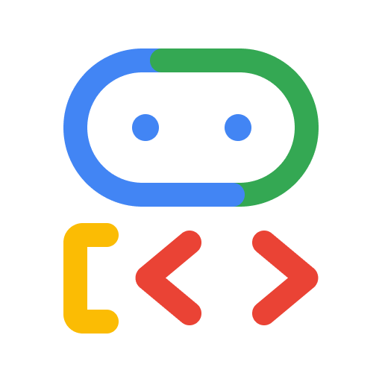


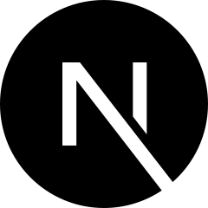

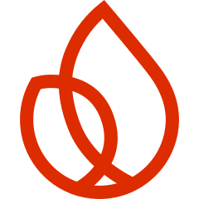
NEWS INTELLIGENCE AGENT
Catch-Up
Your world, caught up — collected, ranked, and summarized by AI.
BUILT WITH
Ahmed Hesham · AI Engineer
Built on Google ADK · Gemini

Slide 2

Catch-Up
THE PROBLEM
Too much news.
Too little time.
— News is scattered across feeds, sites, APIs, and video
— No fast catch-up in both Arabic and English
— Manual monitoring that just doesn't scale
02

Slide 3

Catch-Up
THE SOLUTION
One agent that
catches you up.
— Collects from everywhere
— Ranks what actually matters
— Summarizes in English + Arabic
— Delivers a digest — scheduled or on-demand
03

Slide 4




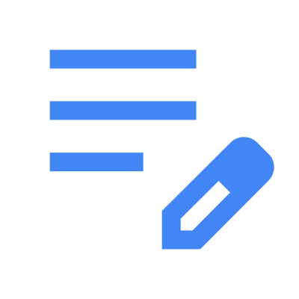
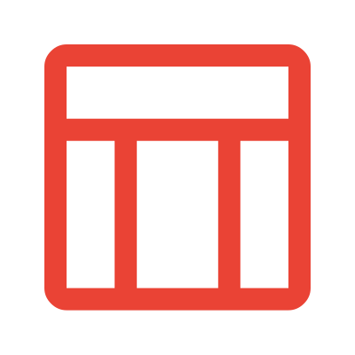
Catch-Up
HOW IT WORKS
A multi-agent pipeline on Google ADK
›
›
›
›
›
Collect
Normalize
Process
Guardrail
Digest
Render
5 sources, parallel
+ de-duplicate
Gemini enrich
fact-check
EN + AR narrative
xlsx · html · md
Everything runs through one ADK agent tree — collectors fan out in parallel, then one Gemini pipeline produces a trustworthy digest.
04

Slide 5
Catch-Up
ORCHESTRATION
One ADK agent tree
NewsCatchUpPipeline
SequentialAgent
1
PipelineInit
create & ID the run
13
2
CollectSources
ParallelAgent — fan-out
RSS · Scrape · API · Search · YouTube — run concurrently
agents · one tree
3
NormalizeDedup
merge · de-duplicate
1
Sequential orchestrator
4
Processing
Gemini enrich
1
Parallel fan-out
5
GuardrailCritic
fact-check · self-correct
5
Source collectors
6
DigestEditor
EN / AR narrative
6
Pipeline stages
7
Render
xlsx · html · md
05

Slide 6
Catch-Up
THE AGENTS
What each agent does
PIPELINE STAGES
GEMINI SUB-AGENTS (LLM)
PipelineInit — create & ID the run
news_processor — categorize · score · summarize
CollectSources — 5 collectors, in parallel
faithfulness_critic — verify vs the source
NormalizeDedup — merge & de-duplicate
digest_editor — compose the narrative
Processing — enrich with Gemini
search_collector — Google Search grounding
GuardrailCritic — fact-check & self-correct
youtube_summarizer — summarize transcripts
DigestEditor — write the EN / AR story
+ news_reprocessor (self-correction) · enrichment_judge (offline eval)
Render — Excel · HTML · Markdown
06

Slide 7
Catch-Up
ARCHITECTURE
Four decisions behind the build
ADK-native
Free → Cloud by config
The agent tree IS the orchestration — no glue code.
Same code runs local or on Google Cloud, not a rewrite.
Swappable storage
Secure by default
SQLite ↔ Firestore behind a clean storage port; AI Studio ↔ Vertex by config.
Loopback-guarded settings, fail-closed auth & guardrails, one SSRF chokepoint.
07

Slide 8




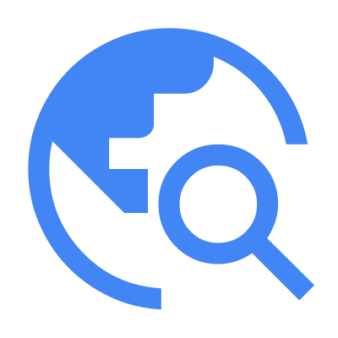
Catch-Up
FEATURE 01
Collect from everywhere
One safe pipeline pulls from five source types — SSRF-guarded and rate-limited.
RSS
Web scrape
News APIs
YouTube
Search grounding
WHY
No single source has the whole picture.
08

Slide 9
Catch-Up
FEATURE 02
Rank & summarize
with Gemini
— Categorize into AI/Tech, Business, World, and Gulf/MENA
— Score importance — see what matters first
— Summarize in English + Arabic
— Extract the people, orgs, and places
WHY
Triage-first — the signal, in your language.
09

Slide 10
Catch-Up
FEATURE 03
An agent you can trust
— An LLM-as-judge critic fact-checks top items against their source
— Unfaithful summaries are flagged — and never shown
— The judge and the critic share one faithfulness rubric
WHY
No hallucinations. No made-up news.
10

Slide 11

Catch-Up
FEATURE 04
Delivered the way you work
— Excel · HTML dashboard · Markdown digests
— A Next.js console to browse, search, and configure
— A one-click macOS desktop app
WHY
Meet every user on the surface they already use.
11

Slide 12
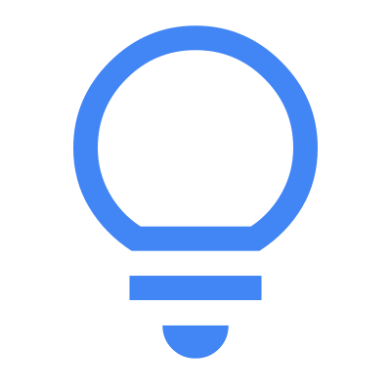


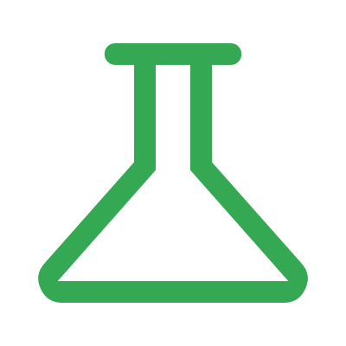


Catch-Up
PROCESS
How I directed the build
›
›
›
›
›
Brainstorm
Spec
Plan
Build
Review
Merge
intent & design
write it down
Codex-reviewed
TDD · subagents
Codex gate
green & verified
I set the architecture & standards up front, then looped every feature through this — reviewed and tested before it merged.
Standards up front
Independent review gates
Persistent memory
Architecture, security & the 'Signal' design system — fixed in CLAUDE.md before any code.
Every plan and task passed an external Codex review before merge.
A living BUILD-LOG and memory kept the agent on-thread across sessions.
12

Slide 13
Catch-Up
SUMMARY
Free today.
Cloud-ready tomorrow.
BUILT WITH
Google ADK
Gemini
FastAPI
Next.js
SQLite
Firestore
— Runs free on your laptop
— Scales to Cloud Run + Vertex AI + Firestore — by config
— Built on Google ADK + Gemini
Catch-Up — News Intelligence Agent
Ahmed Hesham · AI Engineer
13

