Slide 1




Center

Slide 2
TOASOL
Connecting Children, Families & Specialists

Slide 3



TOASOL
Connecting Children, Families & Specialists
A specialized digital platform for:
Speech Delay
Child
Skill Development
Learning Difficulties

Slide 4
TOASOL
Connecting Children, Families & Specialists
Parent
Center
Child
Specialist

Slide 5

PRESENTATION OVERVIEW
PART 2
Follow TOASOL journey through 4 key parts
01
THE PROBLEM AND THE SOLUTION
What Problem Are We Solving & How Does TOASOL Solve the Problem?
PART 3
02
OUR USERS
Who Uses TOASOL?
PART 1
03
THE MARKET
Who Are Our Competitors & Competitive Comparison
04
THE BUSINESS MODEL
Why Invest in TOASOL? Revenue Streams & Capital Cycle
PART 4

Slide 6

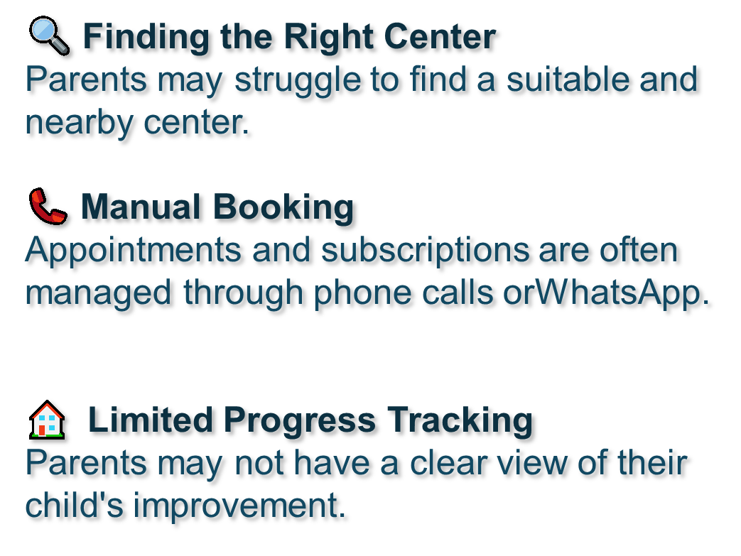
PART 2
What Problem Are We Solving?
PART 3
PART 1
PART 4

Slide 7

PART 2
How Does TOASOL Solve the Problem?
TOASOL provides an integrated platform connecting:
01
02
03
04
05
PART 3
Find
→
Book
→
Attend
→
Practice
→
Track
PART 1
Find the nearest suitable center.
Book and pay for sessions online
Attend the offline therapy session
Continue training at home through videos, exercises and games
Monitor the child performance progress
OFFLINE + ONLINE = CONTINUOUS CARE
OFFLINE + ONLINE = CONTINUOUS CARE
PART 4

Slide 8

PART 2
Who Uses TOASOL?
Parents
Specialists
Find suitable centers
Book sessions
Pay online
Follow their child's progress
Receive home activities
Manage children
Create therapy plans
Monitor progress
PART 3
PART 1
Centers
Children
Manage appointments
Manage subscriptions
View analytics
Videos
Educational games
Home activities
Attend physical sessions
PART 4

Slide 9

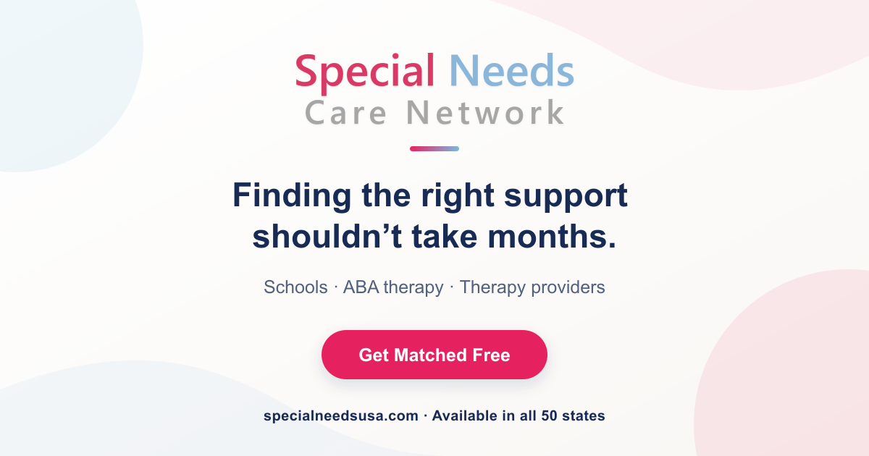
PART 2
Who Are Our Competitors?
Indirect Competitors
Healthcare Booking Platforms — e.g., Vezeeta
Speech & Educational Apps — provide digital exercises and learning activities
Clinic Management Systems — help therapy centers manage appointments and patients
PART 3
PART 1
Direct Competitor
Special Needs Care Network
A specialized platform that helps families discover, compare, and connect with special-needs service providers.
PART 4

Slide 10

PART 2
Who Are Our Competitors?
Feature
TOASOL
Location-Based Search
✓
✓
Provider Information
& Reviews
✓
✓
PART 3
PART 1
Appointment Booking
Limited
✓
✓
Center Management
—
✓
Home Exercises
—
Interactive Games
—
✓
Parent Follow-up
—
✓
Progress Reports
—
✓
PART 4

Slide 11

PART 2
Why Invest in TOASOL?
First-Mover Advantage
An opportunity to lead the Arab market with an integrated digital platform dedicated to children's speech, skill development, and learning support.
Real Problem
We are solving a real problem faced by children, parents, specialists, and therapy centers.
PART 3
PART 1
Clear Target Market
The platform focuses on a specific and underserved segment rather than being a general healthcare application.
Multiple Revenue Streams
PART 4

Slide 12
PART 2
Why Invest in TOASOL?
Multiple Revenue Streams
1. Center Subscription
Therapy centers pay a monthly or annual fee to use the platform.
2. Booking Commission
TOASOL receives a small commission(10%) from each booking made through the platform.
PART 3
PART 1
3. Parent Premium
Parents can subscribe to advanced features such as:
Additional activities
Advanced progress reports
Premium educational content
PART 4

Slide 13
PART 2
How Does the Capital Cycle Work?
→
→
Marketing & Acquire Therapy Centers
Initial Investment
Develop the Platform & Mobile App
→
→
Parents Join the Platform
Centers Subscribe to TOASOL
→
→
PART 3
→
TOASOL Generates Revenue
PART 1
Bookings & Payments
→
Revenue Reinvestment
More Centers → More Users → More Bookings → More Revenue
PART 4

Slide 14
Our Vision
“To make every child’s therapy journey
more connected, engaging, and measurable.”
TOASOL | Connect. Practice. Grow.

Slide 15
Center
Thank You for your time!
Do you have any questions?

