Slide 1

Tutorial 8
Computer Engineering Department
Faculty of Engineering
Cairo University
Image Processing & Computer Vision - CMP(N)446
Texture Analysis

Slide 2
Quiz Time

Slide 3
Algorithms Review
GLCM & LBP

Slide 4
Gray Level Co-occurrence Matrix

Slide 5
Goal
Get a quantitative measure of the texture present in an image (statistical texture analysis approach)

Slide 6
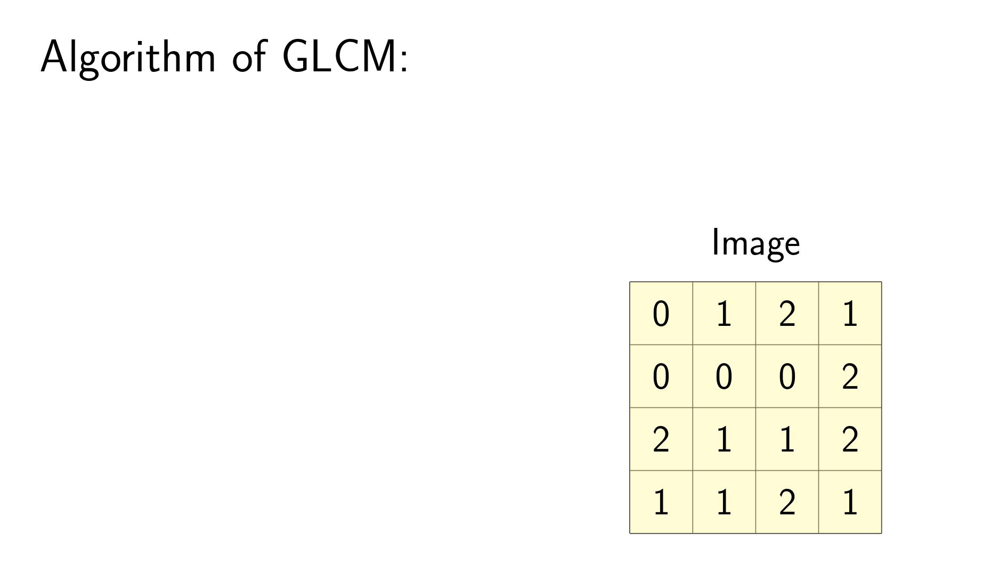

Slide 7
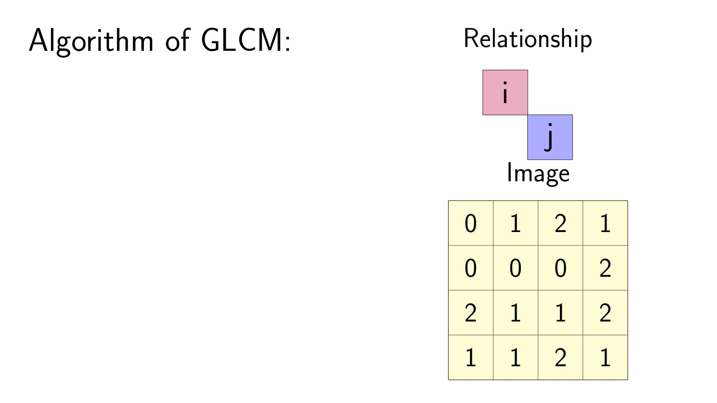

Slide 8
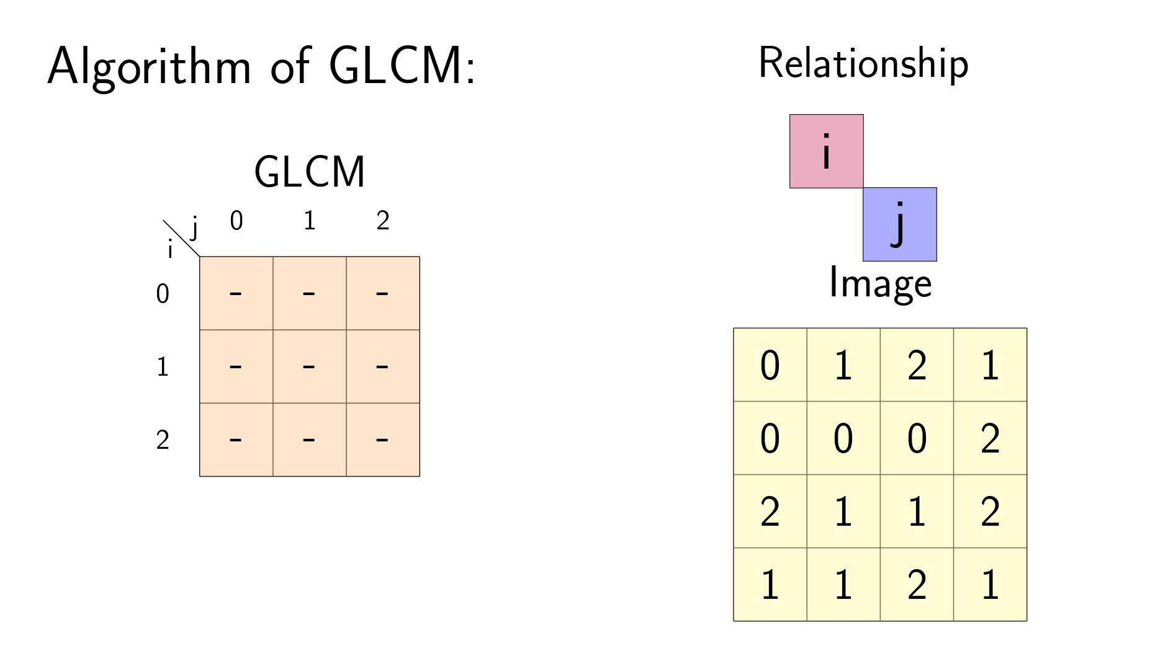

Slide 9


Slide 10
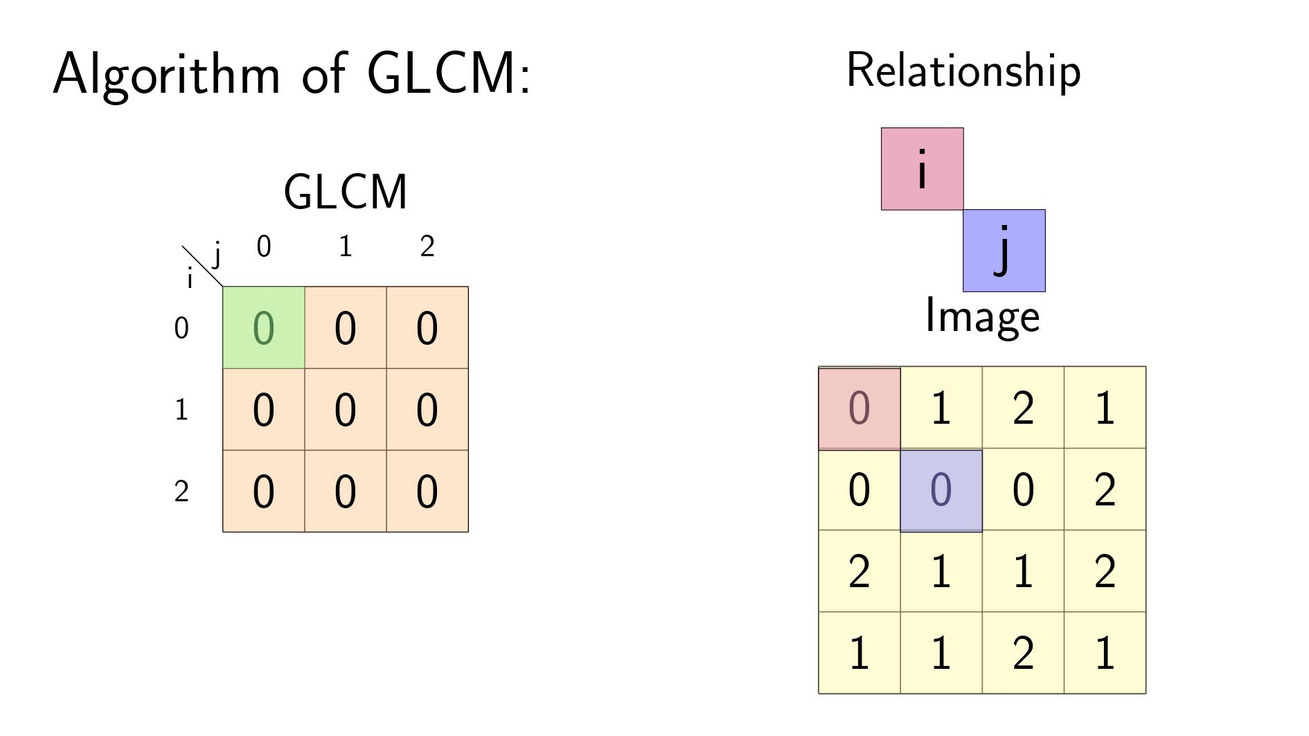

Slide 11


Slide 12
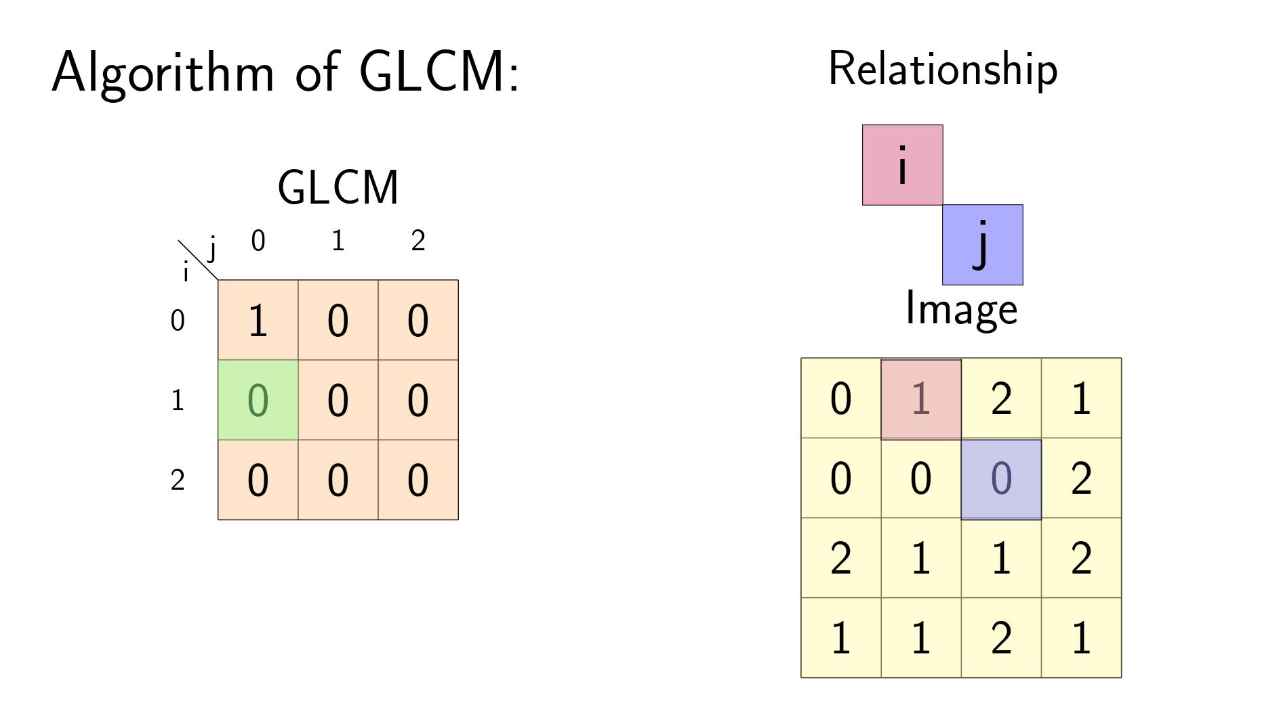

Slide 13


Slide 14
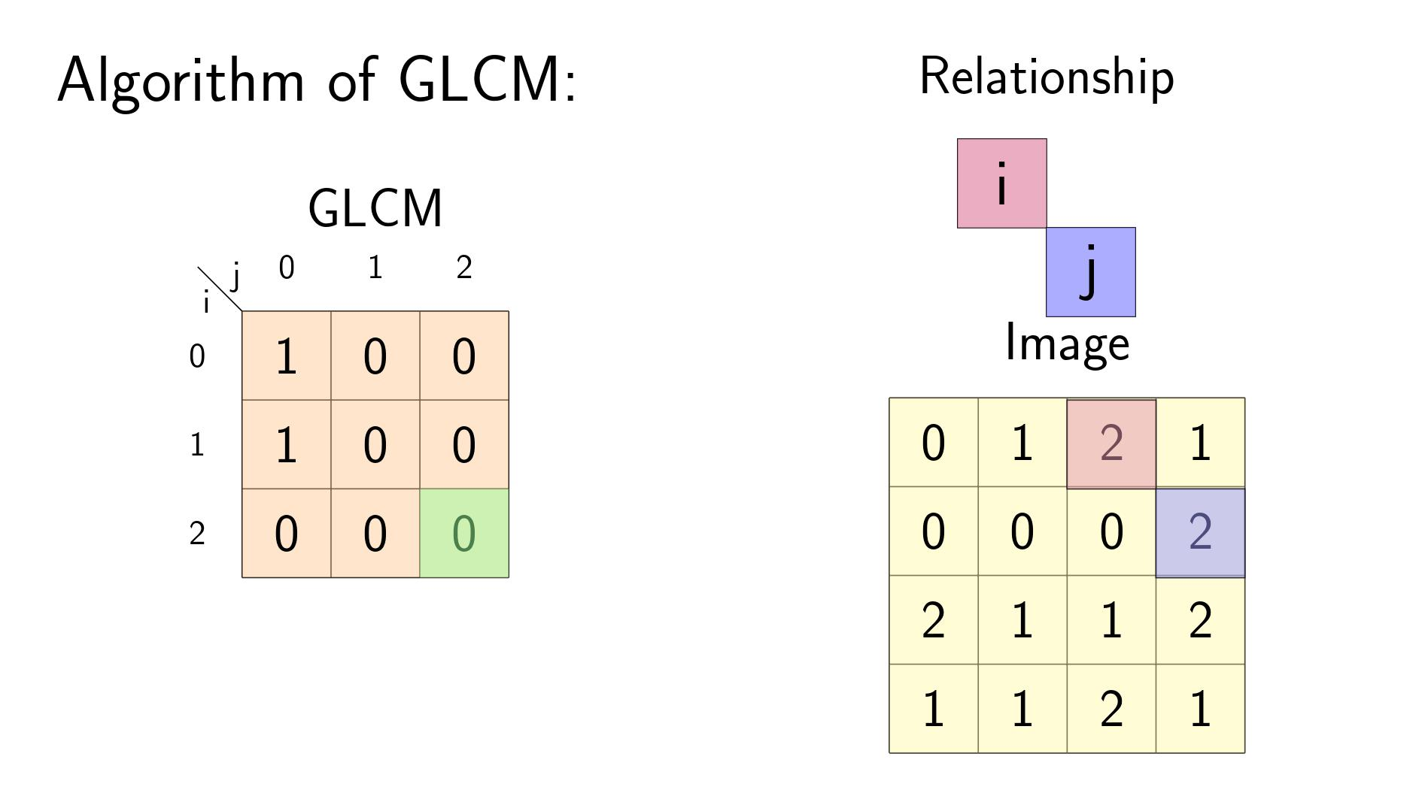

Slide 15


Slide 16
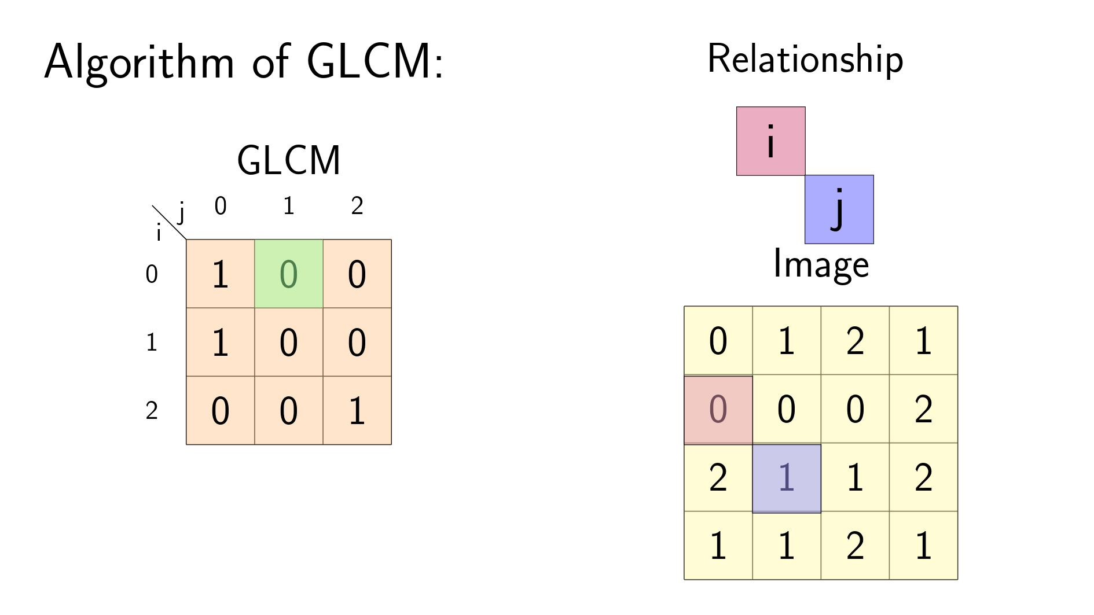

Slide 17


Slide 18
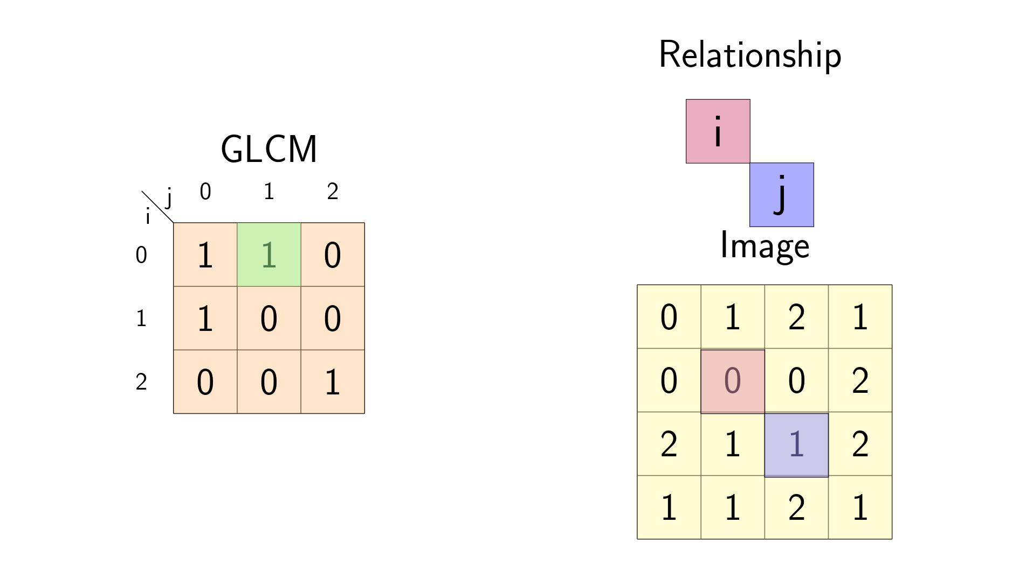

Slide 19
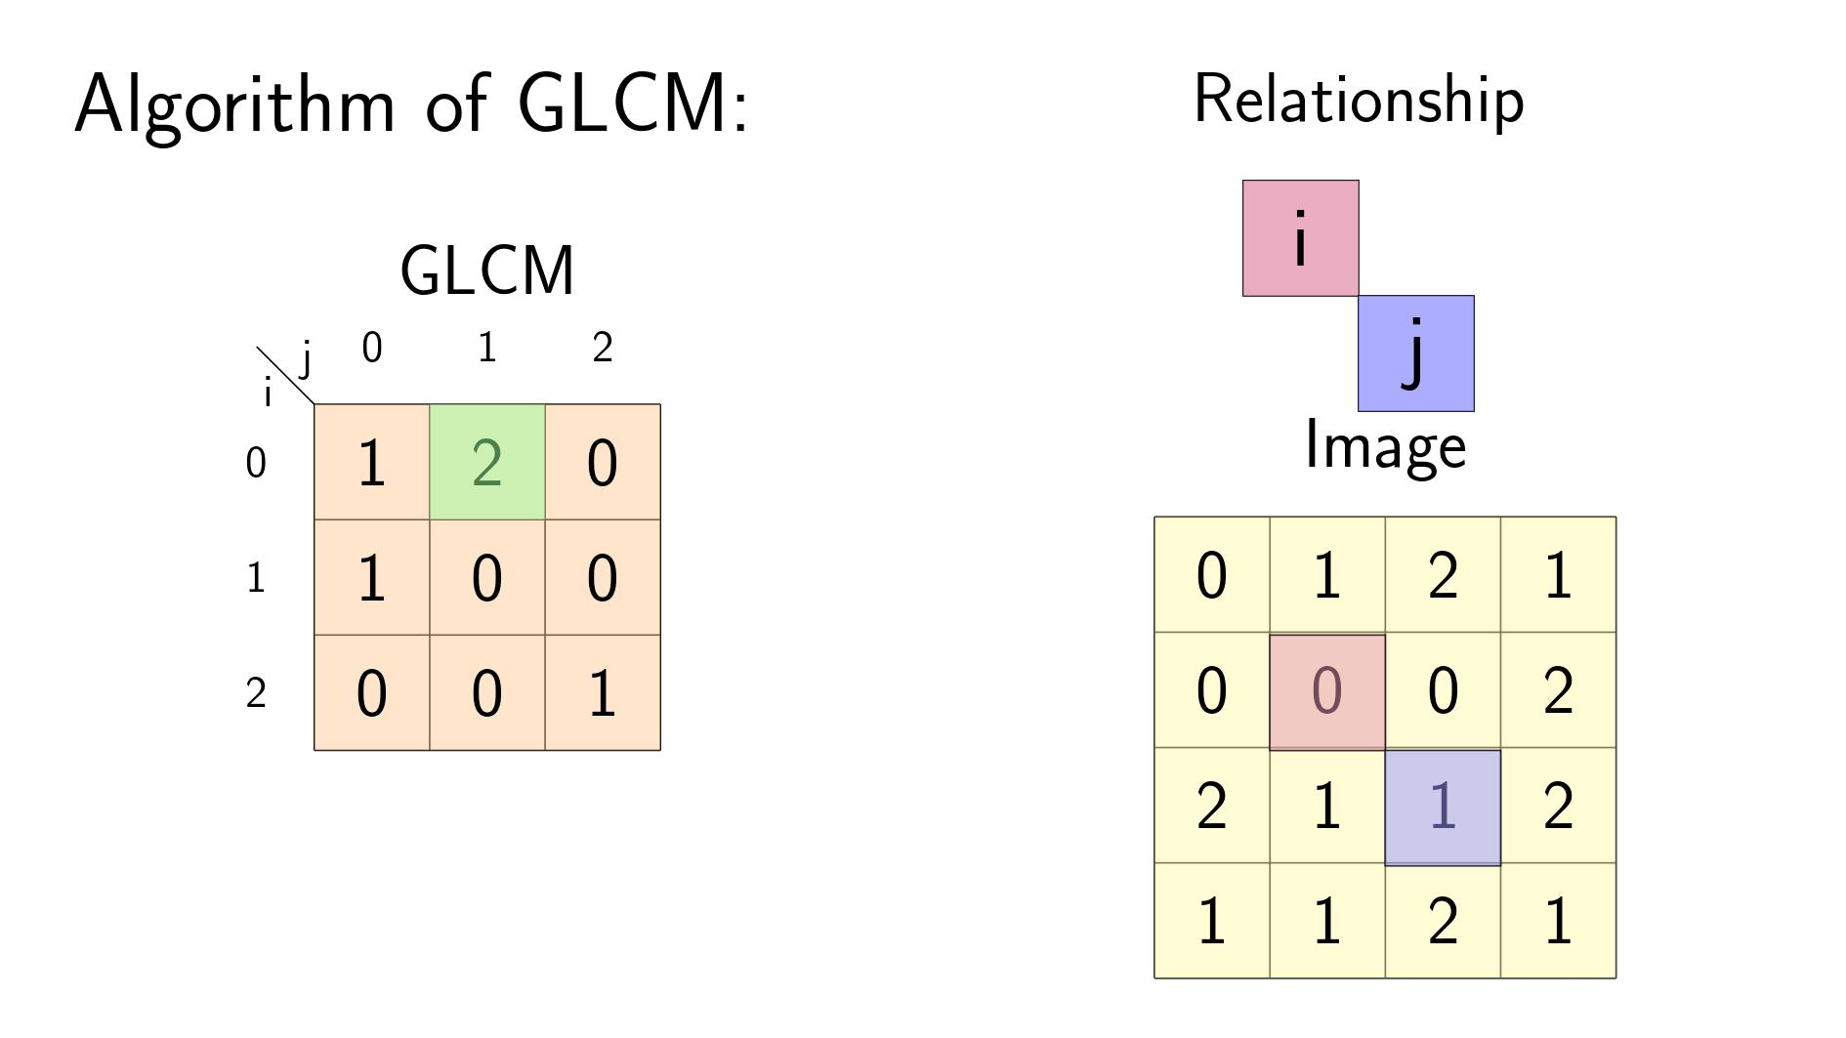

Slide 20


Slide 21
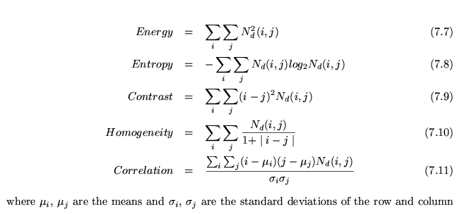
Converting GLCM to a Compact Representation
Since the matrix is often huge and sparse, it is further processed to get a more compact measure (like homogeneity).

Slide 22
Local Binary Pattern

Slide 23
LBP Algorithm
For each pixel, we will create an 8-bit number that represents its relationship to its neighbors.
Then, we will make a histogram from the output 2D matrix.
Notes:
Explain the algorithm on the board.

Slide 24
Lab Time

