Slide 1
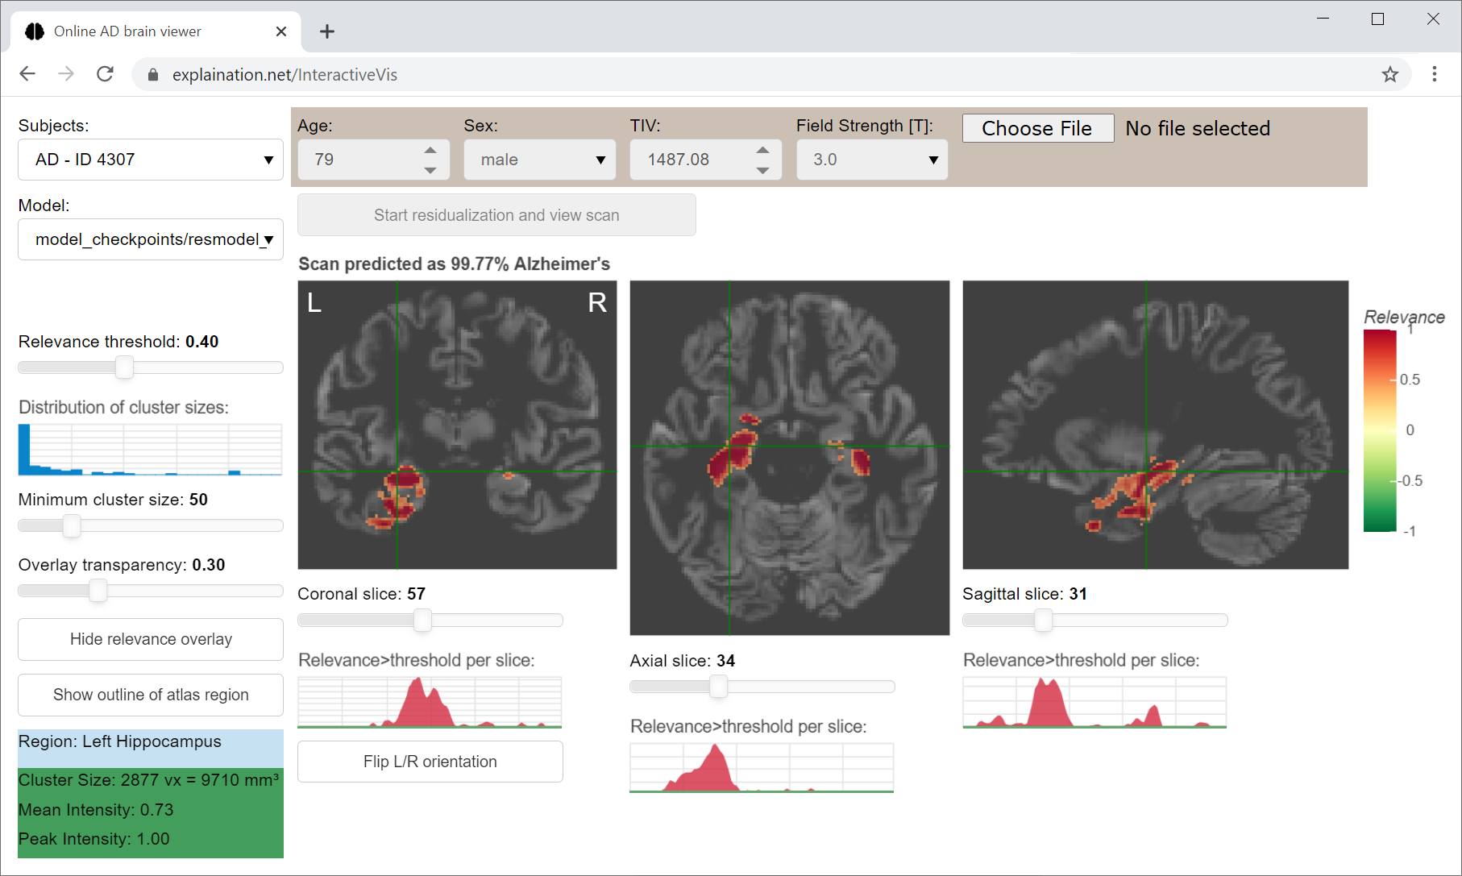
Deep Learning Interactive Visualization

Slide 2
Project Overview
• Purpose: CNN model for Alzheimer's disease detection
• Interactive visualization of brain regions relevance
• Published in Alzheimer's Research & Therapy (2021)
• DOI: 10.1186/s13195-021-00924-2

Slide 3
Key Features
• 3D Convolutional Neural Network for disease detection
• Interactive visualization of relevant brain regions
• Web-based interface using Bokeh
• Docker container support

Slide 4
Technical Architecture
• UML class diagram visualization
• Sequence diagram for subject selection
• Key components and their interactions
• Modular and extensible design

Slide 5
Implementation Details
• Python-based implementation
• TensorFlow 1.15 framework
• Bokeh web application
• Docker containerization
• GPU-accelerated training support

Slide 6
Usage & Deployment
• Public web service (explaination.net/demo)
• Docker container deployment
• Local installation
• Multiple deployment options for different use cases

Slide 7
Technical Requirements
• Python <3.8
• Dependencies managed via requirements.txt
• CUDA-GPU support for model training
• Web browser for visualization interface

Slide 8
Results & Impact
• Improved CNN comprehensibility
• Interactive relevance map visualization
• Validation across multiple datasets
• Clinical application potential
• Enhanced understanding of model decisions

Slide 9
Resources & Links
• GitHub: github.com/martindyrba/DeepLearningInteractiveVis
• Docker Hub: docker pull martindyrba/interactivevis
• Demo: explaination.net/demo
• Documentation available in project README

