Slide 1
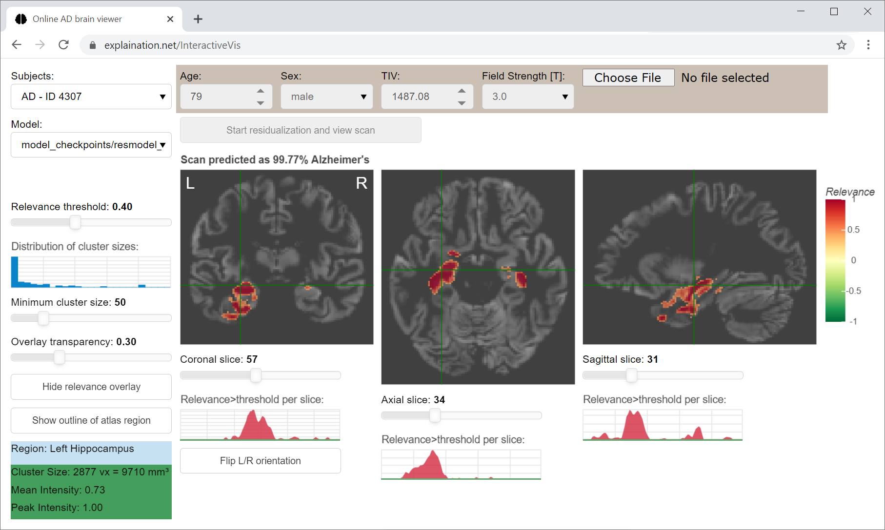
Deep Learning Interactive Visualization
Martin Dyrba
German Center for Neurodegenerative Diseases (DZNE)

Slide 2
Project Overview
• Purpose: CNN model for Alzheimer's disease detection
• Interactive visualization of brain regions relevance
• Published in Alzheimer's Research & Therapy (2021)
• DOI: 10.1186/s13195-021-00924-2

Slide 3
Key Features & Implementation
• 3D Convolutional Neural Network
• Interactive Brain Region Visualization
• Real-time Relevance Mapping
def apply_thresholds(self, relevance_map, threshold=0.5, cluster_size=20):
# Apply threshold to relevance map
self.overlay = np.copy(relevance_map)
self.overlay[np.abs(self.overlay) < threshold] = 0
# Cluster size filtering
labelimg = np.copy(self.overlay)
labelimg[labelimg > 0] = 1 # binarize img
labelimg = label(labelimg, connectivity=2)
# Calculate cluster properties
lprops = regionprops(labelimg, intensity_image=self.overlay)
self.clust_sizes = []
for lab in lprops:
if lab.area < cluster_size:
labelimg[labelimg == lab.label] = 0 # remove small clusters

Slide 4
Visualization Implementation
def overlay2rgba(relevance_map, alpha=0.5):
# Convert relevance map to RGBA visualization
alpha_mask = np.copy(relevance_map)
alpha_mask[np.abs(alpha_mask) > 0] = alpha
# Scale to color range
relevance_map = relevance_map / 2 + 0.5
ovl = np.uint8(overlay_colormap(relevance_map) * 255)
ovl[:, :, :, 3] = np.uint8(alpha_mask * 255)
return ovl.view("uint32").reshape(ovl.shape[:3])

Slide 5
Interactive Features
def click_frontal_callback(event):
# Handle user interaction with frontal brain view
if event.x < 1:
x = 1
elif event.x > slice_slider_sagittal.end:
x = slice_slider_sagittal.end
else:
x = int(round(event.x))
# Update other views
slice_slider_sagittal.update(value=x)
slice_slider_axial.update(value=y)
plot_sagittal()

Slide 6
Technical Architecture
• Model-View-Controller (MVC) Architecture
• Bokeh Web Application Framework
• TensorFlow for CNN Implementation
• Docker Containerization

Slide 7
Implementation Details
• Python-based implementation
• TensorFlow 1.15 framework
• Bokeh web application
• Docker containerization
• GPU-accelerated training support

Slide 8
Usage & Deployment
• Public web service (explaination.net/demo)
• Docker container deployment
• Local installation
• Multiple deployment options for different use cases

Slide 9
Results & Impact
• Improved CNN comprehensibility
• Interactive relevance map visualization
• Validation across multiple datasets
• Clinical application potential
• Enhanced understanding of model decisions

Slide 10
Resources & Links
• GitHub: github.com/martindyrba/DeepLearningInteractiveVis
• Docker Hub: docker pull martindyrba/interactivevis
• Demo: explaination.net/demo
• Documentation available in project README

