Slide 1
Supply Chain Data Cleaning, Analysis & Insights
Presented by: Ahmed Hozayen
Course: Midterm Project CDSP
Instructor: Eng. Mohab Alaam

Slide 2
Project Overview
Goal: Analyze and extract insights from a supply chain dataset
Tools Used: Python, Pandas, Plotly, Streamlit
Key Focus Areas: Data exploration, Data cleaning, data analysis, feature engineering, Data preprocessing , dashboard deployment

Slide 3
Content
Importing libraries and packages
Dataset understanding
Dataset importing
Data exploration
Data cleaning
Data analysis
feature engineering
Data preprocessing
Streamlit

Slide 4
1: Importing Required Libraries
Issue: Need to manipulate and transform the dataset.
Method: Imported NumPy, Pandas, plotly , sklearn preprocessing , streamlit and pipreqs .

Slide 5
Understanding the Dataset
Size: ~180,519+ rows and 53 columns
Types of Data: Numerical and Categorical
Issues: Null values, inconsistent values, Removed irrelevant columns, wrong data types, inconsistent formats, outliers and imbalance.

Slide 6
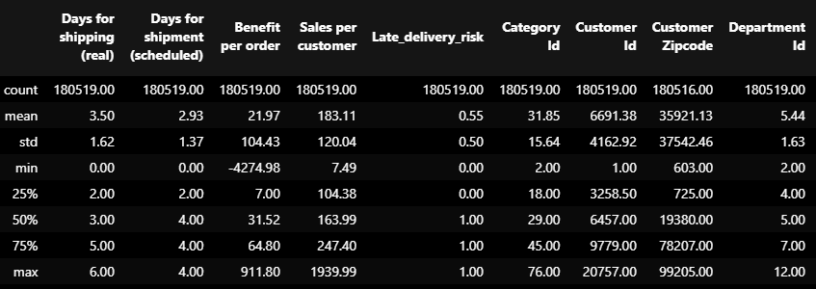
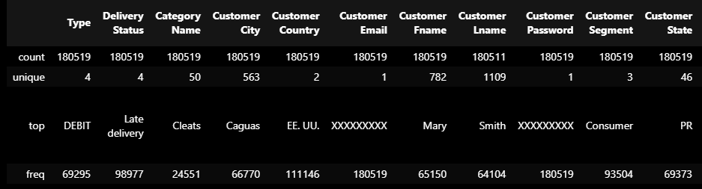
Data Exploration

Slide 7
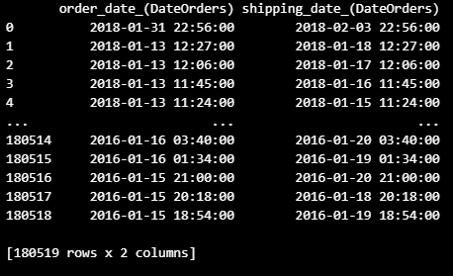
Data Cleaning
Identified Issues: Missing values, duplicate columns, date inconsistencies, negative values and Remove Unnecessary columns.
Fixes: Removed redundancies, filled/dropped missing values, standardized formats, rounded numbers.

Slide 8
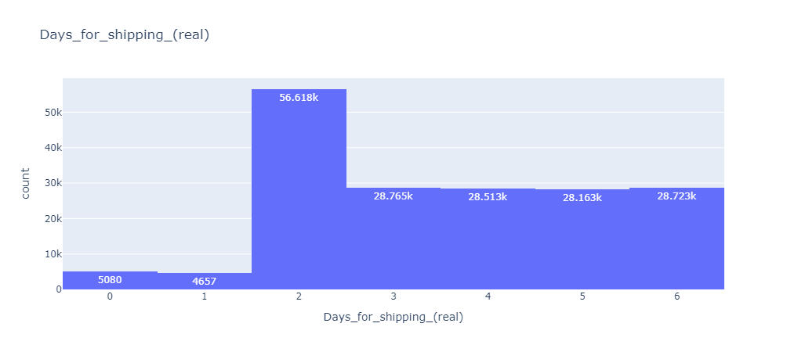
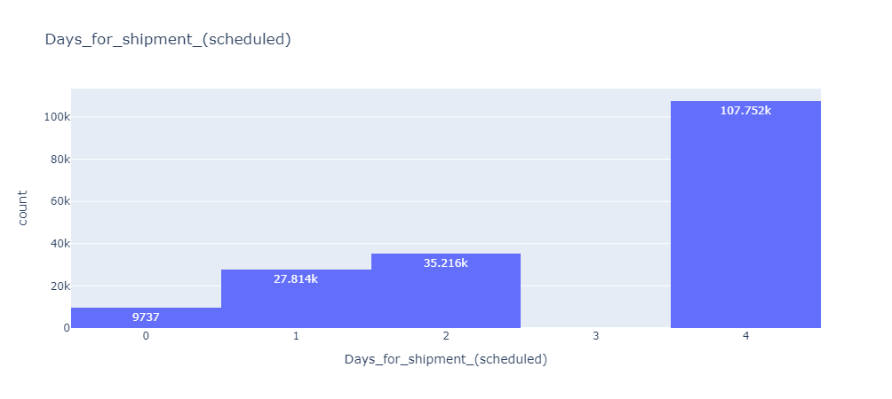
Data Analysis
Insights: Category underperformance, shipping efficiency impacts and profit by categories

Slide 9
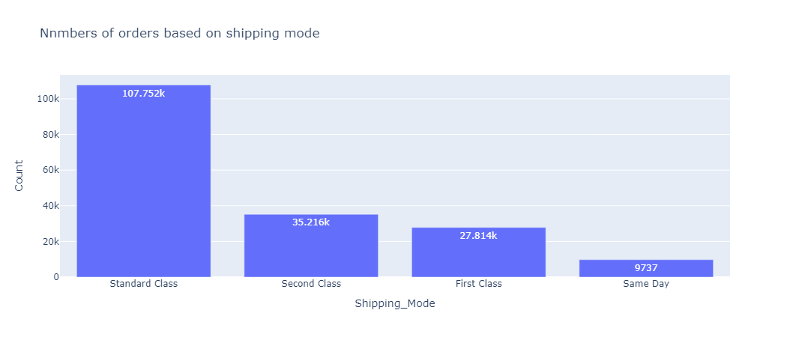
Shipping Modes categories

Slide 10
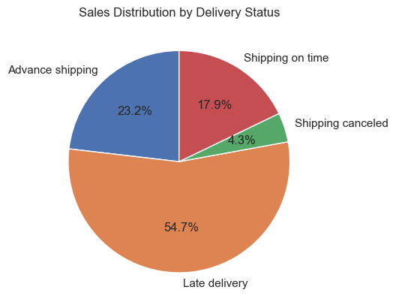
Sales Distribution by Delivery Status

Slide 11
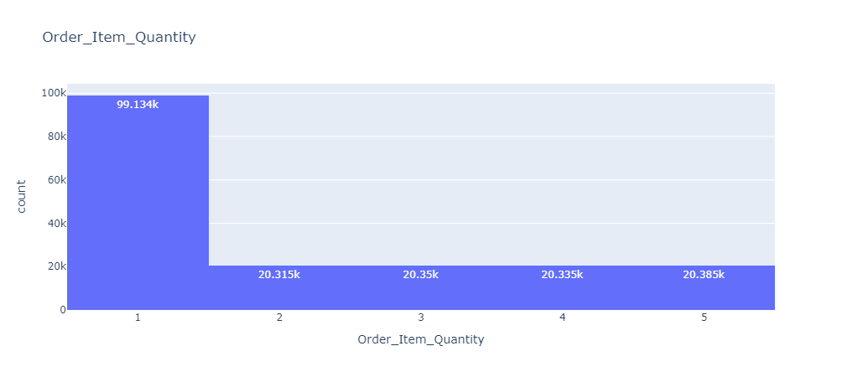
Data Analysis
Quantities of items per order

Slide 12
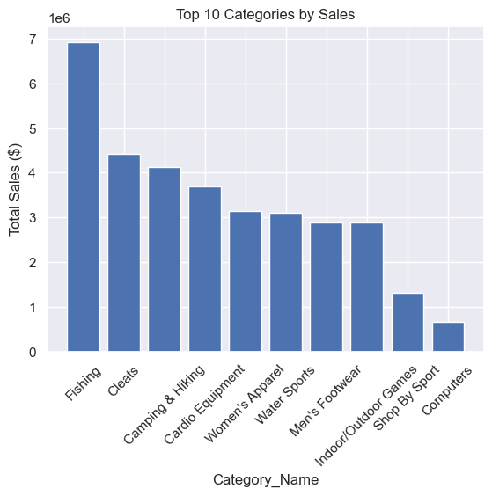
Data Analysis
Top 10 Categories by Sales

Slide 13
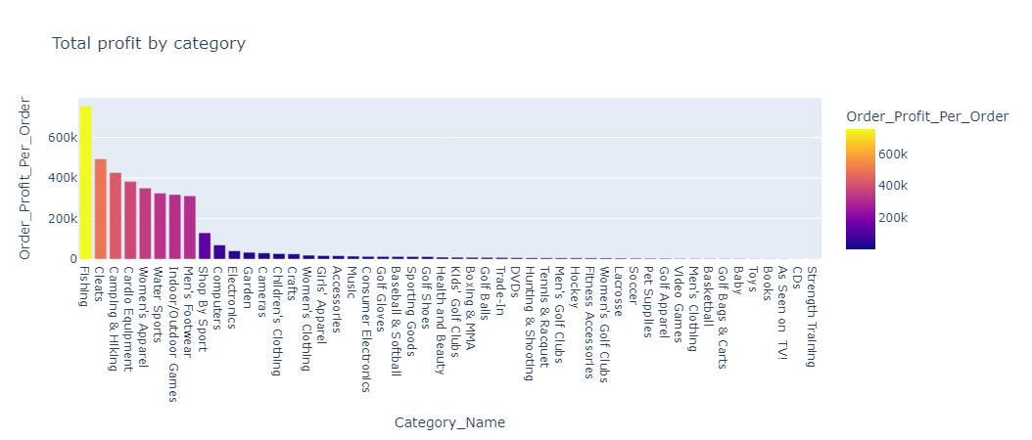
Total profit by categories

Slide 14
Feature Engineering and Data preprocessing
Created Features: Date splits by years, month and days, Full name, fulfillment days, shipping efficiency and SDD & profit flag.
Benefits: Enabled deeper analysis of delays, patterns, and profitability.
Issue: ML models require numerical input.
Method: Used Ordinal Encoder for Shipping Mod and OneHotEncoder for other categorical features.

Slide 15
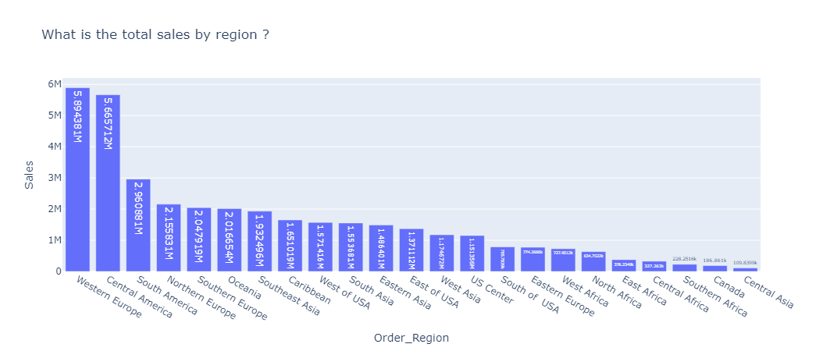
Step1: Visualization Highlights
Visuals: Histograms, bar charts, pie charts, time-series
Purpose: Translate data into actionable insights

Slide 16
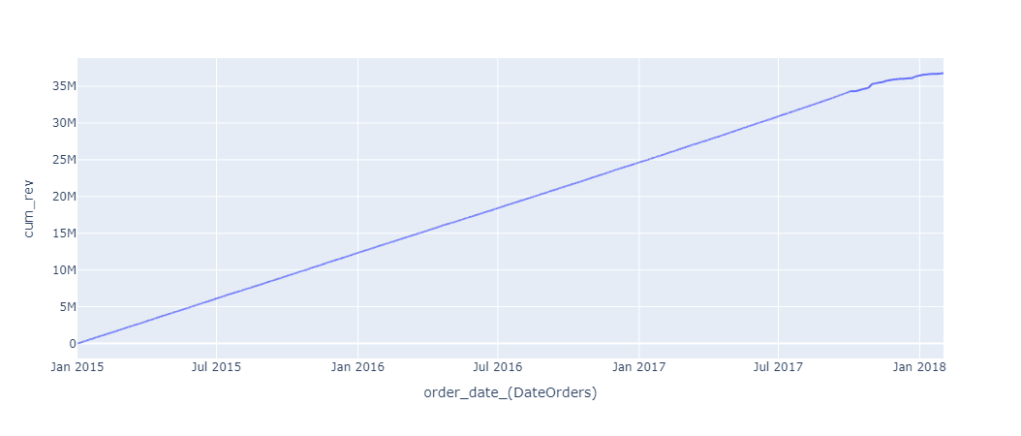
Visualization Highlights
Cumulative revenue sorted by order dates

Slide 17
Step 2: Data Preprocessing
Issue: Data contained duplicated and irrelevant columns.
Method: Dropped columns using Data Frame column filtering.

Slide 18
Step 3: Split Features and Target
Issue: Need to separate input features from prediction target.
Method: Separated 'Late_delivery_risk' as target variable (y) and remaining as features (x).

Slide 19
Step 4: Train-Test Split
Issue: Need to evaluate model on unseen data.
Method: Used sklearn’s train_test_split with 80/20 split and set random_state for reproducibility.

Slide 20
Step 5: Normalize Numerical Features
Issue: Numerical features had different scales.
Method: Tested MinMaxScaler, StandardScaler, and used RobustScaler to reduce the effect of outliers.

Slide 21
Step 6: Handle Class Imbalance
Issue: 'Late_delivery_risk' target was imbalanced.
Method: Used RandomUnderSampler and RandomOverSampler from imblearn to balance the target classes.

Slide 22
Summary of Preprocessing Steps
✓ Imported libraries and loaded dataset
✓ Created Features as full name, fulfillment days, shipping efficiency and SDD & profit flag.
✓ Removed irrelevant/duplicated columns
✓ Encoded categorical variables appropriately
✓ Normalized numerical features
✓ Balanced target variable for model training

Slide 23
Dashboard with Streamlit
Upload files required on GitHub as below link
https://github.com/AhmedHozayen24/SC-Dataset-Repo
Deployment Goals: Interactivity, real-time visualization, usability through stramlit.io as below link
https://sc-dataset-repo-j7ls9gyfh5ucdjvzu6wxhg.streamlit.app/
Database link Kaggle source
https://www.kaggle.com/code/sukanthen/e-commerce-multi-output-models-project-cse07#5)-FEATURE-ENGINEERING
Features: Region/date filters, top products, dynamic charts in second page.

Slide 24
Conclusion & Outcomes
Clean and enriched dataset ready for analysis
Interactive dashboard for business insights
Enhanced understanding of delivery efficiency and areas of improvements.

Slide 25
Thank you

