Slide 1
Spark

Slide 2
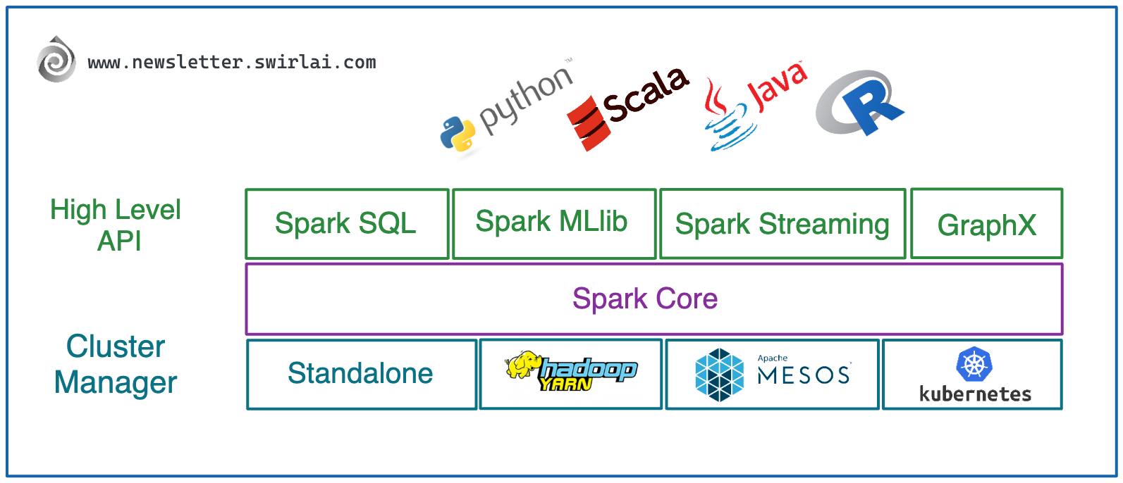
What is Spark ?
Apache Spark is an open-source distributed computing system designed for fast and general-purpose processing of large-scale data. It's widely used for big data analytics and machine learning.
Spark can process data up to 100x faster than traditional Hadoop MapReduce and Hive by using in-memory computing and efficient query execution.

Slide 3
PySpark Syntax & execution
from pyspark.sql.functions import *
df = spark.sql('''
SELECT *
FROM test.PAYMENT p
JOIN test.BILLS b ON p.ID = b.ID
WHERE b.CODE = 112
AND CREATION_DAY = '2025-05-01’
''')
df.count()

Slide 4
Pyspark Syntax
from pyspark.sql.functions import *
payment_df = spark.sql('SELECT * FROM test.PAYMENT’)
bills_df = spark.sql('SELECT * FROM test.BILLS’)
joined_df = payment_df .join(bills_df, payment_df.id == bill_df.id, 'inner’)
first_filter_df = joined_df.where(col(' BILLS.code') == 112)
second_filter_df = first_filter_df.where(col('creation_day') == '2025-05-01’)
second_filter_df.count()

Slide 5
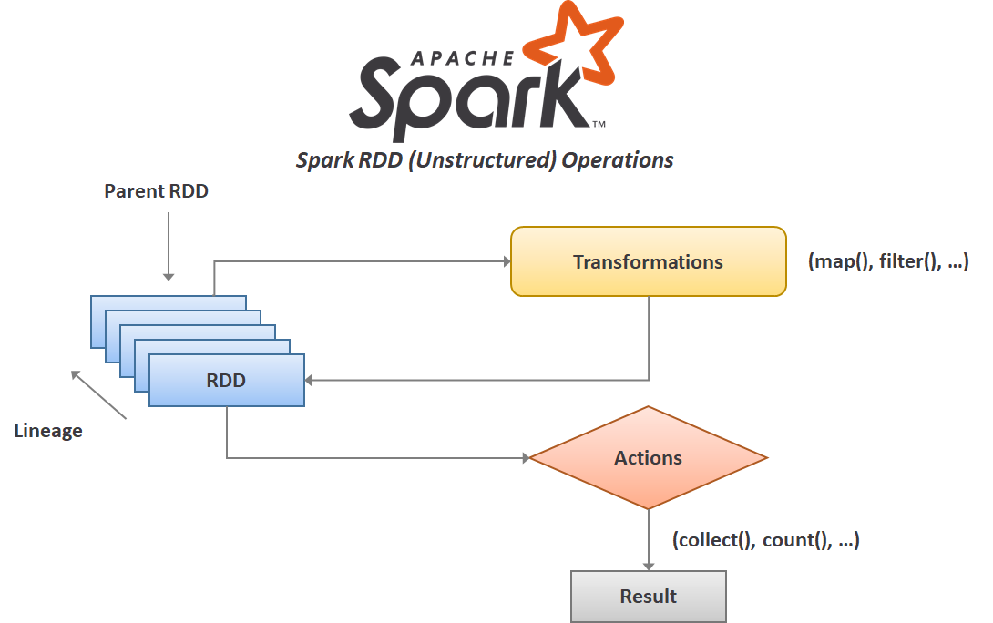
Transformation & action Functions

Slide 6
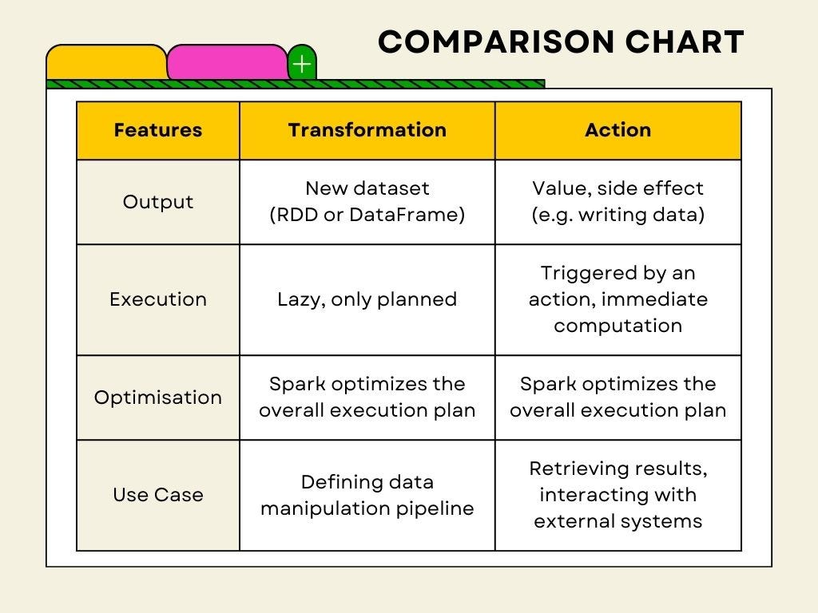
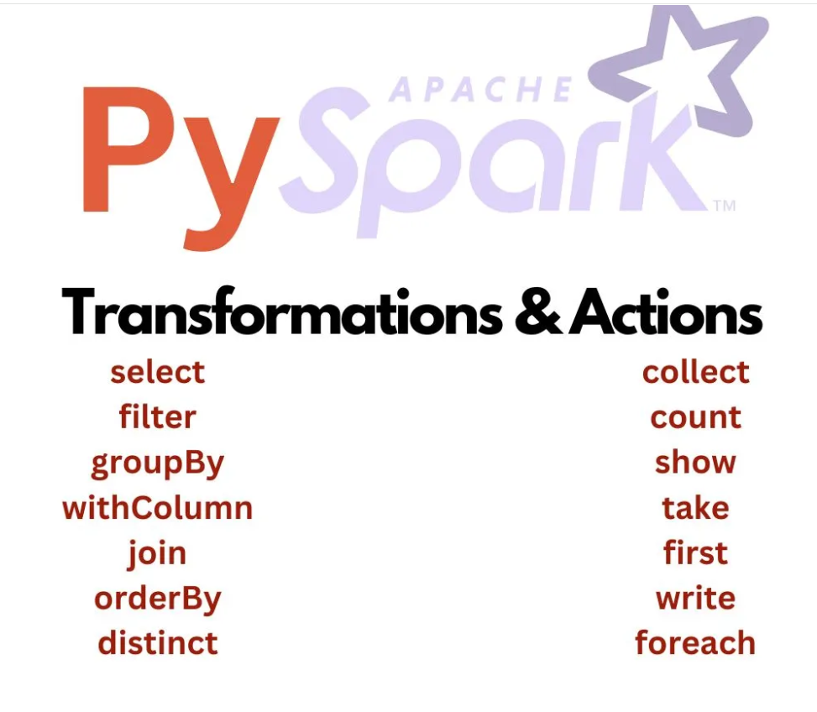
Transformation & action Functions

Slide 7
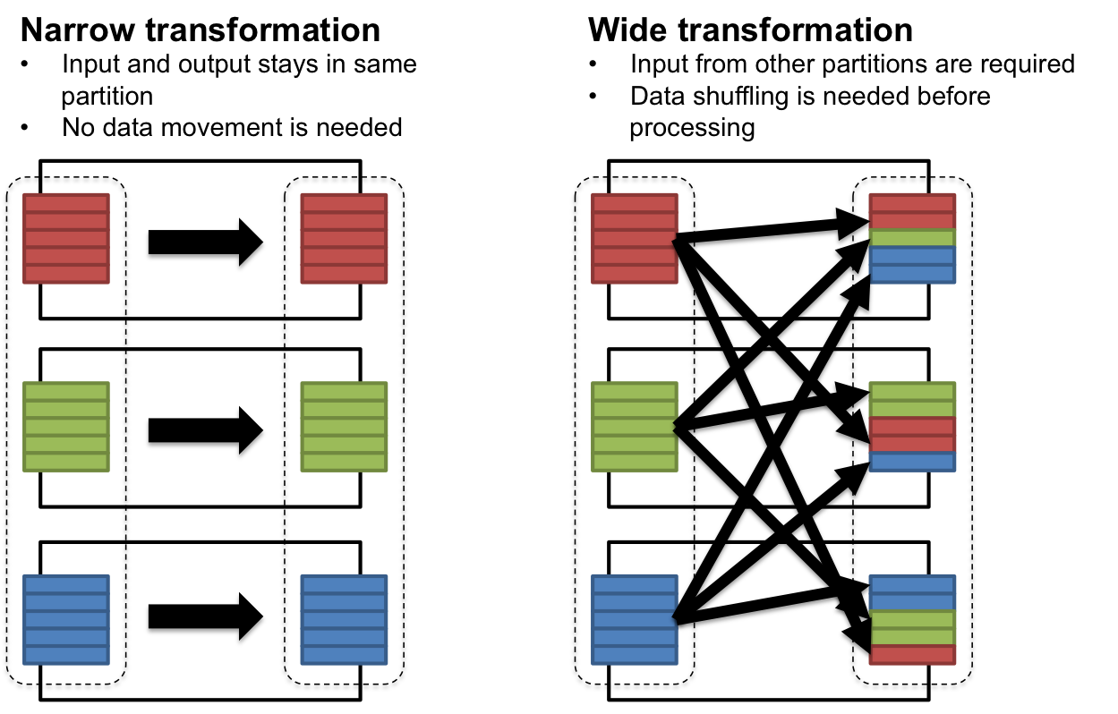
Narrow VS wide Transformations
Partition 1
Partition 2
Partition 3

Slide 8
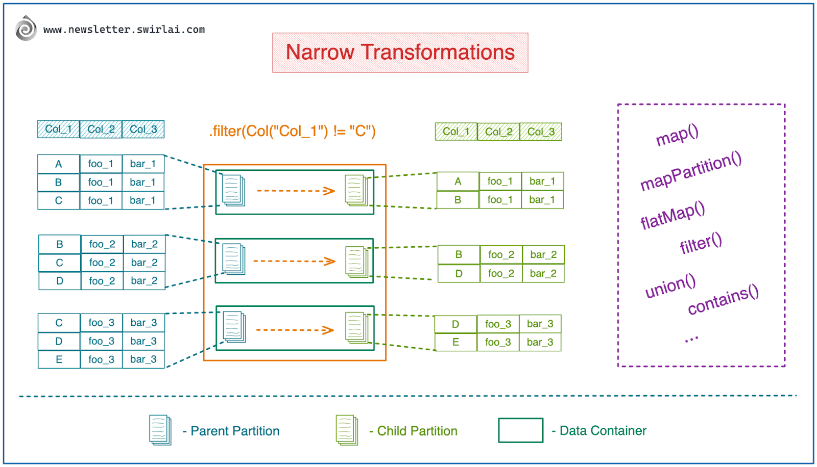
Narrow VS wide Transformations

Slide 9
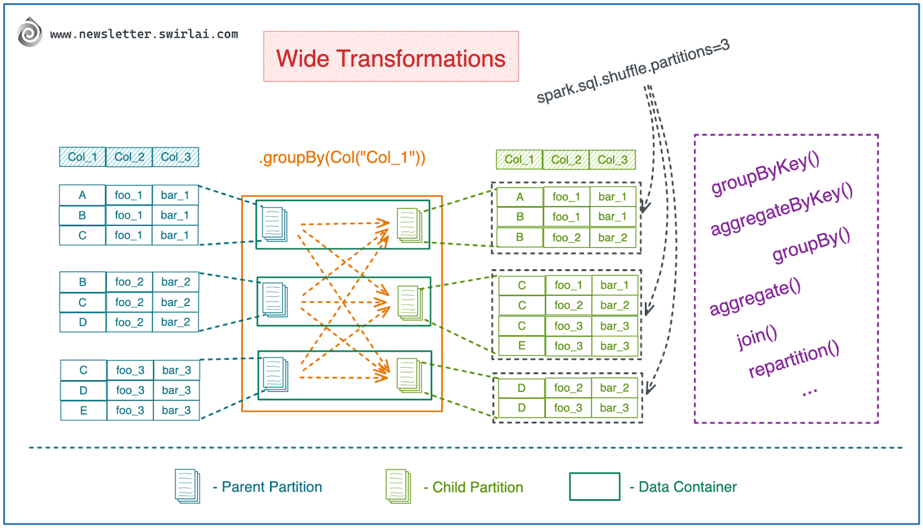
Narrow VS wide Transformations

Slide 10
Understand Execution
from pyspark.sql.functions import *
payment_df = spark.sql('SELECT * FROM test.PAYMENT’)
bills_df = spark.sql('SELECT * FROM test.BILLS’)
joined_df = payment_df .join(bills_df, payment_df.id == bill_df.id, 'inner’)
first_filter_df = joined_df.where(col(' BILLS.code') == 112)
second_filter_df = first_filter_df.where(col('creation_day') == '2025-05-01’)
second_filter_df.count()
Highlight Action Functions, Wide transformation and narrow transformation functions

Slide 11
Understand Execution
from pyspark.sql.functions import *
payment_df = spark.sql('SELECT * FROM test.PAYMENT’)
bills_df = spark.sql('SELECT * FROM test.BILLS’)
joined_df = payment_df .join(bills_df, payment_df.id == bill_df.id, 'inner’)
first_filter_df = joined_df.where(col(' BILLS.code') == 112)
second_filter_df = first_filter_df.where(col('creation_day') == '2025-05-01’)
second_filter_df.count()
Initial Load
Initial Load
Wide Transformation
Narrow Transformation
Narrow Transformation
Action

Slide 12
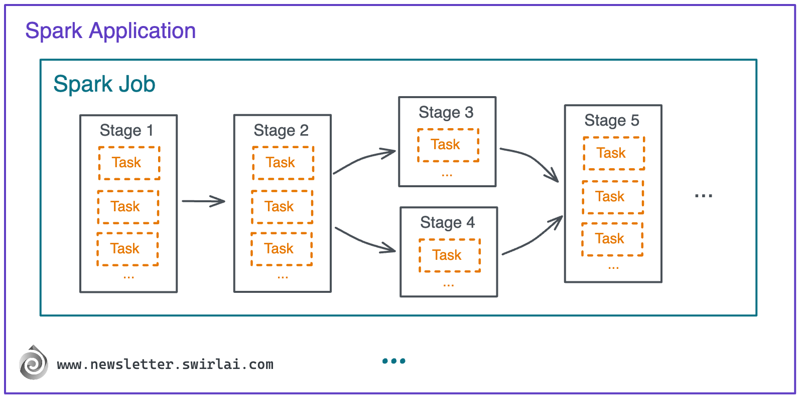
Internals of spark Application
=> Action Function
Wide
Trans.
Wide
Trans.
Partitions No
Partitions No
Partitions No

Slide 13
Internals of spark Job
from pyspark.sql.functions import *
payment_df = spark.sql('SELECT * FROM test.PAYMENT’)
bills_df = spark.sql('SELECT * FROM test.BILLS’)
joined_df = payment_df .join(bills_df, payment_df.id == bill_df.id, 'inner’)
first_filter_df = joined_df.where(col(' BILLS.code') == 112)
second_filter_df = first_filter_df.where(col('creation_day') == '2025-05-01’)
second_filter_df.count()
How many jobs, stages and tasks in this part of code ?

Slide 14
Internals of spark Job
One Job
Two Stages
10 Tasks
from pyspark.sql.functions import *
payment_df = spark.sql('SELECT * FROM test.PAYMENT’)
bills_df = spark.sql('SELECT * FROM test.BILLS’)
joined_df = payment_df .join(bills_df, payment_df.id == bill_df.id, 'inner’)
first_filter_df = joined_df.where(col(' BILLS.code') == 112)
second_filter_df = first_filter_df.where(col('creation_day') == '2025-05-01’)
second_filter_df.count()
Initial Load
Initial Load
Wide Transformation
Narrow Transformation
Narrow Transformation
Action

Slide 15
How to determine partitions Number
Data Size
  The larger the data, the more partitions you should use
  The best partition size is between 100 to 200 MB
  Example, If your data = 10 GB, partition size = 100 MB,
  then partitions count = (10 * 1000) / 100 = 100 partition

Slide 16
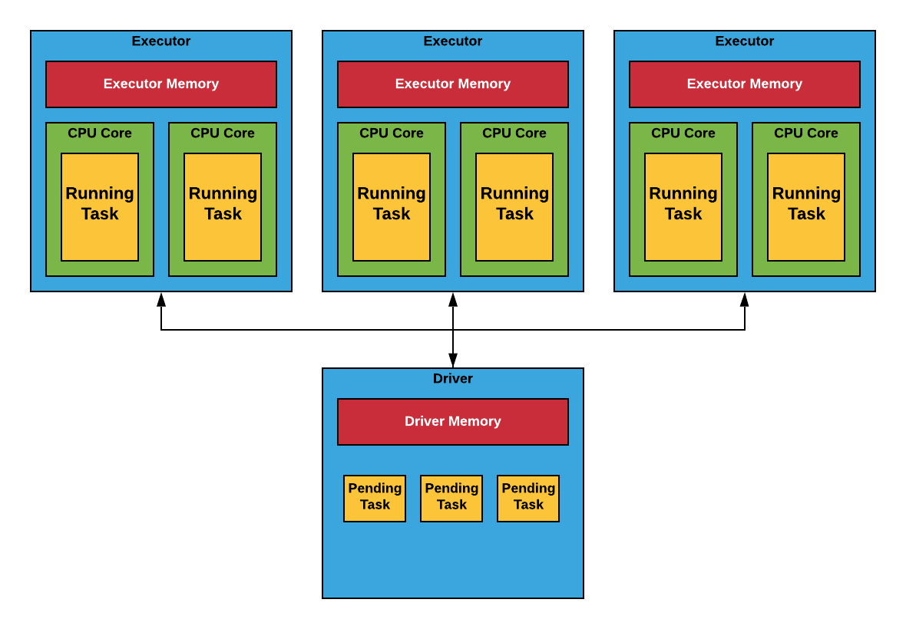
Spark Components
Spark Components
Spark-submit test.py

