Slide 1


Robotics
Ahmed jafar Osman Ahmed

Slide 2

Agenda
Introduction
Methodology
PID
Fuzzy Logic Controller
Right edge following behavior
Obstacle avoidance behavior
Integration both behavior
Results
References

Slide 3
Introduction

Slide 4
Introduction
The proportional-integral-derivative (PID) control has simple structure and clear physical meanings for its three gains. The control performances are acceptable in the most of industrial processes. It has been used in more than 90% of various practical control systems.
Fuzzy logic, developed by Lotfi A. Zadeh, enables mathematical rules and functions for natural language queries. It mimics human thinking by reasoning approximately rather than precisely, handling uncertainty. Fuzzy logic control converts linguistic control information into mathematical control information
In this project, we demonstrate how to implement a PID (Proportional-Integral-Derivative) controller in a robot for right edge following. Furthermore, we utilize the capabilities of Fuzzy Logic Control for obstacle avoidance and right edge following. Additionally, we integrate these systems into one system.

Slide 5
Methodology

Slide 6

Proportional-Integral-Derivative (PID)
There are various processes involved in designing a robot that follows the right edge using a PID controller:
Sensor Selection: we are using LiDAR (Light Detection and Ranging) in this specific project; it is essential to choose the appropriate sensor region in order to precisely sense the wall. In this project I choose (###)
Desired Distance Determination: The following stage is to decide how far away the robot should remain from the wall. A target distance of 0.6 has been selected.
Tuning the PID Parameters: In the third stage, the three parameters of the PID controller Kp (proportional gain), Ki (integral gain), and Kd (derivative gain)— are fine-tuned to maximize its ability to follow the right edge.
Error Calculation: three error calculations are employed. These calculations are essential in determining the adjustments needed for the robot's movement. Check the equations
$ⅇ=$ desired distance – current distance
$$e_{i}=e_{i}+ⅇ$$
$e_{d}=e−e_{P_{r}}$

Slide 7
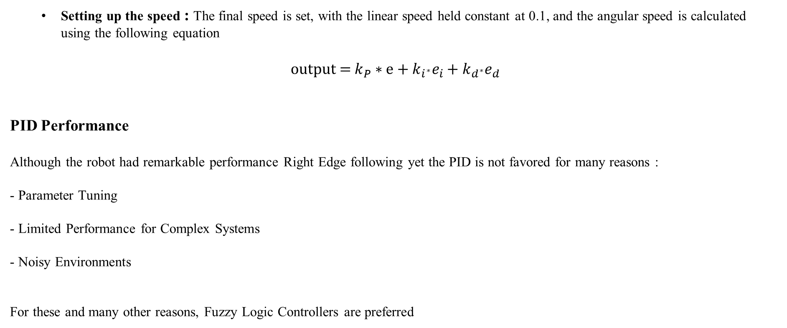
Setting up the speed : The final speed is set, with the linear speed held constant at 0.1, and the angular speed is calculated using the following equation
$$\text{output}\text{ = }k_{P}∗ⅇ+k_{i^{∗}}e_{i}+k_{d^{∗}}e_{d}$$
PID Performance
Although the robot had remarkable performance Right Edge following yet the PID is not favored for many reasons :
- Parameter Tuning
- Limited Performance for Complex Systems
- Noisy Environments
For these and many other reasons, Fuzzy Logic Controllers are preferred

Slide 8
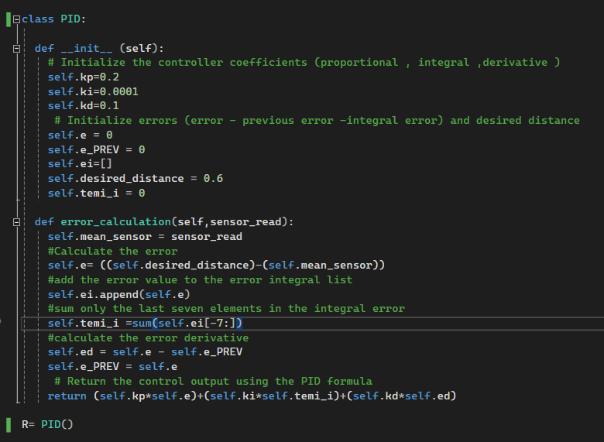
PID Code

Slide 9
Fuzzy Logic Controller
In contrast to PID controllers, fuzzy logic controllers exhibit enhanced robustness in managing noisy environments. The utilization of fuzzy logic mimics human-like decision-making processes, making it intuitive and easy to implement for different systems.
- Right Edge following behavior
There are various processes involved in designing a robot that follows the right edge using a Fuzzy logic controller:
- Sensor Selection: in the is project two sensor or regions (Front Right) and (Back right)
- Choosing Linguistic Variable : defining the distance from the wall ( both inputs) to three linguistic variable (close – Medium – far) and for the output linear speed to (slow – medium - fast) and for the angular speed to (front – left - right) as shown in fig
- Membership Function : define a membership function for each linguistic variable as shown in fig.1 and fig.2
- Rule Base : defining a set of fuzzy rules as show in Table 1 which map the relation between input and output
- Fuzzification: convert the input into fuzzy set
- Inference : Applies the fuzzy rules to determine the fuzzy output.
-defuzzification : Converts the fuzzy output into a crisp value.

Slide 10
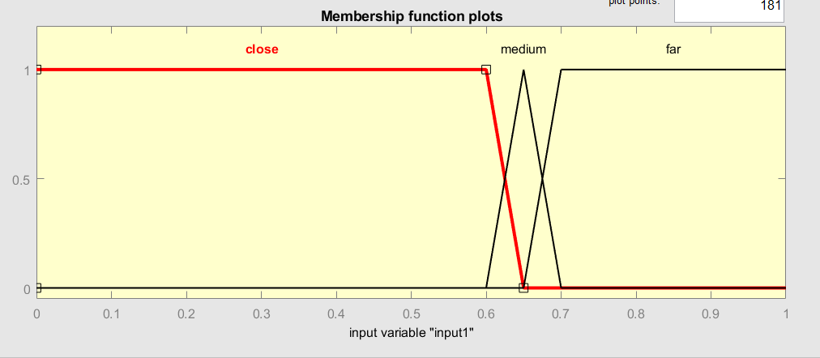
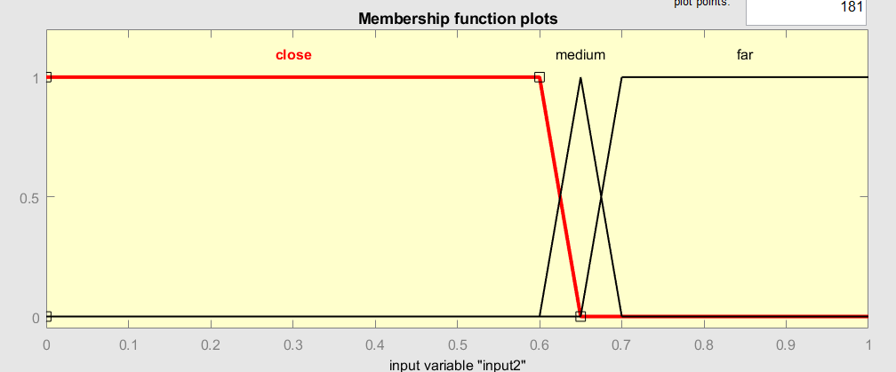
TABLE 1 RULE BASE FOR RIGHT EDGE FOLLOWING
FRONT RIGHT SENSOR | BACK RIGHT SENSOR | LINEAR SPEED | ANGULAR SPEED
Close | Close | Slow | Left
Close | Medium | Slow | Left
Close | Far | Low | Left
Medium | Close | Medium | Front
Medium | Medium | Medium | Front
Medium | Far | Medium | Front
Far | Close | Fast | Right
Far | Medium | Fast | Right
Far | Far | Fast | Right
Fig.1.Input Membership Function

Slide 11
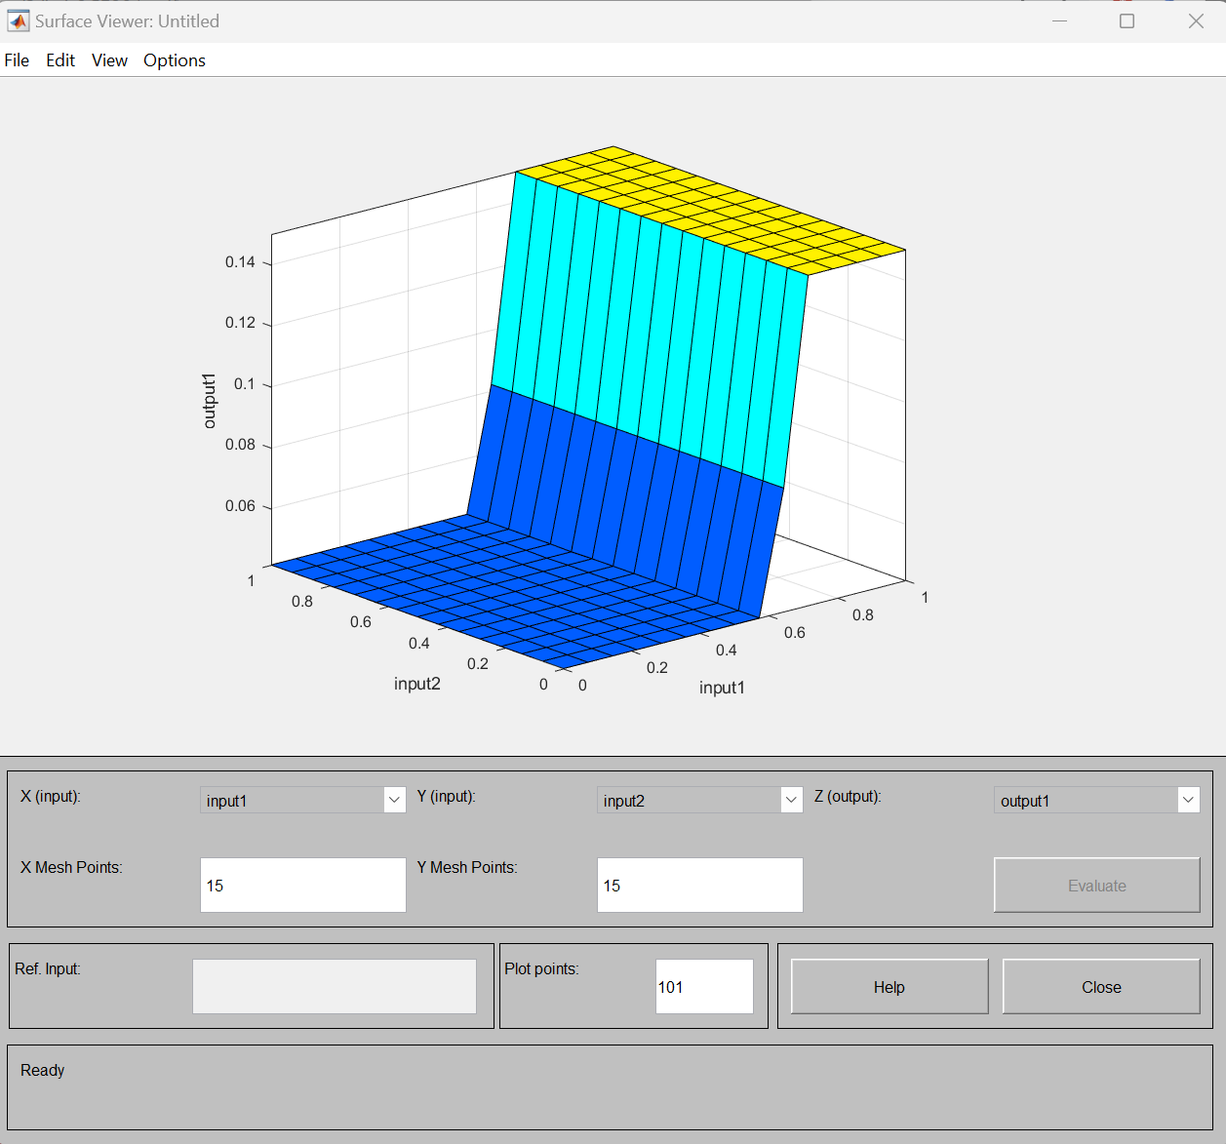
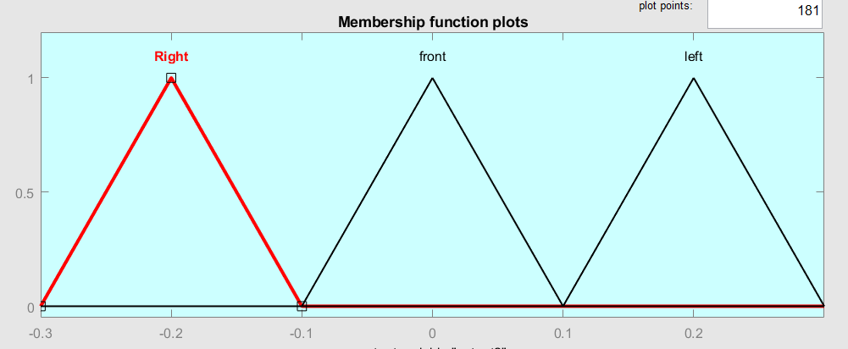
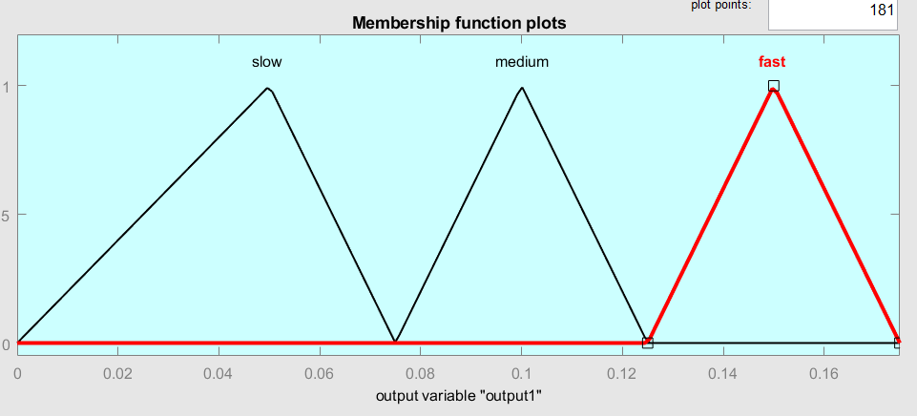
Fig.3. MATLAB Simulation For Right Edge
Fig.2.Output Membership Function

Slide 12
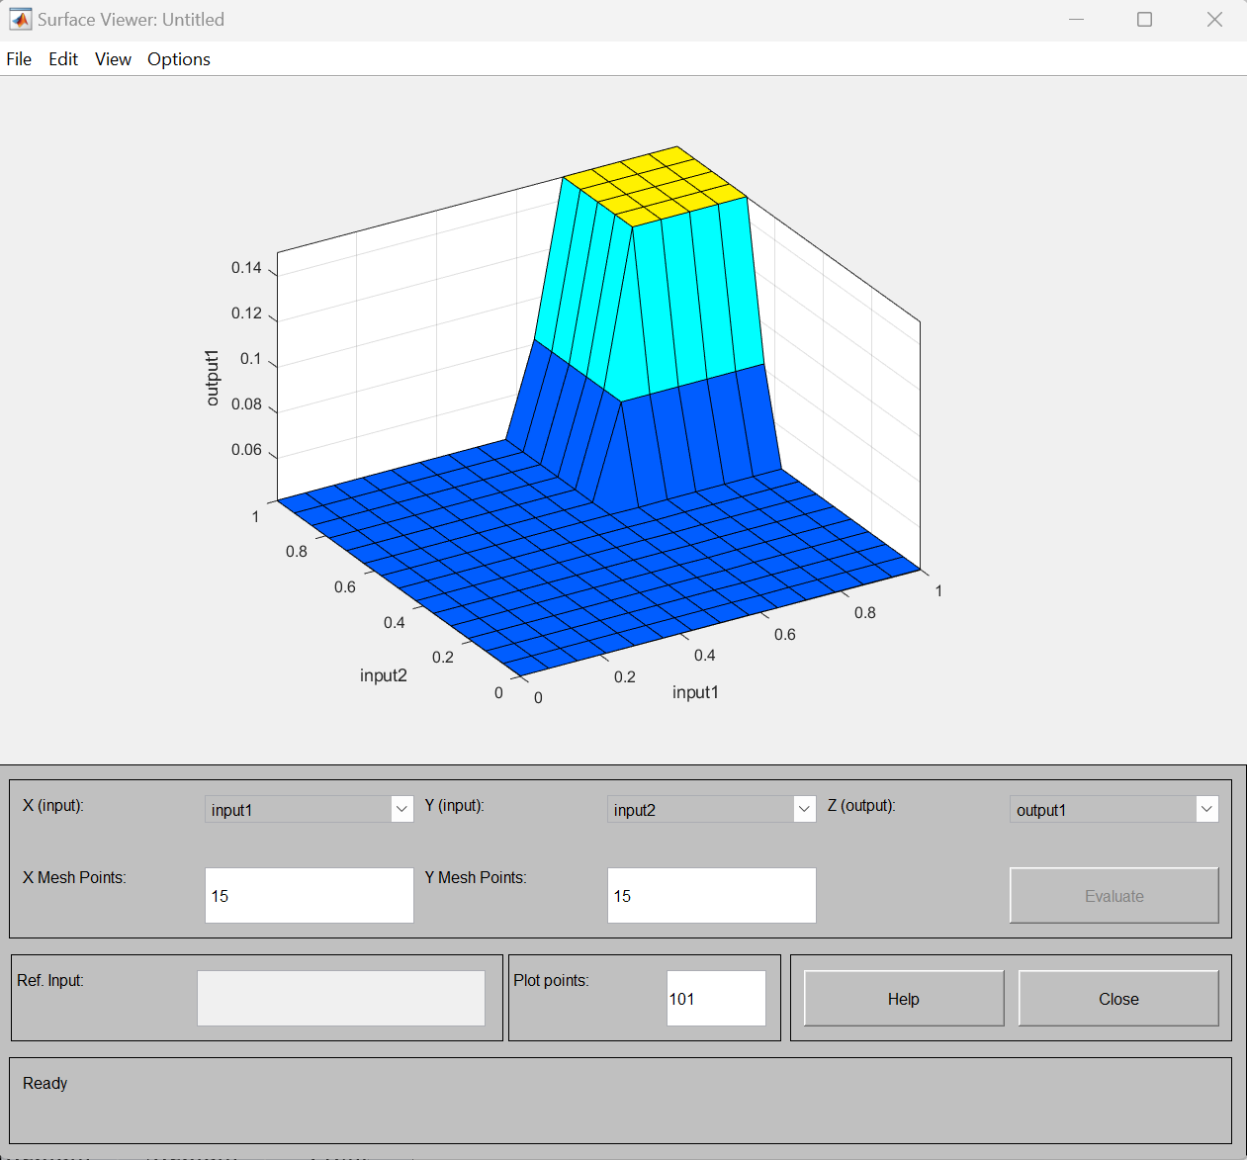
Obstacle avoidance behavior
the same steps for Right edge were executed the only difference is the used sensor ( regions ) and the rule base.
TABLE 2 RULE BASE FOR OBSTACLE AVOIDANCE
FRONT RIGHT SENSOR | BACK RIGHT SENSOR | LINEAR SPEED | ANGULAR SPEED
Close | Close | Slow | Left
Close | Medium | Slow | Left
Close | Far | Slow | Left
Medium | Close | Slow | Left
Medium | Medium | Medium | Front
Medium | Far | Medium | Front
Far | Close | Slow | Left
Far | Medium | Medium | Front
Far | Far | Fast | Front
Fig.4. MATLAB Simulation For Obstacle Avoidance

Slide 13
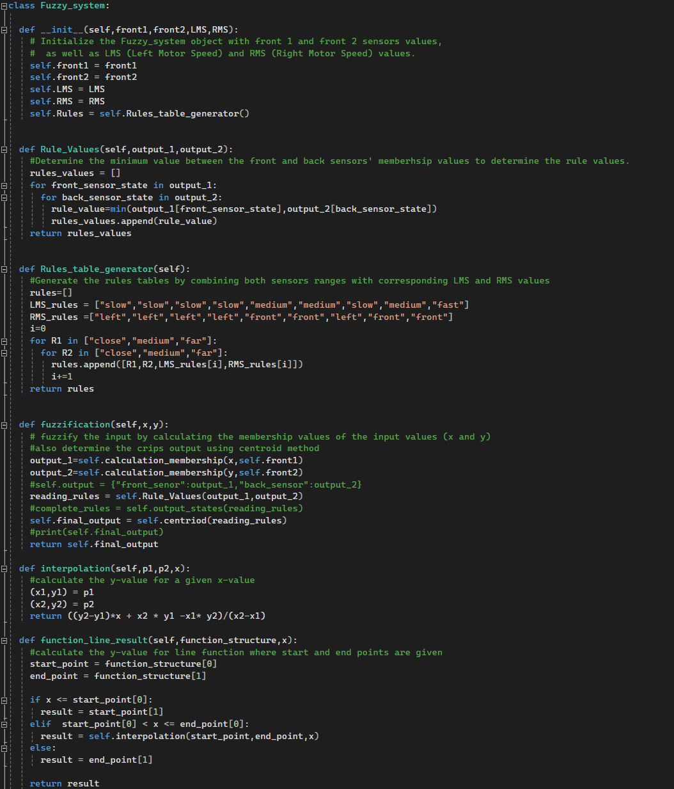
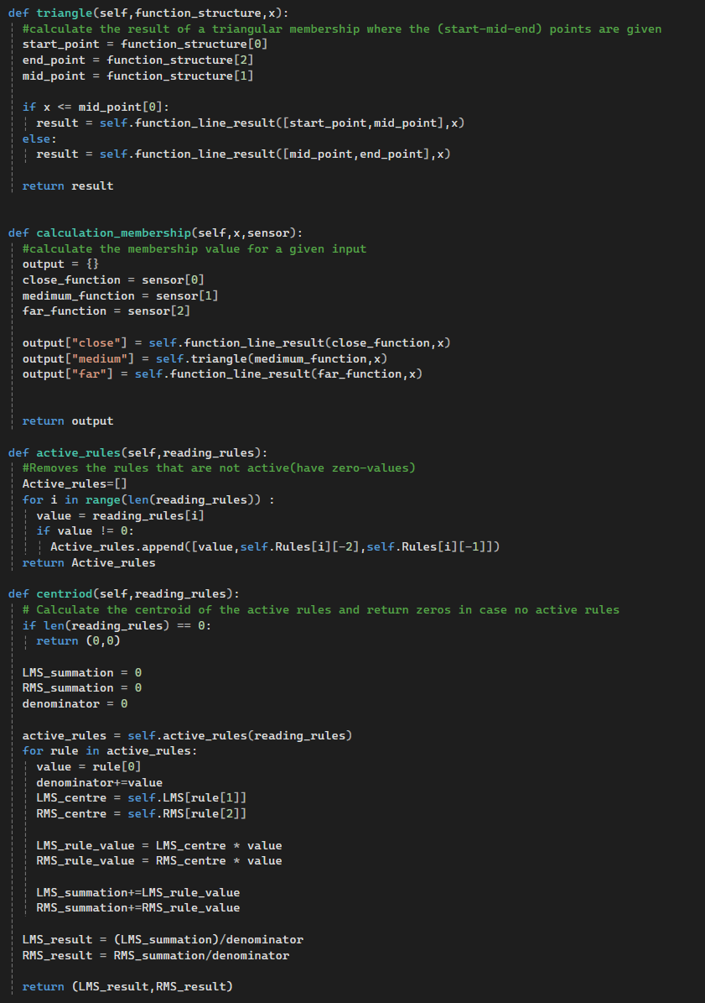
Fuzzy system controller Code

Slide 14
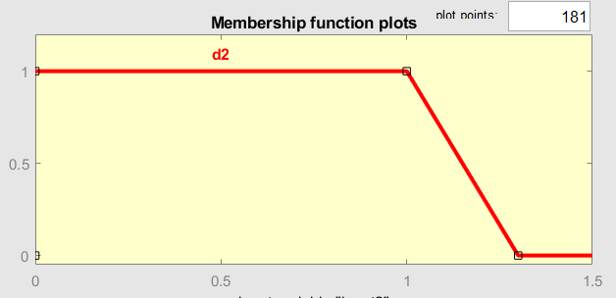
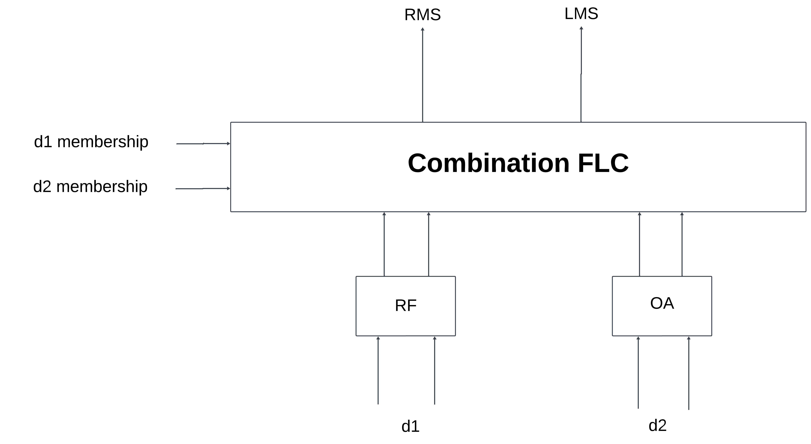
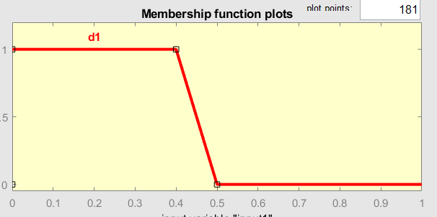
Integration of both behavior
The system is shown in the figure along with the membership functions for both d1 and d2 in figure
Fig.6. Block Diagram For The System
Fig.5. d1 and d2 Membership function

Slide 15
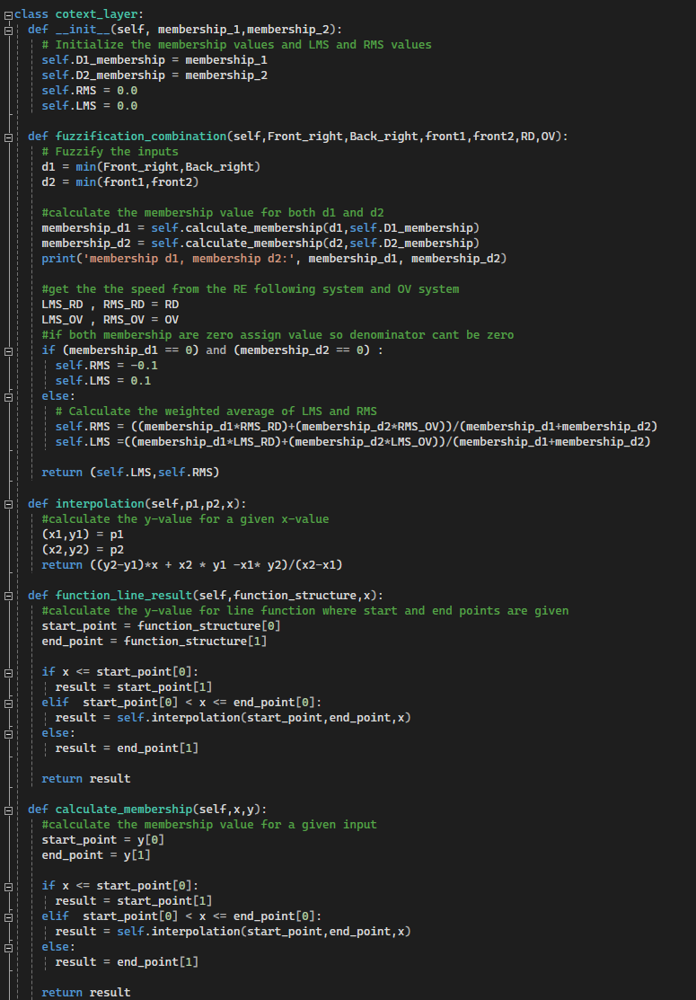
Context layer

Slide 16
Results

Slide 17
Results
Video for PID Right Edge : https://youtu.be/LcpSJCoUrcE
Video for Fuzzy controller Right edge following behavior : https://youtu.be/Qdcx1GOljIQ
Video for Fuzzy controller (Obstacle avoidance behavior) : https://youtu.be/8zcmklsf8PU
Video for Integration of both behavior : https://youtu.be/BE4WXoKOD4A

Slide 18
Questions ?

Slide 19
Thank you

