Slide 1
Coronary Heart Disease Risk Analysis
Prepared by Ahmed Khaled

Slide 2
Agenda
01
02
03
04
Introduction
Data Overview
Feature Insights
Features Realationships

Slide 3
01
Introduction

Slide 4
Introduction
The Framingham Heart Study Dataset is a comprehensive collection of patient information from
an ongoing cardiovascular study in Framingham , Massachusetts. The dataset aims to predict
the 10-year risk of future coronary heart disease (CHD) in patients based on various health
attributes.
It includes over 4,000 records and 15 attributes, making it a valuable resource for researchers
and data scientists working on predictive modeling
in healthcare.

Slide 5
02
Data Overview

Slide 6
Data Overview
Key Features
male | Indicates the gender of the individual (1 = male, 0 = female).
education | The education level of the individual, typically categorized (e.g., 1 for primary, 2 for secondary, 3 for faculty ,4 for graduation.).
currentSmoker | Indicates if the individual is currently a smoker (1 = yes, 0 = no).
cigsPerDay | The number of cigarettes the individual smokes per day.
BPMeds | Indicates if the individual is currently taking blood pressure medication (1 = yes, 0 = no).
prevalentStroke | Indicates if the individual has had a stroke before (1 = yes, 0 = no).
prevalentHyp | Indicates if the individual has been diagnosed with hypertension (1 = yes, 0 = no)
diabetes | Indicates if the individual has diabetes (1 = yes, 0 = no)

Slide 7
Data Overview
Key Features
totChol | Total cholesterol level in the blood (mg/dL).
sysBP | Systolic blood pressure, the pressure in arteries during heartbeats (mmHg).
diaBP | Diastolic blood pressure, the pressure in arteries between heartbeats (mmHg).
BMI | Body Mass Index, calculated as weight (kg) divided by height (m²), an indicator of body fat.
heartRate | The resting heart rate of the individual (beats per minute).
glucose | Blood glucose level, a measure of blood sugar (mg/dL).
TenYearCHD | Indicates if the individual developed coronary heart disease (CHD) within ten years (1 = yes, 0 = no).

Slide 8
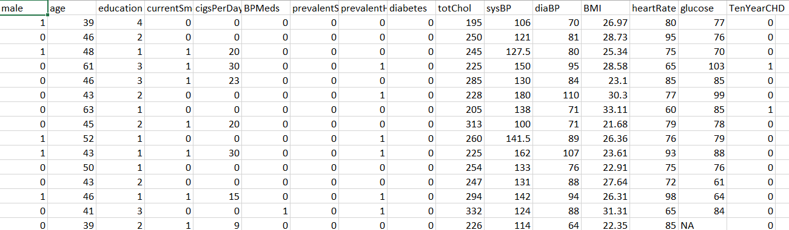
Data Overview

Slide 9
After Cleaning And Preprocessing

Slide 10
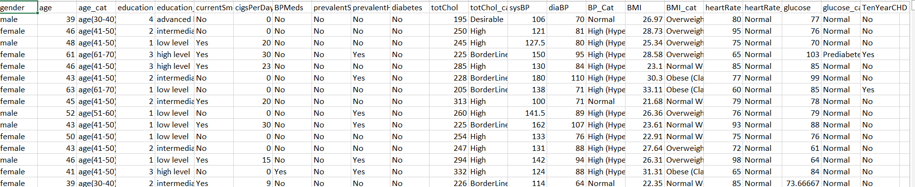
Data Overview

Slide 11
03
Feature Insights

Slide 12
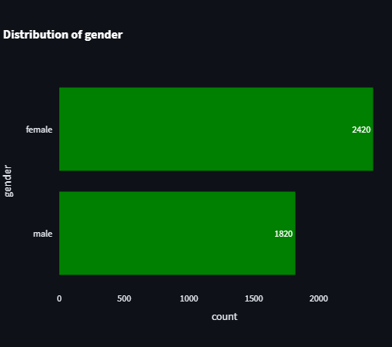
gender
Feature Insights
- As you see the number of females greater
than the number of males .

Slide 13
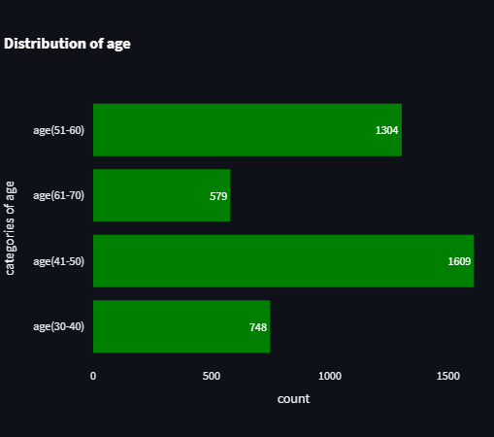
Categories of Age
Feature Insights
I divided age in categories every category differ form the another category by ten years.
Is see that most of ages fill in age from
41 to 50 .

Slide 14
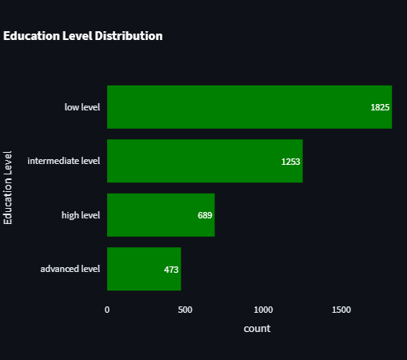
Categories of Education
Feature Insights
- unfortunately, most of data is in the low level and intermediate level

Slide 15
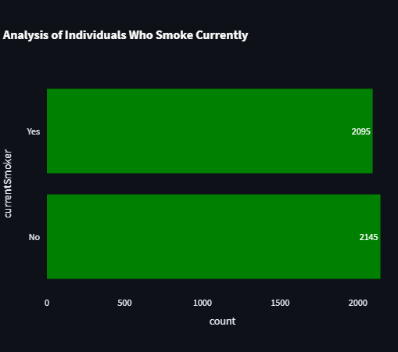
Current Smoker
Feature Insights
The number of smokers and non-smokers are close to each other
which means the percentage of smokers is high.

Slide 16
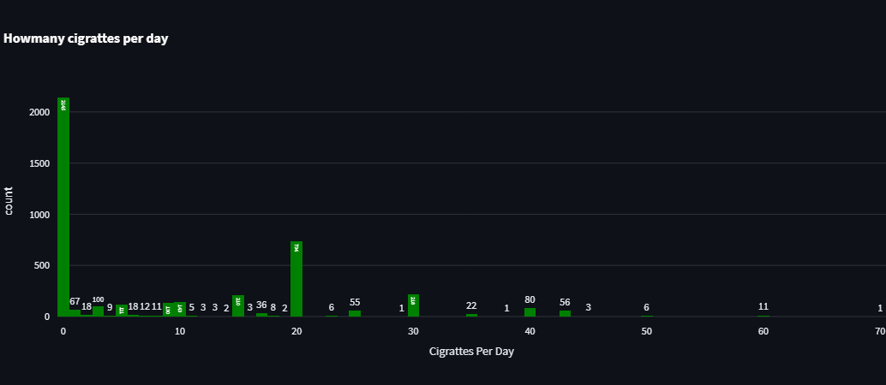
cigsPerDay
Feature Insights
The data is distributed across all numbers, but the average is 20, which is the central value around which all numbers fluctuate.
I see two strange numbers
60 and 70 cigs per day
(12 cases)

Slide 17
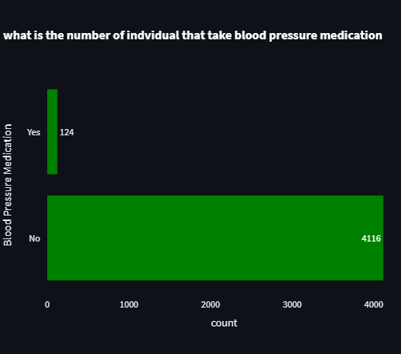
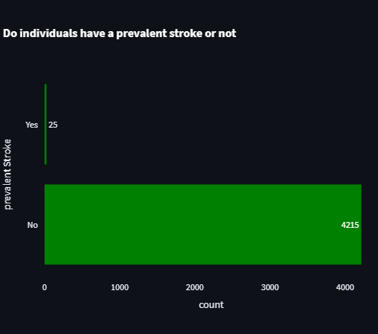
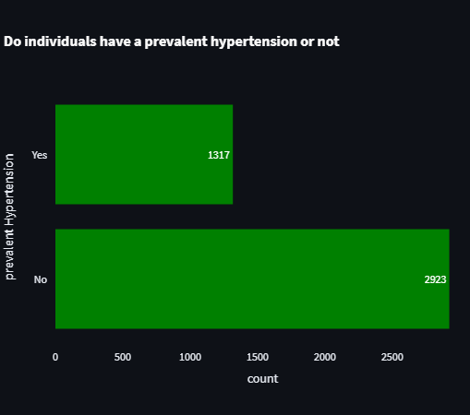
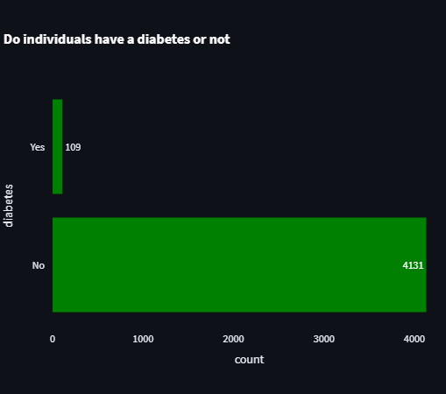
Diseases
Feature Insights

Slide 18
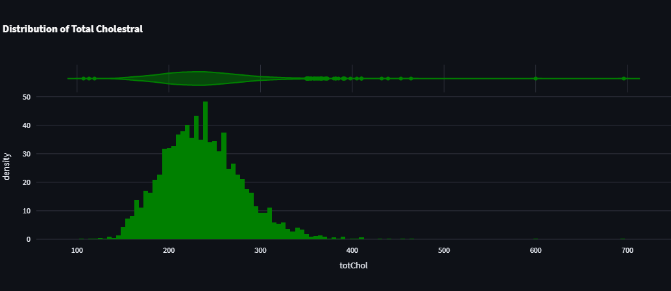
Total cholestral
Feature Insights
I See that data is normally distributed
But there is large numbers more than 248.5
(1540 cases)
There is small numbers
Less than 120.5(3 cases)
- Which of them is important?

Slide 19
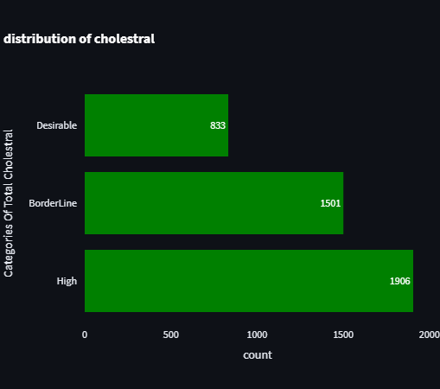
Categories of total choestral
Desirable
Range: Less than 200 mg/dL
BorderLine
Range: 200-239 mg/dL
High
Range: 240 mg/dL and above

Slide 20
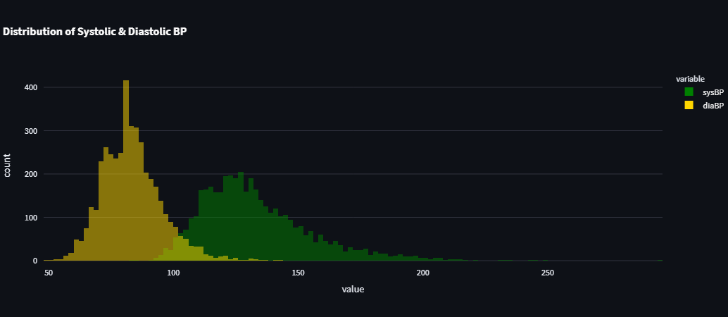
sysBP&diaBP
Feature Insights
I see large numbers in systolic greater than 184.5 (283 cases) 5 cases of them don’t have hypertension
I see small numbers less than 52.5 which is 5 cases (hypotension)

Slide 21
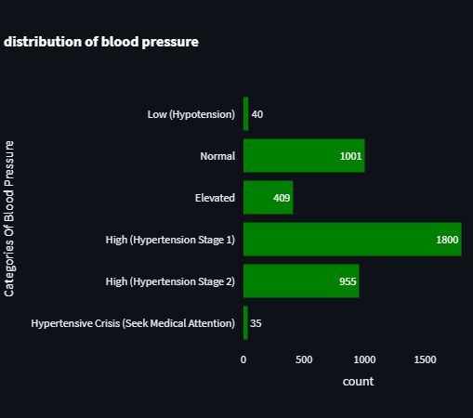
Categories of Blood Pressure
Low(Hypotension)
Range: Sys: <90 | Dia: <60
Normal
Range: Sys: 90-119 | Dia: 60-79
Elevated
Range: Sys: 120-129 | Dia:<80
High (Hypertension Stage 1)
High (Hypertension Stage 2)
Hypertensive crisis

Slide 22
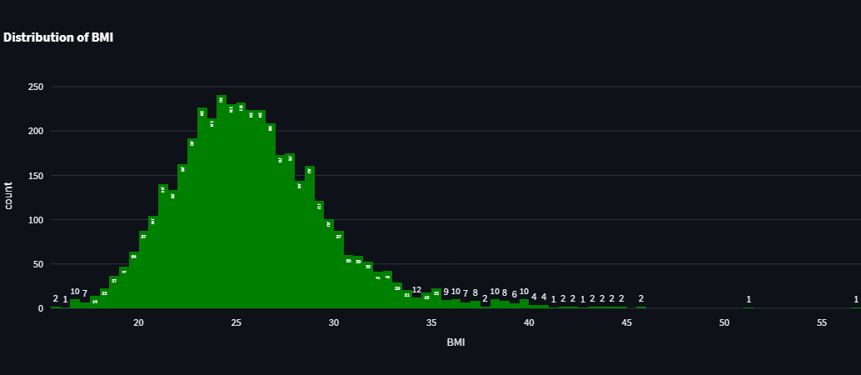
BMI
Feature Insights
I See that data is normally distributed
But there is large numbers more than 35.495
(96 cases)
There is one case
Less than 15.615 (15.54)

Slide 23

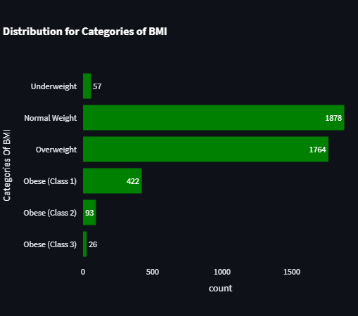
Categories of BMI
Underweight
Obese (Class 1)
Range: BMI < 18.5
Range: BMI 30 - 34.9
Obese (Class 2)
Normal Weight
Range: BMI 18.5 - 24.9
Range: BMI 35 - 39.9
Obese (class 3)
Overweight
Range: BMI 25 - 29.9
Range: BMI ≥ 40

Slide 24
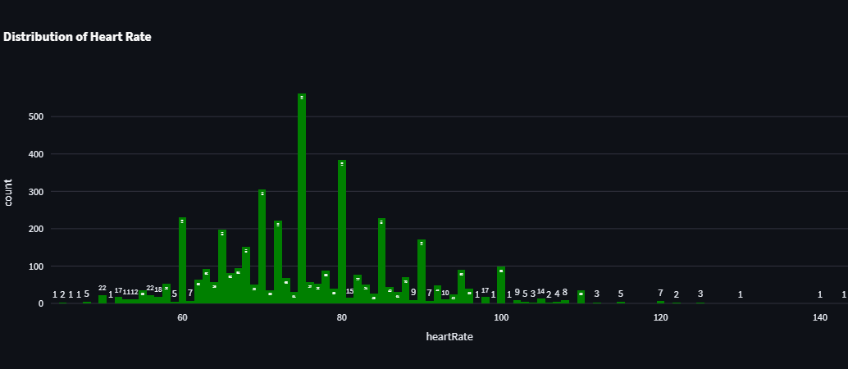
Heart Rate
Feature Insights
But there is large numbers more than 105.5
(73 cases)
There is 3 cases only
Less than (45.5)

Slide 25
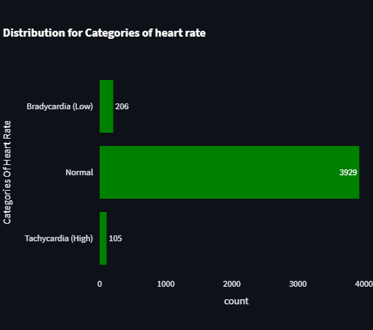
Categories of Heart Rate
Bradycardia (Low)
Range: HR < 60 bpm
Normal
Range: HR 60 - 100 bpm
Tachycardia (High)
Range: HR > 100 bpm

Slide 26
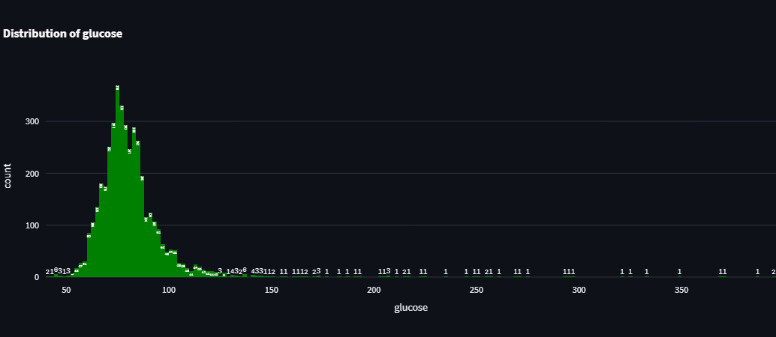
glucose
Feature Insights
I See that data is normally distributed .
But there is large numbers more than 107
(214 cases).
There is 16 cases
Less than 51.
- Which is important?

Slide 27
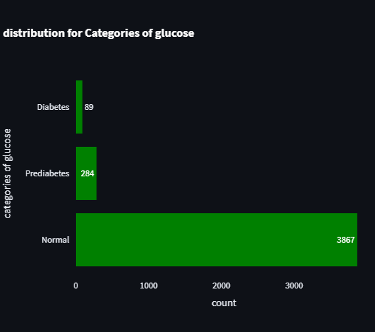
Categories of glucose
Normal
Range: Fasting Glucose < 100 mg/dL
Prediabetes
Range: Fasting Glucose 100 - 125 mg/dL
Diabetes
Range: Fasting Glucose ≥ 126 mg/dL

Slide 28
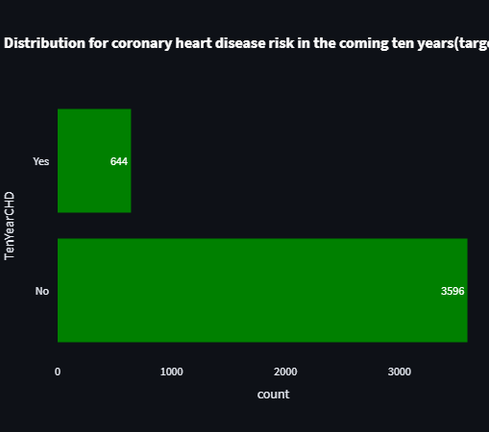
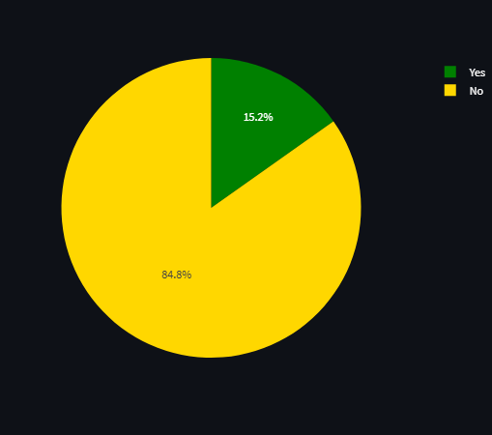
CHD Risk in 10 years
Feature Insights
Target feature - data is imbalanced - No>Yes

Slide 29
04
Feature Relationships

Slide 30
Gender analysis
I see that the number of females greater than males in all education level except in high level.
I see number of male smoking greater than number of females.
Number of males that smoke greater than not unlike females.
I see that people that smoke 60 and70 cigrattes per day all are males.
The number of females that take blood pressure medication(89) greater than number of males(35).
The number of females the have stroke(15) greater than number of males(10)
Same in hypertension.
In diabetes the two numbers are more close to each other 52 and 57.

Slide 31
Gender analysis
Same in total cholesterol females are higher than males in all categories.
Same in hypertension.
Same in BMI except in overweight category males greater than females.
12. Something strange in heart rate, males that have low heart rate (Bardycardia) higher than females.
13. same in glucose but males and females are very close to each other in diabetes category (53,56)
Important: males that have CHD risk in 10 years more than females Although in data number of females
greater than number of males.

Slide 32
Analysis Relationships
In all ranges of age the low level and intermediate level are higher than the other.
2. I have 2 ranges 51 to 60 ,61 to 70 the highest two ranges that take blood pressure medication.
3. The number of smokers increase at the beginning but after range 41 to 50 the no of smokers decrease.
The range from 51 to 60 is the highest in all diseases(stroke , diabetes, hypertension).
I have a lot of people that have high cholesterol but most of them fall in range 41 to 50 and 51 to 60
take care not range 61 to 70 that is mean no relation between age and cholesterol.
6. Blood pressure categories distributed in all ranges but as the range of age increase the crisis category increase.
(41 to 50)&(51 to 60) have the highest bmi (underweight,overweight , obese 1, obese 2,obese 3).
Same in heart rate.

Slide 33
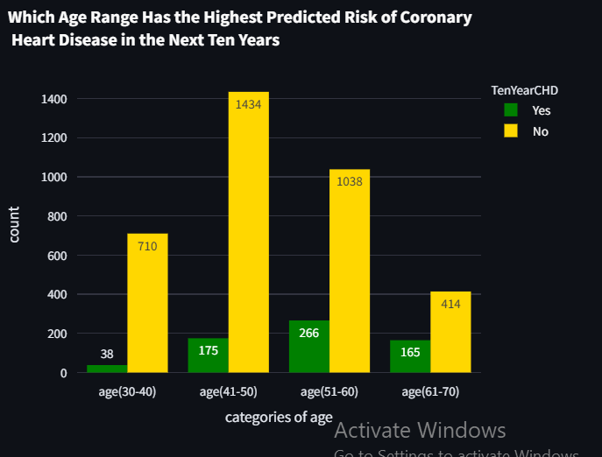
Analysis Relationship
Range 51 to 60 is higher than the other in prediabetes and diabetes.
CHD risk among the ranges of age

Slide 34
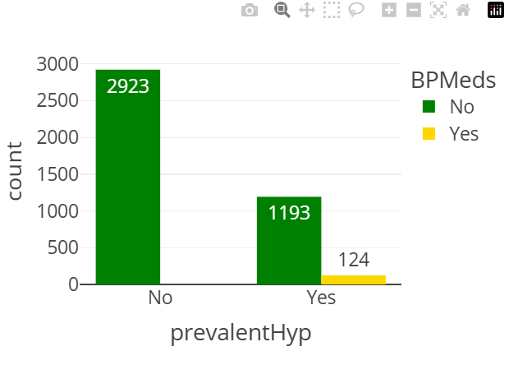
Analysis Relationships
All people that take blood pressure medication have hypertension.

Slide 35
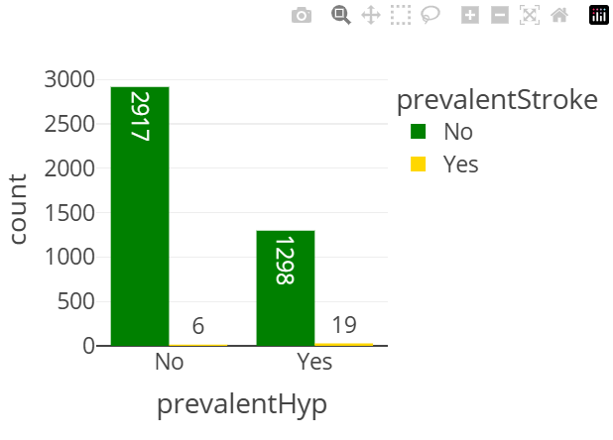
Analysis Relationships
There is a strong relationship between stroke and hypertension.

Slide 36
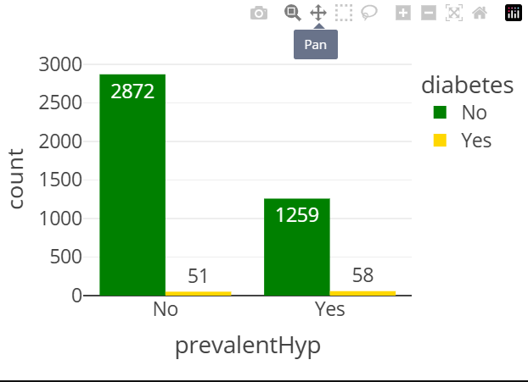
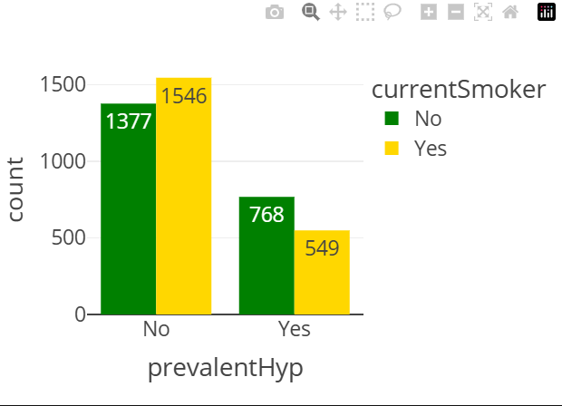
Analysis Relationships

Slide 37
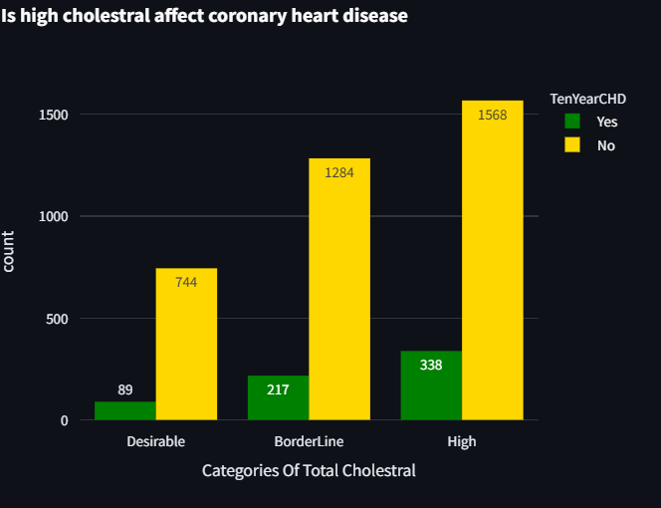
Analysis Relationships
Most of people that have high cholesterol fall in low level education.
There is a strong relationship between current smoker and cholesterol categories look at the plot.
Strong relationship between cholesterol and all diseases(BPMeds, Hypertension, diabetes, stroke).
High cholesterol has the highest number of highest hypertension stage 2 and crisis.
As the BMI , glucose, heart rate increase the total cholesterol increase.
6-

Slide 38
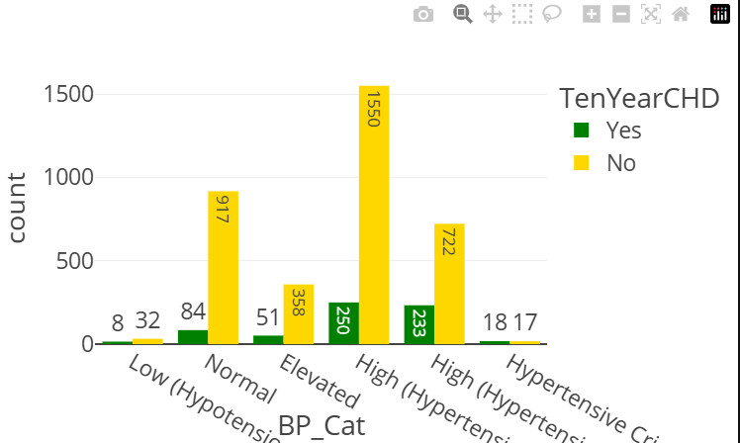
Analysis Relationship
blood pressure and coronary heart disease.

Slide 39
Look at the dashboard

Slide 40
Resources
- github link: https://github.com/AhmedKhaledabdelkader/Coronary_Heart_Disease_Risk_Analysis/
Dashboard link:
https://coronary-heart-disease-risk-analysis.streamlit.app/

Slide 41
End

