Slide 1


Faculty of computer and information sciences
Mansoura University
Information System Department
Intelligent Information System
Lecture 4: Solving Problem by Searching
Dr. Reham Reda Mostafa
Mansoura University
Faculty of Computers and Information
Dept. of Information System
dr.reham2206@yahoo.com
7. March 2017
14. March 2017

Slide 2
Faculty of computer and information sciences
Mansoura University
Information System Department
Outlines
Problem-solving Agents
Well-defined Problems and Solutions
Problem Types
Example Problems
Toy Problems
Real-world Problems
Searching for Solutions
Tree Search Algorithms
Uninformed Search Strategies
Avoiding repeated states

Slide 3
Faculty of computer and information sciences
Mansoura University
Information System Department
Problem-solving Agents
A problem solving agent:
A kind of goal-based agents
Decides what to do by finding sequence of actions that lead to desirable states.
Goal Formulation: It is the first step in problem solving. It is based on the current situation and the agent's performance measure.
Problem Formulation: It is the process of deciding what actions and states to consider, given a goal.

Slide 4
Faculty of computer and information sciences
Mansoura University
Information System Department
Problem-solving Agents (cont’d)
An agent with several immediate options of unknown value can decide what to do by first examining different possible sequences of actions that lead to states of known values, and then choosing the best sequence.
This process of looking for such a sequence is called search.
A search algorithm
takes a problem as input and
returns a solution in the form of an action sequence.
Once a solution is found, the actions it recommends can be carried out. This is called the execution phase.
This is a simple “formulate, search, execute” design for the agent.

Slide 5
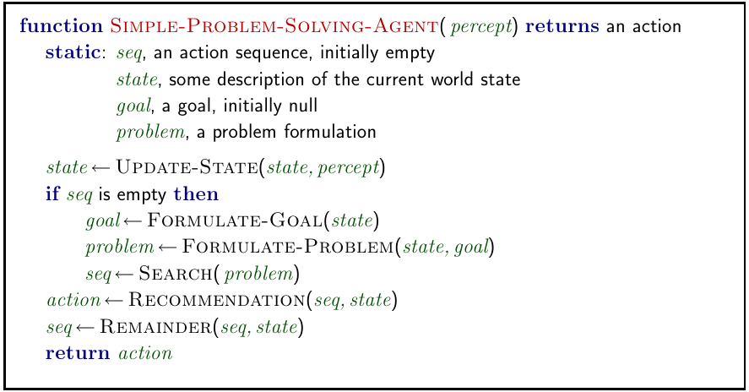
Faculty of computer and information sciences
Mansoura University
Information System Department
Restricted Form of General Agent

Slide 6
Faculty of computer and information sciences
Mansoura University
Information System Department
Well-defined Problems and Solutions
A problem can be defined formally by four components:
The initial state that the agent starts in.
A description of the possible actions available to the agent.
successor function: Given a particular state x, SUCCESSOR-FN(x) returns a set of (action, successor) ordered pairs, where each action is one of the legal actions in state x and each successor is a state that can be reached from x by applying the action.
The goal test, which determines whether a given state is a goal state.
A path cost function that assigns a numeric cost to each path.

Slide 7
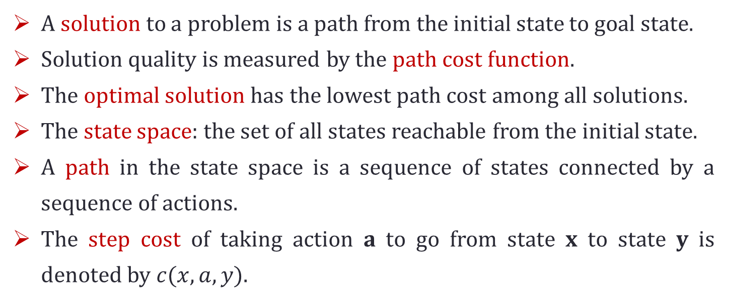
Faculty of computer and information sciences
Mansoura University
Information System Department
Notes
A solution to a problem is a path from the initial state to goal state.
Solution quality is measured by the path cost function.
The optimal solution has the lowest path cost among all solutions.
The state space: the set of all states reachable from the initial state.
A path in the state space is a sequence of states connected by a sequence of actions.
The step cost of taking action a to go from state x to state y is denoted by $c(x,a,y)$.

Slide 8
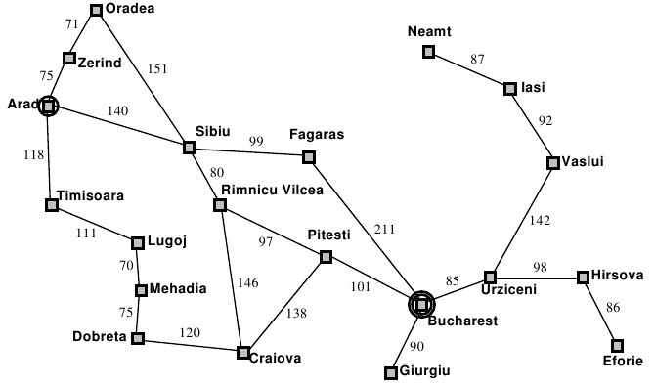
Faculty of computer and information sciences
Mansoura University
Information System Department
Example: Romania
On holiday in Romania; currently in Arad.
Flight leaves tomorrow from Bucharest.
Formulate Goal: be in Bucharest.
Formulate Problem:
States: various cities.
Actions: drive between cities.
Find Solution: sequence of cities, e.g., Arad, Sibiu, Fagaras, Bucharest.

Slide 9
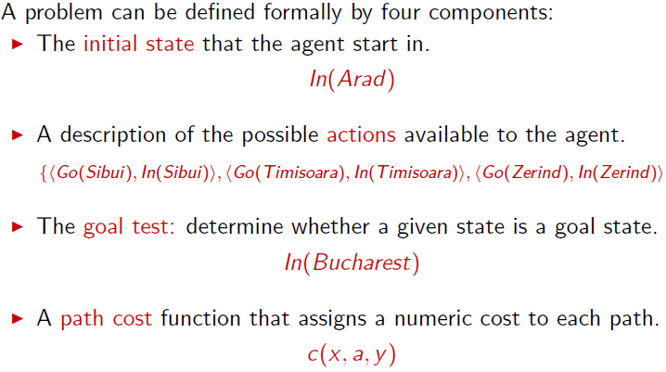
Faculty of computer and information sciences
Mansoura University
Information System Department
Well-defined Problems and Solutions

Slide 10
Faculty of computer and information sciences
Mansoura University
Information System Department
Outlines
Problem-solving Agents
Well-defined Problems and Solutions
Problem Types
Example Problems
Toy Problems
Real-world Problems
Searching for Solutions
Tree Search Algorithms
Uninformed Search Strategies
Avoiding repeated states

Slide 11
Faculty of computer and information sciences
Mansoura University
Information System Department
Example: Vacuum World
This vacuum world has just two locations: square A and B.
The vacuum agent perceives which square it is in and whether there is dirt in the square.
It can choose to move left, move right, suck up the dirt, or do nothing.
One very simple agent function is the following: if the current square is dirty, then suck, otherwise move to the other square.

Slide 12
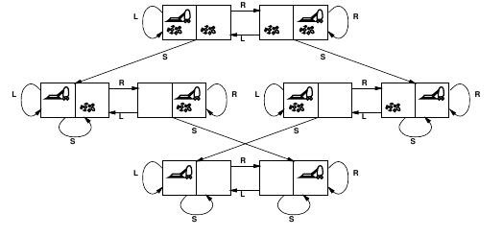
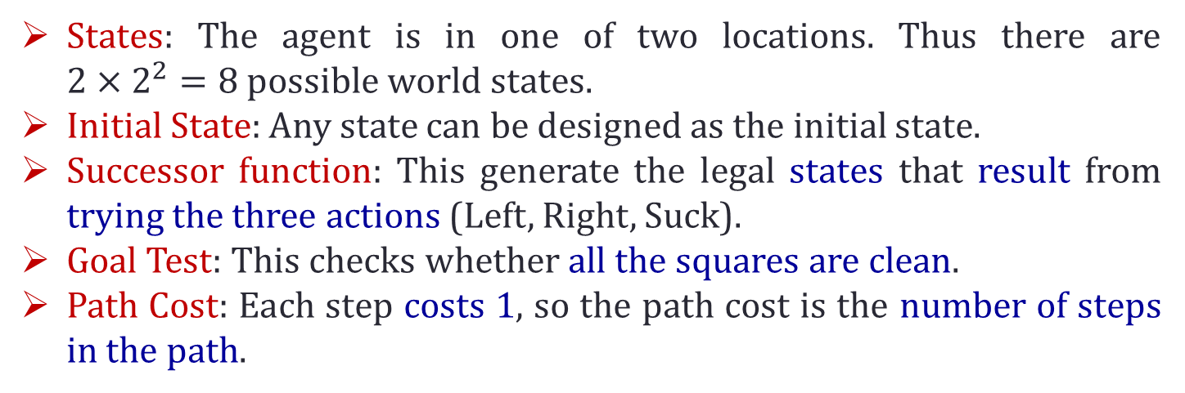
Faculty of computer and information sciences
Mansoura University
Information System Department
Example: Vacuum World (cont’d)
States: The agent is in one of two locations. Thus there are $2×2^{2}=8$ possible world states.
Initial State: Any state can be designed as the initial state.
Successor function: This generate the legal states that result from trying the three actions (Left, Right, Suck).
Goal Test: This checks whether all the squares are clean.
Path Cost: Each step costs 1, so the path cost is the number of steps in the path.

Slide 13
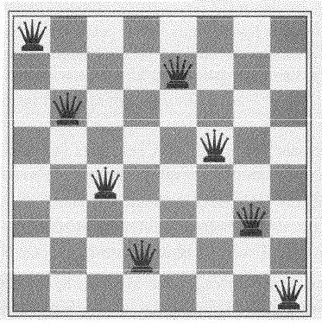
Faculty of computer and information sciences
Mansoura University
Information System Department
Example: 8 Queens
The goal of 8-queens problem is to place 8 queens on chessboard such that no queens attacks any other ( a queen attacks any piece in the same row, column or diagonal)
An incremental formulation involves operators that augment the state description, starting with an empty state.
For the 8-queens problem, this means that each action add queen to the state.
A complete state formulation starts with the 8-queens on the board and move them around.

Slide 14
Faculty of computer and information sciences
Mansoura University
Information System Department
Example: 8 Queens (cont’d)
Incremental formulation:
States: Any arrangement of 0 to 8 queens on the board is a state.
Initial State: No queens on the board.
Successor Function: Add a queen to any empty square that is not attacked.
Goal Test: 8 queens are on the board, none attached.
A complete-state formulation starts with all 8 queens on the board and move them around.

Slide 15
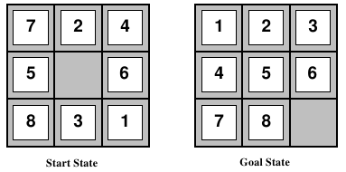
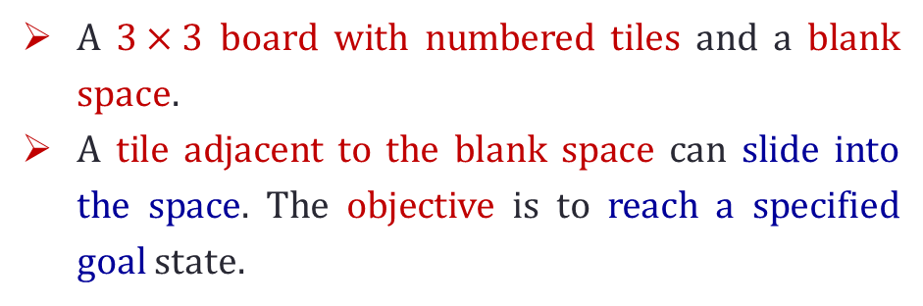
Faculty of computer and information sciences
Mansoura University
Information System Department
Example: 8 puzzle
A $3×3$ board with numbered tiles and a blank space.
A tile adjacent to the blank space can slide into the space. The objective is to reach a specified goal state.
The formulation is:
States: A state description specifies the location of each of the 8 tiles and the blank in one of the 9 squares.
Initial state: Any state can be designated as the initial state.
Successor Function: The simplest formulation defines the actions as movements of the blank space Left, Right, Up, or Down. Different subsets of these are possible depending on where the blank is.
Goal test: This checks whether the state matches the goal configuration
Path cost: Each step costs 1, so the path cost is the number of steps in the path

Slide 16
Faculty of computer and information sciences
Mansoura University
Information System Department
Example: Route-finding
Route-finding problem is defined in terms of specified locations and transitions along links between them.
Route-finding algorithms are used in a variety of applications, such as routing in computer networks, and airline travel planning systems.
Consider the airline travel problems that must be solved by a travel-planning Web site:
States: Each state obviously includes a location (e.g., an airport) and the current time.
Initial state: This is specified by the user’s query.
Actions: Take any flight from the current location, in any seat class, leaving after the current time, leaving enough time for within-airport transfer if needed.
Goal test: Are we at the final destination specified by the user?
Path cost: This depends on monetary cost, waiting time, flight time, customs and immigration procedures, seat quality, time of day, type of airplane, frequent-flyer mileage awards, and so on.

Slide 17
Faculty of computer and information sciences
Mansoura University
Information System Department
Outlines
Problem-solving Agents
Well-defined Problems and Solutions
Problem Types
Example Problems
Toy Problems
Real-world Problems
Searching for Solutions
Tree Search Algorithms
Uninformed Search Strategies
Avoiding repeated states

Slide 18
Faculty of computer and information sciences
Mansoura University
Information System Department
Searching for solutions
Having formulated some problems, we now need to solve them. This is done by a search through the state space.
This chapter deals with search techniques that use an explicit search tree that is generated by the initial state and the successor function that together define the state space.
Figure 3.6 shows some of the expansions in the search tree for finding a route from Arad to Bucharest.
The root of the search tree is a search node corresponding to the initial state, In(Arad)
The first step is to test whether this is a goal state. Because this is not a goal state, we need to consider some other states. This is done by expanding the current state; that is, applying the successor function to the current state, thereby generating a new set of states. In this case, we get three new states: In(Sibiu), In(Timisoara), and In(Zerind).

Slide 19
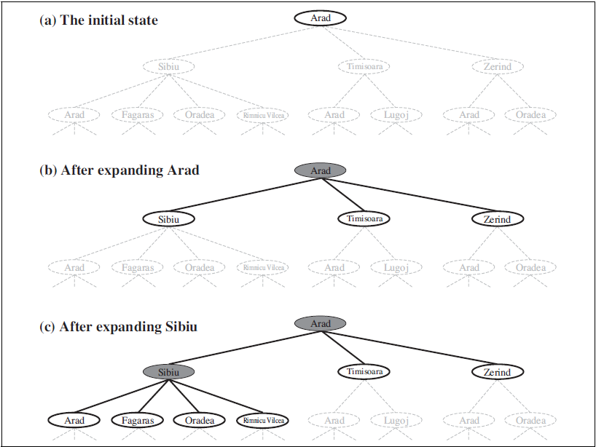
Faculty of computer and information sciences
Mansoura University
Information System Department
Searching for solutions (cont’d)

Slide 20
Faculty of computer and information sciences
Mansoura University
Information System Department
Searching for solutions (cont’d)
Now we must choose which of these three possibilities to consider further.
The choice of which state to expand is determined by the search strategy.
It is important to distinguish between the state space and the search tree. For the route finding problem, there are only 20 states in the state space, one for each city. But there are an infinite number of paths in this state space, so the search tree has an infinite number of nodes.

Slide 21
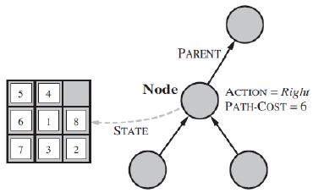
Faculty of computer and information sciences
Mansoura University
Information System Department
Searching for solutions (cont’d)
There are many ways to represent nodes, but we will assume that a node is a data structure with five components:
STATE: the state in the state space to which the node corresponds;
PARENT-NODE: the node in the search tree that generated this node;
ACTION: the action that was applied to the parent to generate the node;
PATH-COST: the cost, traditionally denoted by g(n), of the path from the initial state to the node, as indicated by the parent pointers; and
DEPTH: the number of steps along the path from the initial state.

Slide 22
Faculty of computer and information sciences
Mansoura University
Information System Department
Searching for solutions (cont’d)
A node is a bookkeeping data structure used to represent the search tree.
A state corresponds to a configuration of the world.
We also need to represent the collection of nodes that have been generated but not yet expanded - this collection is called the fringe. Each element of the fringe is a leaf node, that is, a node with no successors in the tree.
The search strategy then would be a function that selects the next node to be expanded from this set.
There are two types of search algorithms:
Uninformed Search Algorithms (blind Search)
Informed Search Algorithms (heuristic search)

Slide 23
Faculty of computer and information sciences
Mansoura University
Information System Department
Searching for solutions (cont’d)
Measuring problem-solving performance: We will evaluate an algorithm's performance in four ways:
Completeness: Is the algorithm guaranteed to find a solution when there is one?
Optimality: Does the strategy find the optimal solution
Time complexity: How long does it take to find a solution?
Space complexity: How much memory is needed to perform the search?
complexity is expressed in terms of three quantities:
b, the branching factor or maximum number of successors of any node;
d, the depth of the shallowest goal node; and
m, the maximum length of any path in the state space.
Time is often measured in terms of the number of nodes generated during the search, and space in terms of the maximum number of nodes stored in memory.

Slide 24
Faculty of computer and information sciences
Mansoura University
Information System Department
Outlines
Problem-solving Agents
Well-defined Problems and Solutions
Problem Types
Example Problems
Toy Problems
Real-world Problems
Searching for Solutions
Tree Search Algorithms
Uninformed Search Strategies
Avoiding repeated states

Slide 25
Faculty of computer and information sciences
Mansoura University
Information System Department
Uninformed Search Strategies
Uninformed search strategies use only the information available in the problem definition.
All they can do is generate successors and distinguish a goal state from non-goal state.
Example:
Breadth-first search
Uniform-cost search
Depth-first search
Depth-limited search
Iterative deepening search

Slide 26
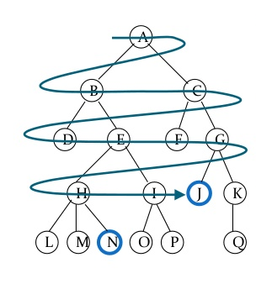
Faculty of computer and information sciences
Mansoura University
Information System Department
Breadth-first Search (BFS)
Breadth-first search is a simple strategy in which the root node is expanded first, then all the successors of the root node are expanded next, then their successors, and so on.
In general, all the nodes are expanded at a given depth in the search tree before any nodes at the next level are expanded.

Slide 27
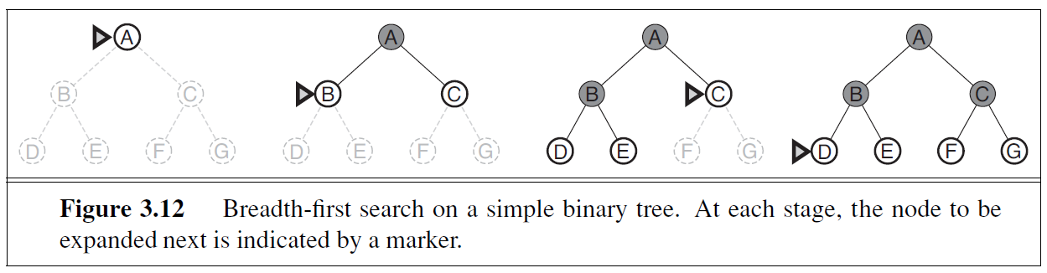
Faculty of computer and information sciences
Mansoura University
Information System Department
Breadth-first Search (BFS)
The following shows the progress of the search on a simple binary tree.

Slide 28
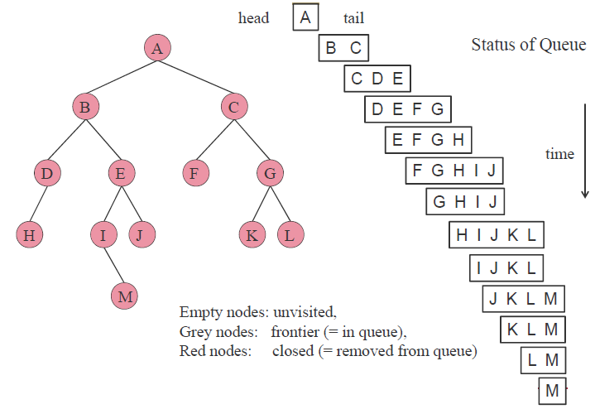
Faculty of computer and information sciences
Mansoura University
Information System Department
Breadth-first Search (BFS) (cont’d)
Implementation
BFS can be implemented by a first-in-first-out (FIFO) queue, assuring that the nodes that are visited first will be expanded first.
The FIFO queue puts all newly generated successors at the end of the queue, which means that shallow nodes are expanded before deeper nodes.

Slide 29
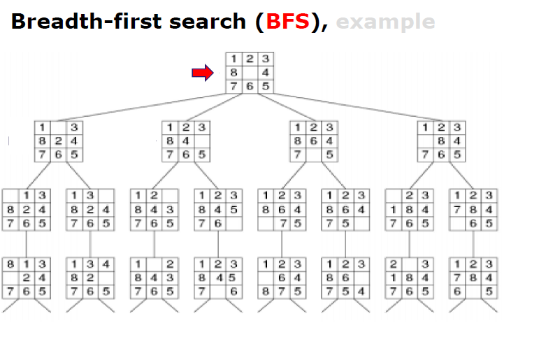
Faculty of computer and information sciences
Mansoura University
Information System Department
Breadth-first Search (BFS) (cont’d)
Example

Slide 30
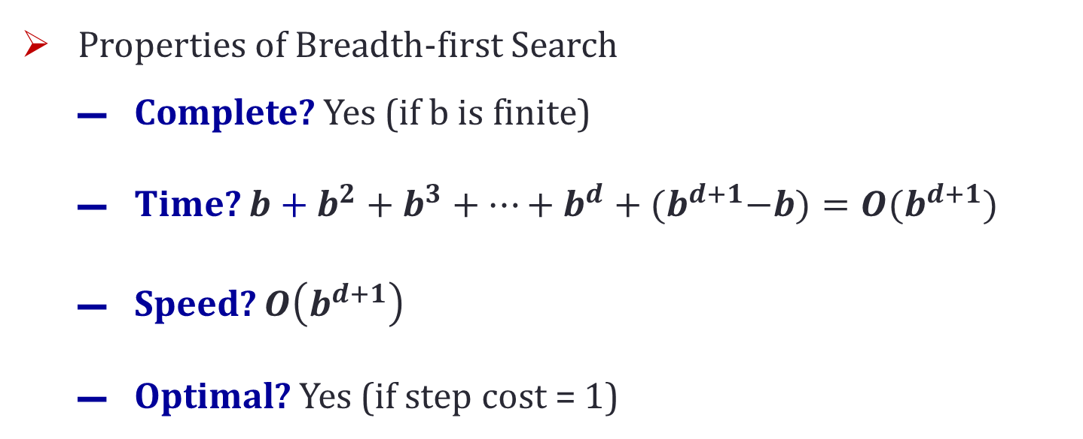
Faculty of computer and information sciences
Mansoura University
Information System Department
Breadth-first Search (BFS) (cont’d)
Properties of Breadth-first Search
Complete? Yes (if b is finite)
Time? $b+b^{2}+b^{3}+…+b^{d}+{(b}^{d+1}−b)=O(b^{d+1})$
Speed? $O\left(b^{d+1}\right)$
Optimal? Yes (if step cost = 1)

Slide 31
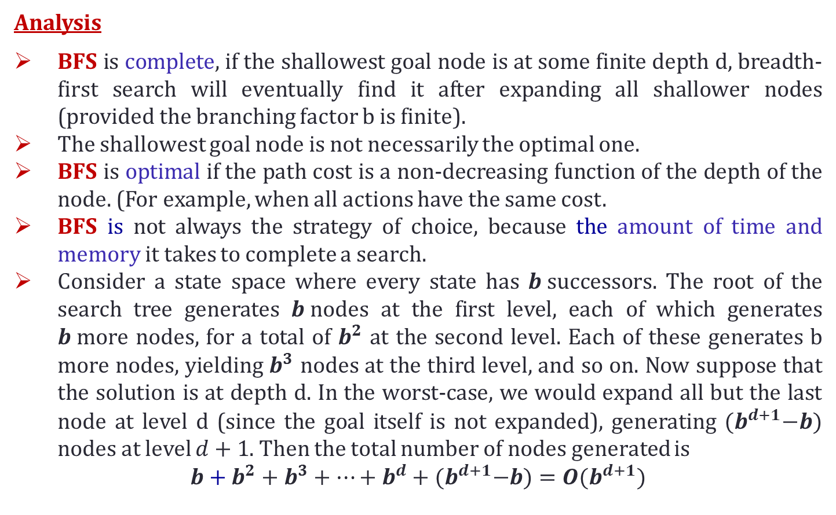
Faculty of computer and information sciences
Mansoura University
Information System Department
Breadth-first Search (BFS) (cont’d)
Analysis
BFS is complete, if the shallowest goal node is at some finite depth d, breadth-first search will eventually find it after expanding all shallower nodes (provided the branching factor b is finite).
The shallowest goal node is not necessarily the optimal one.
BFS is optimal if the path cost is a non-decreasing function of the depth of the node. (For example, when all actions have the same cost.
BFS is not always the strategy of choice, because the amount of time and memory it takes to complete a search.
Consider a state space where every state has $b$successors. The root of the search tree generates $b$nodes at the first level, each of which generates $b$more nodes, for a total of $b^{2}$ at the second level. Each of these generates b more nodes, yielding $b^{3}$ nodes at the third level, and so on. Now suppose that the solution is at depth d. In the worst-case, we would expand all but the last node at level d (since the goal itself is not expanded), generating ${(b}^{d+1}−b)$ nodes at level $d+1$. Then the total number of nodes generated is
$$b+b^{2}+b^{3}+…+b^{d}+{(b}^{d+1}−b)=O(b^{d+1})$$

Slide 32
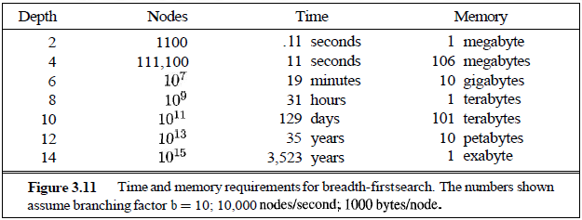
Faculty of computer and information sciences
Mansoura University
Information System Department
Breadth-first Search (BFS) (cont’d)
Analysis (cont’d)
Every node that is generated must remain in memory, therefore the space complexity is the same as the time complexity (plus one node for the root).
The following figure lists the time and memory required for a breadth-first search with branching factor b = 10, for various values of the solution depth d. The table assumes that 10,000 nodes can be generated per second and that a node requires 1000 bytes of storage.

Slide 33
Faculty of computer and information sciences
Mansoura University
Information System Department
Breadth-first Search (BFS) (cont’d)
Analysis (cont’d)
There are two lessons to be learned from the above figure.
First, the memory requirements are a bigger problem for breadth-first search than is the execution time. (31 hours would not be too long to wait for the solution to an important problem of depth 8, but few computers have the terabyte of main memory it would take.
The second lesson is that the time requirements are still a major factor. If your problem has a solution at depth 12, then (given our assumptions) it will take 35 years for breadth-first search (or indeed any uninformed search) to find it.
Note
In general, exponential-complexity search problems cannot be solved by uninformed methods for any but the smallest instances.

Slide 34
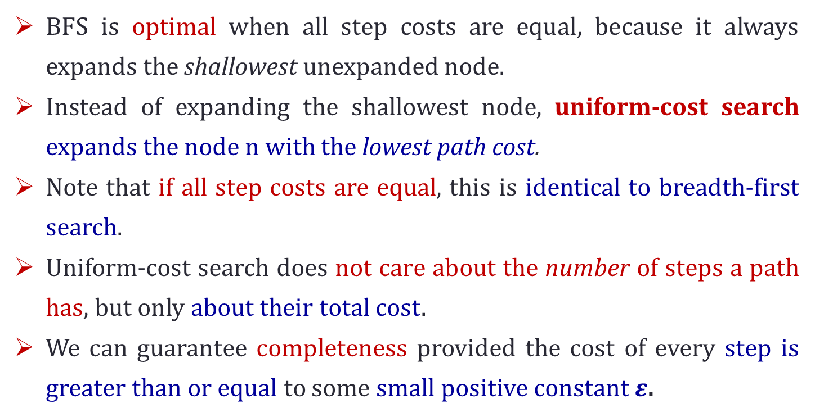
Faculty of computer and information sciences
Mansoura University
Information System Department
Uniform-cost search
BFS is optimal when all step costs are equal, because it always expands the shallowest unexpanded node.
Instead of expanding the shallowest node, uniform-cost search expands the node n with the lowest path cost.
Note that if all step costs are equal, this is identical to breadth-first search.
Uniform-cost search does not care about the number of steps a path has, but only about their total cost.
We can guarantee completeness provided the cost of every step is greater than or equal to some small positive constant $ε$.

Slide 35
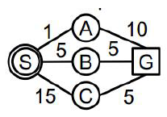
Faculty of computer and information sciences
Mansoura University
Information System Department
Uniform-cost search (Example)
Expand least-cost unexpanded node
Node are stored in Ordered queue. (order by cost)

Slide 36
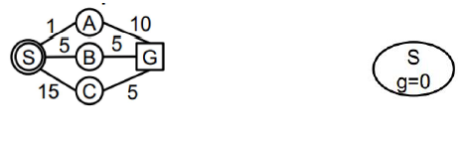
Faculty of computer and information sciences
Mansoura University
Information System Department
Uniform-cost search (Example)
Expand least-cost unexpanded node
Node are stored in Ordered queue. (order by cost)

Slide 37
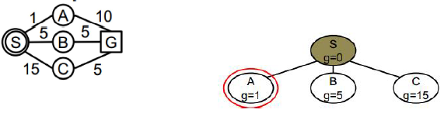
Faculty of computer and information sciences
Mansoura University
Information System Department
Uniform-cost search (Example1)
Expand least-cost unexpanded node
Node are stored in Ordered queue. (order by cost)

Slide 38
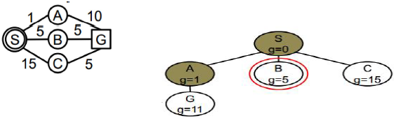
Faculty of computer and information sciences
Mansoura University
Information System Department
Uniform-cost search (Example1)
Expand least-cost unexpanded node
Node are stored in Ordered queue. (order by cost)

Slide 39
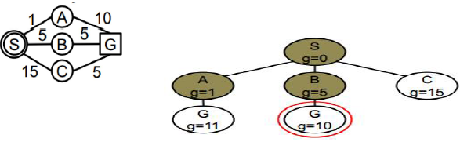
Faculty of computer and information sciences
Mansoura University
Information System Department
Uniform-cost search (Example1)
Expand least-cost unexpanded node
Node are stored in Ordered queue. (order by cost)

Slide 40
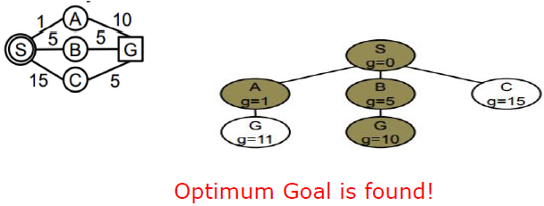
Faculty of computer and information sciences
Mansoura University
Information System Department
Uniform-cost search (Example1)
Expand least-cost unexpanded node
Node are stored in Ordered queue. (order by cost)
Path cost: S ➔ B ➔ G
Cost = 10

Slide 41
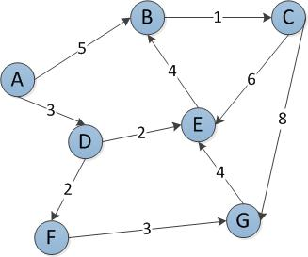
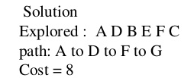
Faculty of computer and information sciences
Mansoura University
Information System Department
Uniform-cost search (Example 2)

Slide 42
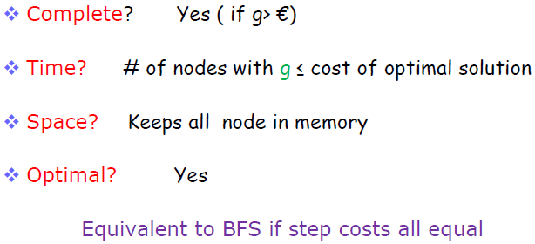
Faculty of computer and information sciences
Mansoura University
Information System Department
Uniform-cost search (cont’d)

Slide 43
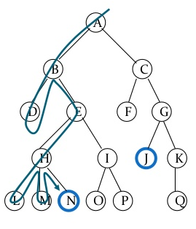
Faculty of computer and information sciences
Mansoura University
Information System Department
Depth-first Search
Depth-first search (DFS) always expands the deepest node in the current fringe of the search tree.
The search proceeds immediately to the deepest level of the search tree, where the nodes have no successors. As those nodes are expanded, they are dropped from the fringe, so then the search "backs up" to the next shallowest node that still has unexplored successors.

Slide 44
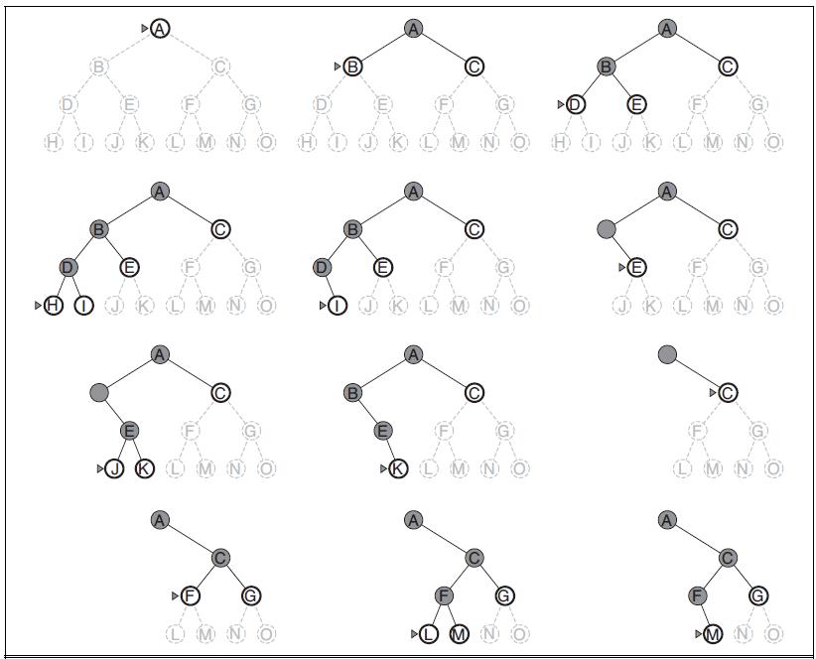
Faculty of computer and information sciences
Mansoura University
Information System Department
Depth-first Search
M is the only goal node

Slide 45
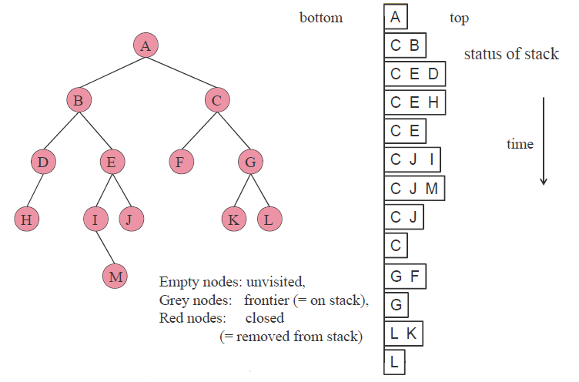
Faculty of computer and information sciences
Mansoura University
Information System Department
Depth-first Search (cont’d)
Implementation
This strategy can be implemented by TREE-SEARCH with a last-in-first-out (LIFO) queue, also known as a stack.
It is common to implement depth-first search with a recursive function that calls itself on each of its children in turn.

Slide 46
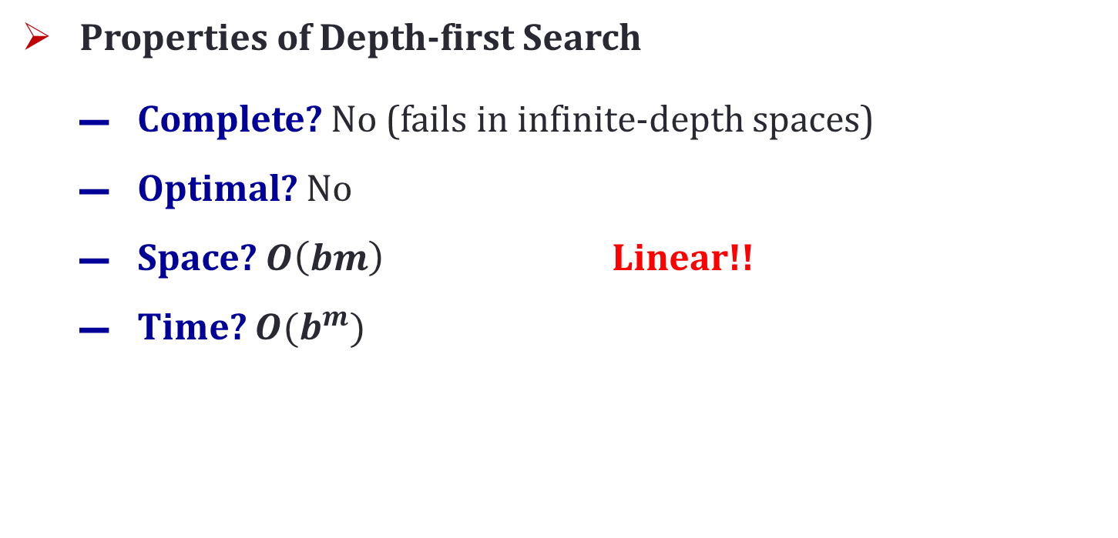
Faculty of computer and information sciences
Mansoura University
Information System Department
Depth-first Search (cont’d)
Properties of Depth-first Search
Complete? No (fails in infinite-depth spaces)
Optimal? No
Space? $O\left(bm\right)$ Linear!!
Time? $O(b^{m})$

Slide 47
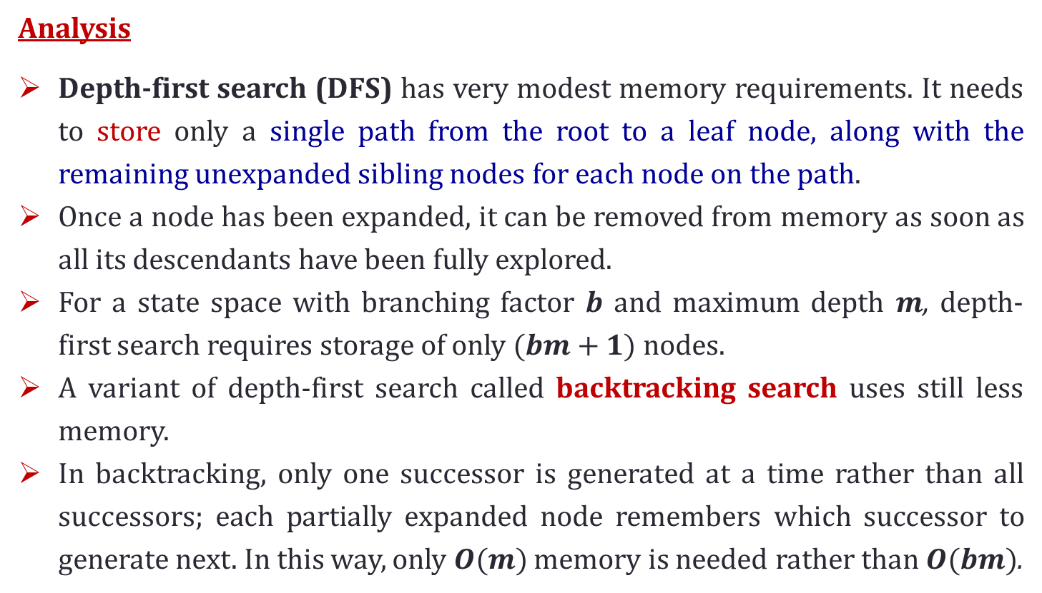
Faculty of computer and information sciences
Mansoura University
Information System Department
Depth-first Search (cont’d)
Analysis
Depth-first search (DFS) has very modest memory requirements. It needs to store only a single path from the root to a leaf node, along with the remaining unexpanded sibling nodes for each node on the path.
Once a node has been expanded, it can be removed from memory as soon as all its descendants have been fully explored.
For a state space with branching factor $b$ and maximum depth $m$, depth-first search requires storage of only $(bm+1)$nodes.
A variant of depth-first search called backtracking search uses still less memory.
In backtracking, only one successor is generated at a time rather than all successors; each partially expanded node remembers which successor to generate next. In this way, only $O(m)$ memory is needed rather than $O(bm)$.

Slide 48
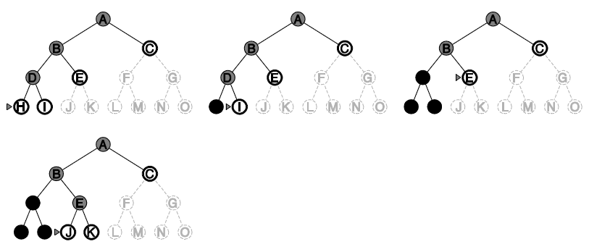
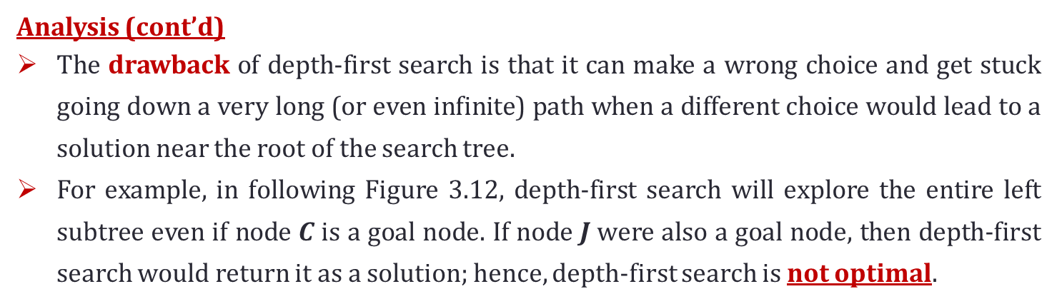
Faculty of computer and information sciences
Mansoura University
Information System Department
Depth-first Search (cont’d)
Analysis (cont’d)
The drawback of depth-first search is that it can make a wrong choice and get stuck going down a very long (or even infinite) path when a different choice would lead to a solution near the root of the search tree.
For example, in following Figure 3.12, depth-first search will explore the entire left subtree even if node $C$is a goal node. If node $J$were also a goal node, then depth-first search would return it as a solution; hence, depth-first search is not optimal.
If the left subtree were of unbounded depth but contained no solutions, depth-first search would never terminate; hence, it is not complete.

Slide 49
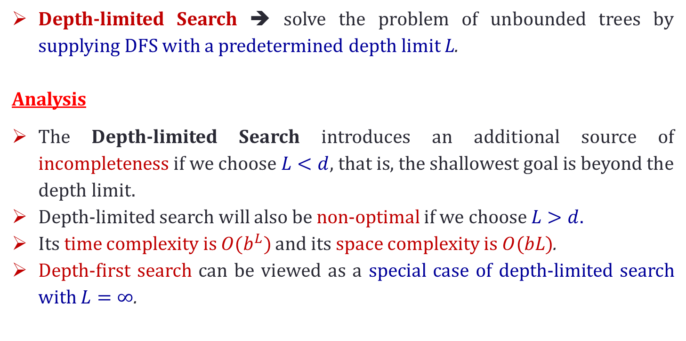
Faculty of computer and information sciences
Mansoura University
Information System Department
Depth-limited Search
Depth-limited Search ➔ solve the problem of unbounded trees by supplying DFS with a predetermined depth limit L.
Analysis
The Depth-limited Search introduces an additional source of incompleteness if we choose $L<d$, that is, the shallowest goal is beyond the depth limit.
Depth-limited search will also be non-optimal if we choose $L>d$.
Its time complexity is $O(b^{L})$ and its space complexity is $O(bL)$.
Depth-first search can be viewed as a special case of depth-limited search with $L=∞$.

Slide 50
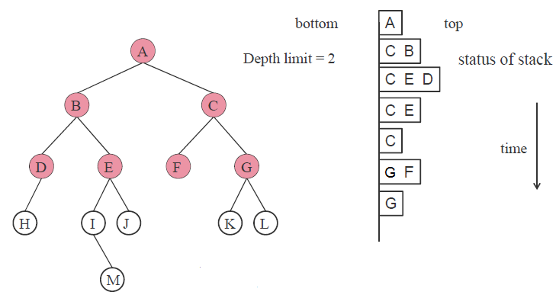
Faculty of computer and information sciences
Mansoura University
Information System Department
Depth-limited Search

Slide 51
Faculty of computer and information sciences
Mansoura University
Information System Department
Iterative Deepening Search
Iterative deepening search (or iterative deepening depth-first search) is a general strategy, often used in combination with depth-first search, that finds the best depth limit.
It does this by gradually increasing the limit-first 0, then 1, then 2, and so on-until a goal is found.
This will occur when the depth limit reaches d, the depth of the shallowest goal node.
Iterative deepening combines the benefits of depth-first and breadth-first search.
Like depth-first search, its memory requirements are very modest: O(bd) to be precise.
Like breadth-first search, it is complete when the branching factor is finite and optimal when the path cost is a non-decreasing function of the depth of the node.

Slide 52

Faculty of computer and information sciences
Mansoura University
Information System Department
Iterative Deepening Search ($l=1$)

Slide 53
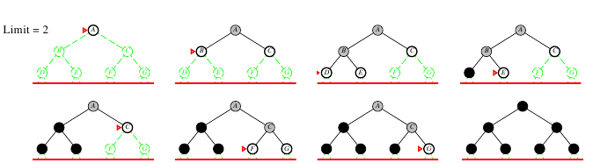
Faculty of computer and information sciences
Mansoura University
Information System Department
Iterative Deepening Search ($l=2$)

Slide 54
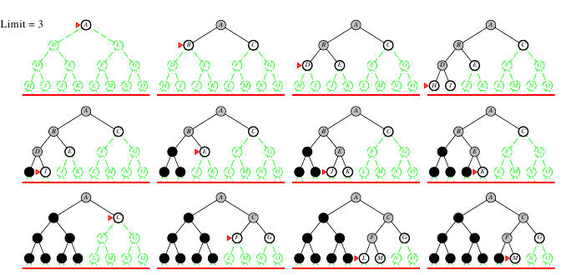
Faculty of computer and information sciences
Mansoura University
Information System Department
Iterative Deepening Search ($l=3$)

Slide 55
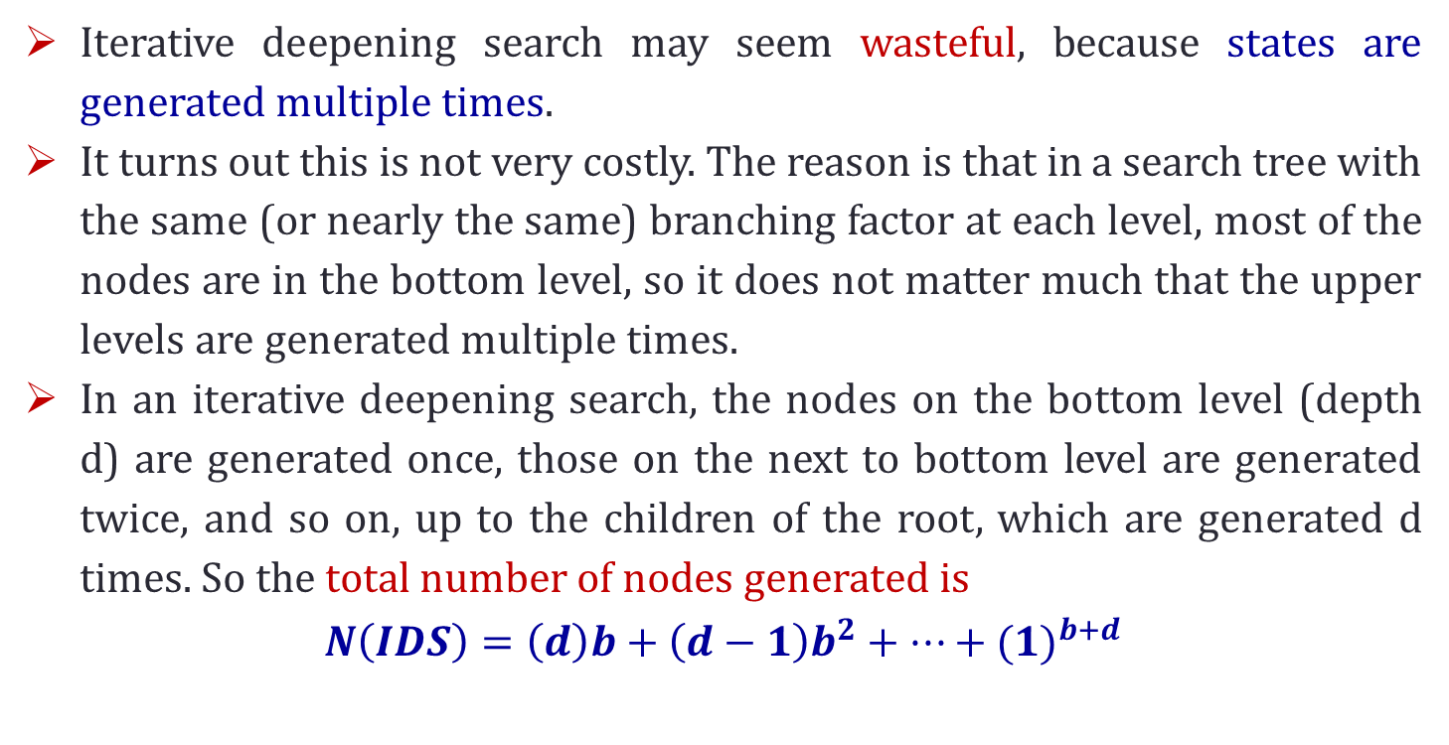
Faculty of computer and information sciences
Mansoura University
Information System Department
Iterative Deepening Search (cont’d)
Iterative deepening search may seem wasteful, because states are generated multiple times.
It turns out this is not very costly. The reason is that in a search tree with the same (or nearly the same) branching factor at each level, most of the nodes are in the bottom level, so it does not matter much that the upper levels are generated multiple times.
In an iterative deepening search, the nodes on the bottom level (depth d) are generated once, those on the next to bottom level are generated twice, and so on, up to the children of the root, which are generated d times. So the total number of nodes generated is
$$N\left(IDS\right)=\left(d\right)b+\left(d−1\right)b^{2}+…+{(1)}^{b+d}$$

Slide 56
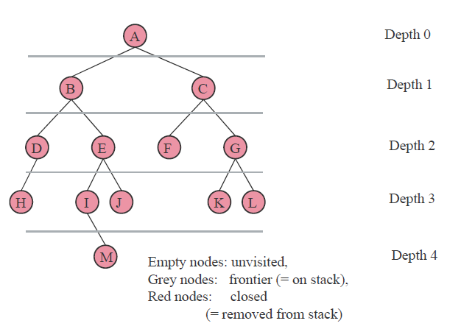
Faculty of computer and information sciences
Mansoura University
Information System Department
Iterative Deepening Search (cont’d)
Example Iterative deepening search:

Slide 57
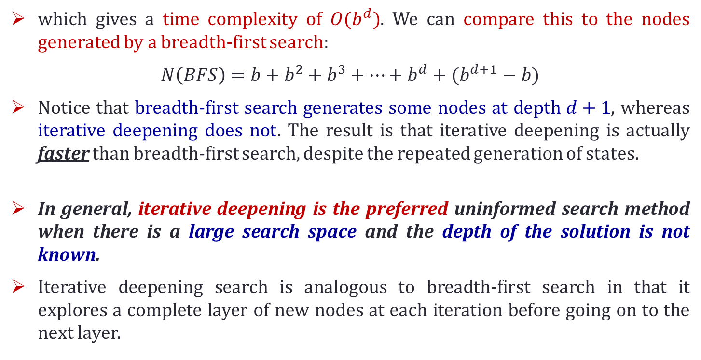
Faculty of computer and information sciences
Mansoura University
Information System Department
Iterative Deepening Search (cont’d)
which gives a time complexity of $O(b^{d})$. We can compare this to the nodes generated by a breadth-first search:
$$N\left(BFS\right)=b+b^{2}+b^{3}+…+b^{d}+(b^{d+1}−b)$$
Notice that breadth-first search generates some nodes at depth $d+1$, whereas iterative deepening does not. The result is that iterative deepening is actually faster than breadth-first search, despite the repeated generation of states.
In general, iterative deepening is the preferred uninformed search method when there is a large search space and the depth of the solution is not known.
Iterative deepening search is analogous to breadth-first search in that it explores a complete layer of new nodes at each iteration before going on to the next layer.

Slide 58
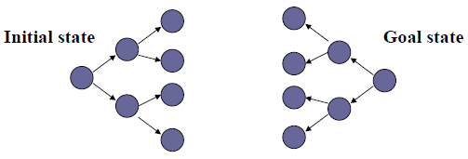
Faculty of computer and information sciences
Mansoura University
Information System Department
Bidirectional Search
The idea behind bidirectional search is to run two simultaneous searches.
One forward from the initial state and the other backward from the goal, stopping when the two searches meet in the middle.
When does it help?
It cuts the size of the search tree by half.
What is necessary?
Merge the solutions.

Slide 59
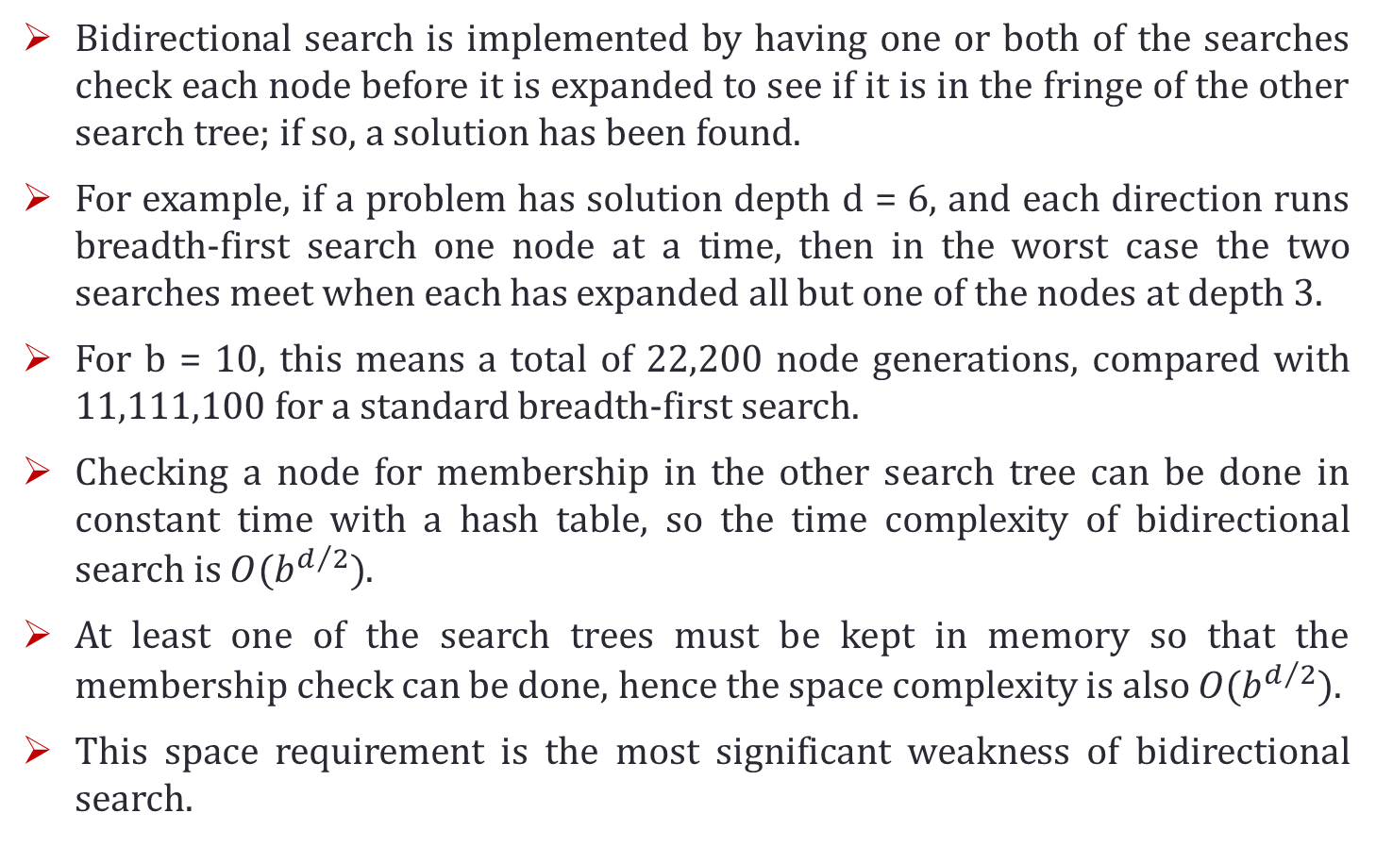
Faculty of computer and information sciences
Mansoura University
Information System Department
Bidirectional Search (cont’d)
Bidirectional search is implemented by having one or both of the searches check each node before it is expanded to see if it is in the fringe of the other search tree; if so, a solution has been found.
For example, if a problem has solution depth d = 6, and each direction runs breadth-first search one node at a time, then in the worst case the two searches meet when each has expanded all but one of the nodes at depth 3.
For b = 10, this means a total of 22,200 node generations, compared with 11,111,100 for a standard breadth-first search.
Checking a node for membership in the other search tree can be done in constant time with a hash table, so the time complexity of bidirectional search is $O(b^{d/2})$.
At least one of the search trees must be kept in memory so that the membership check can be done, hence the space complexity is also $O(b^{d/2})$.
This space requirement is the most significant weakness of bidirectional search.

Slide 60
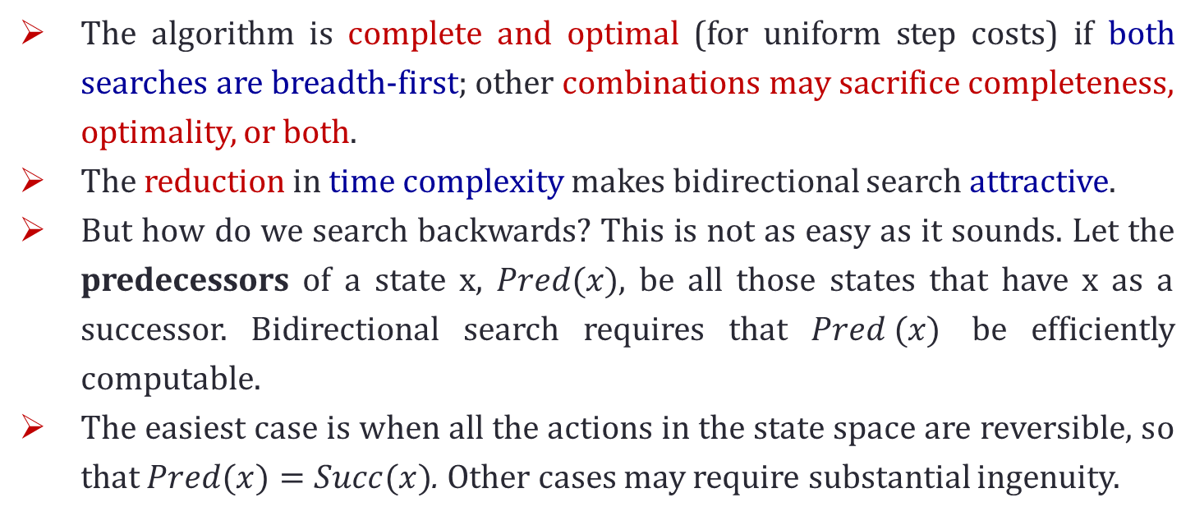
Faculty of computer and information sciences
Mansoura University
Information System Department
Bidirectional Search (cont’d)
The algorithm is complete and optimal (for uniform step costs) if both searches are breadth-first; other combinations may sacrifice completeness, optimality, or both.
The reduction in time complexity makes bidirectional search attractive.
But how do we search backwards? This is not as easy as it sounds. Let the predecessors of a state x, $Pred(x)$, be all those states that have x as a successor. Bidirectional search requires that $Pred (x)$ be efficiently computable.
The easiest case is when all the actions in the state space are reversible, so that $Pred(x)=Succ(x)$. Other cases may require substantial ingenuity.

Slide 61
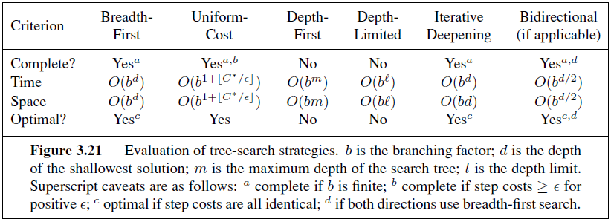
Faculty of computer and information sciences
Mansoura University
Information System Department
Summary of Algorithms

Slide 62
Faculty of computer and information sciences
Mansoura University
Information System Department
Outlines
Problem-solving Agents
Well-defined Problems and Solutions
Problem Types
Example Problems
Toy Problems
Real-world Problems
Searching for Solutions
Tree Search Algorithms
Uninformed Search Strategies
Avoiding repeated states

Slide 63
Faculty of computer and information sciences
Mansoura University
Information System Department
Avoiding repeated states
Repeated states, then, can cause a solvable problem to become unsolvable if the algorithm does not detect them.
Detection usually means comparing the node about to be expanded to those that have been expanded already; if a match is found, then the algorithm has discovered two paths to the same state and can discard one of them.
eliminating repeated states yields an exponential reduction in search cost
For some problems, repeated states are unavoidable. This includes all problems where the actions are reversible, such as route-finding problems and sliding-blocks puzzles.
For depth-first search, the only nodes in memory are those on the path from the root to the current node. Comparing those nodes to the current node allows the algorithm to detect looping paths that can be discarded immediately.

Slide 64
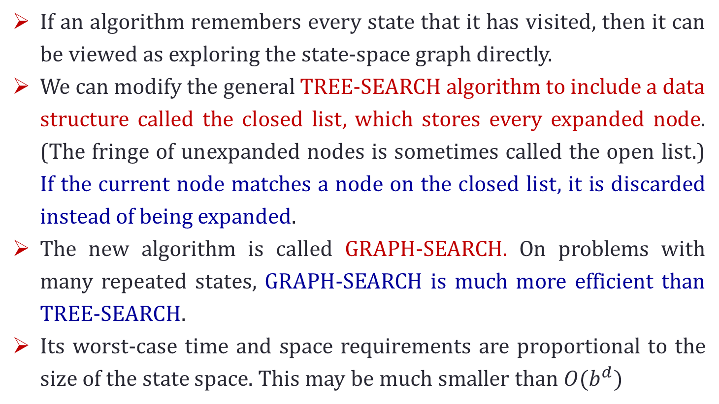
Faculty of computer and information sciences
Mansoura University
Information System Department
Avoiding repeated states (cont’d)
If an algorithm remembers every state that it has visited, then it can be viewed as exploring the state-space graph directly.
We can modify the general TREE-SEARCH algorithm to include a data structure called the closed list, which stores every expanded node. (The fringe of unexpanded nodes is sometimes called the open list.) If the current node matches a node on the closed list, it is discarded instead of being expanded.
The new algorithm is called GRAPH-SEARCH. On problems with many repeated states, GRAPH-SEARCH is much more efficient than TREE-SEARCH.
Its worst-case time and space requirements are proportional to the size of the state space. This may be much smaller than $O(b^{d})$

Slide 65
Faculty of computer and information sciences
Mansoura University
Information System Department
Outlines
Problem-solving Agents
Well-defined Problems and Solutions
Problem Types
Example Problems
Toy Problems
Real-world Problems
Searching for Solutions
Tree Search Algorithms
Uninformed Search Strategies
Avoiding repeated states

Slide 66
Faculty of computer and information sciences
Mansoura University
Information System Department
Readings
Readings
Artificial Intelligence, A Modern Approach, by Stuart Russel and Peter Norvig (2nd Edition 2009)
Chapter 3

Slide 67
Thank You

