Slide 1
Artificial Intelligence

Slide 2
Artificial Intelligence
is the study of systems that act in a way that to any observer would appear to be intelligent.

Slide 3
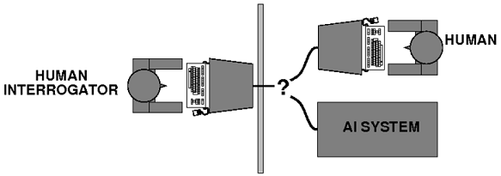
Turing Test
proposed by Alan Turing (1950),
The test state that:
if a person who interrogated the computer could not tell if it was a human or a computer, then to all intents and purposes, it is intelligent.

Slide 4
Turing Test
To pass the Turing test, the computer will need the following capabilities:
Machine learning:
to learn
Knowledge representation:
to store information
Automated reasoning
to think

Slide 5
Turing Test
To pass the Turing test, the computer will need the following capabilities:
Natural language processing
to communicate in English
Computer vision
to see objects

Slide 6
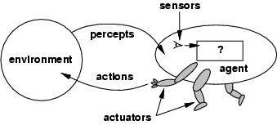
Agent
is anything that can perceive its environment through sensor and act upon that environment through actuator.

Slide 7
Agent
Agents include
humans,
robots,
software, etc.
Example 1: Human agent:
Sensor:
eyes, ears, and other organs
Actuator:
hands, legs, mouth, and other body parts

Slide 8
Agent
Example 2: Robotic agent:
Sensor:
cameras and infrared range finders for sensors;
Actuator:
various motors

Slide 9
Agent
Example 3: Software agent:
Sensor:
keystrokes, file contents, and network packets
Actuator:
acts on the environment by displaying on the screen, Writing files, and sending network packets

Slide 10
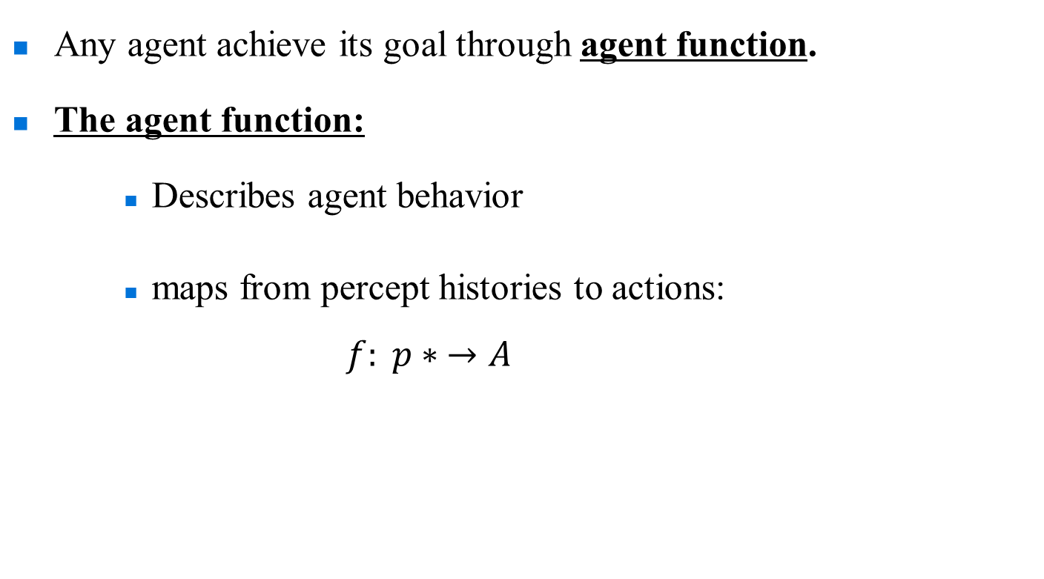
Agent
Any agent achieve its goal through agent function.
The agent function:
Describes agent behavior
maps from percept histories to actions:
$f: p∗ →A$
Array of input
Action

Slide 11
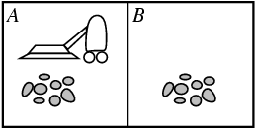
Vacuum cleaner agent
Percept:
Action:
Location
Status
clean
dirty
go left
go right
suck
no operation

Slide 12
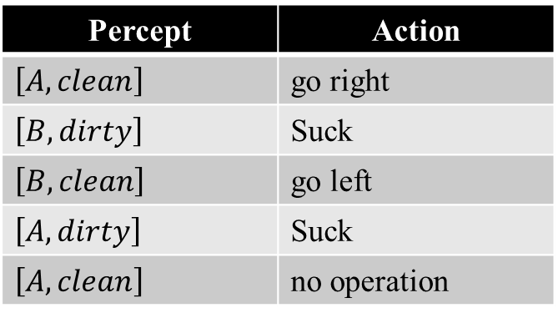
Vacuum cleaner agent
Percept | Action
$\left[A, clean\right]$ | go right
$\left[B,dirty\right]$ | Suck
$\left[B, clean\right]$ | go left
$\left[A, dirty\right]$ | Suck
$\left[A, clean\right]$ | no operation

Slide 13
Rational Agent
An agent that doing the right thing.
Select action that give max performance.

Slide 14
Omniscience Agent
An agent that know every possible probability about specific domain or field.
Example,
When you use a glove to hold a hot plate in the kitchen. This was because you were omniscient in this situation.

Slide 15
Autonomous Agent
Select action according to its experience.
Learn from its experience.

Slide 16
Project

Slide 17
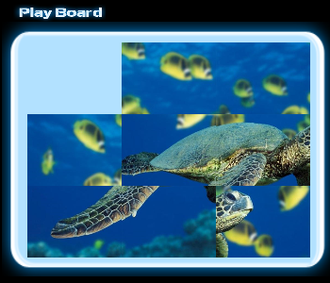
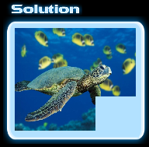
N-Puzzle
Algorithm:
Uninformed Search/Informed Search

Slide 18
The N- Queens
Algorithm:
Uninformed Search/Informed Search/Genetic Algorithm
The goal of the N-queens problem is to place N queens on a chessboard such that no queen attacks any other. (A queen attacks any piece in the same row, column or diagonal).

Slide 19
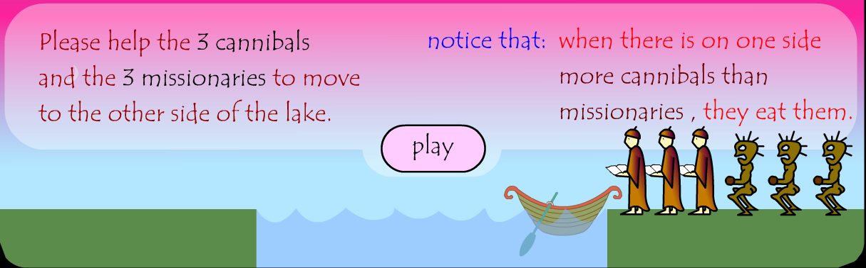
Missionaries and cannibals
Algorithm:
Uninformed Search/Informed Search

Slide 20
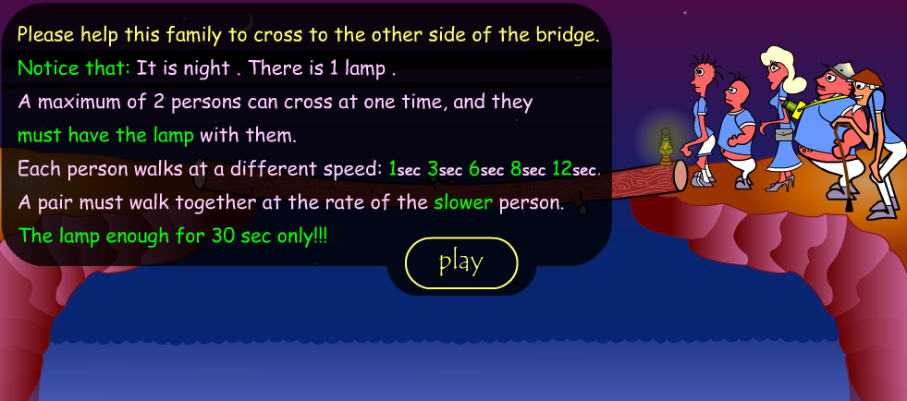
Bridge

Slide 21
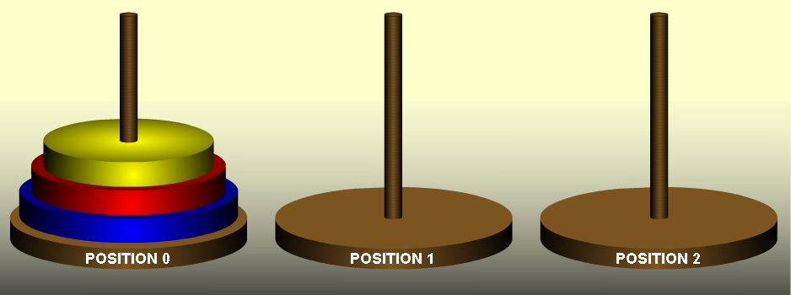
Towers of Hanoi

Slide 22
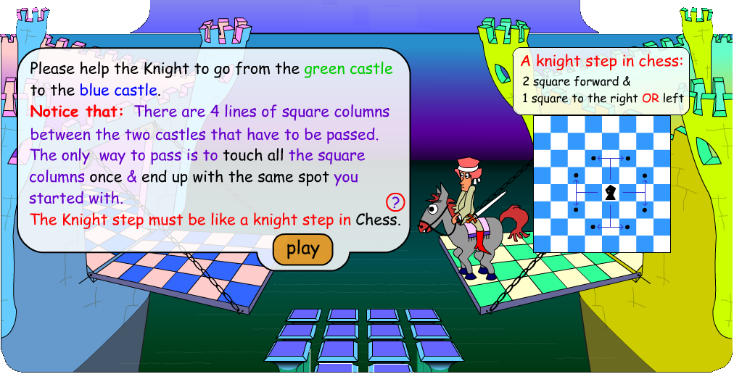
Knight Tour

Slide 23
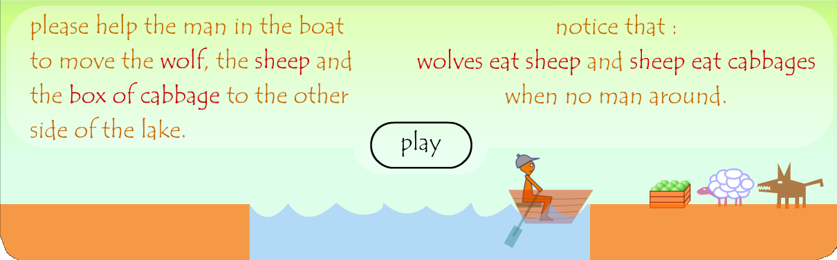
Farmer, Fox & Goat

Slide 24
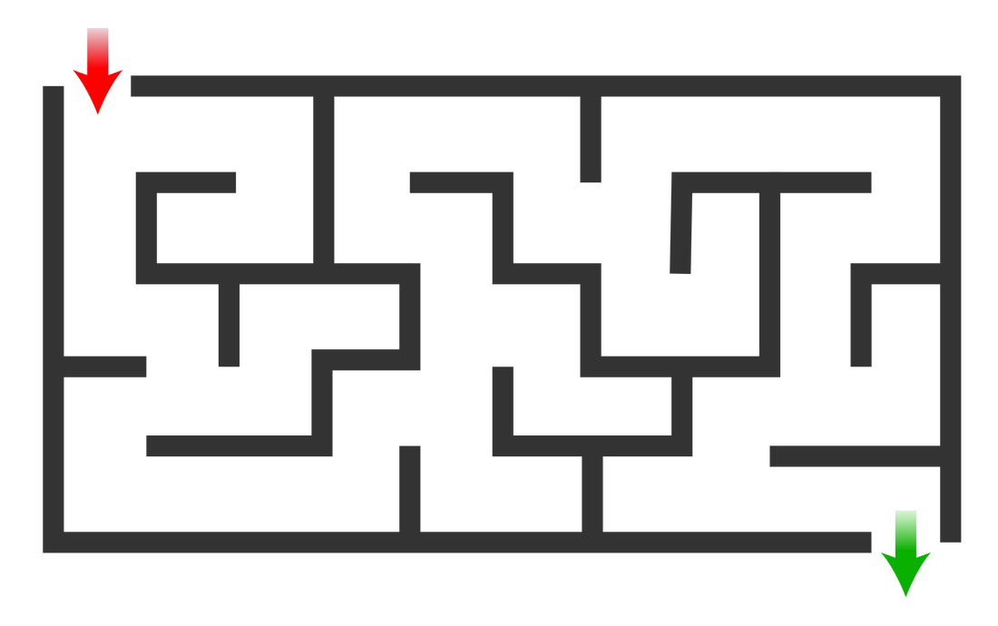
Maze
Algorithm:
Uninformed Search/Informed Search

Slide 25
Other real-world examples
Route finding
Route-finding algorithms are used in a variety of applications, such as routing in computer networks, and airline travel planning systems.
Touring problem
Visit every city at least once, starting and ending in the same city.
Traveling salesperson problems (TSP)
A touring problem in which each city must be visited exactly once. The aim is to find the shortest tour.

Slide 26
Other examples
CSP games such as
Map coloring,
Crypt-arithmatic
Cross-word puzzle
Time tabling
These games will be described in chapter 5.
Adversarial two-players games such as
Chess
Cards
Football game, etc.
These games will be described in chapter 6.

Slide 27
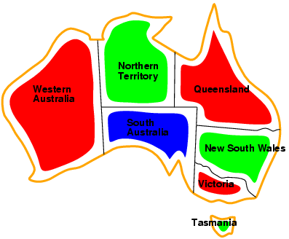
Map-Coloring
Solutions are complete and consistent assignments, e.g., WA = red, NT = green,Q = red,NSW = green,V = red,SA = blue,T = green

Slide 28
Crypt-arithmetic
Example: Solve the following CSP using Relaxation
To make the problem easier, suppose that E=5.

Slide 29
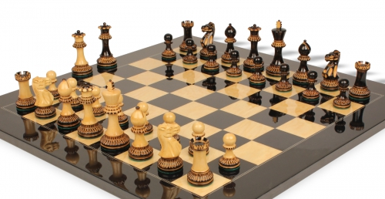
Chess
Algorithm:
minimax algorithm

Slide 30
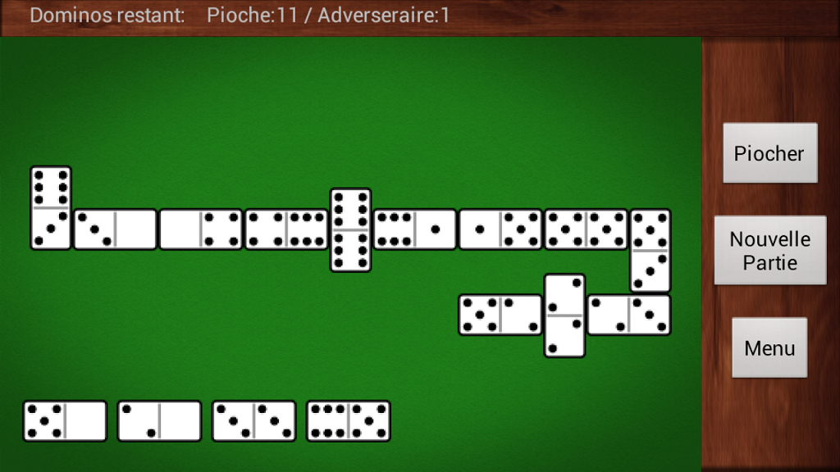
Domino
Algorithm:
minimax algorithm

Slide 31
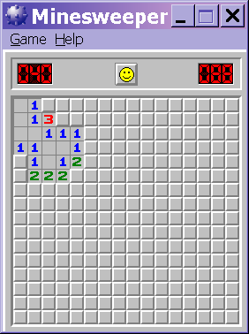
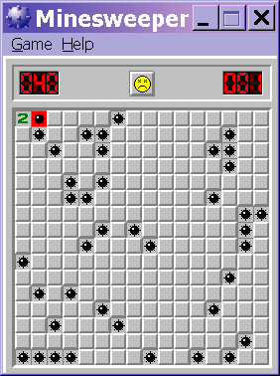
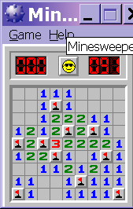
Wumpus world as a game
Mine sweeper is partial Wumpus game, the pits only

