Slide 1
Artificial Intelligence

Slide 2
Agent (PEAS)
Evaluate agent(success, or fail).
PEAS:
P ➔ performance measure
E ➔ Environment
A ➔ Actuator
S ➔ Sensor

Slide 3
Agent (PEAS) – Example
Taxi driver agent:
P ➔ speed, safe, legal, profit
E ➔ street, traffic, customer
A ➔ broke, accelerator, horn
S ➔ camera, GPS

Slide 4
Environment(ODESA)
ODESA:
O ➔ Observability ➔ (fully, or partial) observable
D ➔ Deterministic ➔ deterministic, stochastic, strategic
E ➔ Episode ➔ Episode, sequential
S ➔ Static ➔ static, dynamic, semi-dynamic
A ➔ Agent ➔ Single agent, multi-agent

Slide 5
ODESA – Observability
Fully observable:
Agent can access complete state of environment at any time
Partially observable:
Agent can’t access complete state of environment at any time
i.e. real world

Slide 6
ODESA – Deterministic
Deterministic:
Next state is determined by the current state and actions executed by agents
stochastic:
Next state is not determined by the current state and actions executed by agents

Slide 7
ODESA – Deterministic
Strategic:
The environment is deterministic but actions of other agents
Note:
Environment is fully, then it is
Deterministic, or
Strategic
Environment is partially, then it is
Stochastic

Slide 8
ODESA – Episodic
Episodic:
Agent’s experience is divided into episodes.
Sequential:
Each state is depend on the previous state

Slide 9
ODESA – Static
Static:
The environment is the same (i.e. not change) while deliberating
Dynamic:
The environment can change
Semi-Dynamic:
The environment is not change, but agent performance score does with the passage of time.

Slide 10
ODESA – Static
Note:
Environment is fully, then it is
Static, or
Semi-dynamic
Environment is partially, then it is
Dynamic

Slide 11
ODESA – Agent
Single agent:
One agent
Multi-agent:
More than one agent.
May be co-operative, or competitive.
Competitive multi-agent environment:
max performance measure of entity B, min performance measure of entity A.
Otherwise is co-operative multi-agent

Slide 12
ODESA – Discrete
Any board game (i.e. played on a grid board) is Discrete environment
otherwise is Continuous

Slide 13
ODESA – Example
Taxi driver agent:
O (fully, Partial)
Partial Observable
D (Deterministic, Stochastic, Strategic)
Stochastic
E (Episodic, Sequential)
Sequential
S (Static, Dynamic , Semi-Dynamic)
Dynamic
A (Single agent, Multi-agent)
Multi-agent

Slide 14
ODESA – Example
Crossword puzzle:
O (fully, Partial)
Fully Observable
D (Deterministic, Stochastic, Strategic)
Deterministic
E (Episodic, Sequential)
Sequential
S (Static, Dynamic , Semi-Dynamic)
Static
A (Single agent, Multi-agent)
Single agent

Slide 15
ODESA – Example
Chess with a clock:
O (fully, Partial)
Fully Observable
D (Deterministic, Stochastic, Strategic)
Strategic
E (Episodic, Sequential)
Sequential
S (Static, Dynamic , Semi-Dynamic)
Semi-dynamic
A (Single agent, Multi-agent)
Multi-agent

Slide 16
Types of agent program
Simple reflex agent
Model-based reflex agent
Goal-based reflex agents
Utility-based agents
Learning agent

Slide 17
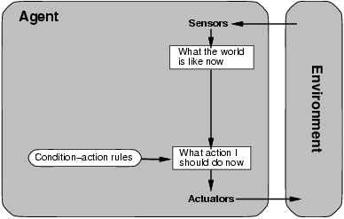
Simple reflex agent
Select action according to the current precept.
Ignoring the reset of percept history.

Slide 18
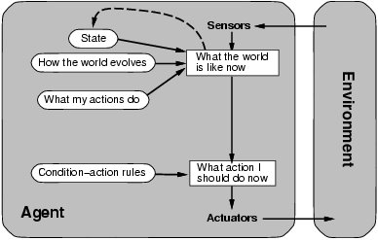
Model-based reflex agent
Select action according to the current precept and the reset of percept history.

Slide 19
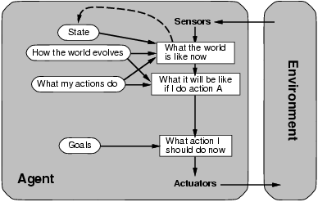
Goal-based reflex agents
Comparing percepts with previous models(history of percepts)
What it will be if I do action A.

Slide 20
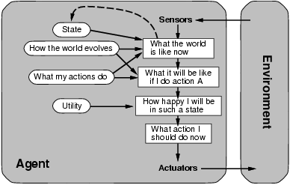
Utility-based agents
Like Goal-based reflex agents, and I see if I was satisfy for this action (i.e. if there is action better than of that)
Ex. To travel from A to C it will cost 20, but there is another way from A to B then to C, and it will cost 10, then second action better than first.
When there are conflicting goals, e.g., speed and safety. Utility is a function that describes the degree of happiness.

Slide 21
Learning agent
Agent execute action and also store its experience to learn, and do not repeat the same mistake
Divide into 4 parts:
Learning element: responsible for making improvements
Performance element: responsible for selecting an action.
Critic: give feedback to learning element on how agent is doing(i.e. evaluate performance).
Problem generator: responsible for suggesting actions that lead to new experiences.

Slide 22
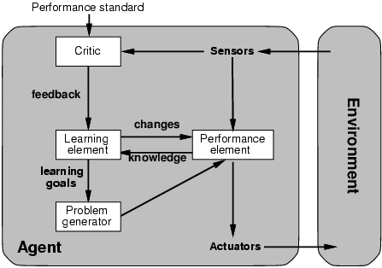
Learning agent

