Slide 1
Artificial Intelligence

Slide 2
Problem solving Agent
A problem-solving agent is a kind of goal-based agent.
It decide what to do by finding sequences of actions that lead to desirable states.

Slide 3
Problem Formulation
A problem can be defined by four components:
initial State:
that agent starts in
Successor Function:
possible actions
Goal Test:
determine whether given state is goal state
Path Cost:
is a function that assigns a numeric cost to each path

Slide 4
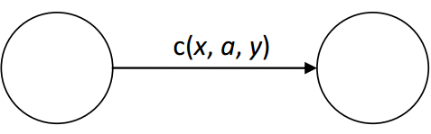
Problem Formulation
A solution to a problem is a path from the initial state to a goal state.
A path in the state space is a sequence of states connected by a sequence of actions.
Solution quality is measured by path cost function.
The optimal solution has the lowest path cost among all solutions.
The state space is the set of all states reachable from the initial state.
c(x, a, y) is step cost of taking action a to go from state x to state y .

Slide 5
Problem Formulation – Example
Puzzle:
Initial State:
Random arrangement of boxes
Successor function:
Blank move left, right, up, down
Goal test:
Boxes in their places
Path cost:
Each move cost one

Slide 6
Problem Formulation – Example
Airline travel problem ( example of Route finding):
Initial State:
specified by the problem
Successor function:
the states resulting from taking any scheduled flight, leaving later than the current time.
Goal test:
are we at the destination on time.
Path cost:
depends on monetary cost, waiting time, etc.

Slide 7
Tree Search– Puzzle
1 | 5 | 8
2 | 4 | 7
6 |  | 3
1 | 5 | 8
2 | 4 | 7
 | 6 | 3
1 | 5 | 8
2 | 4 | 7
6 | 3
1 | 5 | 8
2 |  | 7
6 | 4 | 3

Slide 8
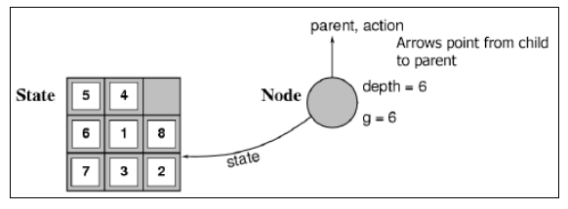
State vs. Node
A state is a (representation of) a physical configuration within the problem state-space.
A node is a (bookkeeping) data structure constituting part of a search tree includes state, parent node, action, path cost , depth

Slide 9
State vs. Node
State: the state to which node corresponds to
Parent-Node: node in search tree that generated this node
Action: action applied to the parent to generate this node
Path-cost: g(x),of the path from initial state to the node
Depth: number of steps from initial state to this
A collection of nodes that are generated but not yet expanded is called the fringe, each element of fringe is a leaf node (i.e. with no successors in tree)

Slide 10
Uninformed search strategies
Uninformed search strategies (blind search) use only information available in the problem definition
Breadth-first search(BFS)
Uniform-cost search(UCS)
Depth-first search(DFS)
Depth-limited search(DLS)
Iterative deepening search(IDS)
Bidirectional

Slide 11
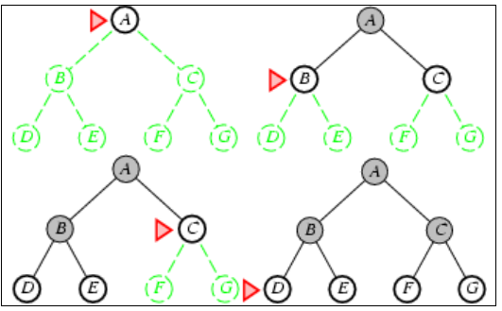
Breadth-first Search (BFS)
Expand shallowest unexpanded node.
Fringe is a FIFO queue, i.e., new successors go at end
Queue trace
tree trace:

Slide 12
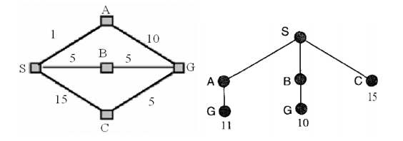
Uniform Cost Search (UCS)
Uniform cost search is BFS by expanding the lowest-cost.
g(Successor(n)) ≥ g(n)

Slide 13
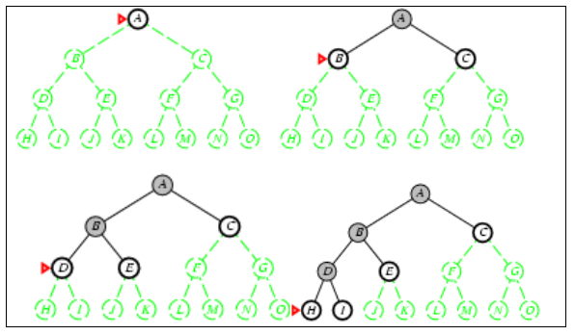
Depth-First Search (DFS)
Always expands the deepest node in search tree.
Modest memory requirements.
fringe = LIFO queue (or stack), i.e., put successors at front

Slide 14
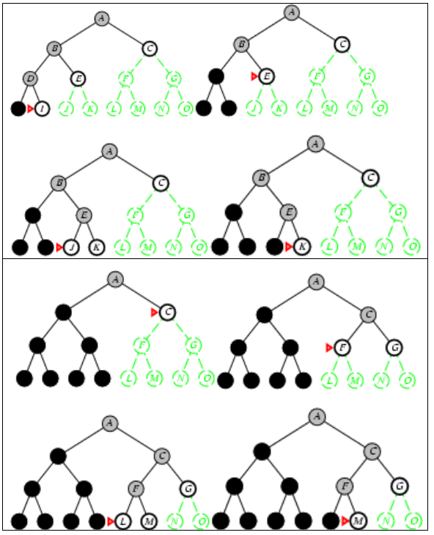

Slide 15
Depth-limited search(DLS)
Depth-limited search (DLS) avoids the pitfalls of depth-first search by imposing a cutoff on the maximum depth of a path.

Slide 16
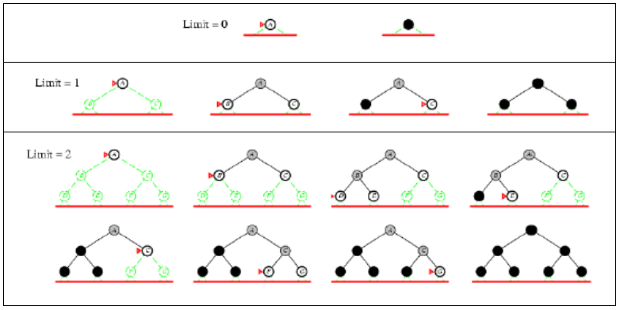
Iterative deepening search (IDS)
Choosing the best depth limit by trying all possible depth limits: first depth 0, then depth 1, then depth 2, and so on.

Slide 17
Bidirectional search
The idea behind bidirectional search is to simultaneously search both forward from the initial state and backward from the goal, and stop when the two searches meet in the middle. It is 2 BFS.

Slide 18
Measuring problem- solving performance search
Search strategies are evaluated based on four criteria:
Completeness: is the strategy guaranteed to find a solution?
Optimality: does the strategy find the highest quality solution when there are several different solution?
Time Complexity: how long does it take to find a solution?
Space Complexity : how much memory does it need to perform the search?
Time and space complexity are expressed in terms of 3 quantities:
b: maximum branching factor of the search tree (or maximum number of successors of any node)
d: depth of the least-cost solution (shallowest goal node)
m: maximum depth (i.e. maximum length of any path) in state space (may be ∞ )
C*: be the cost of the optimal solution

Slide 19
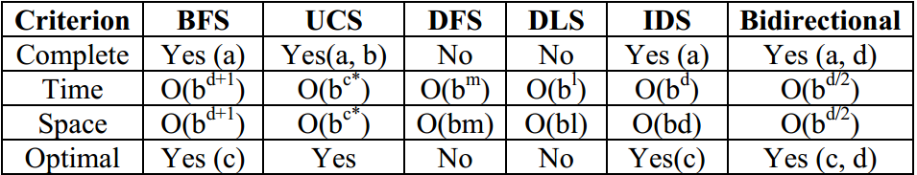
Comparing uninformed algorithms
Conditions for completeness and optimality
a : complete if b is finite
b : complete if costs ≥ 1
c : optimal if step costs are all identical
d : if both directions use BFS

