Slide 1







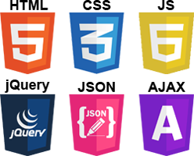
Summer Training 2019
The Best Solution for Empowering Practical/Theoretical Skills

Slide 2
{ Restful : }
:{
“Get” : “ You from Scratch ”,
“Post” : “ You as a Master ” ,
“Put” : “ You in a Great Position ” ,
“Delete” : “ All your Obstacles”
}

Slide 3

And I Wanna be A Master
Let’s Try to
Post : { “Myself to the next-gen”}

Slide 4





Practical
Practicing
Collaboration
Helping
Contribution
Innovation
Optimized
trust
Self
reliance
oriented
Theoretical

Slide 5
Practical
Clear Code
Solid
Maintainable
Practical Wise
Tested
Optimized
trust
Self
reliance
oriented
Theoretical

Slide 6
Practical
Management
organization
Task-oriented
Skills building
Advising
Optimized
trust
Self
reliance
oriented
Theoretical

Slide 7
Practical
On Board
Slide Starting
Sharing Ideas
Advanced Topics
Resource Sharing
Optimized
trust
Self
reliance
oriented
Theoretical

