Slide 1
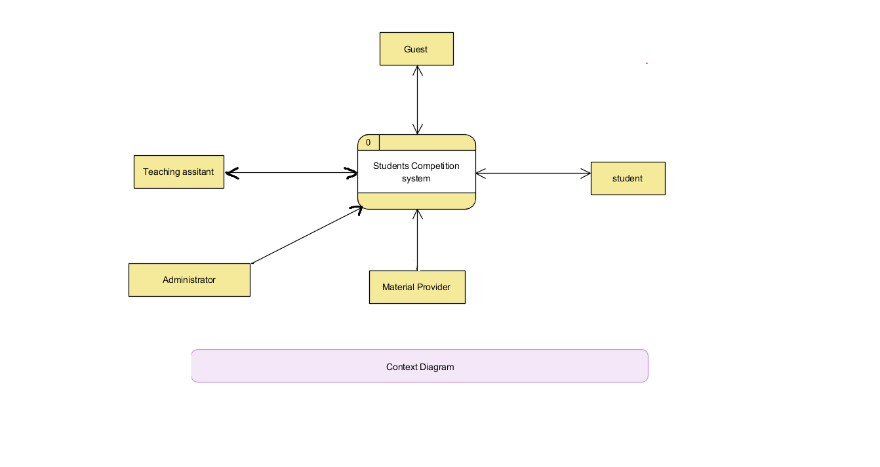
Ahmed Khalil

Slide 2
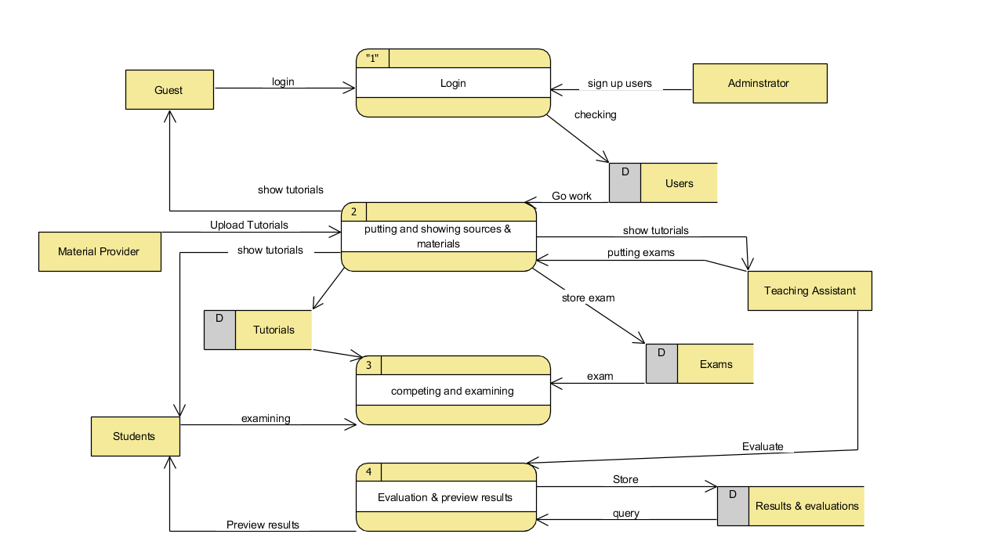
Ahmed Khalil

