Slide 1

PENETRATION TESTING
UHIS Mini Portal — Horus Byte Training Prototype
Ahmed Abdelmoneim Kotb
Penetration Testing & Application Security — NTI Training Program

Slide 2






Agenda
The Project
Methodology
What Horus Byte is, and why UHIS as a scenario
OWASP WSTG black-box testing approach
Findings
Exploitation
Six vulnerabilities, Critical to Low
Live evidence — how each was actually broken
Remediation
Takeaways
Fixes applied and independently re-verified
Recommendations and community value
Horus Byte — UHIS Mini Portal | Penetration Testing & Application Security
2

Slide 3
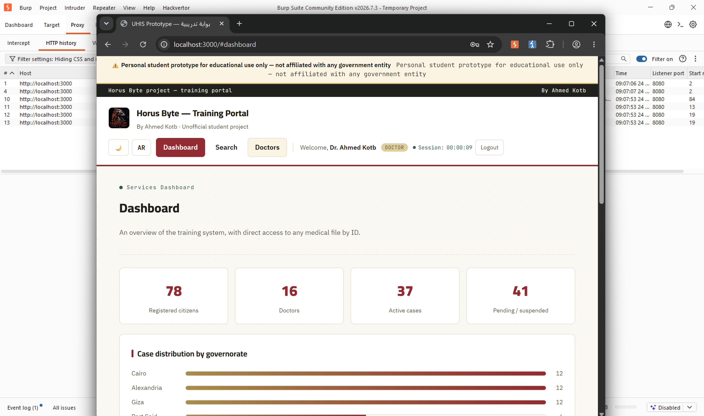
THE PROJECT
What is Horus Byte?
A self-built training prototype simulating a portal for Egypt's Universal Health Insurance System (UHIS) — a real, ongoing national digitization effort.
Built from scratch: Node.js / Express / MySQL, Dockerized
Citizen, doctor, and admin roles with real workflows
Deliberately mirrors patterns seen in real government/health systems
Zero real data — fully synthetic, safe to attack
The live Horus Byte dashboard
Horus Byte — UHIS Mini Portal | Penetration Testing & Application Security
3

Slide 4


CONTEXT
Why a Health-Insurance Scenario?
Egypt is actively rolling out its Universal Health Insurance System nationwide — the second phase began in Minya in 2026.
As this kind of system digitizes millions of medical records, the same class of vulnerabilities tested here becomes a real national risk — not a hypothetical one.
This project demonstrates exactly how such flaws are found and fixed — a practical, reusable methodology for Egyptian digital-transformation teams.
Horus Byte — UHIS Mini Portal | Penetration Testing & Application Security
4

Slide 5
METHODOLOGY
OWASP WSTG — Black-Box Testing
“The tester knows nothing, or as little as possible, about the application.” — tested the full methodology, not just the known bugs.
WSTG-INFO
WSTG-CONF
WSTG-ATHN
Information Gathering
Configuration
Authentication
Map every endpoint via Burp proxy history
Probe for exposed files, allowed HTTP methods
Error-message consistency, brute-force behavior
WSTG-SESS
WSTG-ATHZ
WSTG-INPV
Session Mgmt
Authorization
Input Validation
Cookie flags, session invalidation on logout
Legit access vs. what's actually reachable by ID
Quote + harmless tag before any real payload
Horus Byte — UHIS Mini Portal | Penetration Testing & Application Security
5

Slide 6
FINDINGS
Six Vulnerabilities — Critical to Low
Critical
1
High
2
Medium
2
Low
1
All six were found by following the full WSTG methodology — not just the three vulnerabilities planted by design.
Horus Byte — UHIS Mini Portal | Penetration Testing & Application Security
6

Slide 7
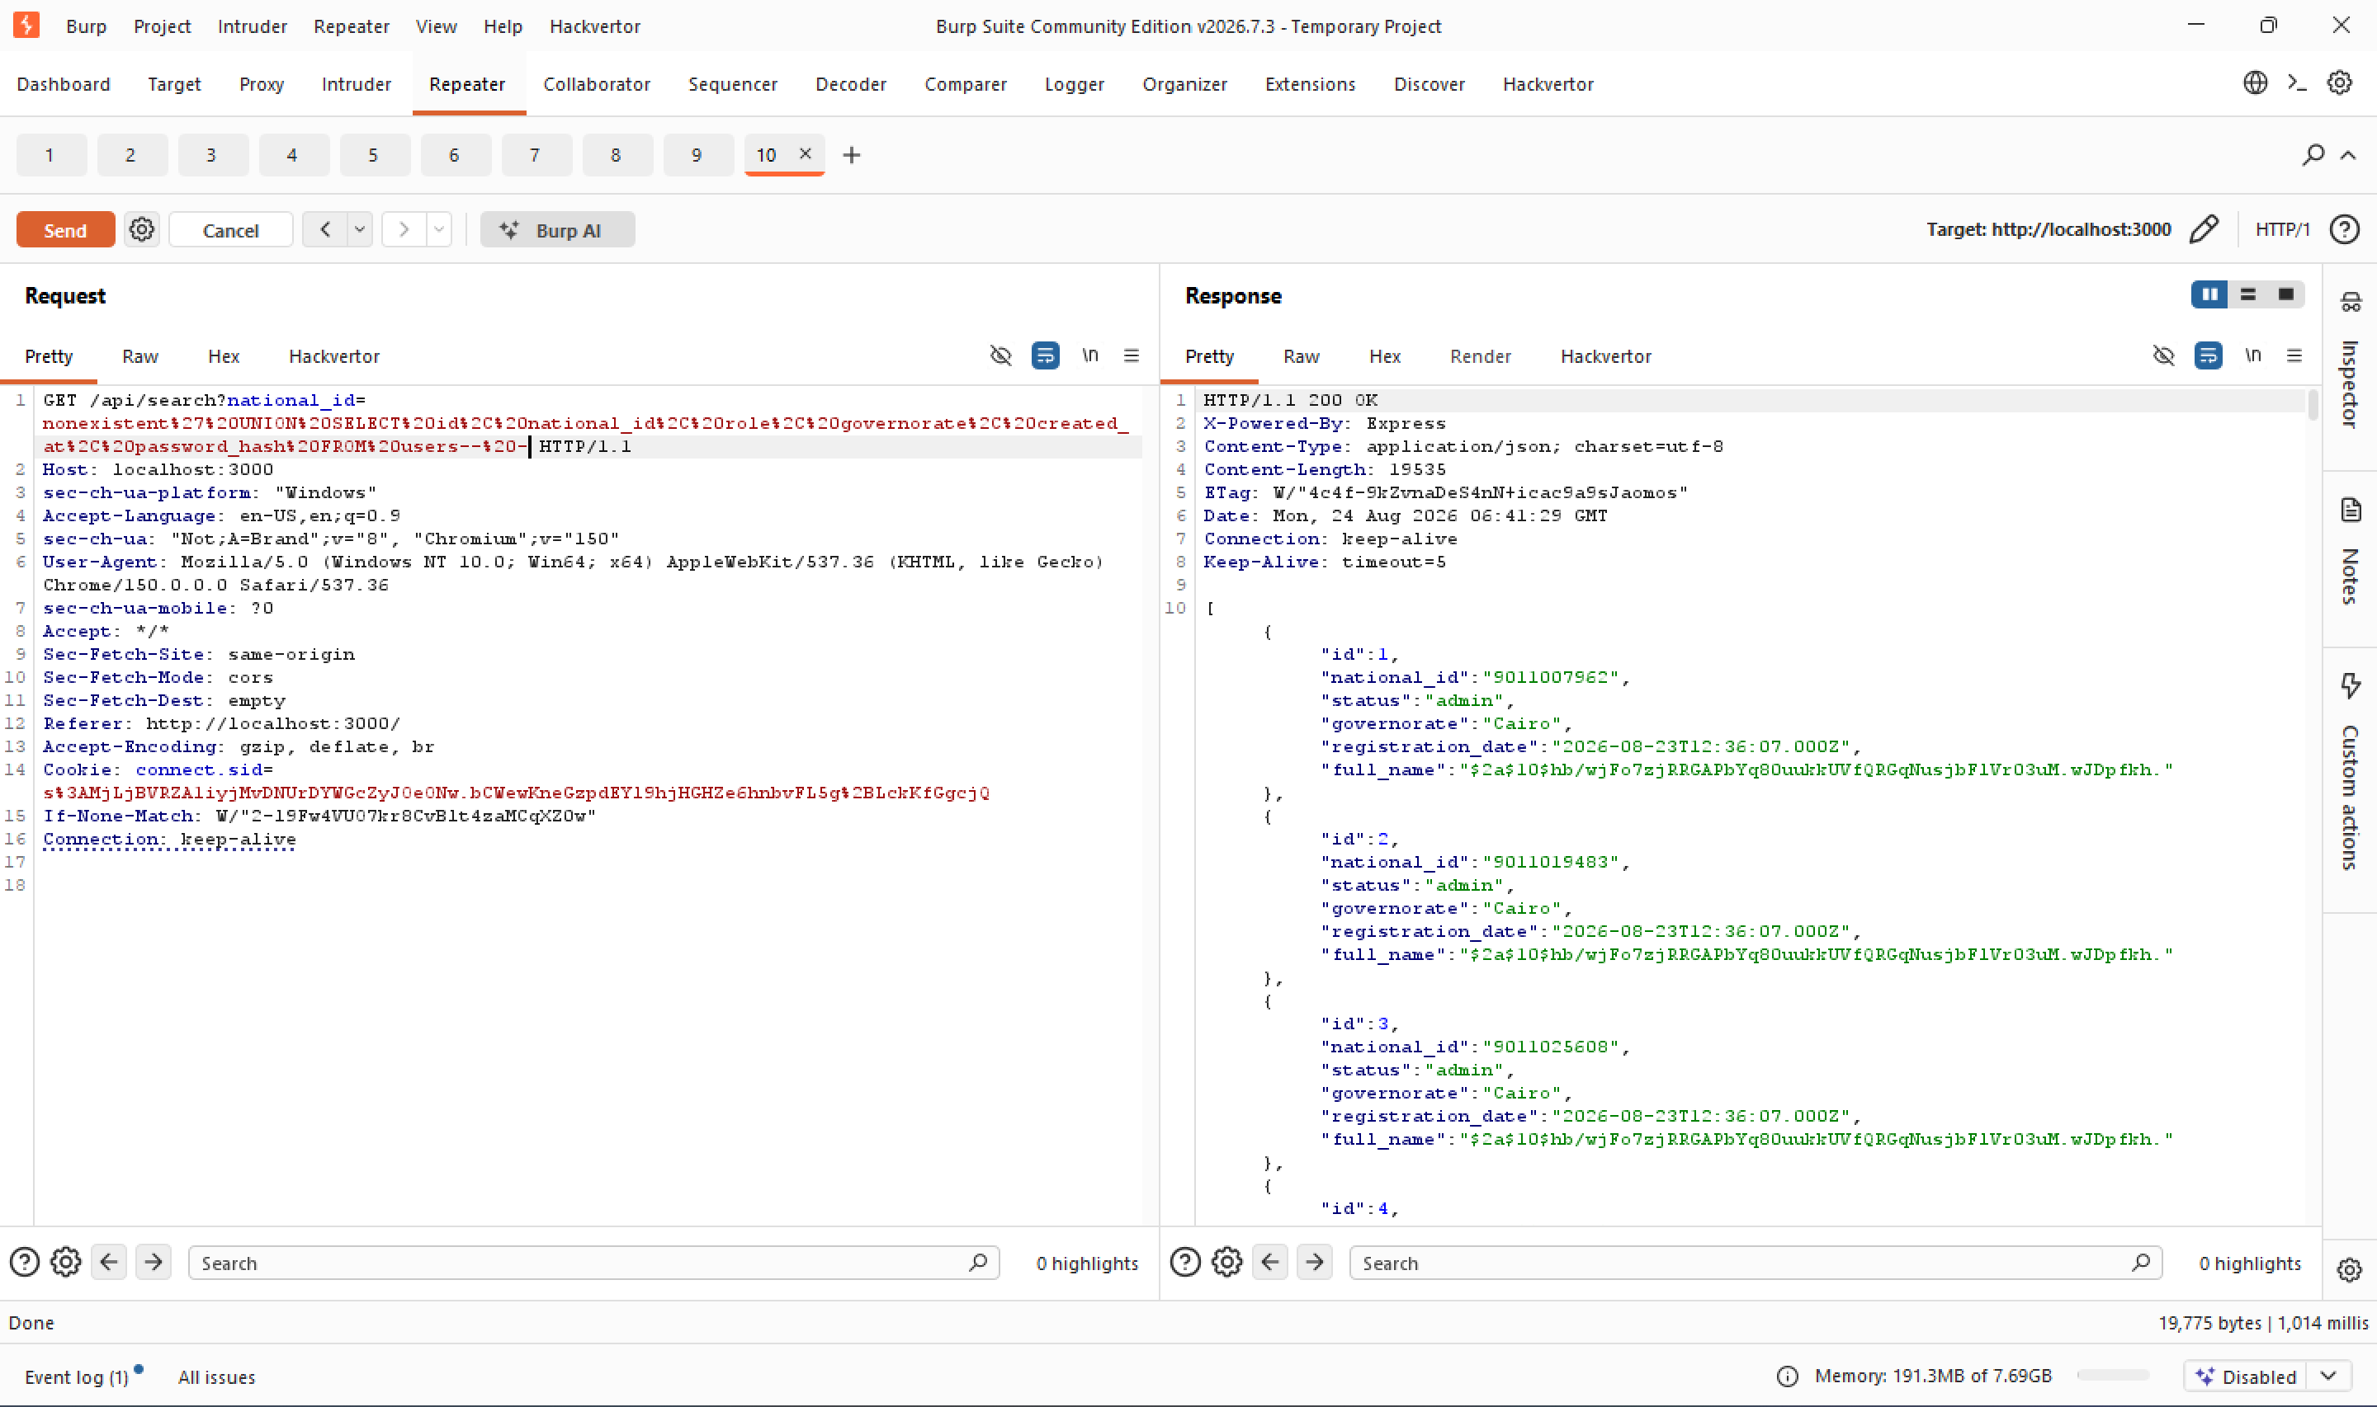

FINDING 1
CRITICAL • 9.1
SQL Injection
The insurance search endpoint concatenates user input directly into SQL. A single UNION SELECT payload pulls data from the users table instead of insurance_cases.
IMPACT
Full users table exfiltrated — national IDs, roles, and password hashes for every citizen, doctor, and admin.
UNION-based payload extracting bcrypt password hashes for every account
Horus Byte — UHIS Mini Portal | Penetration Testing & Application Security
7

Slide 8
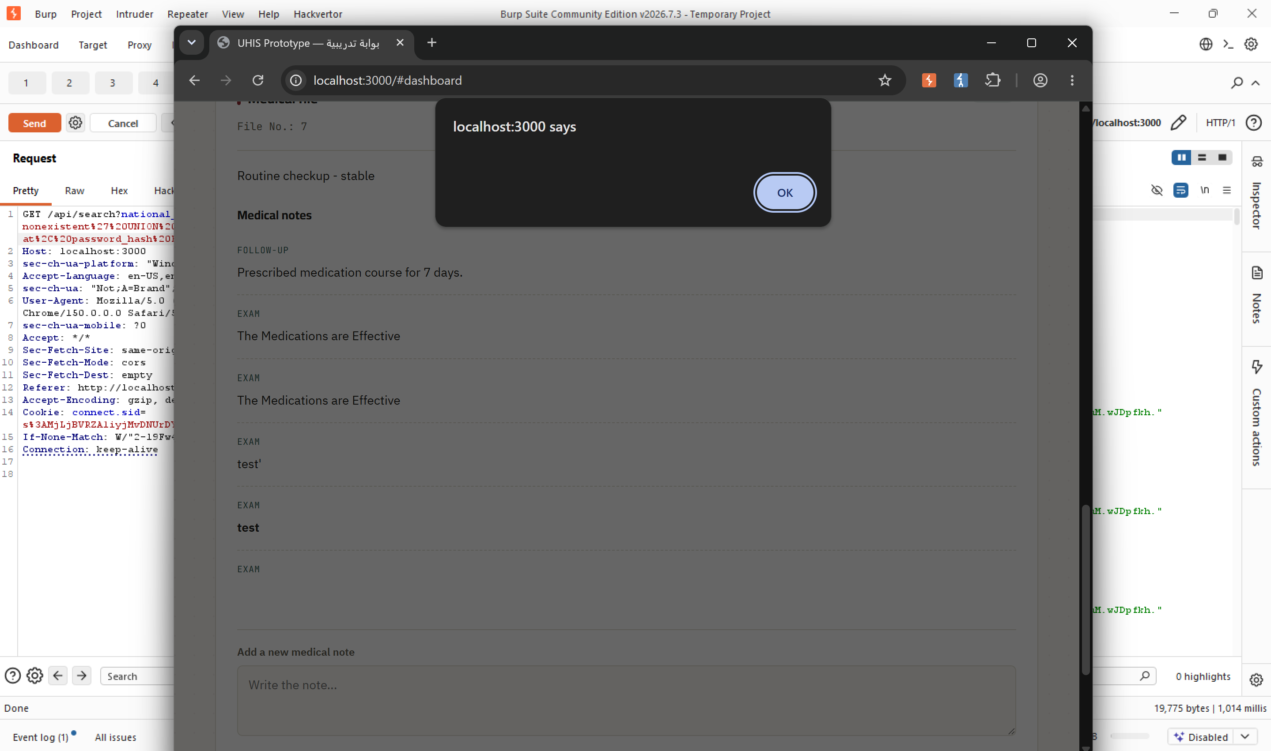

FINDING 2
HIGH • 8.2
Stored Cross-Site Scripting
The medical notes field renders user input via unescaped innerHTML. An event-handler payload persists and executes for anyone who later opens the file.
IMPACT
Persistent script execution in another user's session — enabling session-cookie theft and account hijacking.
JavaScript alert() firing automatically — confirmed exploitable Stored XSS
Horus Byte — UHIS Mini Portal | Penetration Testing & Application Security
8

Slide 9
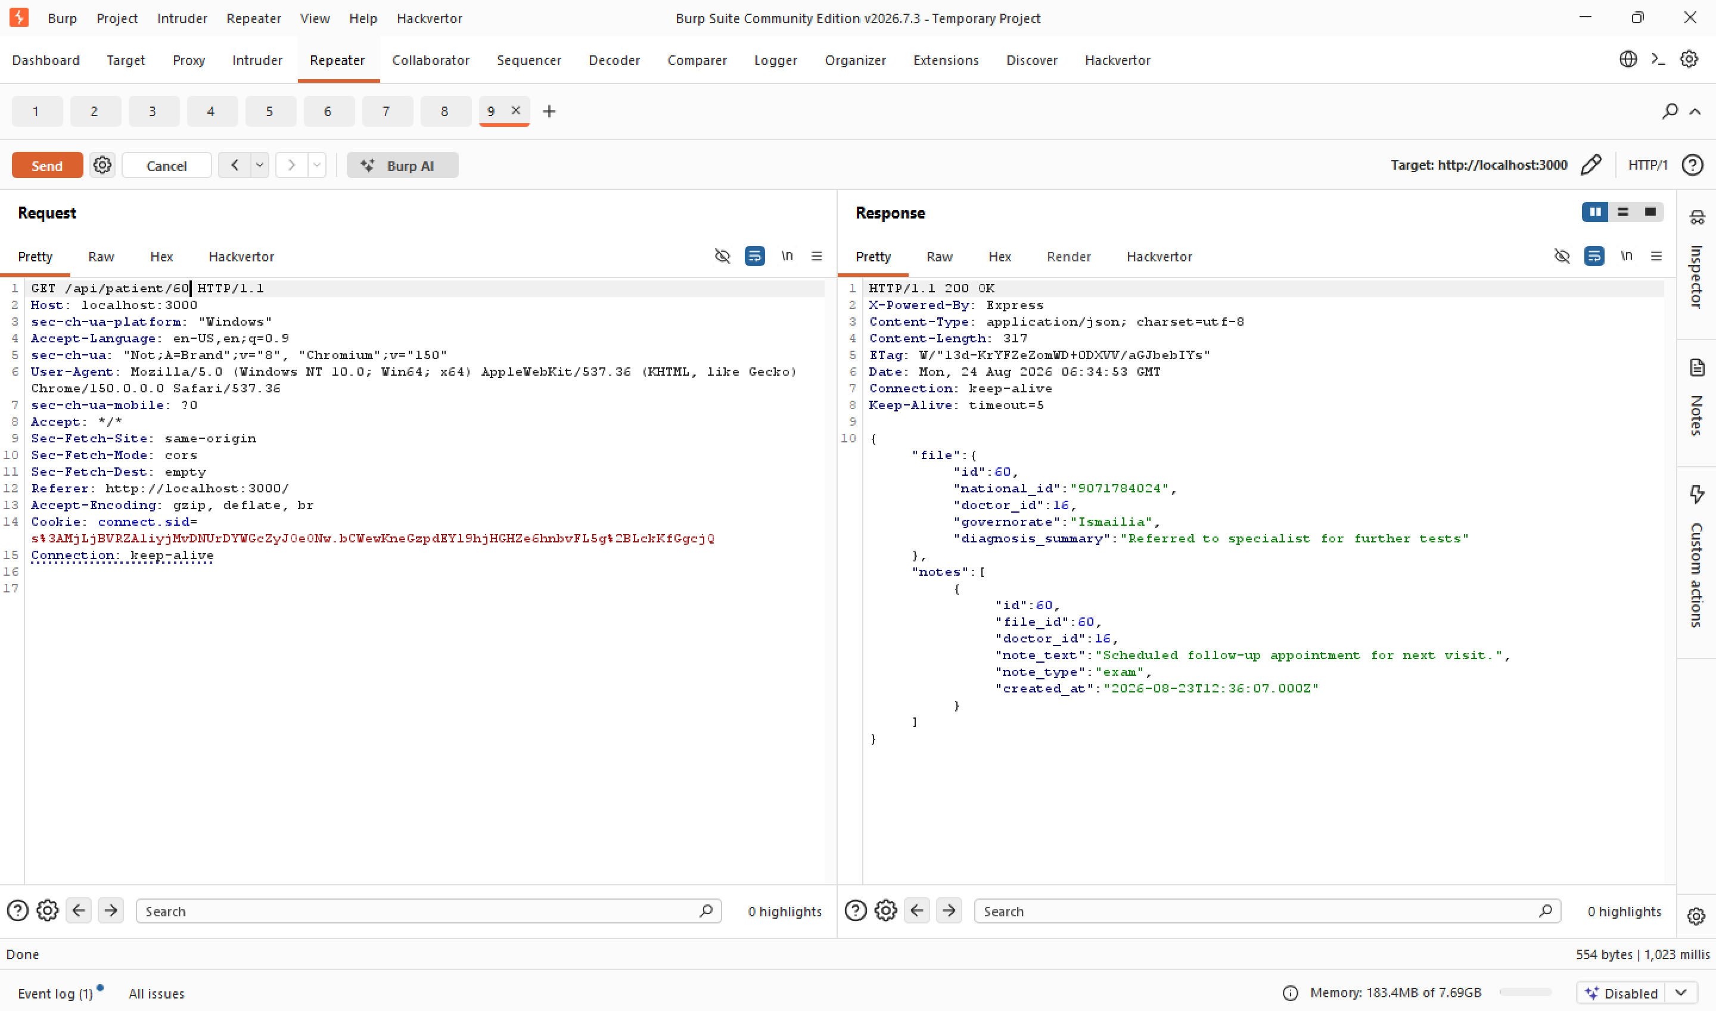

FINDING 3
HIGH • 7.5
Broken Access Control (IDOR)
The patient file endpoint checks only that a session exists — never that the doctor is actually assigned to that file. Incrementing the ID is enough.
IMPACT
Any doctor can read any patient's medical file nationwide, regardless of governorate or assignment.
A Cairo-based doctor account reading a patient file in Ismailia — zero relationship
Horus Byte — UHIS Mini Portal | Penetration Testing & Application Security
9

Slide 10
BEYOND THE KNOWN BUGS
Three More Findings — Found by Following WSTG Fully
MEDIUM • 5.3
MEDIUM • 4.3
LOW • 2.4
Missing Rate Limiting
Missing SameSite Cookie
X-Powered-By Disclosure
Login endpoint accepted unlimited password attempts — no lockout, delay, or CAPTCHA.
Session cookie had HttpOnly but no SameSite/Secure — weak CSRF resistance.
Every response leaked “Express”, aiding framework-specific attack research.
These wouldn't exist in a report that only tested for the three vulnerabilities planted by design — the payoff of following WSTG end-to-end.
Horus Byte — UHIS Mini Portal | Penetration Testing & Application Security
10

Slide 11
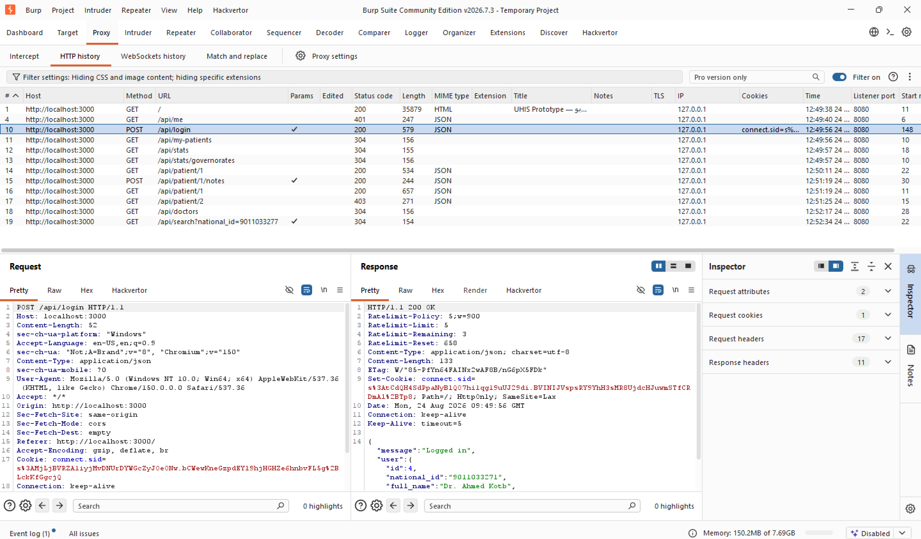
REMEDIATION
Fixed — and Independently Re-Verified
SQL Injection
Before: Raw string concatenation → After: Parameterized queries
Broken Access Control
Before: No ownership check → After: Server-side authorization check
Stored XSS
Before: Unescaped innerHTML → After: textContent-based rendering
Rate Limiting
Before: Unlimited attempts → After: 5 attempts / 15 min, HTTP 429
Post-fix login response: RateLimit headers + SameSite=Lax cookie, both fixed at once
Horus Byte — UHIS Mini Portal | Penetration Testing & Application Security
11

Slide 12

CONFIRMED IMPACT
What Was Actually Proven
Credential material extracted
bcrypt hash for the admin account (id=1) recovered via UNION-based SQLi
Full database exposure
All 78 insurance case records returned from a single boolean-based request
Unauthorized medical access
Cross-governorate patient file (Ismailia) read by an unrelated Cairo doctor
Client-side code execution
JavaScript alert() fired automatically via a stored XSS payload
Horus Byte — UHIS Mini Portal | Penetration Testing & Application Security
12

Slide 13

RECOMMENDATIONS
Already Implemented — Here's the Checklist
Parameterized queries everywhere — no string-built SQL.
Render user content with textContent, never raw innerHTML.
Server-side object-level authorization on every ID-based endpoint.
Rate-limit authentication endpoints (5 / 15 min).
SameSite + Secure flags on all session cookies.
Disable framework fingerprinting headers (X-Powered-By).
Bake WSTG-based testing into routine release review — not just a one-off audit.
Horus Byte — UHIS Mini Portal | Penetration Testing & Application Security
13

Slide 14
WHY IT MATTERS
Beyond a Training Exercise
Mirrors a real national system — UHIS is being rolled out across Egypt right now, not a hypothetical target.
Fully self-contained methodology — OWASP WSTG applied end-to-end, documented, and reproducible by any student.
Every fix independently re-verified — not just “patched,” but proven closed using the exact same exploitation steps.
Horus Byte — UHIS Mini Portal | Penetration Testing & Application Security
14

Slide 15
Thank You
Questions & Discussion
Ahmed Abdelmoneim Kotb • Horus Byte • UHIS Mini Portal Penetration Test

