Slide 1

Liver Cancer Detection
Explainable AI

Slide 2
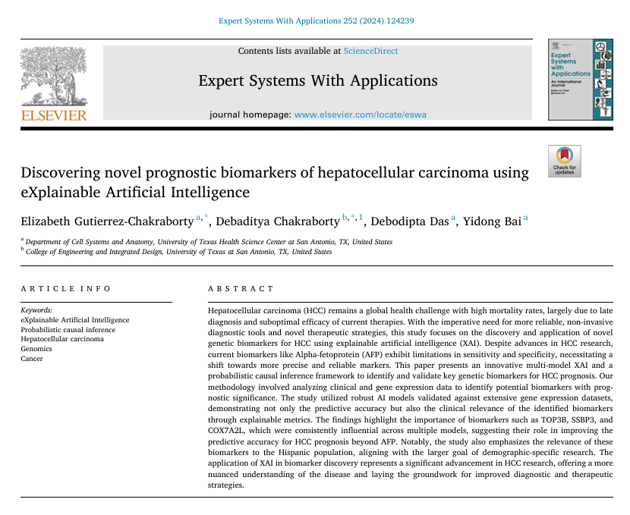

Slide 3
Outline
  Paper Methodology
    Overview
    Models
    Dataset
  XAI Approach
    Game Theory
    Global Insights
    Local Insights
  XAI Model Validation
    Probabilistic Causal Inference Framework
    Traditional Survival Analysis

Slide 4
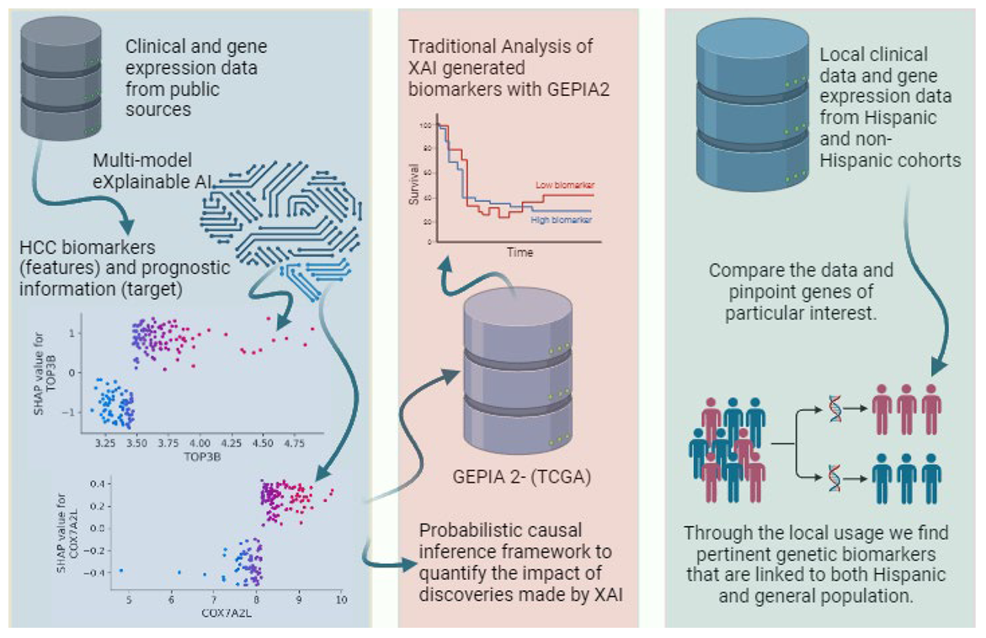
Methodology - Overview

Slide 5

Methodology - Models
Inherently interpretable tree-based ensembled AI algorithms:
XGBoost
Extra Trees
Random Forest

Slide 6
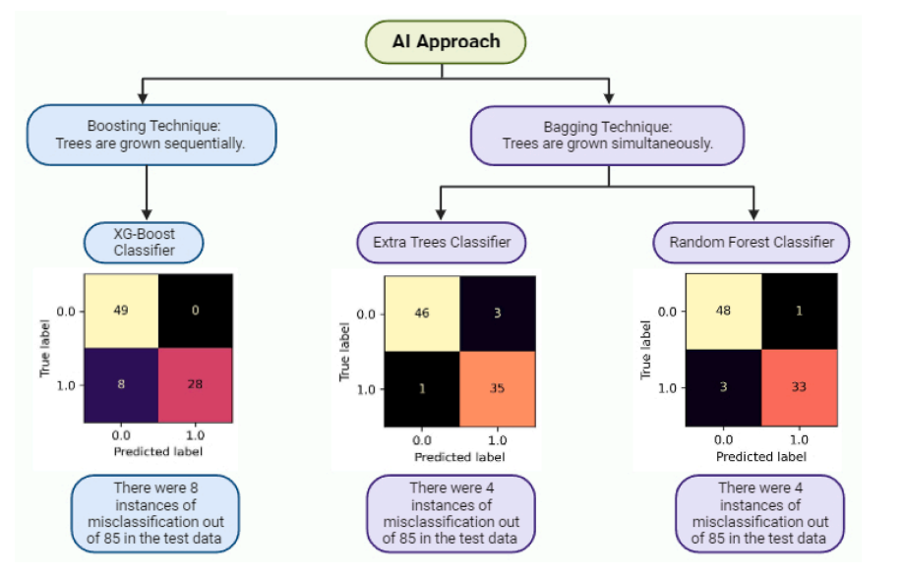
ETC:
95.3 % accuracy, 92.1 % precision, 97.2 % recall, an F1 score of 94.6 %, and ROC_AUC of 0.96 %.
RFC:
95.3 % accuracy, 97.1 % precision, 91.7 % recall, an F1 score of 94.3 %, and ROC_AUC of 0.95 %
XGBoost: 90.6 % accuracy, precision at 100 %, a recall of 77.78 %, an F1 score of 87.5 %, and ROC_AUC of 0.89 %.

Slide 7
Methodology - Dataset
HCCDB: A Database of Hepatocellular Carcinoma Expression Atlas (Lian et al., 2018)
Contains 22 normal liver tissue samples and 231 total samples featuring 12,571 genes
The database has curated RNA-Seq and microarray-based data from multiple sources, including TCGA and GEO.
The models were trained and validated on randomly oversampled data to account for sample imbalance, with XGBoost requiring just 0.03 min and RFC and ETC each taking 0.01 min
train-test (75 %-25 %) split cross-validation.

Slide 8
Methodology – XAI Approach
SHapley Additive exPlanations (SHAP) was used for identifying the most impactful genes in predicting survival outcomes of HCC patients.
Post hoc game theory-based explainer model
Based on the concept of Shapley values from cooperative game theory.

Slide 9
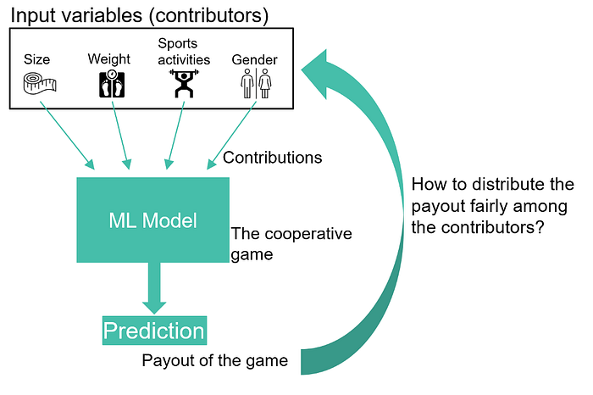
Players: These are the individuals or entities cooperating in the game. In machine learning, they correspond to features (e.g., gene expressions) in a predictive model.
Payout: The total gain or utility achieved by a coalition. In machine learning, this could represent the model's performance (e.g., accuracy) or prediction.

Slide 10
Methodology – XAI Approach
Shapley values provide a way to distribute the total gains from cooperation among all participants in a game
Each player's contribution is determined based on their contribution to the overall outcome when joining different subsets of players

Slide 11
Methodology – XAI Approach
SHAP calculates feature contributions by:
Removing a Feature: It evaluates the model's prediction without the feature.
1
Re-Adding the Feature: It evaluates how the prediction changes when the feature is added back.
2
Averaging: It repeats this process for all possible feature combinations and averages the results to compute the final Shapley value.
3

Slide 12
Methodology – XAI Approach
SHAP provides insight into why and how the models make predictions. It helps:
Identify if the relationship between gene expression and survival is consistent and robust across different models and patient subgroups.
Assess the directionality of the impact (e.g., whether higher/lower expression improves or worsens survival).
Multiple machine learning models independently highlight the same genes as significant.
Consistent results across different algorithms strengthen the argument that these biomarkers are causally linked to survival, not artifacts of specific model behavior.

Slide 13
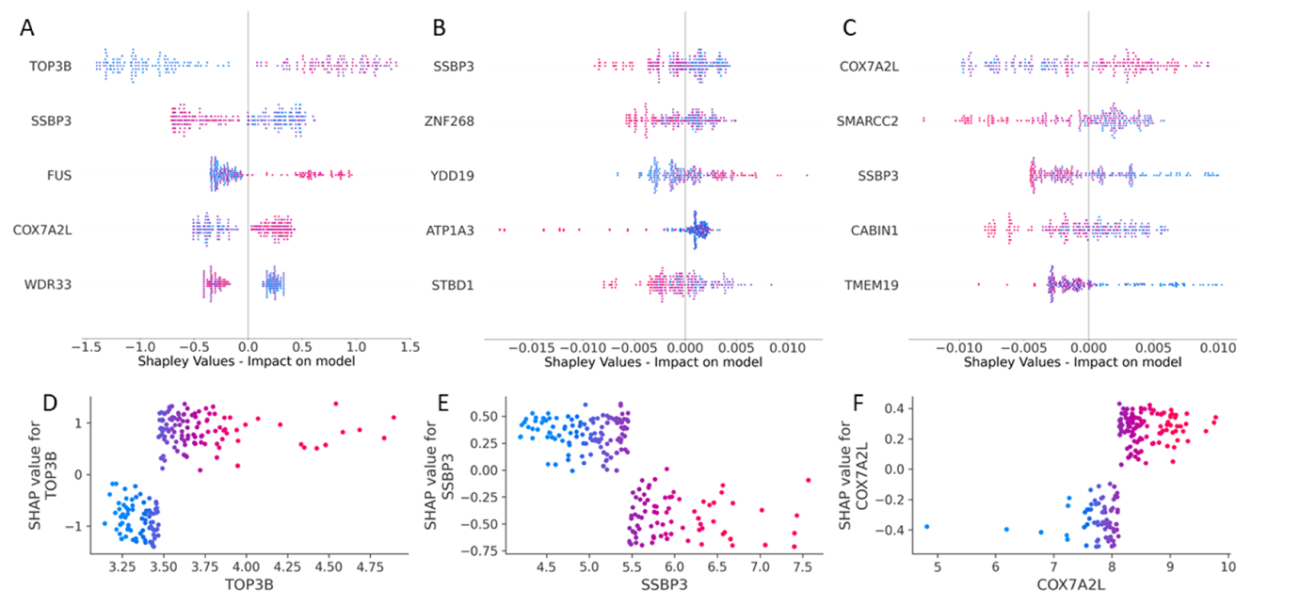
XGBoost Classifier
Extra Trees Classifier
Random Forest Classifier

Slide 14
Global SHAP values rank genes by their overall influence on model outcomes.
  Horizontal axis: SHAP values indicate the impact of gene expression on the model's prediction.
  Positive SHAP values (right side of the axis) indicate that higher gene expression contributes to a higher risk of mortality within five years.
  Negative SHAP values (left side) suggest that higher expression of the gene increases survival likelihood within five years.
  Red dots represent higher gene expression values.
  Blue dots represent lower expression values.
  For instance, SSBP3’s high expression—associated with favorable outcomes—is consistently marked in red and located on the left, suggesting its role as a possible cancer suppressor.
  Conversely, gene expressions marked in red that appear on the right, such as TOP3B and COX7A2L, may be implicated as oncogenic or cancer promoters

Slide 15
Local SHAP values provide insights into how specific gene expression levels affected survival predictions for individual patients.
  TOP3B and COX7A2L show primarily negative impacts, indicating that higher expression correlates with poorer survival outcomes.
  SSBP3 shows positive impacts, suggesting higher expression is associated with better survival.
  The core discovery of this research lies in the explication of critical genes such as TOP3B, SSBP3, and COX7A2L through the lens of XAI. These genes have been identified as the most influential in HCC prognosis by each of the three employed AI models.

Slide 16
XAI Model Validation
The study uses probabilistic causal inference to evaluate whether changes in gene expression levels cause changes in survival outcomes (rather than merely correlate with them)
This method goes beyond correlations by examining conditional dependencies and the likelihood that specific gene expressions directly influence survival.
The framework accounts for potential confounding factors (e.g., patient demographics, clinical conditions) to isolate the independent effects of each gene. This ensures that the relationship between gene expression and survival is not driven by other unrelated variables.

Slide 17
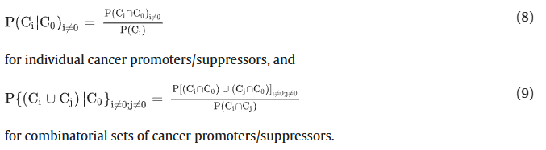
XAI Model Validation
The Probabilistic Causal Inference Framework mathematically evaluates whether the gene expression patterns identified by XAI have a causal effect on patient outcomes (beyond random associations).
Probabilistic causation is a concept in a group of philosophical theories that aim to characterize the relationship between cause and effect using the tools of probability theory. The central idea behind these theories is that causes raise the probabilities of their effects, all else being equal.
C0 is the number of patients in the cohort that survived beyond five years, Ci and Cj are the number of patients in the cohort that satisfy the genetic conditions (i and j) identified by XAI, and P(Ci∩Cj) is the probability that conditions i and j are both satisfied.

Slide 18
XAI Model Validation
Equation (8) measures the conditional probability that a specific gene Ci​ (acting as a cancer promoter or suppressor) is causally associated with survival outcomes C0​. It does so by:
  P(Ci ∩ C0): Calculating the probability that both the gene condition Ci and the survival condition C0 occur simultaneously.
  P(Ci): The probability of the gene condition Ci occurring independently.
Equation (9) extends the analysis to combinatorial sets of genes (e.g., Ci and Cj) by measuring the conditional probability that multiple genes collectively influence survival outcomes. It considers:
  P[(Ci ∩ Co) ∪ (Cj ∩ C0)]: The combined probability that either Ci or Cj​, in conjunction with the survival condition C0​, occurs.
  P(Ci ∩ Cj): The joint probability of the two gene conditions Ci and Cj​ occurring.

Slide 19
XAI Model Validation
Using this probabilistic causal inference approach, this study quantifies the validity of hypotheses generated by XAI models in the context of HCC by calculating the likelihood of specific gene expression patterns being indicative of HCC prognosis.
For instance, the probabilistic truth of the assertion that lower expressions of TOP3 and COX7A2L (below approximately 3.5 and 8 transcripts per million, respectively) are linked to better HCC outcomes, and higher SSBP3 expression (above approximately 5.5 transcripts per million) associates with improved survival, is computed to be 66.7%.
This quantification not only reinforces the credibility of the insights derived from XAI but also substantiates the potential for these gene expressions to serve as predictive markers for patient prognosis.

Slide 20
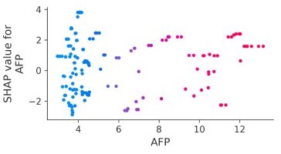
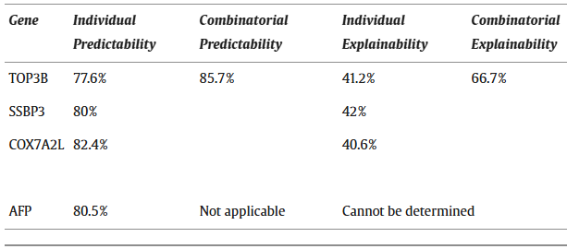
Study Findings
Alpha-fetoprotein (AFP) is an established biomarker for HCC even though it has been reported that up to 20–40 % of HCC patients’ tumor cells do not secrete AFP proteins and that elevated AFP levels are not exclusive to HCC and may arise from other hepatic pathologies or germ cell tumors.
The explainability of AFP is unquantifiable due to the absence of discernible inflection points in the SHAP local explanation plot.
A composite biomarker panel incorporating TOP3B, SSBP3, and COX7A2L genes surpasses the predictive accuracy of AFP alone, achieving an 85.7 % predictability rate. This enhancement suggests the potential superiority of a multi-biomarker approach over the traditional singular use of AFP.

Slide 21
XAI Model Validation - Traditional Survival Anaylsis
To validate the findings, traditional statistical techniques were applied:
Kaplan-Meier Plots: Visualized survival differences between groups with high and low gene expression levels.
Log-rank and Mantel-Cox Tests: Assessed whether survival differences between groups are statistically significant.
Cox Proportional Hazards Model: Quantified the hazard ratio for the identified genes, considering a 95% confidence interval.
This assessment was conducted using GEPIA2 (an online bioinformatics tool that analyzes RNA sequencing data from The Cancer Genome Atlas (TCGA) and Genotype-Tissue Expression (GTEx) databases) on a dataset of 50 normal liver tissue samples and a total of 419 liver samples.
Custom cutoff values (derived from XAI) were used to define gene expression thresholds for "high" or "low" expression groups.

Slide 22
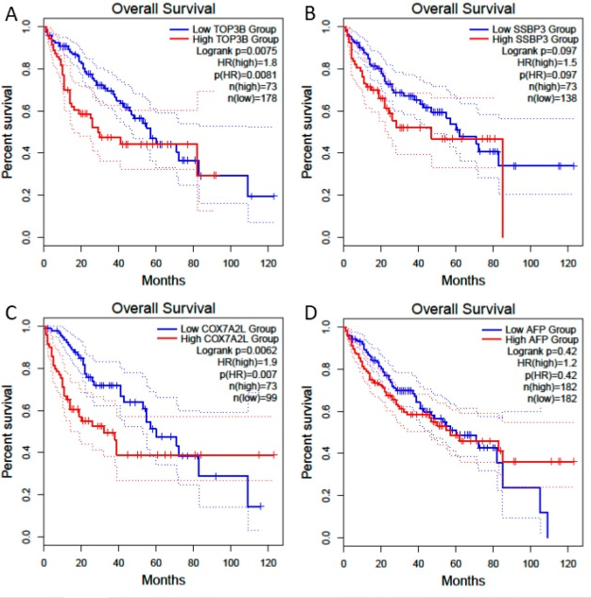
  Y-axis (Percent Survival): Indicates the proportion of patients surviving at each time point.
  Red Line: Patients with high expression of the biomarker.
  Blue Line: Patients with low expression of the biomarker.
  Log-rank p-value: Tests if the survival difference between the two groups is statistically significant.
  Hazard Ratio (HR): Quantifies the risk of death associated with high biomarker expression compared to low expression.
  n(high) and n(low): The number of patients in high and low expression groups.

Slide 23
TOP3B:
Log-rank p = 0.0075: Statistically significant survival difference.
HR(high) = 1.8: Patients with high TOP3B expression have 1.8 times the risk of death compared to those with low expression.
Conclusion: TOP3B is a significant prognostic biomarker.
SSBP3:
Log-rank p = 0.97: No significant survival difference.
HR(high) = 1.5: Suggests higher risk with high expression, but not statistically significant.
Conclusion: SSBP3 is not a significant biomarker in this analysis.
COX7A2L:
Log-rank p = 0.0062: Statistically significant survival difference.
HR(high) = 1.9: Patients with high COX7A2L expression have 1.9 times the risk of death compared to low expression.
Conclusion: COX7A2L is a significant prognostic biomarker.
AFP (Alpha-Fetoprotein):
Log-rank p = 0.42: No significant survival difference.
HR(high) = 1.12: Slightly higher risk with high expression, but not statistically significant.
Conclusion: AFP, a known biomarker for HCC, is not statistically significant here.

Slide 24
The absence of statistical significance is observed not only in SSBP3 but also in AFP.
This divergence in results obtained from XAI methods compared to those from traditional survival analysis shows that traditional methods for identifying influential biomarkers in HCC may treat the problem as linear and one-dimensional.
This approach might be insufficient for capturing the complexity inherent in the biological interactions that underlie HCC as the identification of critical biomarkers is a non-linear and multi-dimensional challenge that requires the nuanced analysis provided by advanced computational techniques like XAI.

Slide 25
Thank you

