Slide 1
ADVANCED COMPUTER NETWORKS
Ahmed DIRIE
Admas University
Hargeisa, Somaliland

Slide 2
Intro to Networking

Slide 3
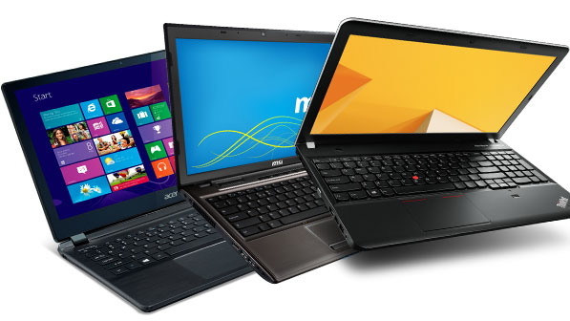
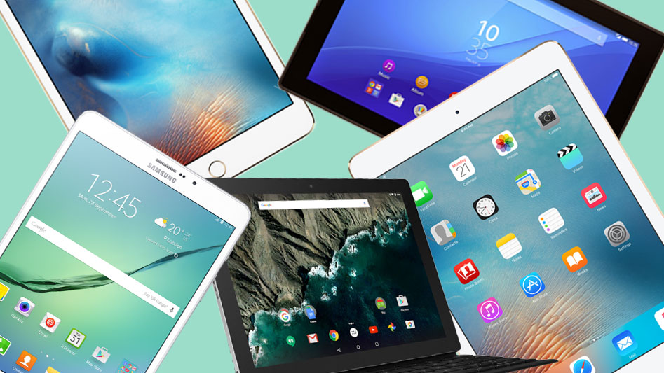
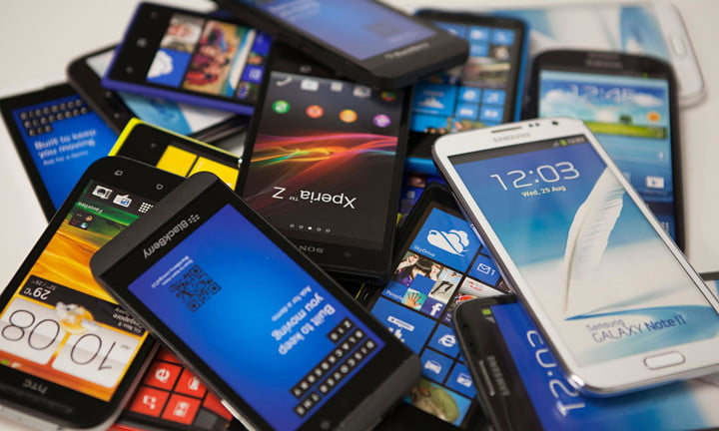
“Networking” … What do YOU think of?

Slide 4
Physical Components of Networks - Hosts
Hosts
Laptops
PCs
Tablets
Smart Phones
Servers

Slide 5




Physical Components of Networks – Network Infrastructure
Network Access Devices
Hubs
Switches
Access Points
Network Infrastructure Devices
Routers
Firewall

Slide 6
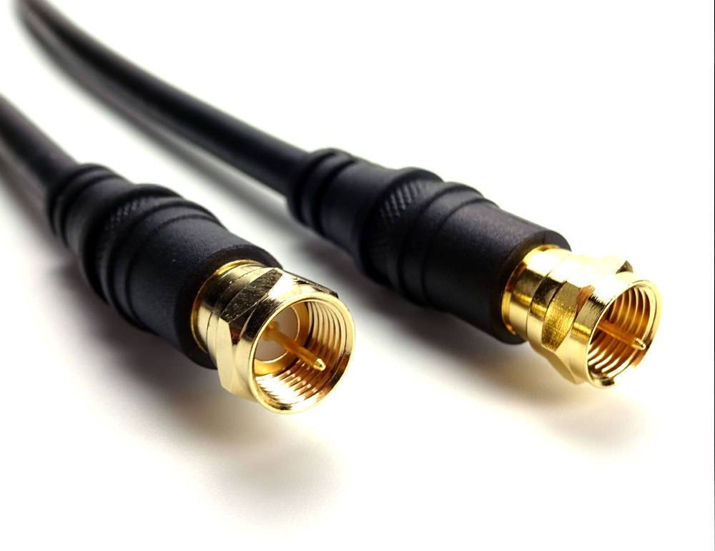
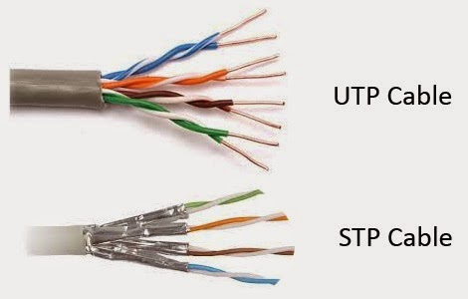
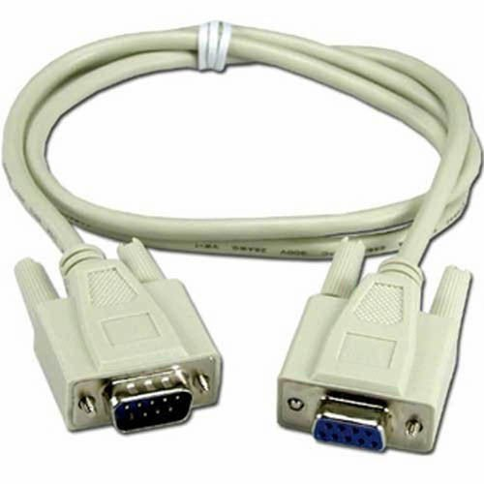
Cables – Copper
Copper Cables (LAN)
Co-axial
Twisted Pair
Shielded
Unshielded
Copper Cables (WAN)
Serial Cables

Slide 7
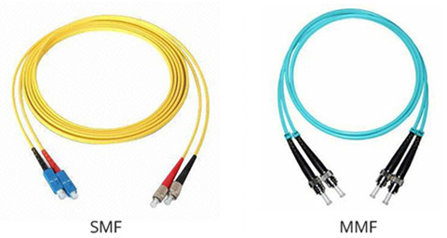
Cables – Optics
Fiber Optic Cables
MMF: Multi Mode Fiber
SMF: Single Mode Fiber

Slide 8

Network/Topology Diagrams

Slide 9
Topologies – Logical and Physical
Logical Topology
What the network looks like to the end-device
Physical Topology
How the network is actually cabled
Bus
Star
Ring
Fully-Meshed vs. Partially-Meshed

Slide 10
What is a “Protocol”?
Rules of operation
May facilitate vendor interoperability
Provides easier troubleshooting
Governed by different standards bodies
IEEE
IETF
IANA

Slide 11
OSI Reference Model
Comprised of seven layers
The benefits of using a layered approach are:
Provides easier troubleshooting
Standardizes the networking architecture
Allows vendor interoperability

Slide 12
OSI Layers
Application
Presentation
Session
Transport
Network
Data Link
Physical

Slide 13
OSI Layers Cont’d ...
Upper Layer
Application
Presentation
Session
Lower Layer
Transport
Network
Data link
Physical

Slide 14
Application Layer
Features
Interacts with the user applications (Firefox, Outlook, etc.)
Provides initial network connection for user applications
Manages the application connections between hosts

Slide 15
Presentation Layer
Performs encryption within an application
Ensures that data is presented correctly to the application used
Performs translation of cross-platform standards that may be understood by the local machine:
Pict. Into .jpg file translation
.wav into .mp3

Slide 16
Session Layer
Helps establish session with reserved port numbers
Session identifier is assigned
Tracks connections between hosts and remote computers/servers

Slide 17
Session Layer Cont’d ...
Well-known ports
Ranges from 0 to 1023
Port numbers used by well-known services
Examples: HTTP(80), HTTPS(443), DNS(53), FTP(20,21), TELNET(23), SSH(22), etc.
Registered ports
Reserved for the applications
Ranges from 1024 to 65535

Slide 18
Transport Layer
Fragmentation
Sequencing and reassembling
Windowing, buffering, congestion avoidance
Error correction
Examples: TCP/UDP/EIGRP/OSPF

Slide 19
Transport Layer Cont’d ...
Identifying services
TCP
Connection oriented
Reliable
Protocol number 6
UDP
Connectionless
Unreliable
Protocol number 17

Slide 20
Network Layer
Segmentation of network topology into logical partitions
Logical addressing
Path discovery and selection

Slide 21
Network Layer Terminology
Routed Protocol
Protocols that are used for identification
IP, IPX, AppleTalk
Routing Protocol
Protocols that determine best paths for the routed protocols
EIGRP, OSPF, RIP, BGP, etc.
Example
Router, Multilayer Switch (L3 Switch)

Slide 22
Data Link Layer
Media-Access Layer
Link-Layer Addressing
Error checking
Devices used at the Data Link Layer
Switches, Bridges

Slide 23
Physical Layer
Electrical signals carried over the physical layer
Devices used at the physical layer
Hubs
Repeater
Network Interface Cards (NICs)
Cables (Ethernet, Fiber-Optics, Serial, etc.)

Slide 24
Protocol Data Units (PDUs)
PDU
The final, structured data unit created by an OSI layer
PDUs created at one layer are meant to be used by the same layer on receiving device

