Slide 1
KIT ROOM · FINAL DEMO
PLAN · ORDER ROUTE
One order,
followed all
the way down.
BROWSER
API GATEWAY
#3
ORDER SERVICE
OUTBOX
SQS QUEUE
ONE TX
POSTGRES
WORKER
How Team Alpha took a nine-service order platform from provided source code to Amazon EKS in four weeks, on a $200 budget, and built it for the orders that go wrong.
PLACED
CONFIRMED
PROCESSING
SHIPPED
DELIVERED
TEAM ALPHA
SHEET 01
ORDER #3 · SHIPPED
TEAM ALPHA · CODERCO PRODUCTION ENGINEERING SIMULATION · 13 OCTOBER 2026
Notes:
[0:30] TAKEAWAY: We will follow one real order from the click down to the infrastructure.
SAY: We are Team Alpha. In four weeks we took a nine-service order platform that CoderCo gave us as source code and ran it on Amazon EKS, on a $200 budget. Instead of touring every resource, we will follow one order, order number 3, from the browser all the way down, and stop at the decisions that mattered.
NEXT: First, what the product is.

Slide 2
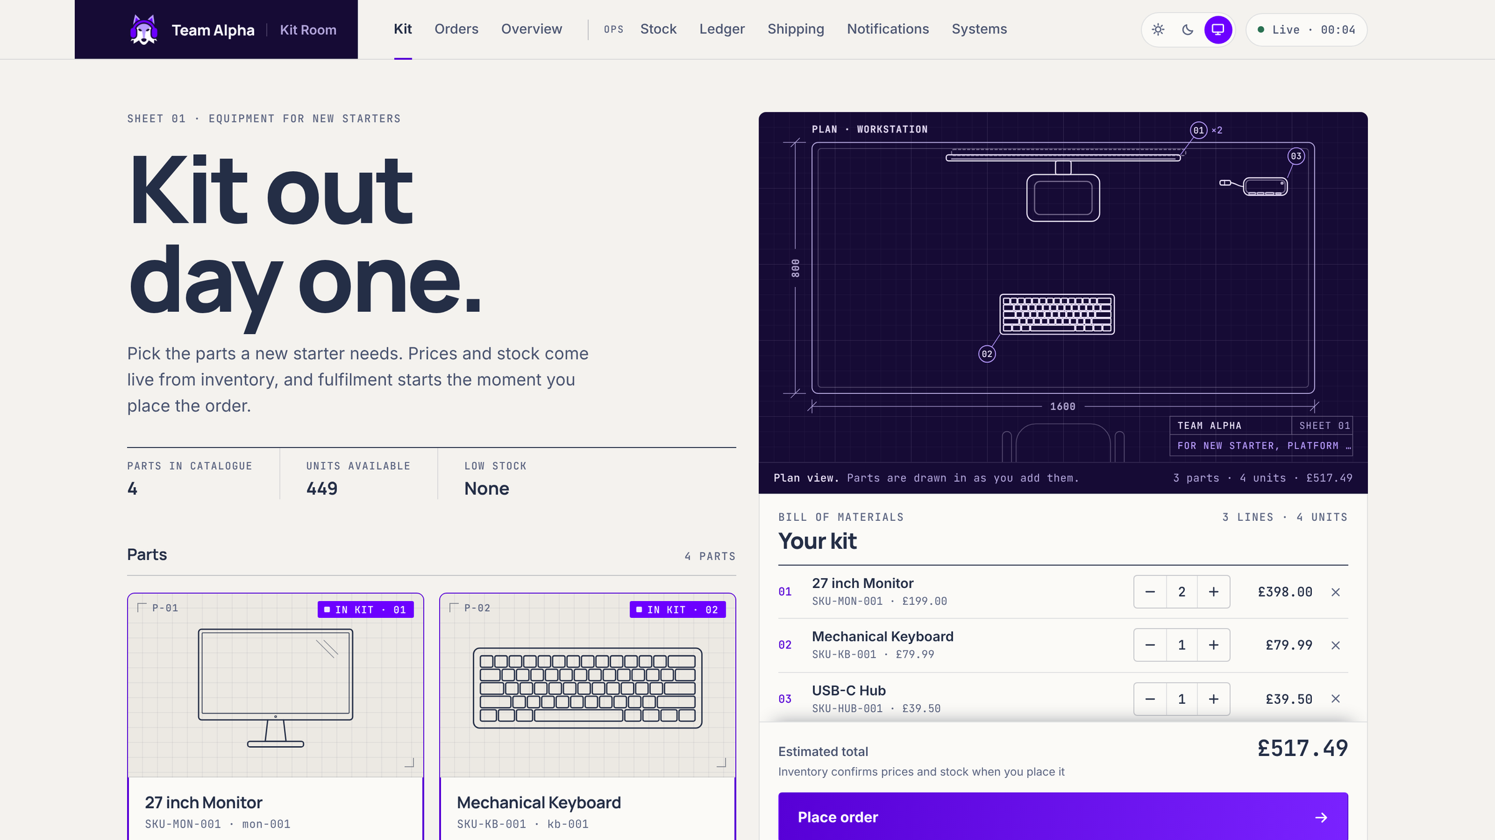
Kit Room equips new starters from one page
ACT I · CONTEXT
An operations team picks the parts a new starter needs. Kit Room prices them from live stock, takes payment, ships them and keeps everyone told.
WHO IT SERVES
The person ordering
builds a kit, places the order, tracks it.
Operators
manage stock, payments and shipping.
ONE JOURNEY
01
Build a kit
02
Place the order
03
Fulfilment runs by itself
THE KIT PAGE · CURRENT BUILD, RUN LOCALLY, 13 OCT
04
Track it to delivery
Notes:
[1:00] TAKEAWAY: Kit Room is an ordering tool for equipping new starters. The journey is build, place, fulfil, track.
SAY: The code we were given was a generic order platform. We kept its workflow and gave it one clear use: an operations team ordering monitors, keyboards and hubs for people starting next week. Two audiences use one page: whoever places the order, and the operators who run stock, payments, shipping and messages from the OPS pages.
IF ASKED: It is the same API flow the brief grades: create order, reserve inventory, take payment, ship, deliver. The page signs itself in as one admin user. That is a known limit, slide 19.
NEXT: Here is what we were actually handed.

Slide 3
Out of the box, no order got past pending
ACT I · THE STARTING LINE
168
AS PROVIDED · ORDER-SERVICE/MAIN.GO
test functions in 20 files. The provided services had none.
data, _ := json.Marshal(event)
log.Printf("Event -> SQS: %s", string(data))
// Students implement actual SQS SendMessage here
BUILT INTO THE APP
Transactional outbox and SQS publisher
The worker: reserve, charge, confirm, commit
AS PROVIDED · WORKER/MAIN.GO
Idempotency keys on orders and payments
func receiveSQSMessages(ctx context.Context,
queueURL string) []string {
// Students implement with AWS SDK SQS ReceiveMessage
return nil
}
A route allow-list at the gateway
BUILT AROUND IT
9 multi-stage Dockerfiles, distroless, non-root
Terraform: 6 modules, 3 environments, a bootstrap
Publishing was a log line. Nothing read the queue. No tests.
One Helm chart for 9 services, ArgoCD app-of-apps
8 GitHub Actions workflows
Notes:
[0:45] TAKEAWAY: The provided code could not move an order past pending. The heart of the order flow, and everything around it, is ours.
SAY: Two stubs sat at the centre. Publishing an order event was a log line, and the worker that processes orders had no queue code. Out of the box every order stayed pending for ever, and there were no tests. So our job was not only Docker, Terraform and Kubernetes. We had to build the part that makes an order real, and prove it holds up under retries.
EVIDENCE: codercohq/eks-v2 at e19e419 (our import af985c9 is identical): order-service main.go "Students implement actual SQS SendMessage here"; worker main.go receiveSQSMessages returns nil. Ours: outbox.go, publisher.go, the worker, idempotency.go in order and payment, allowlist.go, pricing.go, retention.go, 20 test files with 168 Test functions.
CAREFUL: Do not claim graceful shutdown, /livez or waitForDB. Upstream added those in May.
NEXT: So what did done mean for us?

Slide 4
Five aims, shaped by a $200 budget
ACT I · GOALS AND CONSTRAINTS
WHAT WE SET OUT TO DO
CONSTRAINTS
01
Never lose an accepted order
$200
even when a downstream service or AWS is briefly down.
AWS spend CoderCo reimburses per team. Every cost needs a reason.
02
Never charge twice
a retry, a redelivery or a double click changes nothing.
STAKEHOLDER PRIORITY ORDER, 14 SEP
1 Cost
2 Security
3 Uptime
4 Features
03
Hold no long-lived AWS keys
nothing in Git, CI or an image can reach AWS on its own.
FIXED BY THE BRIEF
04
Change the platform only through Git
EKS across 3 AZs · Karpenter · Traefik behind an NLB · cert-manager and ExternalDNS · ArgoCD app-of-apps · Postgres and Redis on StatefulSets · GitHub OIDC · image scanning
Terraform for AWS, ArgoCD for the cluster.
05
Ship one service without touching eight
and roll it back the same way.
4 weeks · 5 engineers · 1 AWS account
AIMS, NOT GUARANTEES. SLIDE 18 SAYS WHICH ARE PROVEN.
Notes:
[1:15] TAKEAWAY: Cost came first, so every choice had to earn its spend. The five aims are aims; slide 18 says which are proven.
SAY: Our stakeholder set the order on 14 September: cost, then security, then uptime, then features. CoderCo reimburses up to $200 of AWS per team and asked us to justify every cost. The brief also fixed many tools, so our real choices were how to use them. From that we set five aims. Read them as aims, not guarantees: at the end we will show which ones we have evidence for.
IF ASKED (currency): Saad said $200 at the 13 Sep orientation; some team notes say pounds. The deck uses dollars throughout.
IF ASKED (priority): One stakeholder nudge on 6 Oct put security first. The written order from 14 Sep is cost first.
NEXT: Let us see the product do its job.

Slide 5
Watch one order travel
ACT II · LIVE DEMO
01
02
03
04
Build a kit
Place the order
Wait a few seconds
Ship it
NOTICE
NOTICE
NOTICE
NOTICE
Prices and stock come live from inventory. The browser never sets a price.
"Placed" comes back at once: the order is saved and queued before any work begins.
It turns "Confirmed" by itself: a background worker reserved the stock and took the payment.
Shipment, tracking number and emails appear, and each is created once.
LIVE dashboard.dev.eksv2.naimaosmann.com IF DEV IS DOWN slides 6 and 7 show the same journey from this build
Notes:
[3:00 including the live demo] TAKEAWAY: One coherent journey. What matters is what happens between the clicks.
DO (live, in the browser, full screen):
1. Kit page. Add 27 inch Monitor, Mechanical Keyboard, USB-C Hub. Press + once on the monitor. Point at the plan drawing and the line "Prices and stock come live from inventory".
2. Type a note: "New starter, Platform team". Press Place order. Point at "Placed" and "Queued for the fulfilment worker".
3. Wait about 5 seconds. Point at Confirmed, and at Units available dropping.
4. Track order. Start processing, then Mark shipped. Point at the shipment, tracking number and the two emails.
IF THE CARD IS DECLINED (the simulated provider declines about 1 in 10): say "That is the failure path, live: stock released, order cancelled, customer told." Then place the kit again.
IF DEV IS DOWN OR SLOW: stay in the deck and use slides 6 and 7. Say so plainly: "Dev is torn down when idle to save cost; these frames come from the same build."
NEXT: Here is what you just saw, frozen, so we can point at it.

Slide 6
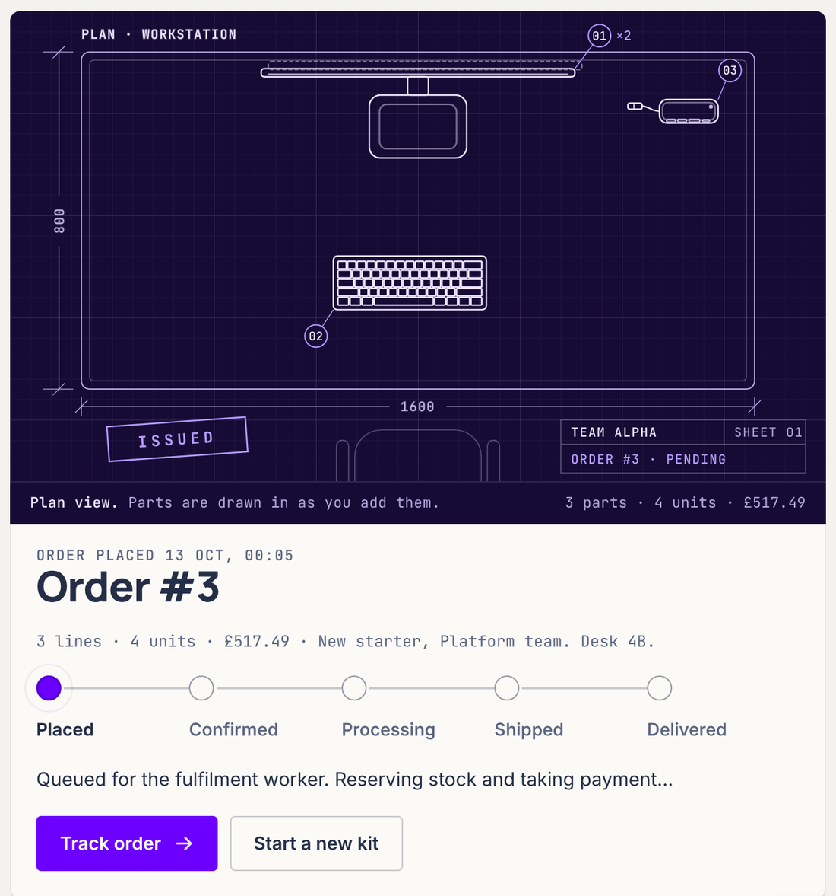
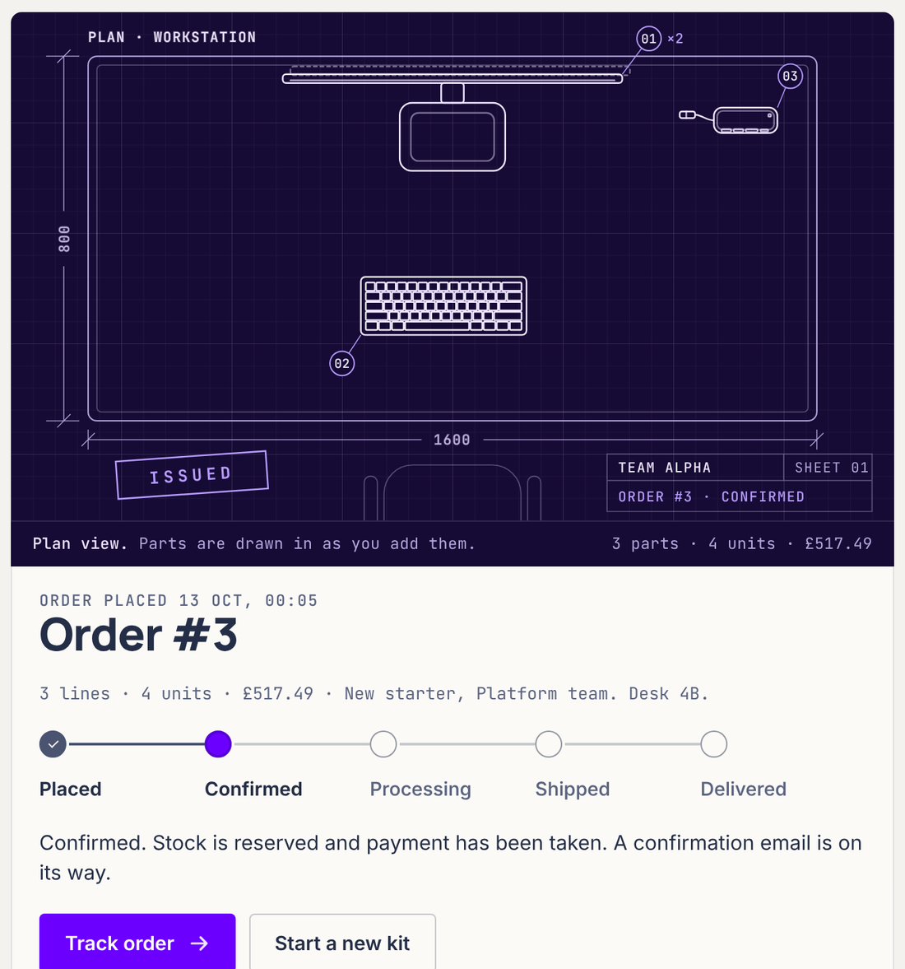
Answered at once, confirmed seconds later
ACT II · THE DEMO, FRAME BY FRAME
1
MOMENT OF THE CLICK
2
SECONDS LATER, NO CLICK
1
Placed is the API's 201 reply.
The order, its history row and its event were saved together. Nothing has been processed yet.
2
Nobody pressed confirm.
The worker read the event from SQS, reserved stock, charged the card and confirmed the order.
Stock leaves the shelf last.
It is committed only after the charge succeeds, so a declined card never takes stock.
ORDER #3, CURRENT BUILD RUN LOCALLY ON 13 OCT. A LIVE ORDER WILL HAVE ANOTHER NUMBER.
Notes:
[0:45, or skip if the live demo worked] TAKEAWAY: Accepting an order and processing it are separate on purpose.
SAY: On the left is the moment of the click: the API has replied 201 and the order is saved, but nothing is processed yet. On the right, seconds later, nobody clicked anything: the worker took the event from the queue, reserved the stock, charged the card and confirmed. Stock leaves the shelf only after the charge succeeds.
NEXT: The rest of the journey.

Slide 7
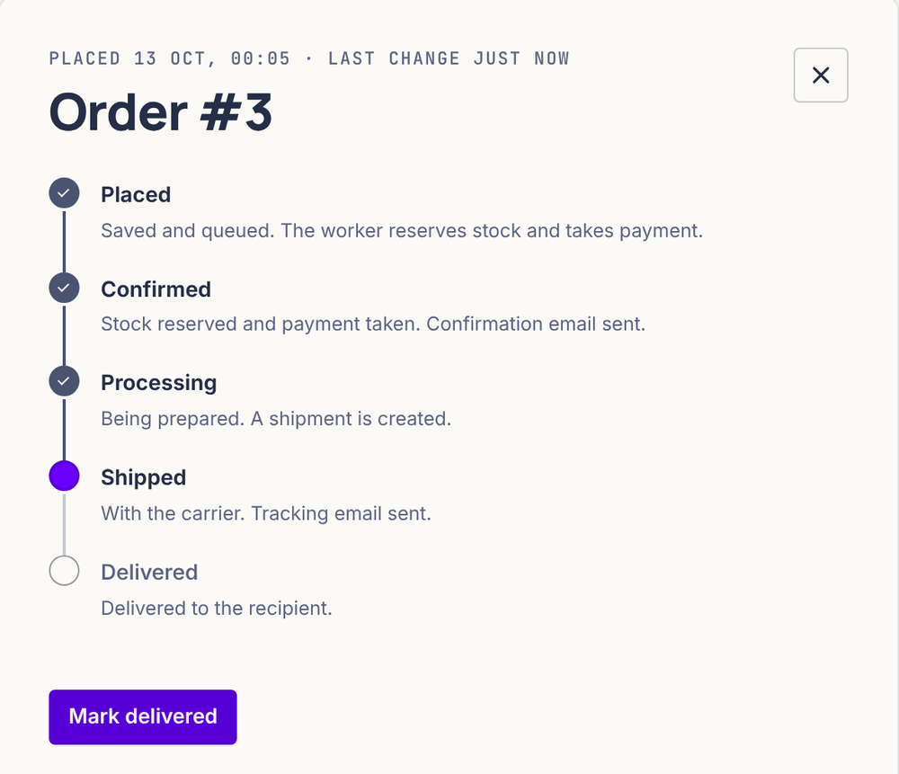
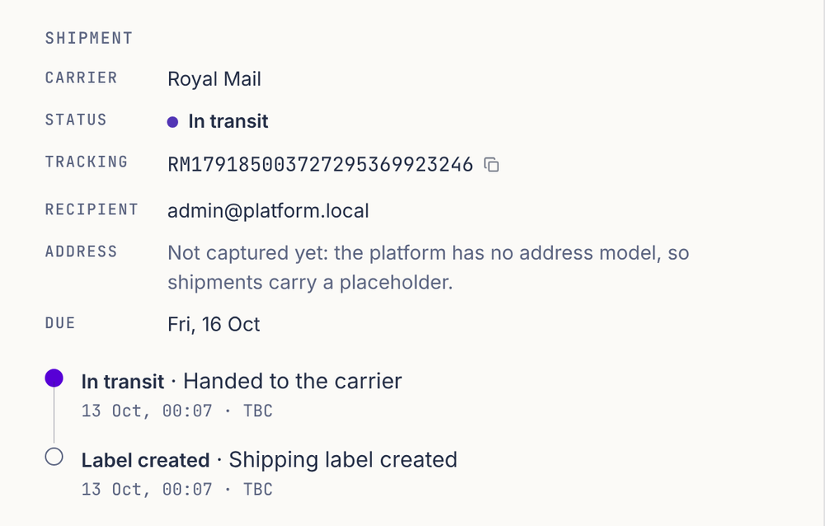
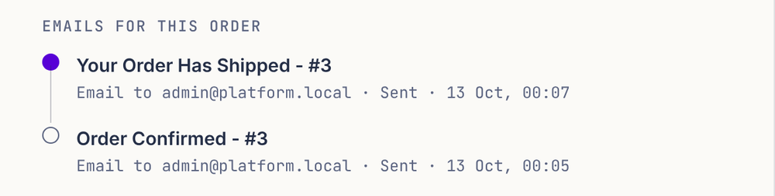
Every later step is visible, and happens once
ACT II · THE DEMO, FRAME BY FRAME
Shipping follows the status.
Processing creates the shipment; shipped moves it in transit and emails the tracking number.
Each email is sent once.
It carries a dedupe key, template plus order, so a replayed event sends nothing new.
A gap we show, not hide.
There is no address model yet, and the page says so.
ORDER #3 MOVED TO PROCESSING AND SHIPPED FROM THE ORDERS PAGE.
Notes:
[0:30, or skip] TAKEAWAY: Every later step is visible and happens once.
SAY: Moving to processing creates the shipment. Shipped puts it in transit and emails the tracking number. Each email has a dedupe key, so if an event is replayed, no second email goes out. And there is no address model yet; the page says so rather than inventing one.
NEXT: The operators' side.

Slide 8
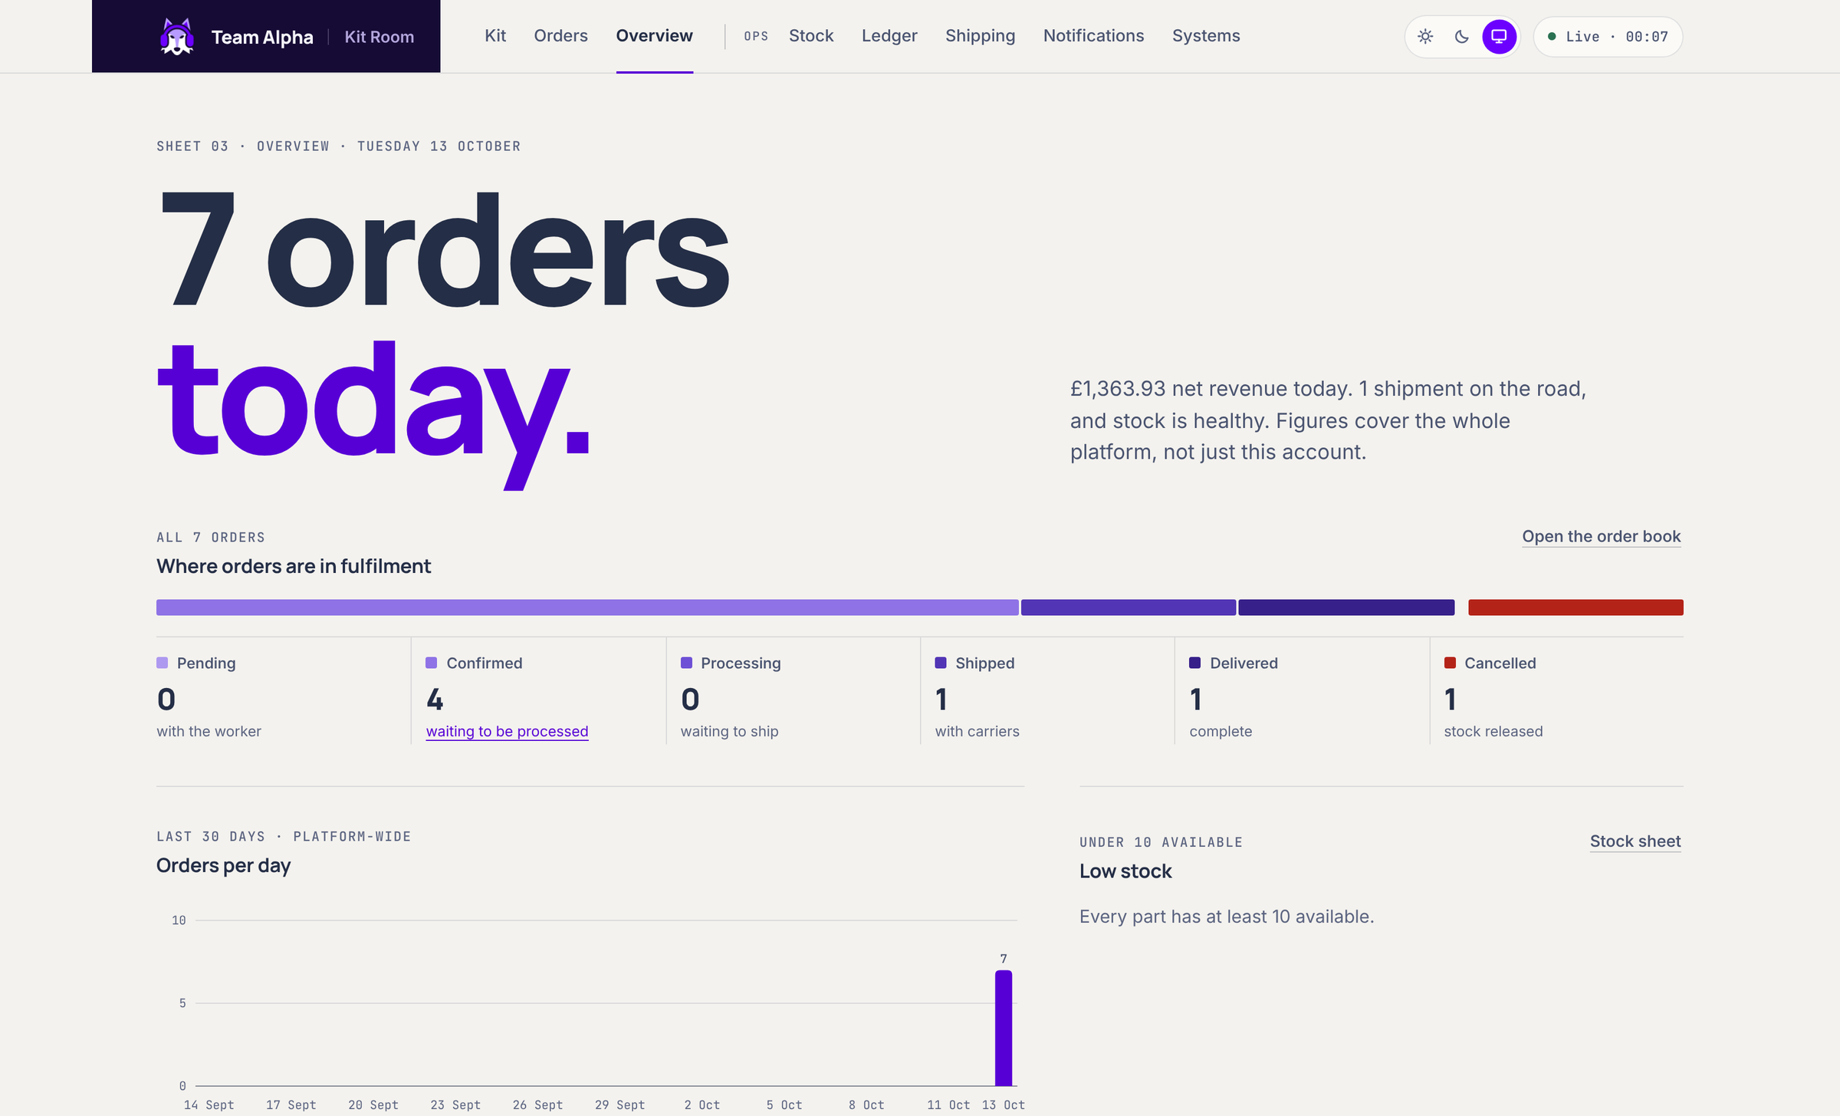
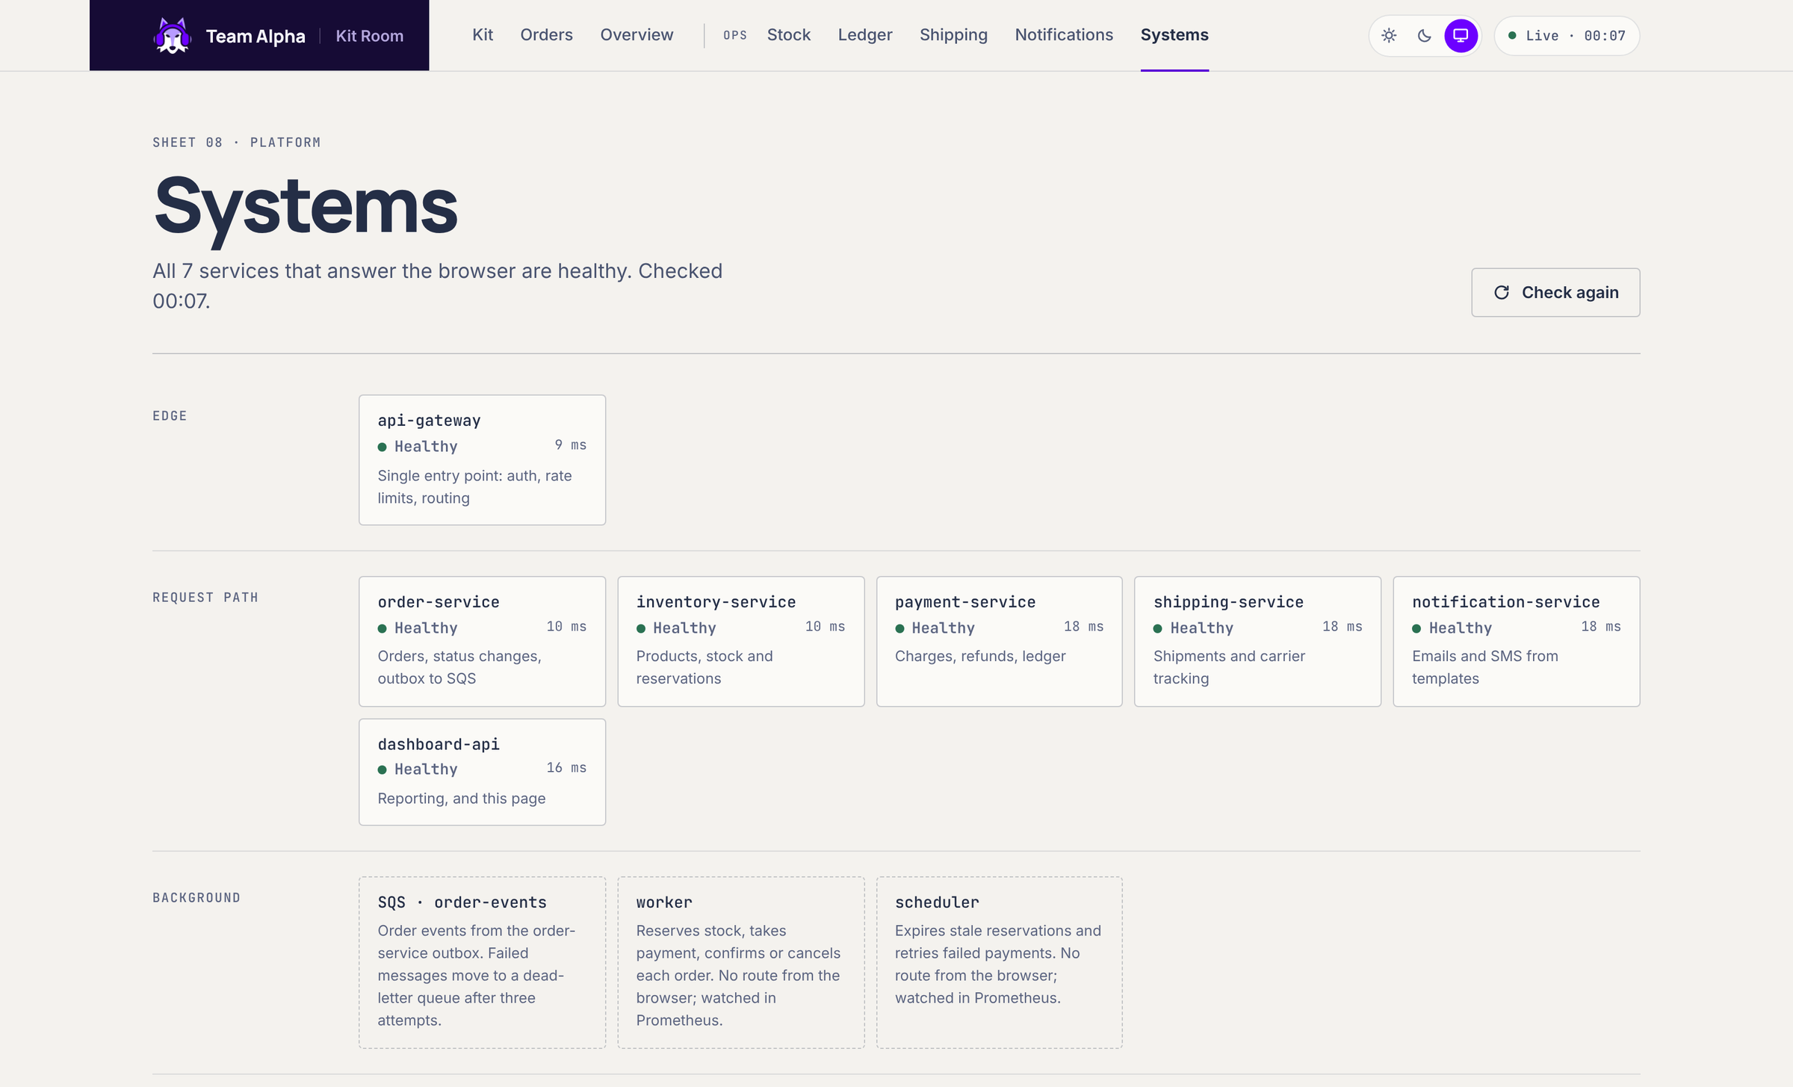
The same page runs the platform
ACT II · THE OPERATOR'S VIEW
OVERVIEW
SYSTEMS
Every figure comes from a service API through the gateway. Nothing is invented on the page.
Seven services answer the browser. The worker and scheduler have no route from outside, by design.
Notes:
[0:20] TAKEAWAY: Nine services sit behind this one page.
SAY: Operators see the same platform: today's orders and where they are, and the health of every service the browser can reach. The worker and scheduler do not show a latency because nothing from outside can reach them. That is deliberate. Let us lift the lid.
NEXT: Architecture.

Slide 9
One entry point, nine services, one queue
ACT III · ARCHITECTURE
AWS EU-WEST-2 · ONE VPC PER ENVIRONMENT · 3 AZS · EKS 1.35 ON PRIVATE SUBNETS
Edge
api-gateway
order-service
SQS
worker
Browser
Route 53, NLB, Traefik. TLS from cert-manager and Let's Encrypt.
The only public service. JWT, rate limits, route allow-list.
order-events, fed by the outbox
long-polls SQS, drives fulfilment
Kit Room page
inventory-service
payment-service
DLQ
shipping-service
after 3 failures
Redis
calls 5 services over HTTP
rate-limit counters, StatefulSet with AOF
notification-service
dashboard-api
scheduler
seven services
expires stock holds, cancels stale orders
Postgres, one DB
DB, and order-service API
dev: StatefulSet, 20 Gi gp3. staging and prod: RDS
PLATFORM ArgoCD from Git · Karpenter · External Secrets · Pod Identity · Prometheus, Grafana
Notes:
[2:00] TAKEAWAY: One public entry point, synchronous services for reads and writes, and one queue for the work that must not be lost.
SAY, left to right: Traffic enters through Route 53 and a Network Load Balancer to Traefik, which ends TLS with a certificate from cert-manager. The API gateway is the only public service. It checks the token, applies rate limits held in Redis and only forwards routes meant for the outside. Behind it, six HTTP services share one Postgres database. The interesting path is the queue: order-service hands events to SQS through an outbox, and the worker turns each event into reserve, charge, confirm, ship and email calls. Failed messages go to a dead-letter queue. A scheduler expires stock holds and cancels abandoned orders. Underneath, ArgoCD deploys everything from Git, Karpenter adds nodes, External Secrets brings in secrets, and every AWS caller gets its own role.
IF ASKED: Each environment has its own VPC across three AZs; nodes and pods are in private subnets; one NAT gateway (slide 16). Postgres runs as a StatefulSet in dev; staging and prod are written for RDS but have not been deployed.
NEXT: Now follow order 3 through it.

Slide 10
Accepting an order: all or nothing
ACT III · END TO END, PART 1: ACCEPT
ONE POSTGRES TRANSACTION
1 Browser
2 api-gateway
3 order-service
4 Reply
POST /api/orders with an Idempotency-Key; a retry reuses the same key.
Valid JWT? Under the rate limit? A route the outside may call?
Seen this key? Replay the first answer. Otherwise price every line from inventory.
INSERT idempotency_keys
201 Created. Order #3, pending. The customer has an order number.
claim (customer, key): the guard
INSERT orders
order #3, status pending
INSERT order_events
order_created, for history
INSERT order_outbox
order.created, waiting to send
COMMIT. All four rows exist, or none do.
THEN, EVERY SECOND
IF SQS IS UNREACHABLE
THE PRICE WE PAY
The outbox relay claims unsent rows (FOR UPDATE SKIP LOCKED, so replicas never collide), sends each to SQS and marks it sent.
The row stays unsent, attempts + 1, and is retried next tick. New orders are still accepted.
A crash after SQS accepts but before "sent" is saved sends the event twice, so consumers must be idempotent.
Notes:
[1:15] TAKEAWAY: Accepting an order is all or nothing, and it answers before any slow work.
SAY: The browser sends the order with an idempotency key. If the request gets no clear answer, a retry sends the same key. The gateway checks the token, the rate limit and the route. order-service first asks: have I seen this key? If yes, it replays the first answer. If not, it prices every line from inventory; a price from the browser is ignored. Then one database transaction claims the key, writes the order, its history and its outbox event. All four rows exist, or none do. Only then do we reply: 201, order 3, pending. Separately, a relay sends outbox rows to SQS every second. If SQS is unreachable, the row waits; the order is already safe.
DEPTH: The claim on (customer, key) is the guard. Two identical requests at once: the second INSERT waits on the first transaction, then replays its order. The price we pay: if the process dies after SQS accepts but before sent_at is saved, the event goes twice, so consumers must be idempotent.
NEXT: What the worker does with it.

Slide 11
Processing: a worker that can safely run twice
ACT III · END TO END, PART 2: PROCESS
SQS order-events
WORKER, FOR ORDER #3
THREE POSSIBLE ENDINGS
Long poll 20 s, up to 10 messages. A message is hidden for 60 s while it is worked on.
0
Check the order first
Success
pending: run below. confirmed: only commit stock. cancelled: undo.
Message deleted. Status events follow: confirmation email, then shipment and tracking as the order moves on.
1
Reserve stock
inventory /reserve. A repeat returns the same hold.
third
failure
A final "no"
2
Charge
Out of stock or card declined: release stock, cancel, tell the customer, delete. Retrying would not change the answer.
payment /charge, key charge-order-3. A repeat replays the first answer.
order-events-dlq
3
Confirm
The third failed receive lands here. Kept 14 days. Redrive once the cause is fixed.
order /status, compare-and-set: only if still pending.
An error or timeout
4
Commit stock, delete message
Not deleted. SQS hands it out again after 60 s. On the third failure it moves to the DLQ.
Stock leaves the shelf only now.
Notes:
[1:15] TAKEAWAY: The worker is written so that running it twice is harmless.
SAY: SQS delivers at least once, so the same message can arrive twice. The worker's first move is to read the order's status: if it is already confirmed it only makes sure stock is committed, if it is cancelled it undoes anything taken. Then reserve, charge with a fixed key per order, confirm with compare-and-set, and commit stock last. Three endings: success deletes the message; a final no, out of stock or declined, cancels and also deletes, because retrying would not change the answer; an error leaves the message, SQS hands it out again after 60 seconds, and the third failure goes to the dead-letter queue.
IF ASKED (why not FIFO): We do not need ordering; the worker reads current state instead of trusting message order.
IF ASKED (visibility): A batch of 10 slow messages could outrun 60 seconds. Known limit; every step is safe to repeat, so the cost is extra work, not double charges.
NEXT: How do we know this works?

Slide 12
We broke it first, then made retries safe
ACT III · WHY RETRIES ARE SAFE
WHERE A REPEAT IS ABSORBED
LAYER
A REPEAT LOOKS LIKE
WHAT ABSORBS IT
REPRODUCED BEFORE THE FIX
Request
double click, client retry
Idempotency-Key. Primary key on (customer, key) lets one request win.
25 of 30
NOW 0
runs where a concurrent confirm and cancel both succeeded
Worker
SQS redelivery
Check the order first. Status changes are compare-and-set.
−57
NOW 0
Payment
charge retried
Key charge-order-N, and a unique index: one completed charge per order.
stock "reserved" after 20 concurrent releases of a hold of 3
Email
event replayed
Dedupe key template:order, held by a unique index.
6 rows
NOW 1
in payments after 6 retries of one charge
168 test functions pass with the race detector on, re-run against Postgres, Redis and a local SQS on 13 Oct.
Team fix-evidence log, 23 to 24 Sep, against a Postgres 16 test database.
Notes:
[1:15] TAKEAWAY: Retries are safe because every layer absorbs a repeat, and we measured the failures before fixing them.
SAY: A repeat can enter at four layers, and each has its own guard: the request key, the worker's status check and compare-and-set, the payment key with a unique index, and the email dedupe key. We did not assume the bugs existed. We reproduced them: 25 of 30 runs where a concurrent confirm and cancel both won, stock driven to minus 57 by concurrent releases, six payment rows for one retried charge. Each is now a test, and all 168 test functions pass with the race detector on.
EVIDENCE: Claude outputs/fix-evidence-log.md (23 to 24 Sep, Postgres 16 test database). Re-run on 13 Oct: every service's go test -race passes against Postgres 16, Redis and floci.
NEXT: Five decisions behind this.

Slide 13
SQS behind a transactional outbox
ACT III · DECISION 1 OF 5
THE PROBLEM
WE GAINED
Saving an order (Postgres) and announcing it (SQS) are two systems. If the announcement is lost after the save, nothing ever reserves stock or takes payment.
SQS outage: orders still accepted, events wait
Retries, visibility timeout and DLQ built in
Managed and near free at our volume
The services were already written for SQS
order-service
Postgres
relay
SQS
writes the order and its event
orders and order_outbox, one commit
every 1 s, SKIP LOCKED
then the worker
The order and its event share one commit. If SQS or the NAT path is down, the event row waits and the relay retries every second. Lost becomes late.
WE GAVE UP
At-least-once: duplicates are possible, so every consumer step must be safe to repeat
No ordering, no replay once a message is deleted
Up to about 1 s extra before processing starts
Payment and shipment events are not on an outbox yet
ALTERNATIVES WE WEIGHED
Kafka on Strimzi: three brokers on volumes, producer rewrites. Publish after commit: a crash loses the event. SQS FIFO: ordering we do not need.
EVIDENCE outbox_test.go (relay retry, shutdown mid-batch); local drill 24 Sep: payment stopped, 3 receives, DLQ, redrive, order processed.
Notes:
[0:55] TAKEAWAY: We chose a boring queue and made it safe with an outbox, so an SQS outage makes orders late, not lost.
SAY: Two systems, one write: that is the problem. The outbox puts the event in the same commit as the order, and a relay delivers it. We gained a managed queue with retries and a dead-letter queue built in, at almost no cost. We gave up exactly-once delivery, which is why the last two slides mattered.
IF ASKED: Kafka would have meant three brokers on persistent volumes in a cluster already holding Postgres and Redis, and rewriting the producers. Payment and shipment events are still only logged; moving them onto an outbox is on our list.
NEXT: Where the data lives.

Slide 14
Postgres in the cluster for dev, RDS beyond
ACT III · DECISION 2 OF 5
THE PROBLEM
WE GAINED
An order, its stock hold, its payment and its outbox row commit together, so one relational database. The brief wants a StatefulSet; production wants failover and backups we would rather not hand-run.
Dev meets the brief and costs only a volume
Prod gets managed failover and point-in-time restore
Services never know: External Secrets builds DATABASE_URL
DEV
STAGING
PROD
StatefulSet postgres-0
RDS db.t4g.medium
RDS db.m7g.large
20 Gi encrypted gp3, daily EBS snapshot, 7 kept
single AZ, smaller and cheaper
Multi-AZ. Terraform refuses prod without deletion protection and 7+ days of backups
WE GAVE UP
Dev Postgres is one pod on one AZ's disk: lose the AZ, writes stop until a restore
Two database setups to understand
RDS has never run live: staging and prod are not deployed
RAN ON EKS
IN CODE ONLY
IN CODE ONLY
ALTERNATIVES WE WEIGHED
StatefulSet everywhere: we own failover and backups. RDS everywhere: skips the StatefulSet the brief grades, costs while idle. CloudNativePG: one more operator.
EVIDENCE dev StatefulSet and SnapScheduler (daily, keep 7) in Git and on EKS; snapshot class confirmed on dev 10 Oct. A restore with a data check is not recorded.
Notes:
[0:55] TAKEAWAY: The data model wants one relational database; where it runs is a cost and risk trade-off we made per environment.
SAY: An order, its stock hold, its payment and its outbox row must commit together, which is why it is one Postgres. Dev runs it as a StatefulSet on an encrypted 20 gig volume with daily snapshots: that meets the brief and costs only the disk. For staging and prod we wrote RDS: managed failover and point-in-time restore. Be clear: staging and prod were never deployed, so RDS has never run live.
IF ASKED (the brief says RDS is not an option): The brief's author said on 6 Oct that RDS is sensible but does not show the StatefulSet skill. That is why dev runs the StatefulSet. The RDS module enforces prod settings: Terraform refuses prod without Multi-AZ, deletion protection, a final snapshot and 7+ days of backups.
IF ASKED (restore): The snapshot class and schedule run on dev. A restore checked against known data is not in our records; it is next step 3.
NEXT: How changes reach the cluster.

Slide 15
CI builds, Git decides, ArgoCD deploys
ACT III · DECISION 3 OF 5
THE PROBLEM
WE GAINED
Nine services ship on their own schedules. A change to one must not redeploy or risk the other eight, and the pipeline should hold no keys to the cluster.
Rollback is one revert, for one service
CI has no cluster credentials at all
ArgoCD reverts hand edits (self-heal)
Only changed services are built
commit
CI
ECR
Git
ArgoCD
canary
one service
vet, tests, build, Trivy
one image per commit
tag in dev values
one app per service
50%, check, 100%
WE GAVE UP
Prod never auto-syncs: promotion copies a tested tag dev to staging to prod by pull request, and someone syncs prod in ArgoCD.
A deploy waits for ArgoCD to notice the commit
A bot must be allowed to write to main
One chart bug reaches all nine (schema and kubeconform guard it)
Canary analysis passes when there is no traffic
ALTERNATIVES WE WEIGHED
CI runs helm upgrade: cluster keys in CI. Flux: equally valid, the team knew ArgoCD. Kustomize overlays: simpler patches, logic copied nine times.
EVIDENCE smoke test on EKS dev, 8 Oct: 8 failures before the hardening deploy, all steps passing after. Zero downtime is not proven (slide 18).
Notes:
[0:55] TAKEAWAY: CI never touches the cluster. Git is the record of what runs, so one service rolls back with one revert.
SAY: The pipeline builds only what changed, tests it with the race detector, scans it with Trivy, pushes one image and commits its tag. ArgoCD sees the commit and syncs that one service. We gained a pipeline with no cluster keys and a rollback that is a git revert. We gave up a little speed, and we need a bot allowed to write to main.
CAREFUL: Do not claim zero downtime. A 30 to 60 second blip during an ArgoCD sync on 10 Oct still has no root cause. The Argo Rollouts canary (50%, then error-rate and p95 checks) landed last and has not been tried against a bad release.
NEXT: The cost decision.

Slide 16
One NAT gateway, on purpose
ACT III · DECISION 4 OF 5
THE PROBLEM
WE GAINED
Private nodes must reach the internet: GitHub for ArgoCD, Let's Encrypt for certificates, public image registries, and AWS APIs for the pods. The brief says avoid NAT if you can.
The cheapest design that still reaches GitHub and Let's Encrypt
S3 traffic, including image layers, skips the NAT through a free gateway endpoint
AZ a private nodes
OUT TO THE INTERNET
NAT gateway
GitHub, Let's Encrypt, quay, ghcr, and AWS APIs: SQS, STS, Secrets Manager, ECR
AZ b private nodes
one, in AZ a
AZ c private nodes
WE GAVE UP
One AZ outage cuts outbound traffic for all three AZs
Image pulls, certificate renewals, ArgoCD syncs and SQS calls fail until it returns
Traffic inside the cluster carries on
S3 GATEWAY ENDPOINT free: image layers in S3 skip the NAT
ALTERNATIVES WE WEIGHED
A NAT per AZ: survives an AZ loss at 3× the hourly cost. Interface endpoints: 6+ services × 3 AZs = 18 billed endpoints, and still no route to GitHub.
EVIDENCE modules/vpc: one aws_nat_gateway, one S3 gateway endpoint. The outbox keeps orders safe while SQS is unreachable.
Notes:
[0:55] TAKEAWAY: One NAT gateway is a deliberate single point of failure, accepted because cost is priority one, and softened by the outbox.
SAY: Private nodes need the internet for GitHub, Let's Encrypt and public images; endpoints cannot reach those at all. Doing AWS traffic through interface endpoints would mean at least six services across three AZs, eighteen billed endpoints running every hour. So we pay for one NAT and route S3 through a free gateway endpoint. If that AZ fails, all outbound traffic stops, including SQS calls, and that is where the outbox earns its place again: orders keep being accepted and wait.
IF ASKED: One teammate described two NATs in an earlier review; the code has one. The Terraform is the source of truth.
NEXT: Credentials.

Slide 17
No long-lived AWS keys anywhere
ACT III · DECISION 5 OF 5
THE PROBLEM
WE GAINED
Pipelines and pods both call AWS. A static access key in a secret or an image works anywhere, for anyone who copies it, until someone rotates it.
Nothing in Git, CI or an image can reach AWS on its own
Each workload can do one job: order-service sends, the worker receives and deletes
The same role definitions work on every cluster
PIPELINES
GitHub job
OIDC token
role per env
runs as an Environment
short-lived, signed
PRs: read-only plan. Prod: a second approver
PODS
pod
Pod Identity
role per workload
WE GAVE UP
its own service account
agent on the node
order-service: SendMessage. worker: Receive, Delete
We departed from the brief's wording (IRSA) while keeping its intent
Needs the Pod Identity agent on every node, and no Fargate
More roles to reason about
ALTERNATIVES WE WEIGHED
IRSA: an OIDC provider per cluster, named in every trust policy. Static keys in GitHub secrets: simple, and exactly what the brief rules out.
EVIDENCE bootstrap/github-actions-roles.tf (trust pinned to org, repo and Environment); modules/pod-identity; IMDSv2 hop limit 1, so pods cannot borrow the node role.
Notes:
[0:55] TAKEAWAY: Nothing we ship holds an AWS key. Every caller borrows a short-lived role scoped to one job.
SAY: GitHub Actions signs in with OIDC to a role per environment. The trust is pinned to our organisation and repository IDs and to the GitHub Environment, so another repo or branch cannot assume it. Pull requests get a read-only plan role, and a prod apply waits for someone other than the person who started it. Inside the cluster, Pod Identity gives each workload its own role: order-service may only send to the queue, the worker may only receive and delete. IMDSv2 with a hop limit of one stops pods borrowing the node's role.
IF ASKED (brief asked for IRSA): Same intent, least privilege per workload. Pod Identity avoids an OIDC provider per cluster, so the role definitions work on every environment.
NEXT: What we can stand behind.

Slide 18
What we have proven, and what we have not
ACT IV · WHERE WE STAND
DEMONSTRATED ON EKS DEV
PROVEN IN TESTS, NOT UNDER LOAD
DEFINED IN CODE, NOT YET RUN
All nine services healthy behind HTTPS at a real DNS name (Let's Encrypt staging certificate)
The full order lifecycle, including cancel and refund: smoke test, 8 Oct, every step passing
Internal routes refused at the gateway (404 from outside)
Built from Git: Terraform pipelines, then ArgoCD bootstrapping the platform in sync waves
Daily EBS snapshots of the dev database scheduled
168 test functions, all passing with the race detector on (re-run 13 Oct)
Duplicate and concurrent requests: one order, one charge, one email
Payment outage: retries, DLQ, redrive, order processed (local drill)
The whole journey on the current build, run locally on 13 Oct
Staging and prod, including RDS and promotion between them
k6 load tests: plan and scripts written, never executed
A restore checked against known data; a chaos drill
Argo Rollouts canary against a deliberately bad release
Not claimed: zero downtime. A 30 to 60 second blip during an ArgoCD sync on 10 Oct still has no root cause.
Notes:
[1:00] TAKEAWAY: We separate what ran on EKS, what tests prove, and what exists only as code.
SAY: Left column: things we watched happen on EKS dev, with a smoke test from 8 October. Middle: things proven by tests and local drills, not by real load. Right: things that exist in code and have not run: staging, prod, RDS, load tests, a restore checked against data, and the canary against a bad release. And we do not claim zero downtime.
WHY: The panel can check all of this. Saying it first is stronger than being caught.
NEXT: The limits that matter.

Slide 19
Limits that matter, and what we would do next
ACT IV · LIMITS AND NEXT STEPS
LIMITS THAT MATTER
Anyone can sign in.
NEXT, IN THIS ORDER
Login accepts any email, and every signed-in user sees every order.
01
Measure before tuning.
Run the k6 plan on dev, then size the pools or add PgBouncer from what it shows.
Connections run out first.
Seven pools allow 115 connections against Postgres's default 100.
02
Real identity.
Customer accounts and ownership checks at the gateway, before any real user.
Two event types bypass the outbox.
Payment and shipment events are only logged, and the DLQ alarm notifies nobody.
03
Rehearse the bad day.
Dev Postgres lives in one AZ.
Stand up staging, restore a snapshot against known data, roll back a bad release on purpose.
Lose that AZ and writes stop until a snapshot is restored elsewhere.
Notes:
[0:45] TAKEAWAY: We know the limits, and the next steps are ordered by risk.
SAY: Four limits matter most. Anyone can sign in and see every order. Database connections are the first thing that will break: seven pools allow 115 against a default limit of 100. Payment and shipment events skip the outbox. And dev Postgres lives in one AZ. Next, in order: measure before tuning with the k6 plan we wrote, add real identity, then rehearse the bad day on staging.
NEXT: Close.

Slide 20
KIT ROOM · TEAM ALPHA
Engineered for the
order that goes wrong.
IF SQS GOES QUIET
IF A REQUEST REPEATS
IF THE REPO LEAKS
orders are still accepted. Their events wait in the outbox.
nothing doubles. Keys and state checks absorb it.
it holds no AWS key. Pipelines and pods borrow short-lived roles.
Built for a $200 budget, by five engineers, in four weeks.
QUESTIONS WELCOME · APPENDIX A1 TO A8 HOLDS THE DETAIL
Notes:
[0:30] TAKEAWAY: The happy path was never the hard part; we spent our time and budget on the orders that go wrong.
SAY: If SQS goes quiet, orders still land. If a request repeats, nothing doubles. If our repository leaked tomorrow, it would hold no AWS key. That is what five engineers built in four weeks on a $200 budget. Happy to take questions; the appendix has the detail.
THEN: Leave this slide up during Q&A, or jump to the appendix slide that matches the question.

Slide 21
A change to payment-service, from commit to traffic
APPENDIX A1 · DEPLOYMENT PIPELINE
1
Pull request
2
Infra checks, if touched
3
Merge to main
4
Tag commit
Only payment-service changed, so only its job runs: go vet, go test with the race detector, docker build, Trivy (fails on HIGH or CRITICAL).
helm lint and kubeconform on every rendered service; terraform fmt, validate, Checkov and a plan per environment.
The image is built once, tagged with the service and commit, and pushed to ECR. No other service is rebuilt.
A GitHub App commits the new tag to the dev values file for payment-service. Git now says what dev should run.
5
ArgoCD sync
6
Canary
7
Promote
8
Roll back
Only payment-service-dev changes. The other eight Applications see no diff.
Argo Rollouts sends 50%, checks error rate (5% max) and p95 (500 ms max) in Prometheus, then 100%.
The Promote workflow opens a PR copying the tested tag to staging, then prod. Prod needs approval and a manual sync.
Revert the tag commit. The old image is still in ECR, so it is one rollout.
The canary landed last, in the 13 Oct sync. Not yet tried against a bad release; with no traffic its checks pass by default.
Notes:
Use for: "A developer pushes a change to payment-service. Walk us through it." Point at steps 1 to 6, then promote and roll back. Caveat: the canary landed last and passes by default with no traffic.

Slide 22
From Secrets Manager to a pod, and what rotation does
APPENDIX A2 · SECRETS
Terraform
Secrets Manager
External Secrets
Kubernetes Secret
Pod
generates the JWT secret, DB password and Grafana password, write-only
encrypted with a customer-managed KMS key
the only reader, through Pod Identity; refresh every 15 min
one per service, only the keys it needs; KMS envelope encryption in etcd
loads it as env vars; non-root, read-only filesystem, no SA token
ROTATED | WHO RESTARTS | THE GAP
JWT secret | api-gateway only (Reloader watches its Secret) | Tokens signed with the old secret stop working; users sign in again.
Database password | The seven services that use Postgres, one pod at a time | Until the refresh lands (up to 15 min), new connections from old pods fail; open ones keep working.
Who never restarts | The worker: it holds no secret at all | It reaches SQS through Pod Identity, not a key.
Notes:
Use for: "How do secrets reach a pod? What happens when you rotate?" Key line: only the services that use a changed secret restart, one pod at a time. The gap is new connections from old pods, up to 15 minutes, for the DB password.

Slide 23
What scales, on what signal, and what breaks first
APPENDIX A3 · SCALING
COMPONENT | SCALES ON | LIMITS IN DEV
api-gateway | HPA, CPU 70% | 2 to 3 pods
Six HTTP services | HPA, CPU 70% | 1 to 3 pods each
worker | fixed | 1 pod. Queue depth (KEDA) is the better signal
scheduler | never | 1 pod. Chart refuses more, uses Recreate
Postgres, Redis | never | 1 pod each, StatefulSet
Nodes | Karpenter, pending pods | 3 base t3.medium; on-demand only, 16 vCPU and 64 GiB cap
WHAT BREAKS FIRST
Reasoned from configuration, not measured.
Connections. 115 allowed by the pools, 100 by Postgres. Each new pod adds up to 25.
Postgres itself. One writer on one volume.
Redis down. The gateway fails open: up, but unthrottled.
Worker behind. SQS keeps the backlog for 4 days. Slower, not lost.
Notes:
Use for: "What scales, on what, and what breaks first?" Say plainly that the breaking order is reasoned from configuration; the k6 tests were not run.

Slide 24
What happens when things fail, and how we know
APPENDIX A4 · FAILURE SCENARIOS
SCENARIO | WHAT HAPPENS | HOW WE KNOW
Worker fails 3 times | Not deleted, back after 60 s; third failure goes to the DLQ (kept 14 days). Redrive after the fix; steps are safe to repeat. | Local drill, 24 Sep
payment-service down 2 min | Orders still accepted. Charges fail and the messages return; most succeed once it is back. Stock is held 15 min. | Code path and local drill
SQS or the NAT unreachable | Orders accepted; outbox rows wait and the relay retries every second. The worker pauses. | outbox tests
Same order sent twice | The same Idempotency-Key returns the first order. | Smoke test on EKS, 8 Oct
Bad notification-service image | New pods fail readiness; old ones keep serving. Revert one tag commit; eight services untouched. | Design; not drilled
Postgres pod deleted | StatefulSet recreates it on the same volume; services reconnect. | Expected; not drilled
AZ holding the dev DB lost | Pod stays Pending. Restore the latest snapshot in another AZ, losing writes since. | Procedure only
Notes:
Use for any "what happens if" question. Read the "How we know" column honestly: drills and smoke tests versus design only.

Slide 25
Dev database: storage, snapshots and restore
APPENDIX A5 · STORAGE AND RESTORE
SETTING | VALUE
Volume | 20 Gi gp3, encrypted (StorageClass)
Placement | WaitForFirstConsumer: disk in the pod's AZ
Snapshots | SnapScheduler, daily 01:00 UTC, keep 7
Snapshot class | ebs-csi, deletionPolicy Delete
Redis | AOF on a 1 Gi gp3 volume (brief: 10 Gi)
Migrations | CREATE TABLE IF NOT EXISTS on start-up
RESTORE: A NEW DISK, NEVER THE OLD ONE
1
Take a snapshot of data-postgres-0; wait for READY
2
Scale the Postgres StatefulSet to 0
3
Delete the PVC data-postgres-0
4
Create it again with the snapshot as dataSource
5
Scale back to 1, then check known orders are back
Status. The snapshot class and schedule run on dev. A restore checked against known data is not in our records. Schema changes: the plan is golang-migrate as an ArgoCD PreSync Job, with changes that expand first and contract later. Not built yet.
Notes:
Use for storage, snapshot and migration questions. Note the snapshot class uses deletionPolicy Delete (an older doc said Retain), and that Redis runs on a 1 Gi volume, smaller than the brief's 10 Gi, to save cost.

Slide 26
Three environments in code, one that has run
APPENDIX A6 · ENVIRONMENTS
 | DEV | STAGING | PROD
Status | The one that has run; torn down between sessions to save cost | Defined in code, never deployed | Defined in code, never deployed
VPC | 10.6.0.0/16 | 10.7.0.0/16 | 10.8.0.0/16
Database | Postgres StatefulSet | RDS db.t4g.medium, single AZ | RDS db.m7g.large, Multi-AZ
Nodes (base) | 3 x t3.medium, max 4 | 3 x t3.medium, max 5 | 3 x t3.medium, max 6
ArgoCD sync | Automatic | Automatic | Manual
Terraform apply | Saved plan, manual run | Plan made on main only | Plan on main, plus a second approver
Separation | Each has its own VPC, cluster, Terraform state, GitHub Environment and IAM role, in one AWS account
One account, not three: cross-account access for the shared ECR, Route 53 zone and state did not fit the time we had.
Notes:
Use for "Is prod running?" Answer: no. Staging and prod are fully defined and planned, never deployed; dev is the environment that has run, and it is torn down when idle to save money.

Slide 27
Known gaps we would name before you do
APPENDIX A7 · SECURITY
GAP | WHY IT MATTERS | FIRST FIX
Open login | Any email and password gets a token; every user sees every order. | Accounts, ownership checks
One shared database user | A bug in one service can read or change another's tables. | A role per service
Redis | No password, no NetworkPolicy, no TLS. | AUTH and a NetworkPolicy
Carrier webhook | Public and rate limited, but unsigned. | HMAC signature
Browser headers | No CSP or HSTS yet. | Set them at Traefik
Money as float | Totals are rounded to pence, but summed as floats in Go. | Integer pence
Dev certificate | Let's Encrypt staging: browsers warn. | Production issuer
Notes:
Use for security questions. Own each gap and give its first fix.

Slide 28
Where the money goes, and what we did about it
APPENDIX A8 · COST
Tear down when idle
Environments are rebuilt from Git, so dev did not run around the clock.
SPEND ON RECORD
about $50
One NAT gateway
Not one per AZ, and no paid interface endpoints (slide 16).
of AWS spend recorded by 10 Oct, mostly EC2, against the $200 cap.
Capped autoscaling
Karpenter on-demand only, 16 vCPU and 64 GiB at most, consolidation after 5 min.
In-cluster data in dev
Billed by the hour whenever dev is up: the EKS control plane, three base nodes, the NAT gateway and the NLB. That is why tear-down is the biggest lever.
Postgres and Redis share nodes we already pay for; only volumes cost extra.
Small fixed footprint
One shared ECR repository keeping the newest 40 images; control-plane logs kept 30 days.
Notes:
Use for cost questions. Replace "about $50 by 10 Oct" with the final bill before presenting; the figure comes from the 10 Oct meeting record.

