Slide 1
Telecom Customer Churn Prediction
A Data Science Classification Project

Slide 2
Project Overview
This project aims to predict customer churn using machine learning classification models.
I preprocess data, apply feature engineering, train models, and evaluate performance.

Slide 3
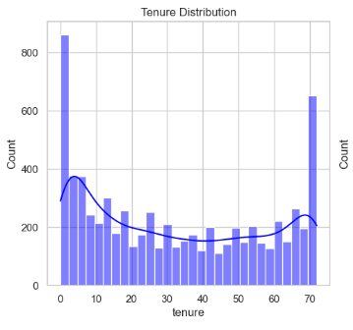
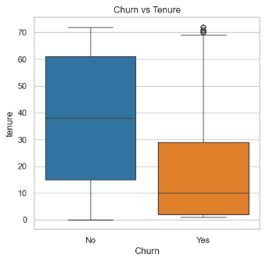
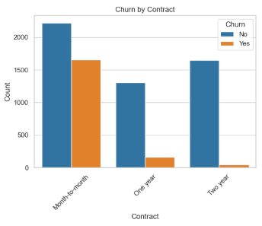
Data Preprocessing & Feature Engineering
Handling missing values
Encoding categorical variables
Feature scaling with Standard Scaler
Splitting data into train-test sets

Slide 4
Model Selection & Training
Logistic Regression for baseline performance
Other models like Decision Trees & Random Forests
Hyperparameter tuning & performance comparison
- Logistic Regression Accuracy: 0.7984
- Random Forest Accuracy: 0.7899
- XGBoost Accuracy: 0.7842

Slide 5
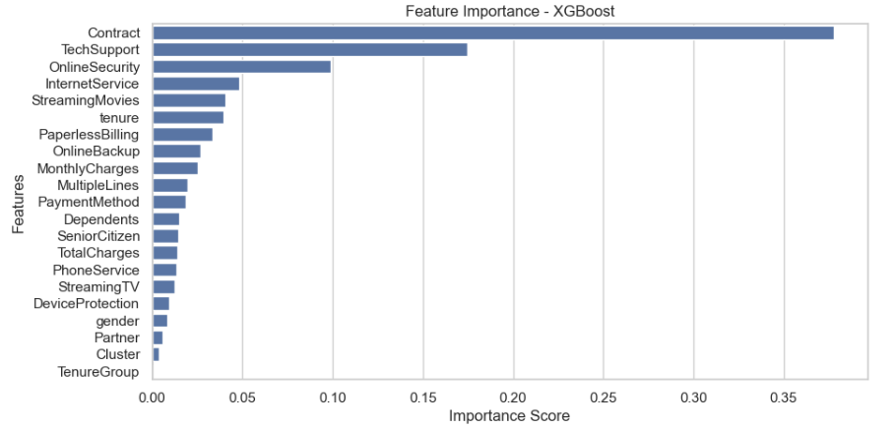
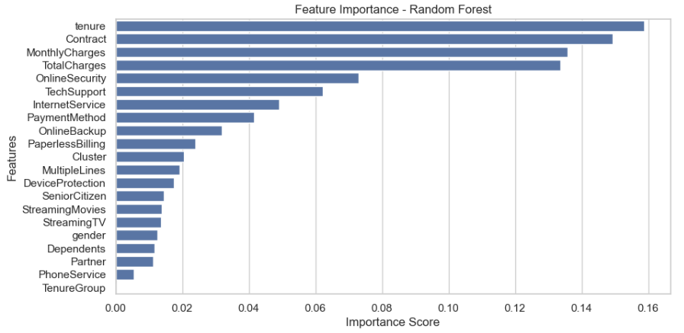
Model Evaluation
Accuracy, Precision, Recall, F1-Score
Confusion Matrix & ROC Curve
Feature importance analysis

Slide 6
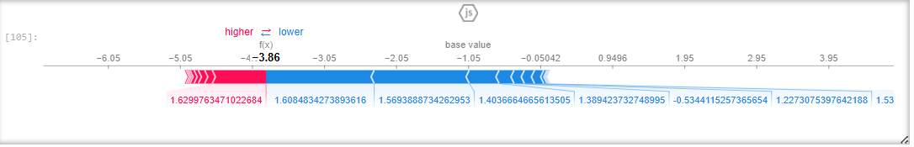
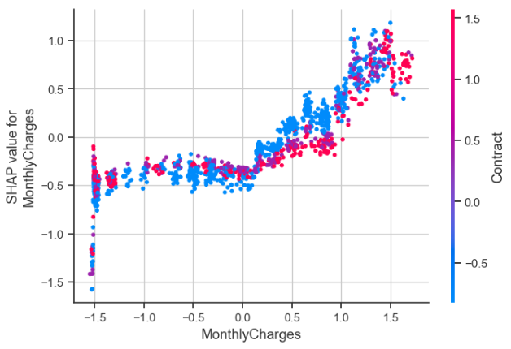
Key Findings & Conclusion
Identified key factors influencing churn
Improved model performance using feature engineering
Future improvements: Advanced models, deep learning, and better feature selection

